Slide 1
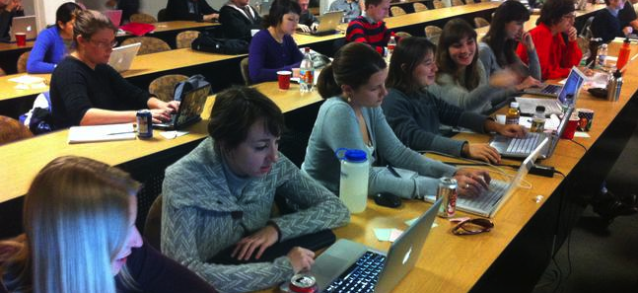



COMPUTATIONAL LITERACY WORKSHOP
JANUARY 12 & 13 (9AM-5PM)
KENT HALL 120
A 2-day intensive workshop organized by
LEARN concepts, tools, and techniques
Topics include: the UNIX SHELL, PYTHON, version control, program design, testing, and data management.
All materials can be used on Linux, Windows, and Mac OS X.
FREE LUNCH BOTH DAYS!
Participants must have some prior programming experience to participate.
REGISTER NOW:
http://computational-literacy.eventbrite.com/
If you have any questions, please contact Katy Huff at khuff@anl.gov or Anthony Scopatz at scopatz@gmail.com. If you have special access concerns or additional needs, please email Kalee Ludeks at kalee@uchicago.edu.

