Slide 1


Slide 2
Version Control
Introduction

Slide 3


Slide 4
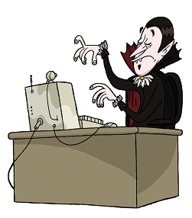

Slide 5
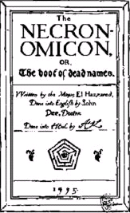
Notes:
Necronomicon image from http://www.2dollarstore.payloadz.com/details/801984-eBooks-Religion-and-Spirituality-Abdul-Alhazred-Al-Azif-The-Cipher-Manuscript-Known-As-Necronomicon.html

Slide 7
?

Slide 8


Slide 13


Slide 14
version control!

Slide 16
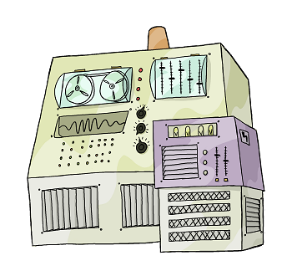

Slide 17


Slide 23
?

Slide 25


Slide 32
!

Slide 35
More gooder

Slide 36
No Overwrites

Slide 37
No arguments

Slide 38
nothing ever lost

Slide 40
1

Slide 41
1
2

Slide 42
1
2
.
.
.
6

Slide 43

1
2
.
.
.
6

Slide 44
nothing's perfekt

Slide 46


Slide 47

Notes:
Cthulhu image from http://www.nyder.com/cthulhu/cthulhucomic.html

Slide 48


Slide 49
Git

Slide 50
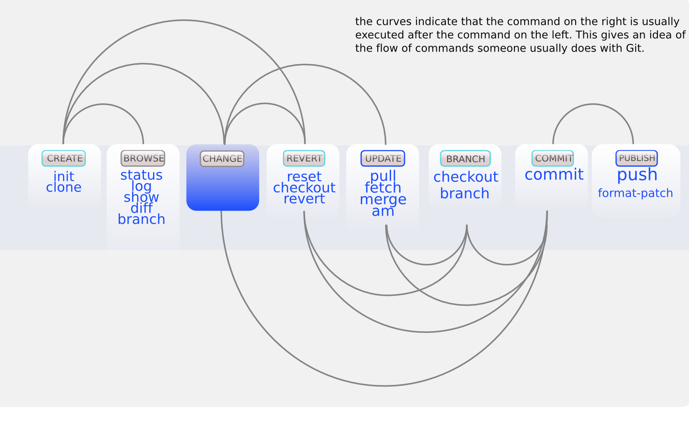
Create
clone
pull
commit
push
modified from http://zrusin.blogspot.com/2007/09/git-cheat-sheet.html

Slide 51
Browse
clone
status
pull
commit
push
modified from http://zrusin.blogspot.com/2007/09/git-cheat-sheet.html

Slide 52
Change
clone
status
pull
commit
push
modified from http://zrusin.blogspot.com/2007/09/git-cheat-sheet.html

Slide 53
Revert
clone
status
pull
commit
push
modified from http://zrusin.blogspot.com/2007/09/git-cheat-sheet.html

Slide 54
Update
clone
status
pull
commit
push
modified from http://zrusin.blogspot.com/2007/09/git-cheat-sheet.html

Slide 55
Branch
clone
status
pull
commit
push
modified from http://zrusin.blogspot.com/2007/09/git-cheat-sheet.html

Slide 56
Commit
clone
status
pull
commit
push
modified from http://zrusin.blogspot.com/2007/09/git-cheat-sheet.html

Slide 57
Publish
clone
status
pull
commit
push
modified from http://zrusin.blogspot.com/2007/09/git-cheat-sheet.html

Slide 58
clone
pull
commit
push
modified from http://zrusin.blogspot.com/2007/09/git-cheat-sheet.html

