Slide 1

PSI Swarm Robot
By Team Robits

Slide 2
Team Members
Andrew Hardie – Project Manager
Kamil Kokot – Hardware Specialist/Raspberry Pi Tech lead
Konstantin Tomov – Robot Hardware specialist
Lewis Jamieson – Software Developer/Python/Robot OS (ROS)
Jack Broadway – Software Developer C++/Test Analyst
Robbie Lewis – Software Developer C++/Researcher

Slide 3
Overview of Project
To extend the functionality of a PSI Swarm robot platform
Connecting a Raspberry Pi Zero W to the on-board controller.
Allows the use of Linux as operating system and ROS as middleware.
This way, any programming language can be used to implement the robot controller.
Additionally, A Raspberry Pi Camera can be attached and used for limited on board computer vision.

Slide 4
Project Aims
Create robot functionality by exposing robot actuators and sensors within micro controller (Mbed System)
Use ROS loaded on Raspberry Pi to communicate with micro controller
These are connected via a software bridge (Serial Connection built in Python)

Slide 5
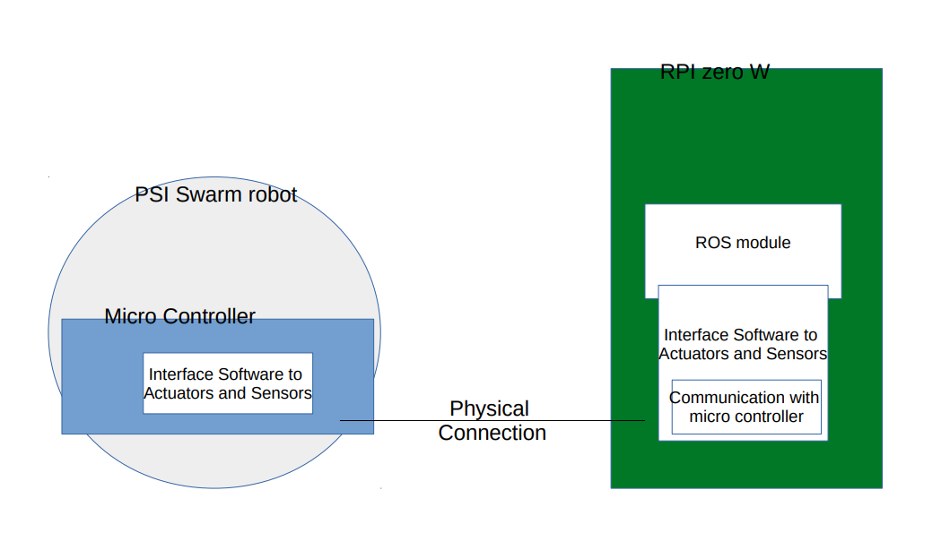
Approach
Research
Micro Controller (Mbed Software) (Konstantin)
Robot Commands Exposing Sensors and Actuators (Robbie)
Robot Operating System (ROS) (Kamil)
Linux (R.Pi & Linux OS Laptop)
Software Bridge (Serial Connection) (Lewis)
Python Library
Testing (Jack)

Slide 6
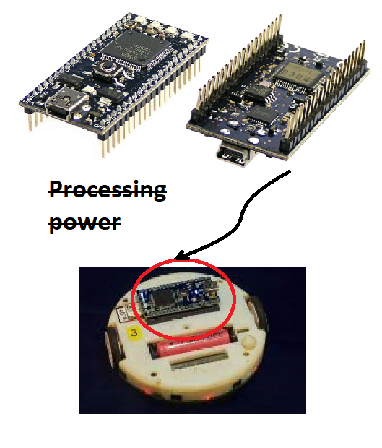
MBed board used (lpc 1768)
Benefits ( cheap, versatile, easy )
Negatives ( slow…very slow)
Biggest drawback ( only one serial channel with a small buffer )
Mbed compiler
Psi Swarm Library v0.9 (some C++)
Library not completed ( sound )
Missing hardware ( Color sensor / speakers / random parts ?)

Slide 7
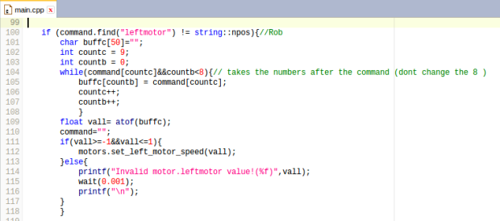
Robot Commands
Achieved 96% functionality
48/50

Slide 8
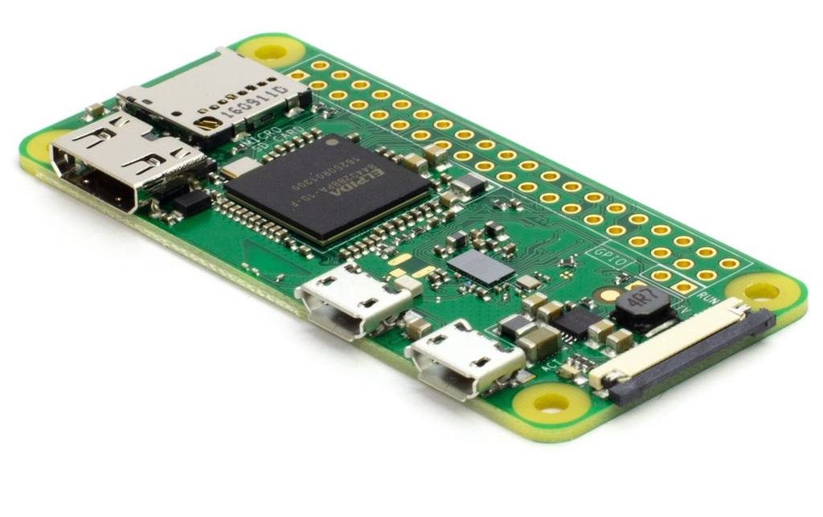

Robot Operating System & Raspberry pi Zero
What is ROS ?
Getting ROS to work with Linux
Installing ROS on raspberry Pi zero
- Dependency issues
- Problems while building ROS workspace

Slide 9

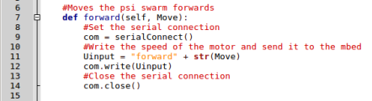

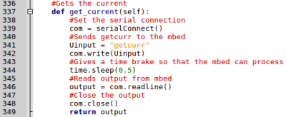
Software bridge and library
The software bridge is the serial connection
It is used in the python library which holds all of the functions
The ROS program then uses the library to run the ROS functions

Slide 10
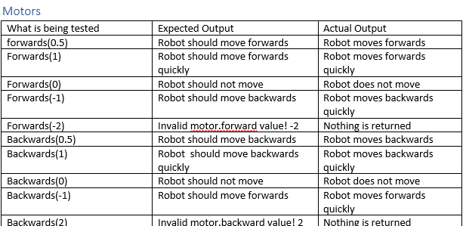
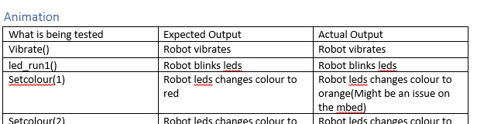
Testing
Carried out Unit Testing
Checked for Normal, Extreme and Exceptional data for the motors.
Make sure the Animations, Colour, Display, LED and Sensors worked as expected

Slide 11
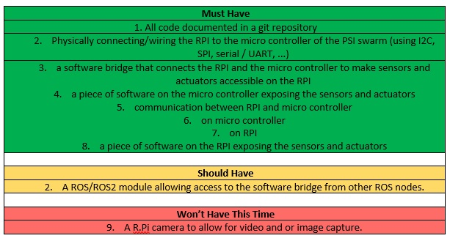
Summary

Slide 12
Thank you

