Slide 1

Citi Bike Trend Analysis
June 2019 – February 2020
Lauren Parrish

Slide 2
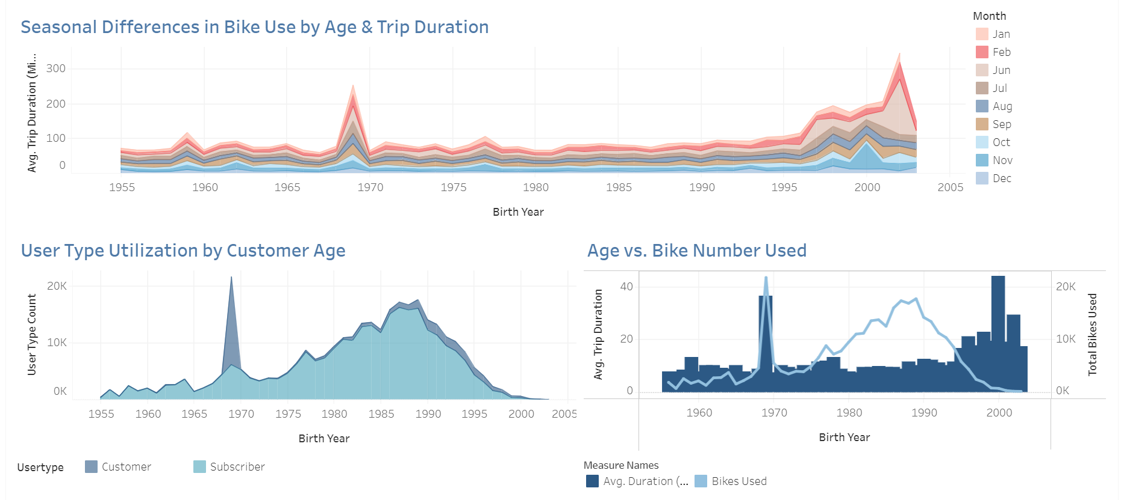
1969 Anomaly

Slide 3
1969 Anomaly - Analysis
The data reflected that the ages of individuals using Citi Bikes is largely normally distributed except for those individuals born in the year 1969 where there is a significant spike in usage.
The 1969er use type for Citi Bikes utilize the “Customer” rather than “Subscriber” payment method. This customer payment method is designed for 24 Hour or 3 Day use. Additionally, the 1969ers use a larger number of bikes, take longer rides, and are more numerous during mild months. This is aligned with leisure activity.
When looking at this evidence together, it is fair to conclude that the New York and New Jersey area see a high proportion of tourist born in the year 1969 making them around 50 years old at the time of the sample. This high proportion of individuals may be visiting the area due to the momentous birthday or are simply of the age where tourists can enjoy more attractions not specifically geared towards younger families.

Slide 4
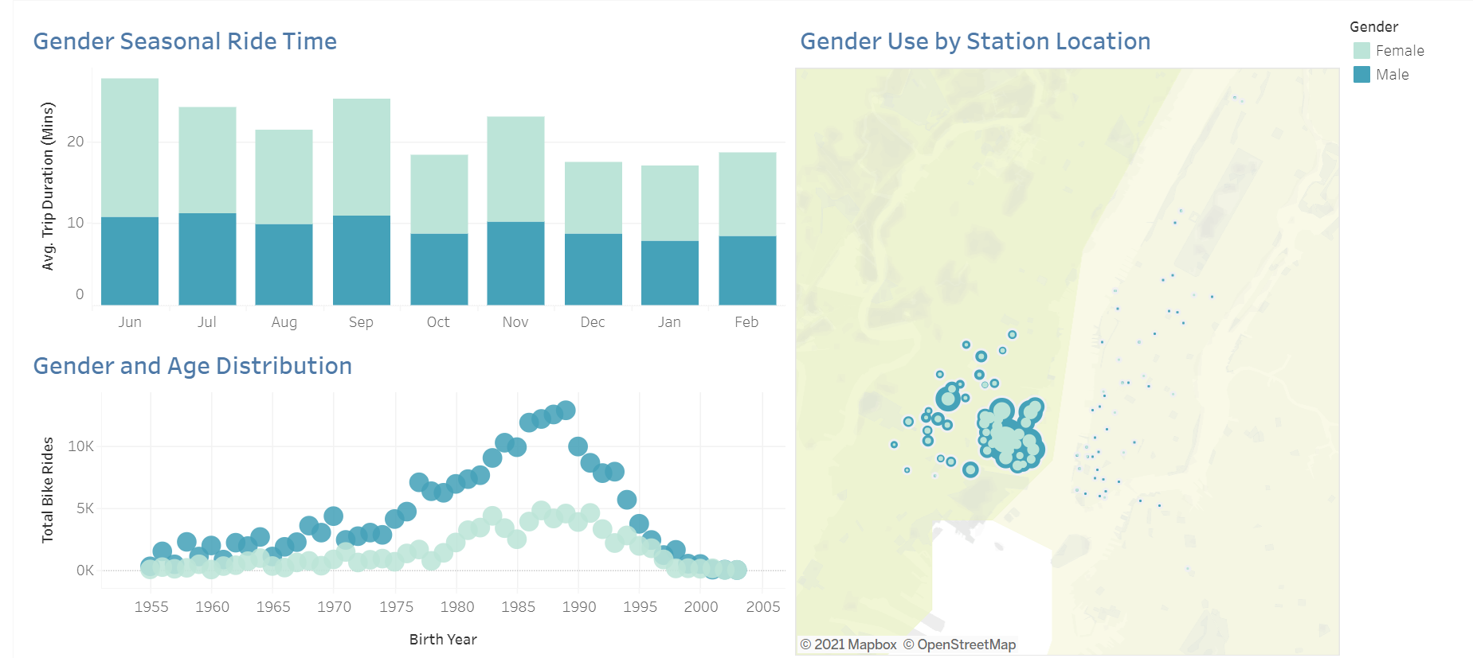
Gender Out-reach

Slide 5
Gender Out-reach - Analysis
Women are less inclined to use Citi Bikes based on the data gathered for the time period of June 2019 – February 2020. A reason for this may be that women are more inclined to use multiple forms of transportation particularly to avoid inclement weather. The data hints at this in the seasonal ride time where women are more inclined have rides with greater durations during more mild months.
Women are also more inclined to ride Citi Bikes in New Jersey. There is a slightly higher proportion of women to men in New Jersey as noted by the map’s coloration different. However, it is more likely that a greater number of women use Citi Bikes in New Jersey due to fewer transportation options and greater distances to walk between start and end points. New Jersey may also be safer to cycle or have more designated cycling areas which may appeal to women who are generally more risk adverse.
Interestingly, there is a wider age range of women who are open to Citi Bikes when compared to the male steeper slope.

Slide 6
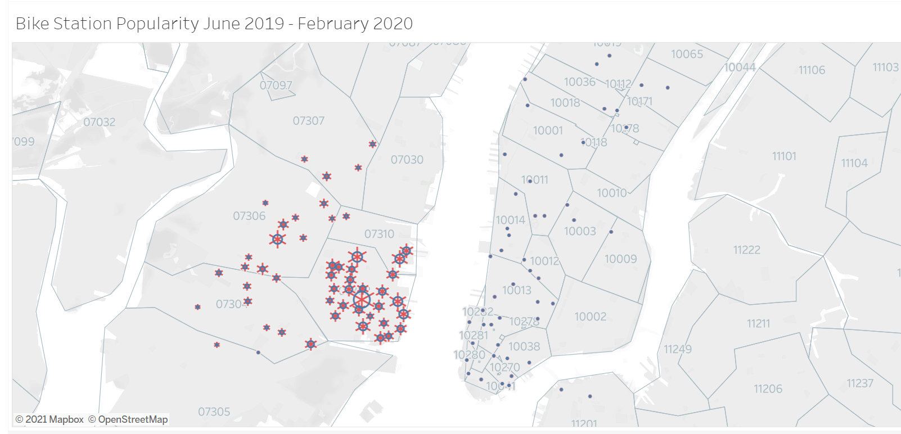
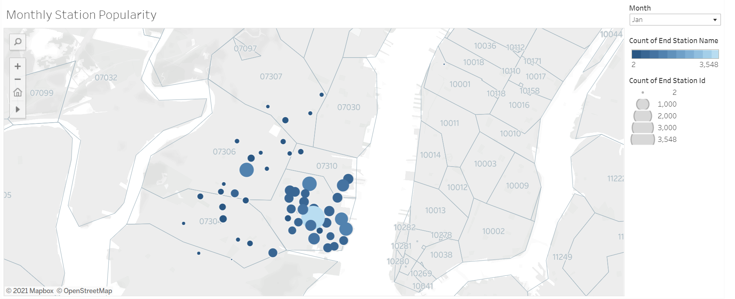
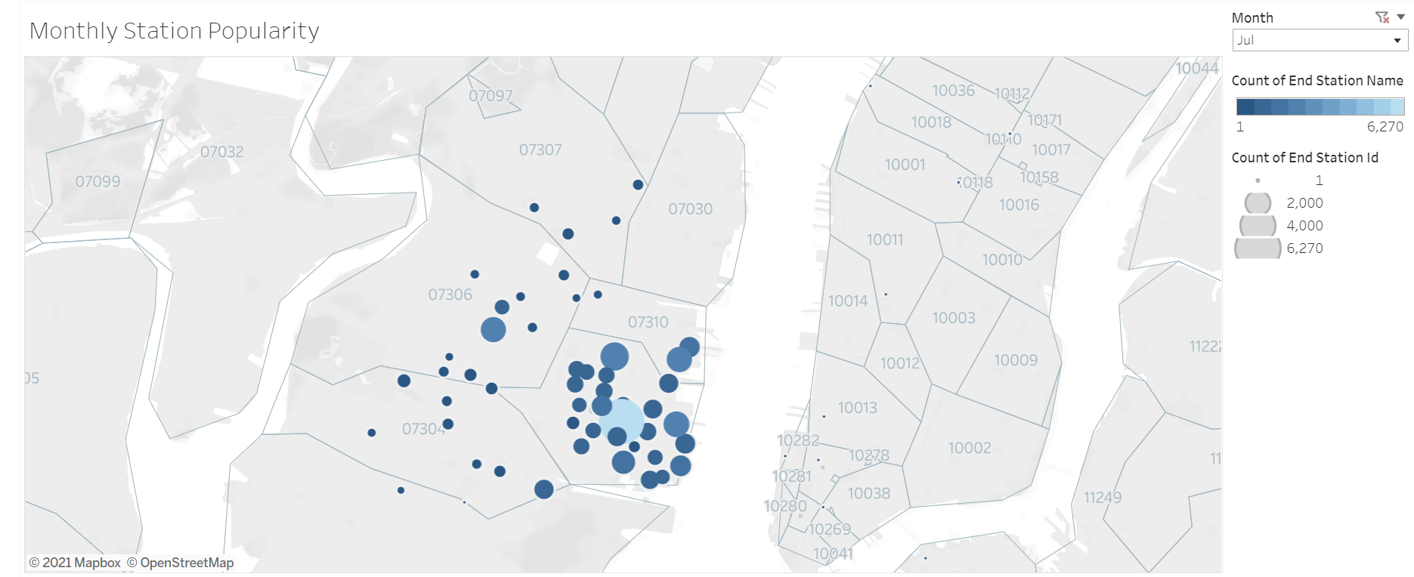
Station Popularity

Slide 7
Station Popularity - Analysis
Interestingly, Station Popularity analysis reflects that Citi Bikes are significantly more popular in New Jersey than the New York Boroughs during analysis period.
Stations located in New Jersey sustained higher popularity in both starting and ending locations. It can therefore be inferred that the individuals using Citi Bikes stay within New Jersey. This trend does reduce seasonally where end locations occur with greater frequency in Manhattan during warmer months.
A possible root cause for this trend is that there are fewer transportation options in New Jersey than in the Boroughs. Additionally, the distances between starting and ending points may be of slightly greater distance which disposes an individual to use Citi Bikes rather than walking.

