Slide 1
Sms spam filtering
Group F
Yamile Harfush, Begum Irkdas, Lionel Johnnes, Ahmed Nash, Xuan Nguyen, Jesus Parker, June Santos, Rangga Ugahari

Slide 2
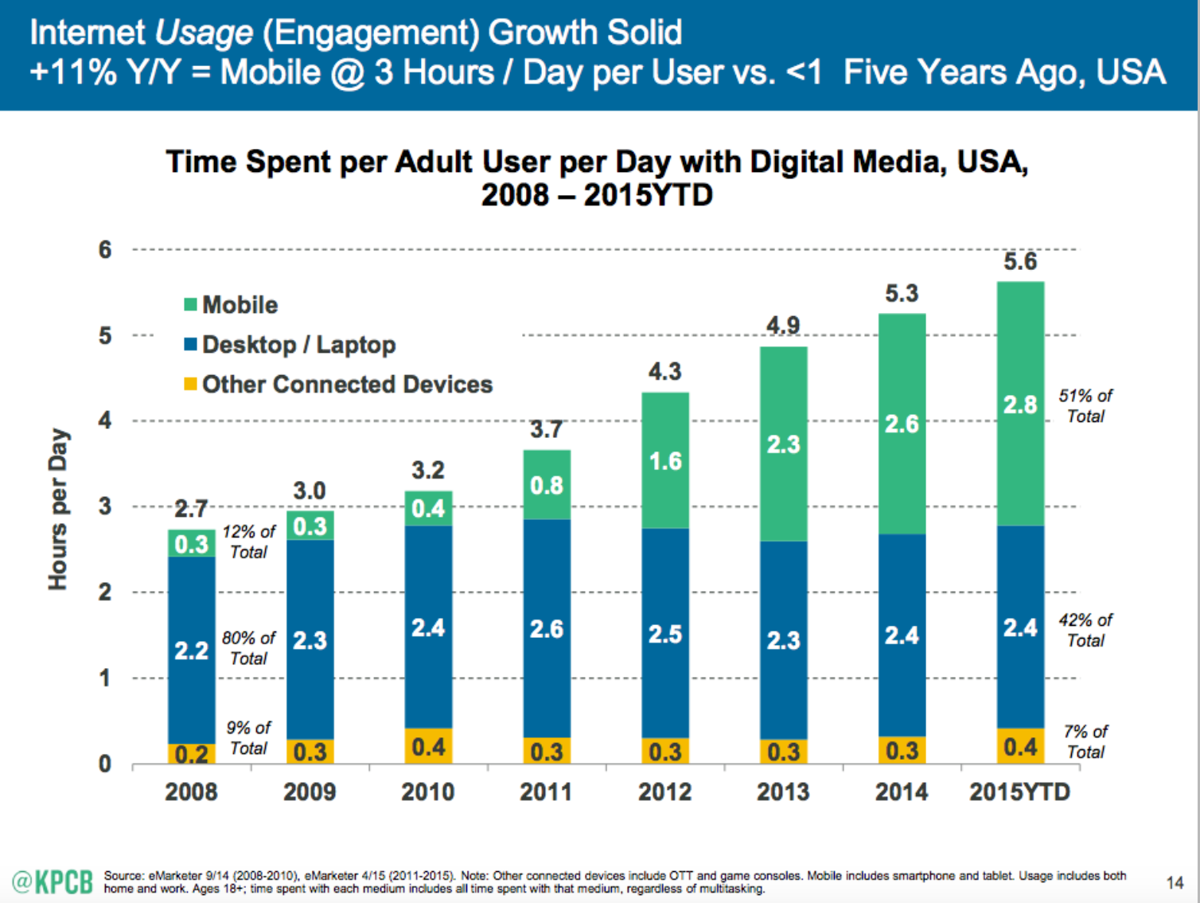
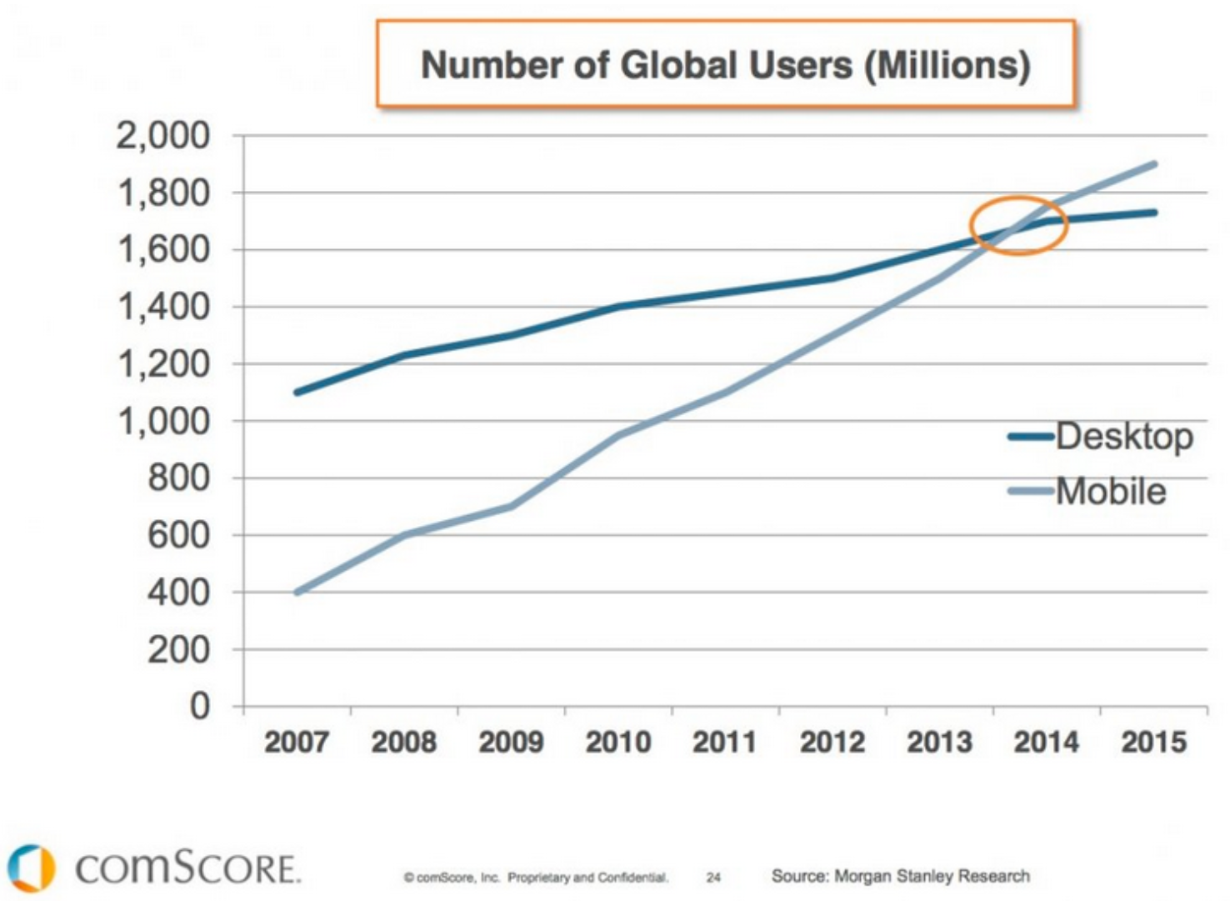
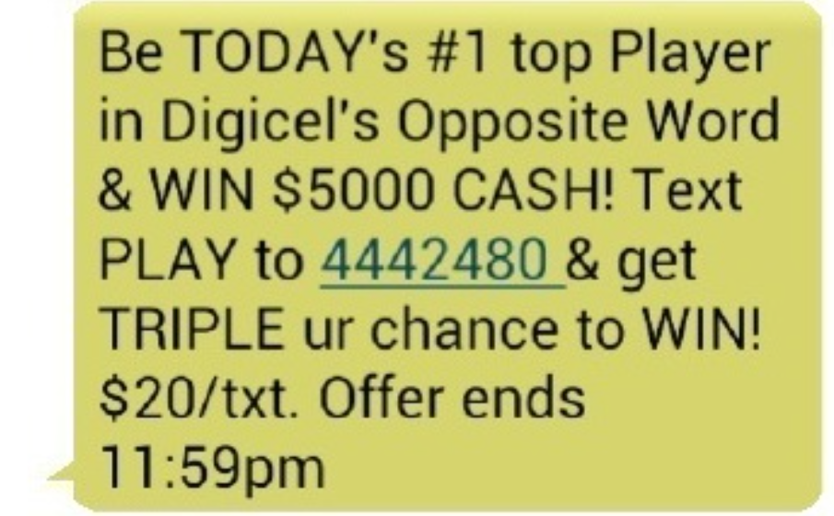
WHY?
2.12 Trillion text messages are sent every year in the US
There are over 320 Million wireless subscribers in the US
Only 40% of consumers own smartphones today
Lower costs lead to more advertising SMS: 30% of total SMS sent are spam
Customer complaints on spam SMS: 40% -> ANNOYING!!!

Slide 3
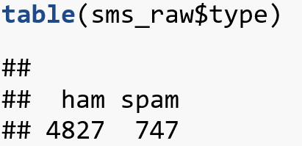
GOALS & DATASET
Applying NLP and different ML algorithms to SMS spam classification, compare their performance to gain insights.
Design an application based on the algorithm that can filter SMS spam with the highest performance
Dataset: 5.574 text messages from UCI Machine Learning repository gathered in 2012.

Slide 4
MAJOR STEPS
Pre-processing: Load data and create a corpus (create, clean, tokenize), stemming.
Feature extraction.
Train model on training set and evaluate model performance on testing set.
Improve model performance: k-fold cross validation; change parameters.
Test and visualize accuracy with different training sizes.
Repeat above steps with different algorithms.
Compare performances between different algorithms.
Conclusion.

Slide 5
PRE-PROCESSING
Raw data
## 'data.frame': 5574 obs. of 2 variables: ## $ type: chr "ham" "ham" "spam" "ham" ... ## $ text: chr "Go until jurong point, crazy.. Available only in bugis n great world la e buffet... Cine there got amore wat..." "Ok lar... Joking wif u oni..." "Free entry in 2 a wkly comp to win FA Cup final tkts 21st May 2005. Text FA to 87121 to receive entry question(std txt rate)T&C"| __truncated__ "U dun say so early hor... U c already then say..." ...

Slide 6
PRE-PROCESSING
Create corpus
Clean corpus: convert to lower characters, remove numbers, remove stop words (based on English), remove punctuation, strip white space
Created versions of corpus with stemming
Create a sparse matrix: for feature extraction.

Slide 7
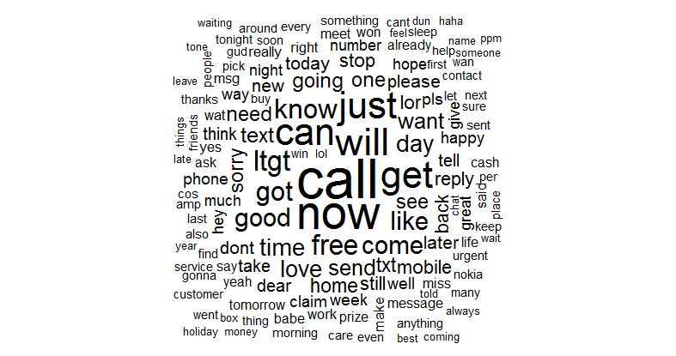
PRE-PROCESSING
Word cloud visualization

Slide 8
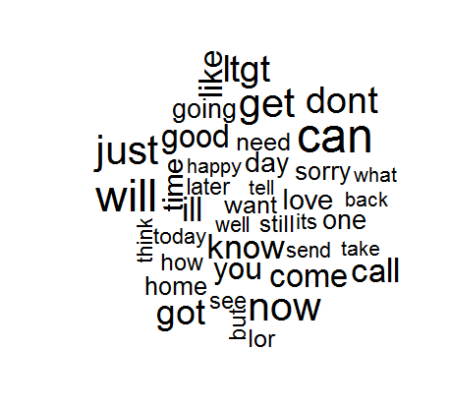
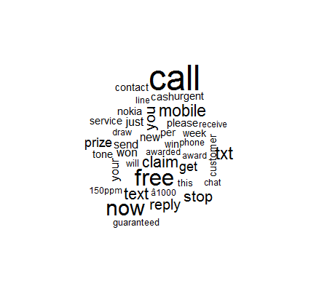
PRE-PROCESSING
Word cloud visualization (cont.)
Ham Spam

Slide 9
FEATURE EXTRACTION
Examine words that appear in at least 5 SMS (0.1% of the dataset)
Feature extractions: TF-IDF
## <<DocumentTermMatrix (documents: 4459, terms: 1297)>> ## Non-/sparse entries: 25757/5757566 ## Sparsity : 100% ## Maximal term length: 19 ## Weighting : term frequency (tf)
Here we can see training and testing data includes 1.297 features corresponding only to words that appear in at least 5 SMS.

Slide 10
PERFOMANCE
 |  | Actual
 |  | Ham | Spam
Predict | Ham | TP | FN
 | Spam | FP | TN
Accuracy = (True Positive + True Negative)/Total samples
Spams caught (SC) = True negative cases/Number of spam
Blocked hams (BH) = False positive cases/Number of hams
Cost function (assumption): 1 blocked ham costs 3 times as much as a passed spam, as it may contain important information for end-users.

Slide 11
NAÏVE-BAYES CLASSIFICATION
Parameter | Laplace = 0 | Laplace = 1
Accuracy (%) | 98.9 | 98.7
Spam caught (%) | 93.3 | 90.7
Blocked ham (%) | 0.2 | 0.1
We choose this

Slide 12
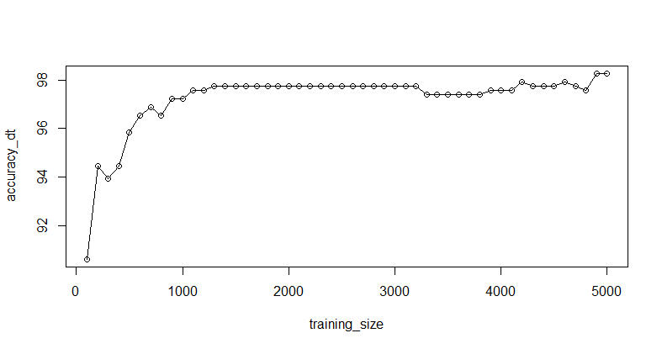
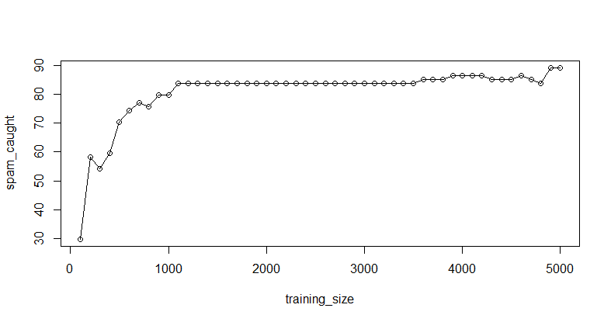
NAÏVE-BAYES CLASSIFICATION

Slide 13
DECISION TREE
Parameter | C5.0 only | With Boosting, 10 trials | With Cost function
Accuracy (%) | 96.8 | 97.2 | 95.2
Spam caught (%) | 87.3 | 83.3 | 66
Blocked ham (%) | 1.76 | 0.62 | 0.2
We choose this

Slide 14
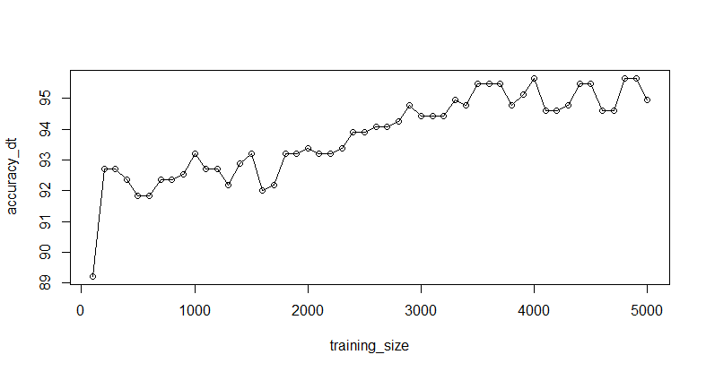
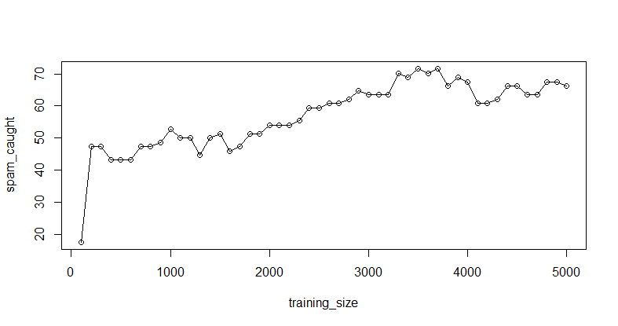
DECISION TREE

Slide 15
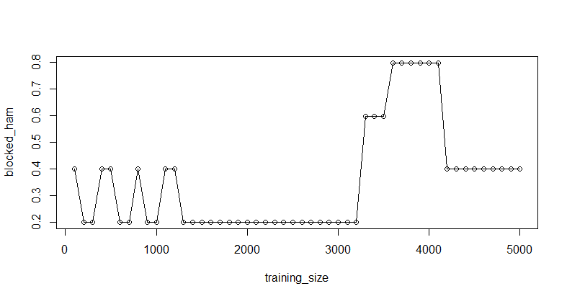
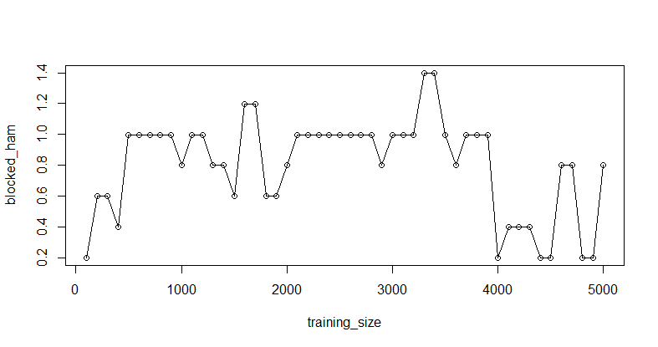
CONCLUSION
Algorithm | Naïve Bayes | C5.0
Accuracy (%) | 98.7 | 95.2
Spam caught (%) | 90.7 | 66
Blocked ham (%) | 0.1 | 0.2
Learning curve
We choose this

Slide 16
PREGUNTAS?

