Slide 1
Build business applications with Power Apps, Microsoft Flow, and Office 365
ShivaPrasad Pola
Developer

Slide 2
Agenda
Introduction to PowerApps and Flow
What are Microsoft Flow and Microsoft PowerApps?
Microsoft’s Business Application Platform
PowerApps and Flow with Connectors, Custom APIs, Gateways
PowerApps and Flow with SharePoint Modern Lists

Slide 3
Microsoft PowerApps

Slide 4
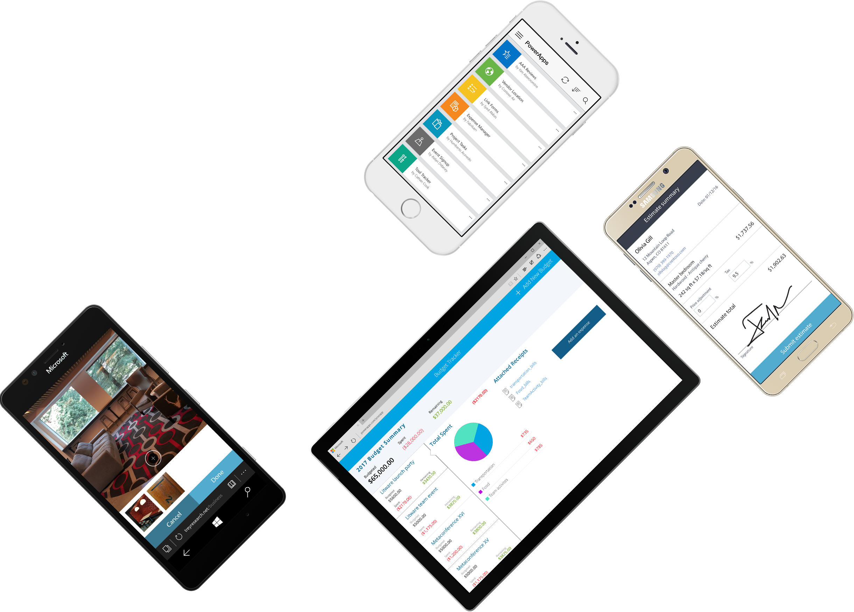
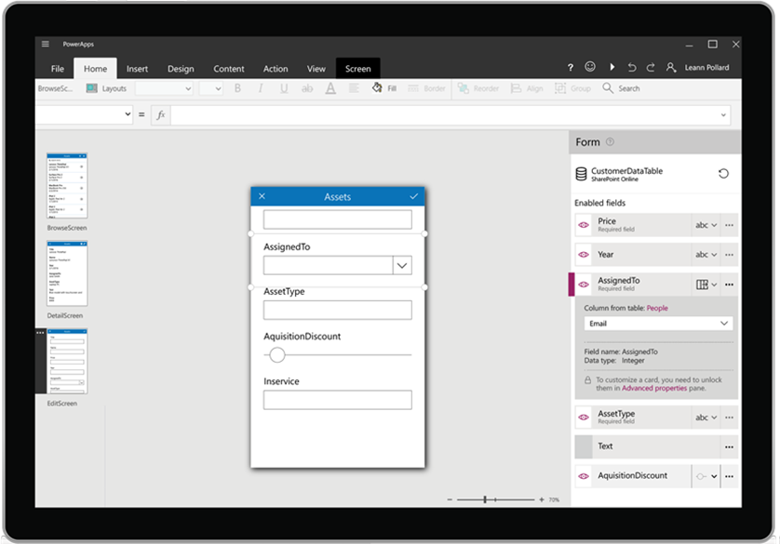














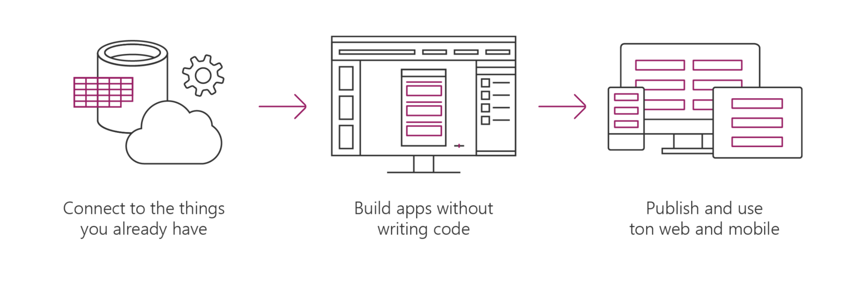











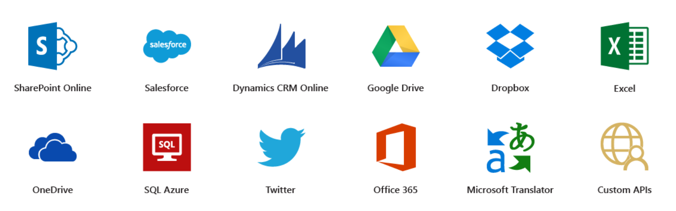




Microsoft PowerApps is a service for creating and using custom business apps across platforms
Connect to existing systems and data sources
Common Data Platform
Azure Functions & REST services
Build apps, forms, and workflows without writing code
Publish apps instantly for web and mobile

Slide 5
Microsoft Flow

Slide 6

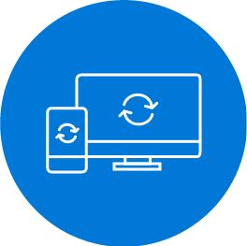
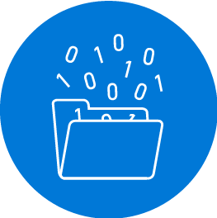

Microsoft Flow helps you work smarter by automating workflows across your apps and services
Get notifications
Synchronize files
Collect data
Automate approvals

Slide 7
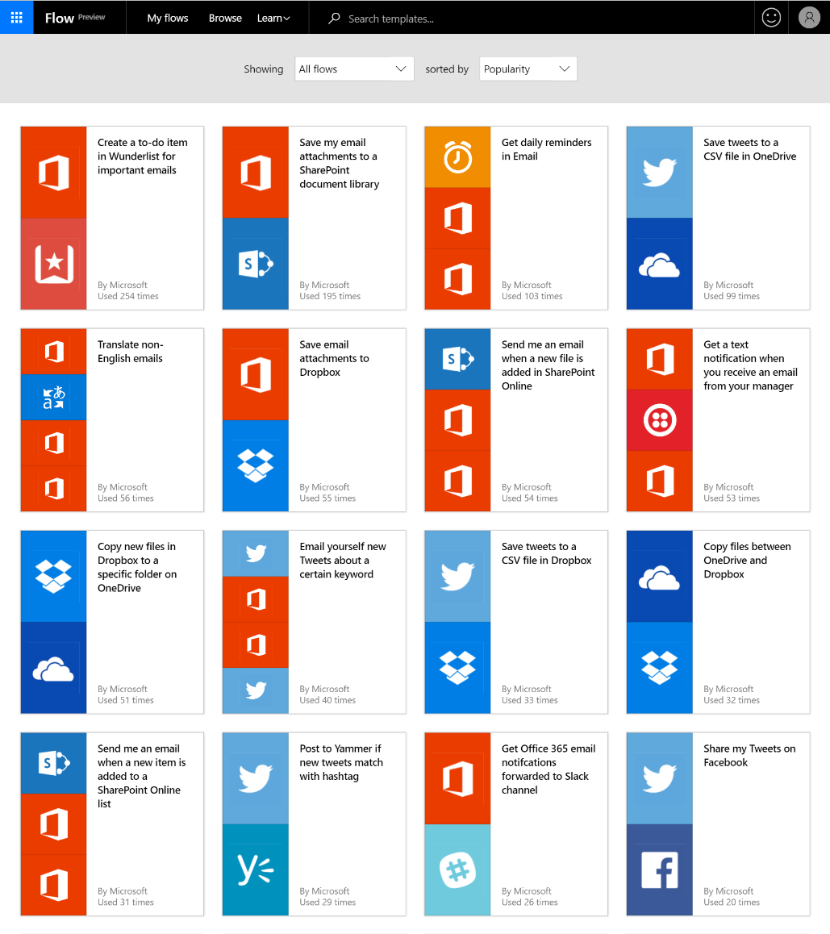
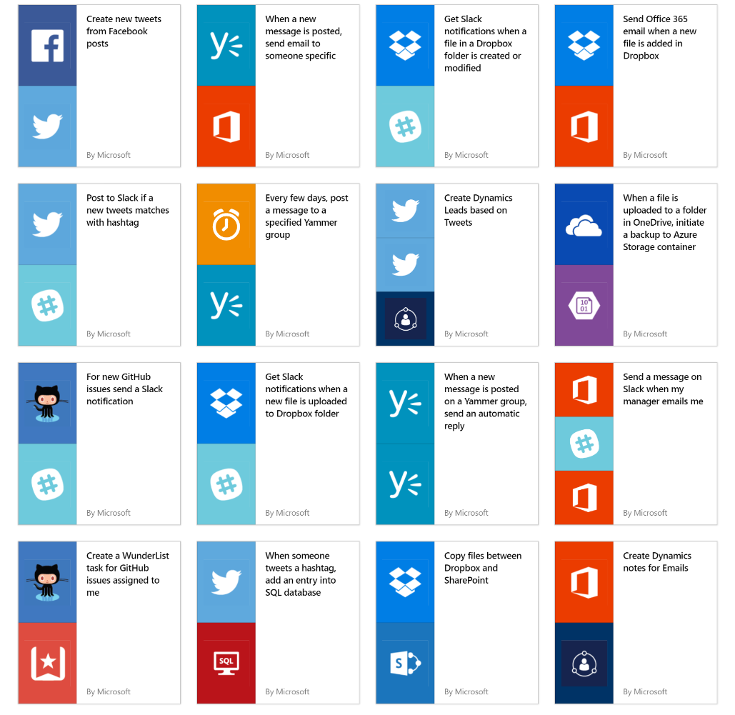
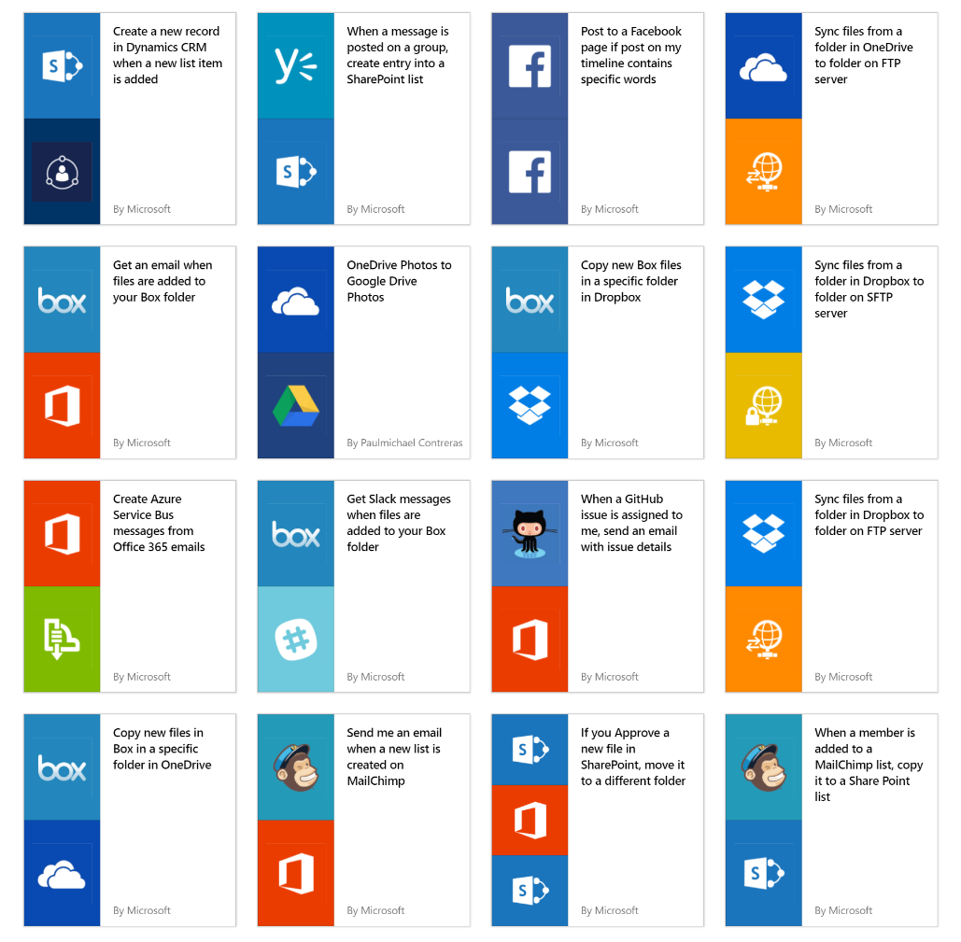
Get started quickly with over a hundred useful templates

Slide 8
Connectors, Custom APIs,

Slide 9
Integrate the systems you’re already using…

Slide 10
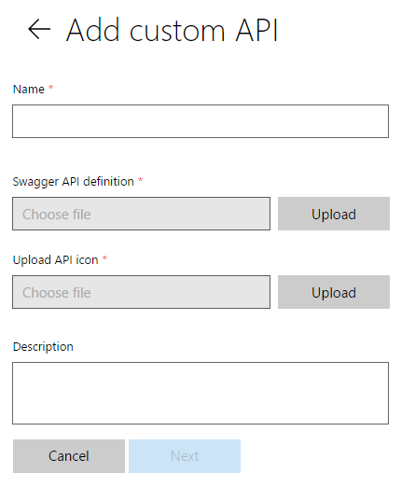
Connecting your services to PowerApps & Flow
PowerApps & Flow are fully metadata-driven and extensible so you can connect to any of your own services
Even connect to 3rd party services you consume
Custom APIs within an organization
Scoped to a company so that you can build something that’s unique to that organization
Leverage Azure functions within your apps & flows
Via custom APIs.

Slide 11
What you just saw
PowerApps
Customized navigation across screens
Custom APIs to connect to external APIs & Azure functions
Mobile, cross-platform on iOS, Android, and Windows Phone*
Integration with SharePoint mobile*
Flow
Flow embedded in PowerApps
Nested conditional logic
Access to org hierarchy w/Microsoft Graph
Easy approvals over email
Connectivity to external data sources (Wunderlist and Twilio)

Slide 12
Demo Questions & Answers

