Slide 1












devConf LK 2019
LK MUG
Saturday, Feb 23rd 2019
9:00 AM – 5:00 PM
LYIT, Port Road, Letterkenny
Event Partners
Join Us >> http://bit.ly/devConfLK2019

Slide 2

Letterkenny, Ireland
Agenda:
Date: Saturday, 23rd Feb Time: 9:00AM – 5:00PM
Time | Session | Speaker
9:00AM – 9:30AM | Registration
9:30AM – 10:30AM | Azure App Services with Socket.io – Build an online multi-player game! | Ray Hogan Senior Specialist, Pramerica
10:30AM – 11:30AM | Hosting and scaling service-based applications on Azure | Mark Allan Microsoft MVP - Azure
11:30AM -- 11:45AM | Break
11:45AM – 12:45PM | akka.net Actor system in nutshell | Greg Bernas Software Development Manager, Antaris Consulting
12:45PM – 1:30 PM | Lunch Break + Networking
1:30PM – 2:30PM | How relevant JMeter to me? | Giulio Vian DevOps Lead, Microsoft MVP, ALM DevOps Ranger
2:30PM – 3:00PM | Automated Nodejs api deployment using GitHub and Azure Pipelines | Velin Georgiev Microsoft MVP, Tech Architect - Pramerica
3:00PM - 3:15PM | Break
3:15PM – 3:45PM | You're the DBA now: Storage choices in Azure in 30 mins | Joon Du Rant Solution Architect, Pramerica
3:45PM - 4:15 PM | Zero to PowerBI Hero in 30 mins | Richard Fisher Solution Architect, Pramerica
4:15PM - 4:45 PM | .NET Core, EF Core and some sweet generics in 30 mins | Aleksandar Velichkovski Specialist, Pramerica
4:45PM – 5:00PM | Q&A’s, Closing Note and Swag time
Bit.ly/devConfLK2019
#DevConfLK2019

Slide 3
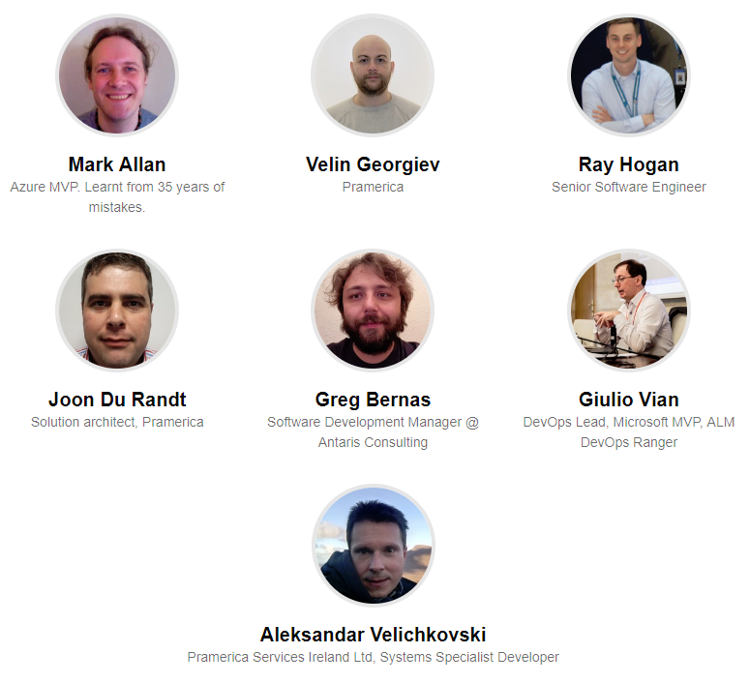
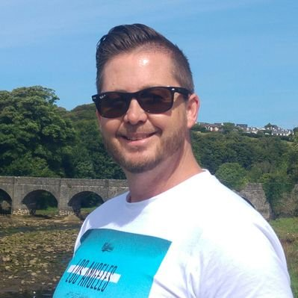
Letterkenny, Ireland
Microsoft MVP – Office Dev
Richard Fisher
Solution Architect, Pramerica

Slide 4
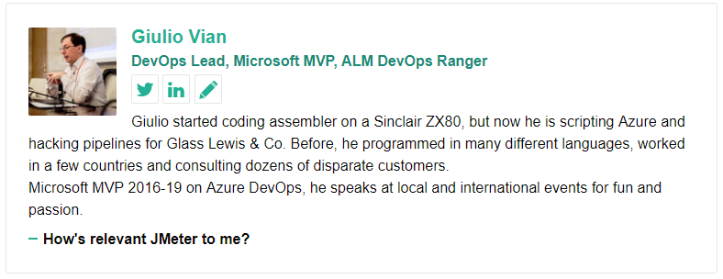
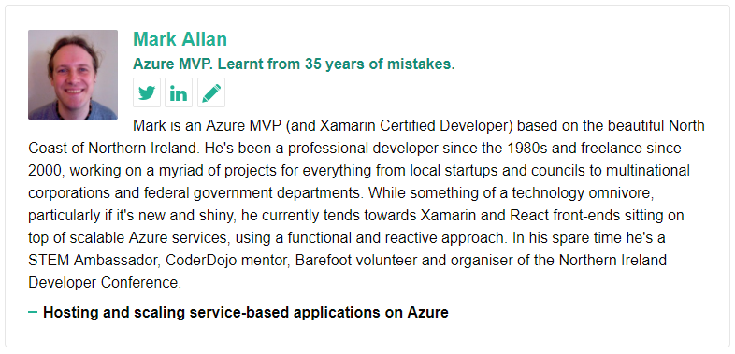
Letterkenny, Ireland
Bit.ly/devConfLK2019
#DevConfLK2019

Slide 5
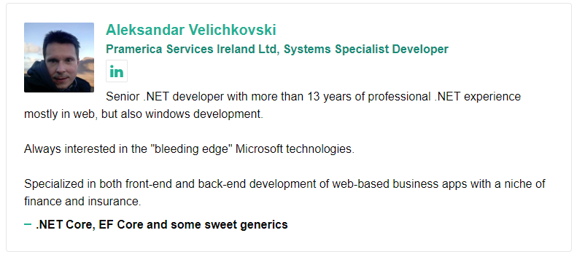
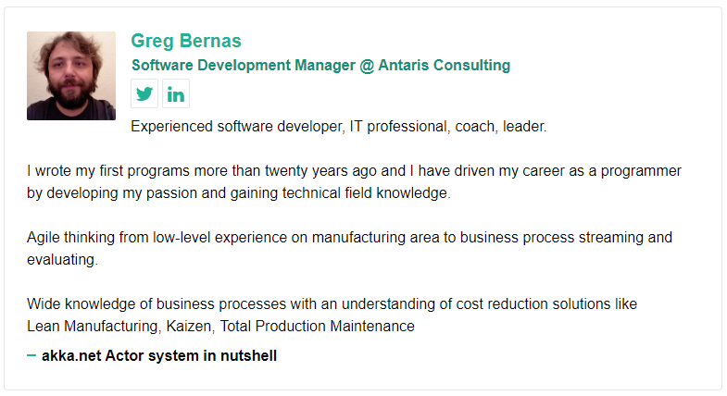
Letterkenny, Ireland
Bit.ly/devConfLK2019
#DevConfLK2019

Slide 6
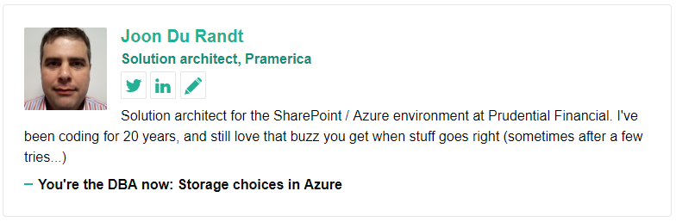
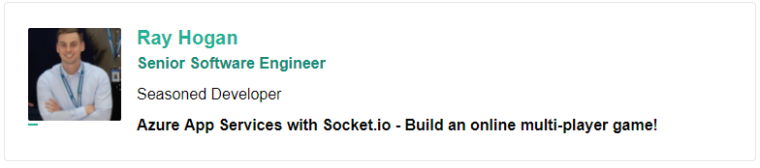
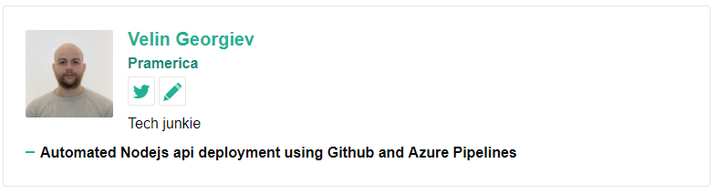
Letterkenny, Ireland
Bit.ly/devConfLK2019
#DevConfLK2019

Slide 7
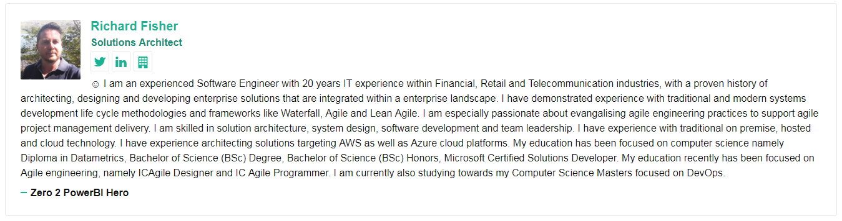

Slide 8
Conference Code of Conduct
Letterkenny, Ireland
All attendees, speakers, sponsors and volunteers at our conference are required to agree with the following code of conduct. Organisers will enforce this code throughout the event. We expect cooperation from all participants to help ensure a safe environment for everybody.
Our conference is dedicated to providing a harassment-free conference experience for everyone, regardless of gender, gender identity and expression, age, sexual orientation, disability, physical appearance, body size, race, ethnicity, religion (or lack thereof), or technology choices.
We do not tolerate harassment of conference participants in any form. Sexual language and imagery is not appropriate for any conference venue, including talks, workshops, parties, Twitter and other online media.
Conference participants violating these rules may be sanctioned or expelled from the conference without a refund at the discretion of the conference organisers.
Need Help?
Write us on lk-mug@outlook.com or talk to one of the organizers Nithin/Sibin

