Slide 1
Letterkenny DotNet Azure User Group
2018
The Microsoft User Group for Donegal County
http://lk-mug.org
@lkmsug

Slide 2







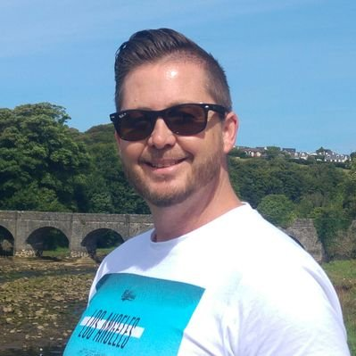
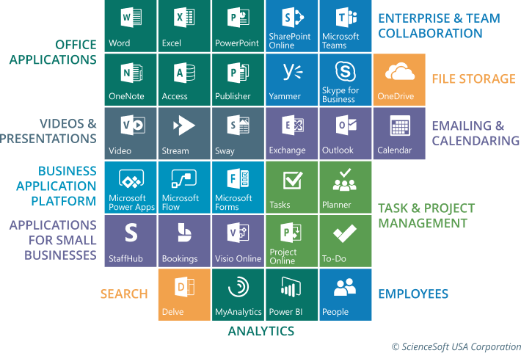
Letterkenny
MUG
#lkmug
Nov 10, 2018
9:00AM – 5:30PM
Pramerica Services,
Letterkenny, Donegal, Ireland
Keynote & Introduction
Introduction to Office 365 Developer Landscape
Richard Fisher
Solutions Architect
Pramerica
@RichJFish
linkedin.com/in/rjfisher-architect
@lkmsug
www.lk-mug.org
#mvpbuzz #Office365 #O365DevBootCamp
Richard Fisher

Slide 3
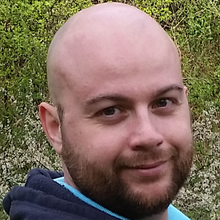

Letterkenny
MUG
#lkmug
Nov 10, 2018
9:00AM – 5:30PM
Pramerica Services,
Letterkenny, Donegal, Ireland
The Power of PnP PowerShell
Getting started with the PnP Provisioning Engine and PnP PowerShell
Velin Georgiev
Microsoft MVP, Office Dev
UK & Ireland
@VelinGeorgiev
@lkmsug
www.lk-mug.org
https://blog.velingeorgiev.com
#mvpbuzz #Office365 #O365DevBootCamp
Contributor: @pnp/office365-cli

Slide 4

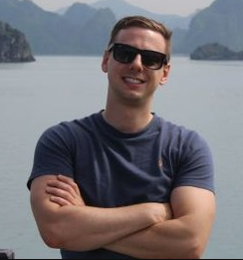

Letterkenny
MUG
#lkmug
Nov 10, 2018
9:00AM – 5:30PM
Pramerica Services,
Letterkenny, Donegal, Ireland
Deep Dive in to PowerApps and Flow
Building an HR Job application workflow with PowerApps and Flow
Ray Hogan
Senior Specialist
Pramerica Services
@RayHogan
@lkmsug
www.lk-mug.org
https://rhogan.ie
#mvpbuzz #Office365 #O365DevBootCamp
linkedin.com/in/ray-hogan

Slide 5
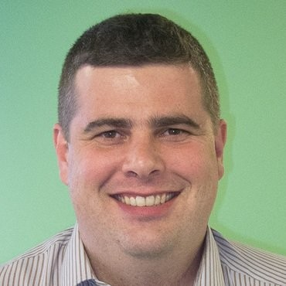
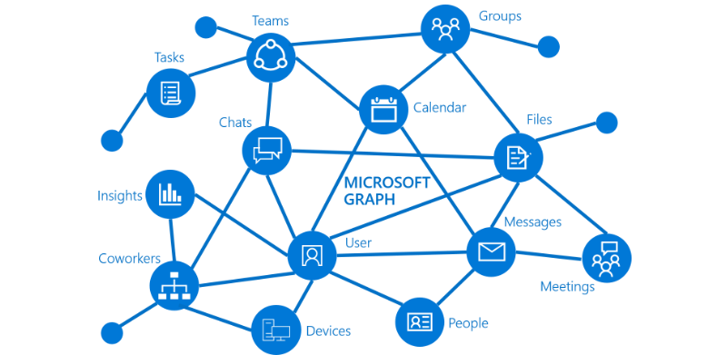
Letterkenny
MUG
#lkmug
Nov 10, 2018
9:00AM – 5:30PM
Pramerica Services,
Letterkenny, Donegal, Ireland
Introduction to Microsoft Graph
Build smarter Productivity apps using Microsoft Graph
Joon Du Rant
Solutions Architect
Pramerica
https://developer.microsoft.com/en-us/graph
@joon_net
linkedin.com/in/joondurandt/
@lkmsug
www.lk-mug.org
#mvpbuzz #Office365 #O365DevBootCamp
Richard Fisher

Slide 6
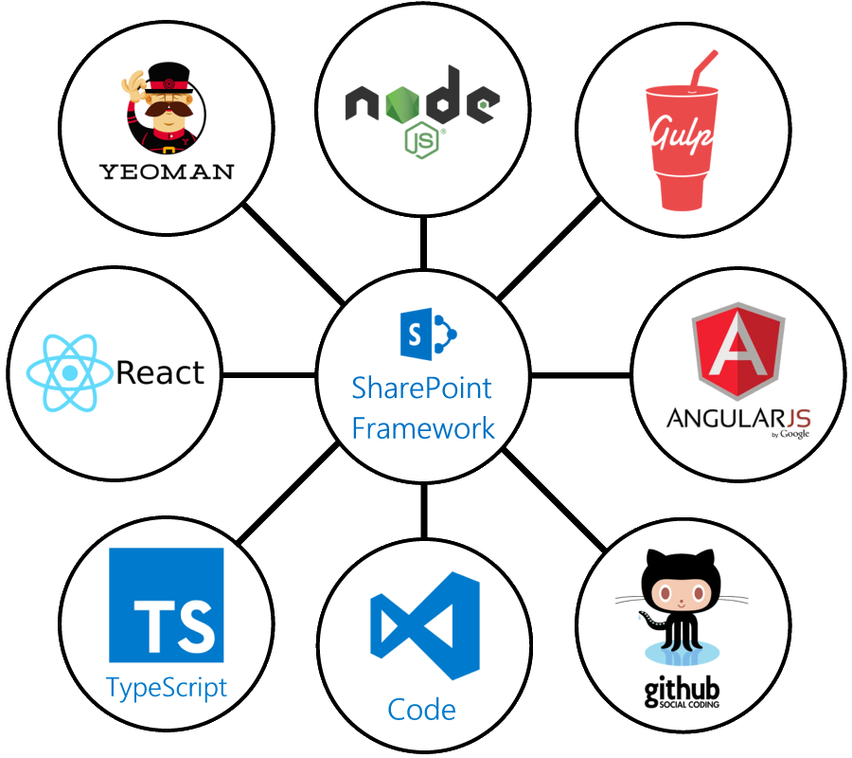
Letterkenny
MUG
#lkmug
Nov 10, 2018
9:00AM – 5:30PM
Pramerica Services,
Letterkenny, Donegal, Ireland
Introduction to
SharePoint Framework
Build your first SharePoint Framework web part
Joon Du Rant
Solutions Architect
Pramerica
@joon_net
linkedin.com/in/joondurandt/
@lkmsug
www.lk-mug.org
#mvpbuzz #Office365 #O365DevBootCamp
Richard Fisher

Slide 7
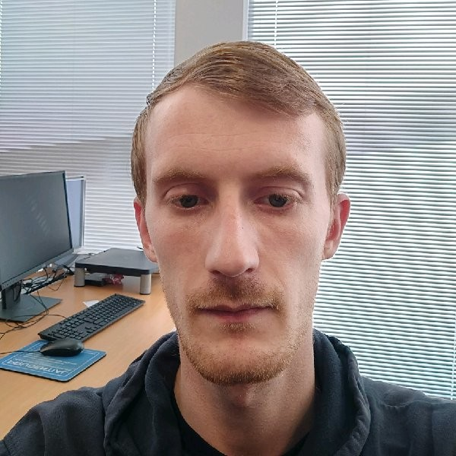
Letterkenny
MUG
#lkmug
Nov 10, 2018
9:00AM – 5:30PM
Pramerica Services,
Letterkenny, Donegal, Ireland
Integration of Graph JS SDK
Build SharePoint Framework Client-Side Web Parts Using the Microsoft Graph JavaScript SDK
Austin Breslin
Senior Developer
Pramerica
@AustinBreslinDev
linkedin.com/in/austin-breslin-84b4a74b
@lkmsug
www.lk-mug.org
#mvpbuzz #Office365 #O365DevBootCamp
Richard Fisher

Slide 8






Letterkenny
.MUG
Letterkenny Dotnet Azure UG
Hosted by
Venue:
Pramerica
Letterkenny Business & Technology Park
Letterkenny, Donegal, Ireland
Date:
Saturday, 10th Nov
Time:
9:00AM – 5:30PM
Register at:
https://lnkd.in/ee8STGe
Event Sponsors

Slide 9

Agenda:
Date: Saturday, 10th Nov Time: 9:00AM – 5:30PM
Time | Session | Speaker
9:00AM – 9:30AM | Registration & Networking Breakfast
9:30AM – 10:00AM | Welcome and Keynote (Introduction to the Office 365 developer landscape) | Richard Fisher (Solutions Architect, Pramerica)
10:00AM – 11:15AM | Deep Dive into Power Apps and Flow Automating internal job application | Ray Hogan (Senior Specialist, Pramerica)
11:15AM -- 11:30AM | Break
11:30AM – 12:30PM | Build your first SharePoint Framework web part Creating a Web part Debugging a Web part Integrate Web part with GitHub data * Participants would setup necessary tool chain | Joon Du Rant/ Nithin Mohan (Senior Specialist, Pramerica) Velin Georgiev
12:30PM – 1:30PM | Lunch Break + Networking
1:30PM – 2:00PM | Introduction to Microsoft Graph | Joon Du Rant (Solutions Architect, Pramerica)
2:00PM - 3:30PM | Build SharePoint Framework Client-Side Web Parts Using the Microsoft Graph JavaScript SDK | Austin Breslin (Specialist Dev, Pramerica)
3:30PM - 3:45PM | Break
3:45PM – 5:00PM | Getting Started – OfficeDevPnP PowerShell and PnP Provisioning Engine | Velin Georgiev (Technical Architect, Pramerica)
5:00PM – 5:45PM | Q&A’s, Closing Note and Swag time | Richard Fisher

Slide 10

Sponsors:
Date: Saturday, 10th Nov Time: 9:00AM – 5:30PM
Venue & Refreshments
RAFFLE for one, 1 year license
RAFFLE for one, 1 year license
Swags, T-Shirts

Slide 11
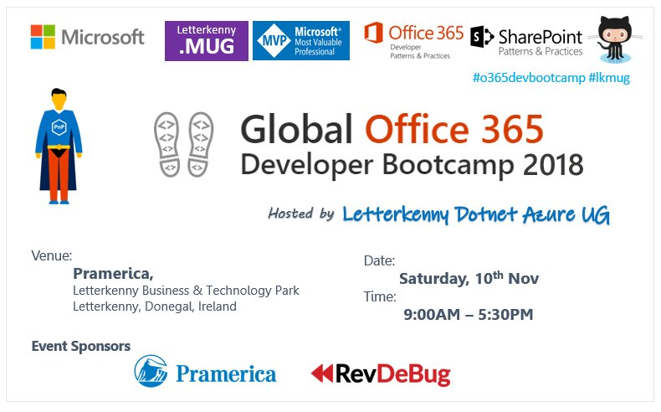

Slide 12
#o365devbootcamp
2018
Hosted by
Letterkenny Dotnet Azure UG
Venue:
Letterkenny,
Co Donegal,
Ireland
Date:
Saturday, 10th Nov
Time:
9:00AM – 5:30PM
@OfficeDev
@OfficeDevPnP
@LKMSUG

