Slide 1



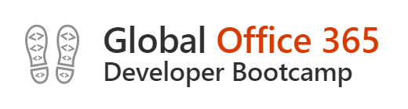



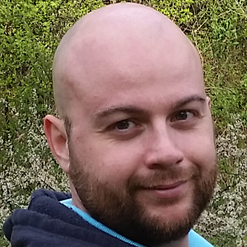

Letterkenny
MUG
#lkmug
Nov 10, 2018
9:00AM – 5:30PM
Pramerica Services,
Letterkenny, Donegal, Ireland
The Power of PnP PowerShell
Getting started with the PnP Provisioning Engine and PnP PowerShell
Velin Georgiev
Microsoft MVP, Office Dev
UK & Ireland
@VelinGeorgiev
@lkmsug
www.lk-mug.org
https://blog.velingeorgiev.com
#mvpbuzz #Office365 #O365DevBootCamp
Contributor: @pnp/office365-cli

Slide 3




Letterkenny
.MUG
#o365devbootcamp #lkmug
2018
Hosted by
Letterkenny Dotnet Azure UG
Where?
Pramerica
Letterkenny
When:
10th Nov
9:00AM
- 5:30PM
Event Sponsors
Date:
Saturday, 10th Nov
Time:
9:00AM – 5:30PM

Slide 4
Letterkenny
.MUG
#o365devbootcamp #lkmug
2018
Hosted by
Letterkenny Dotnet Azure UG
Venue:
Pramerica,
Letterkenny Business & Technology Park
Letterkenny, Donegal, Ireland
Date:
Saturday, 10th Nov
Time:
9:00AM – 5:30PM
Event Sponsors

Slide 5
#o365devbootcamp
2018
Hosted by
Letterkenny Dotnet Azure UG
Venue:
Letterkenny,
Co Donegal,
Ireland
Date:
Saturday, 10th Nov
Time:
9:00AM – 5:30PM
@OfficeDev
@OfficeDevPnP
@LKMSUG

