Slide 1







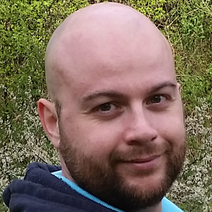

Letterkenny
MUG
#lkmug
Nov 10, 2018
9:00AM – 5:30PM
Pramerica Services,
Letterkenny, Donegal, Ireland
The Power of PnP PowerShell
Getting started with the PnP Provisioning Engine and PnP PowerShell
Velin Georgiev
Microsoft MVP, Office Dev
UK & Ireland
@VelinGeorgiev
@lkmsug
www.lk-mug.org
https://blog.velingeorgiev.com
#mvpbuzz #Office365 #O365DevBootCamp
Contributor: @pnp/office365-cli

