Slide 1







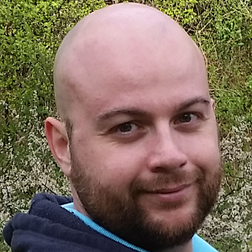

Letterkenny
MUG
#lkmug
Nov 10, 2018
9:00AM – 5:30PM
Pramerica Services,
Letterkenny, Donegal, Ireland
The Power of PnP PowerShell
Getting started with the PnP Provisioning Engine and PnP PowerShell
Velin Georgiev
Microsoft MVP, Office Dev
UK & Ireland
@VelinGeorgiev
@lkmsug
www.lk-mug.org
https://blog.velingeorgiev.com
#mvpbuzz #Office365 #O365DevBootCamp
Contributor: @pnp/office365-cli

Slide 2

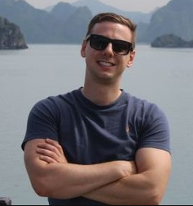

Letterkenny
MUG
#lkmug
Nov 10, 2018
9:00AM – 5:30PM
Pramerica Services,
Letterkenny, Donegal, Ireland
Deep Dive in to PowerApps and Flow
Building an HR Job application workflow with PowerApps and Flow
Ray Hogan
Senior Specialist
Pramerica Services
@RayHogan
@lkmsug
www.lk-mug.org
https://rhogan.ie
#mvpbuzz #Office365 #O365DevBootCamp
linkedin.com/in/ray-hogan

Slide 3
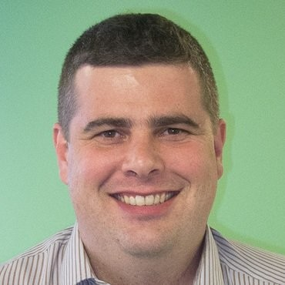
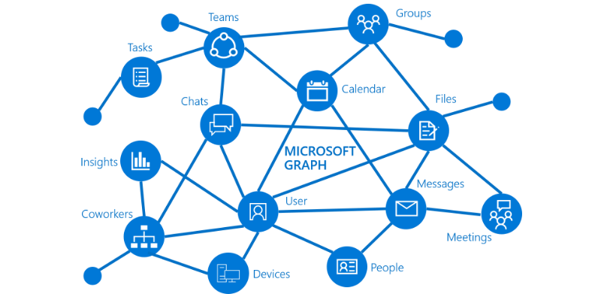
Letterkenny
MUG
#lkmug
Nov 10, 2018
9:00AM – 5:30PM
Pramerica Services,
Letterkenny, Donegal, Ireland
Introduction to Microsoft Graph
Build smarter Productivity apps using Microsoft Graph
Joon Du Rant
Solutions Architect
Pramerica
https://developer.microsoft.com/en-us/graph
@joon_net
linkedin.com/in/joondurandt/
@lkmsug
www.lk-mug.org
#mvpbuzz #Office365 #O365DevBootCamp
Richard Fisher

Slide 4
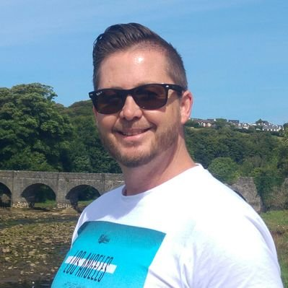
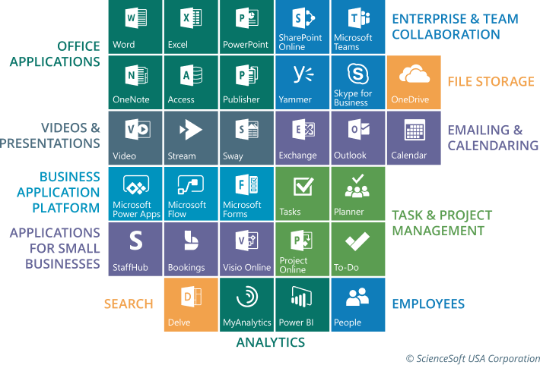
Letterkenny
MUG
#lkmug
Nov 10, 2018
9:00AM – 5:30PM
Pramerica Services,
Letterkenny, Donegal, Ireland
Keynote & Introduction
Introduction to Office 365 Developer Landscape
Richard Fisher
Solutions Architect
Pramerica
@RichJFish
linkedin.com/in/rjfisher-architect
@lkmsug
www.lk-mug.org
#mvpbuzz #Office365 #O365DevBootCamp
Richard Fisher

Slide 5
Letterkenny
MUG
#lkmug
Nov 10, 2018
9:00AM – 5:30PM
Pramerica Services,
Letterkenny, Donegal, Ireland
Keynote & Introduction
Introduction to Office 365 Developer Landscape
Richard Fisher
Solutions Architect
Pramerica
@RichJFish
linkedin.com/in/rjfisher-architect
@lkmsug
www.lk-mug.org
#mvpbuzz #Office365 #O365DevBootCamp
Richard Fisher

Slide 6






Letterkenny
.MUG
Letterkenny Dotnet Azure UG
Hosted by
Venue:
Pramerica
Letterkenny Business & Technology Park
Letterkenny, Donegal, Ireland
Date:
Saturday, 10th Nov
Time:
9:00AM – 5:30PM
Register at:
https://lnkd.in/ee8STGe
Event Sponsors

Slide 7
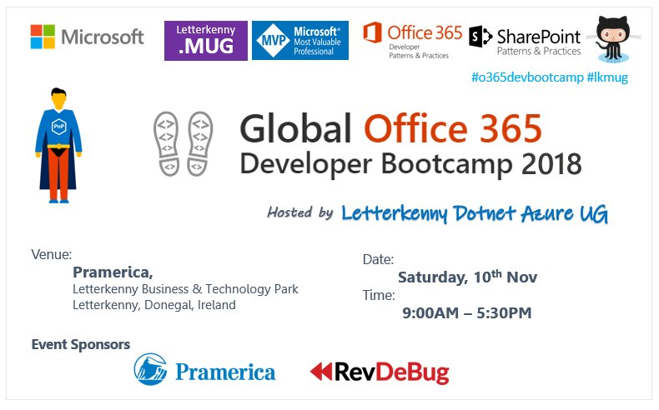

Slide 8
#o365devbootcamp
2018
Hosted by
Letterkenny Dotnet Azure UG
Venue:
Letterkenny,
Co Donegal,
Ireland
Date:
Saturday, 10th Nov
Time:
9:00AM – 5:30PM
@OfficeDev
@OfficeDevPnP
@LKMSUG

