Slide 1

Introduction to ITIL ITIL Framework Service Lifecycle Key ITIL Processes Service Management Principles Roles and Responsibilities Service Design and Service Transition Service Operation Continual Service Improvement

Slide 2
ITIL, which stands for Information Technology Infrastructure Library, is a widely recognized framework for IT Service Management (ITSM). It provides a set of best practices and guidelines for managing IT services efficiently and effectively. ITIL helps organizations align their IT services with their business goals and deliver value to their customers.
History: ITIL was originally developed by the UK government in the 1980s as a collection of best practices for IT service management. It has since evolved and gained widespread adoption worldwide
IT services refer to the various technology-related services and solutions that organizations provide to their users, customers, or employees to support their business operations and goals. These services encompass a wide range of activities, from hardware and software support to network management, cybersecurity, application development, and more. Essentially, IT services are the means by which technology is delivered and utilized within an organization IT Service Management (ITSM) is a discipline or framework that focuses on effectively and efficiently managing these IT services to ensure they meet the needs of the organization and its customers. It involves planning, designing, delivering, operating, and controlling IT services, with a primary emphasis on aligning IT with the business objectives. ITSM helps organizations streamline their IT operations, enhance service quality, and maintain a customer-centric approach

Slide 3
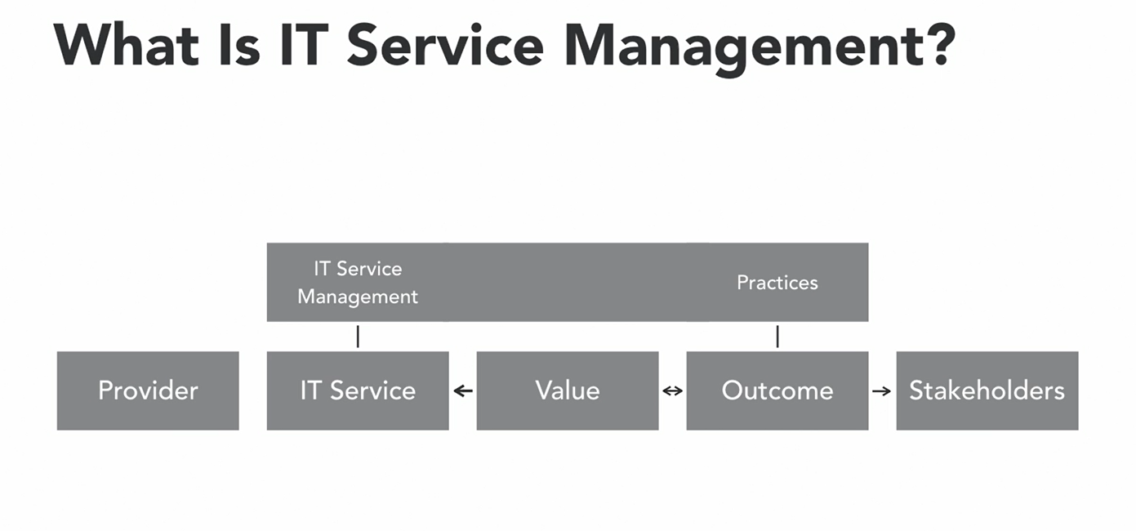

Slide 4
Implementing ITIL (Information Technology Infrastructure Library) within your organization can have several significant benefits, impacting various aspects of your IT service delivery and overall business operations. Here's what ITIL can mean for your organization:
Improved Service Quality Alignment with Business Goals
Efficient Resource Utilization
Enhanced Customer Satisfaction
Effective Change Management
Better Problem Resolution
Clearer Roles and Responsibilities Cost Control / Risk Management Compliance and Governance / Continuous Improvement / IT Staff Development

Slide 5

Framework Structure: ITIL
Service Strategy: This publication focuses on the high-level strategy and planning aspects of IT service management. It helps organizations align their IT services with their overall business goals and objectives. Key topics covered in this book include service portfolio management, demand management, financial management for IT services, and strategies for achieving business outcomes through IT.
1
Service Design: The Service Design publication provides guidance on designing IT services that meet the needs of the business and customers. It covers topics such as service level management, service catalog management, capacity management, availability management, and IT service continuity management. The goal is to create services that are both efficient and effective
2
Service Transition: This publication deals with the processes and activities involved in transitioning new or changed services into the live environment. It includes change management, release and deployment management, service asset and configuration management, knowledge management, and more. The focus is on ensuring that changes are implemented smoothly and without disrupting existing services
3
Service Operation: Service Operation is all about the day-to-day management and delivery of IT services. This publication covers incident management, problem management, event management, request fulfillment, access management, and other operational processes. The aim is to provide reliable and efficient services to users and customers
4
Continual Service Improvement (CSI): The CSI publication emphasizes the importance of continuous improvement in IT service management. It provides a framework for organizations to regularly assess their services, processes, and performance. Key components include the Deming Cycle (Plan-Do-Check-Act), service measurement and reporting, and techniques for identifying areas for improvement.
5

Slide 6
Key Concepts
Service: In ITIL, a service is defined as a means of delivering value to customers by facilitating outcomes they want to achieve without the ownership of specific costs and risks.
Service Lifecycle: ITIL is often depicted as a service lifecycle with five phases: Service Strategy, Service Design, Service Transition, Service Operation, and Continual Service Improvement. Each phase contributes to the overall management of IT services
Process: ITIL emphasizes the importance of well-defined processes for managing IT services. Processes provide a structured approach to achieving specific objectives, such as incident management or change management.
Roles and Responsibilities: ITIL defines various roles within an organization, each with specific responsibilities related to IT service management. Examples include Service Desk Analyst, Incident Manager, and Change Manager

Slide 7
Lean IT is an approach that focuses on applying lean principles to IT operations and processes to increase efficiency, reduce waste, and improve overall service delivery. If you're a beginner looking to learn about Lean IT, here are some steps to get started Read Books and Articles:
There are several books and articles dedicated to Lean IT. Consider reading "Lean IT: Enabling and Sustaining Your Lean Transformation" by Steven C. Bell and Michael A. Orzen or exploring online resources and articles

Slide 8

Value Stream Mapping (VSM):
Value Stream Mapping is a visual tool used to analyze and document the flow of information, materials, and activities required to deliver a specific product or service. It helps identify areas of waste, bottlenecks, and opportunities for improvement in IT processes.
Kaizen (Continuous Improvement):
Kaizen is the philosophy of continuous improvement. In Lean IT, it involves encouraging all team members to regularly look for small, incremental improvements in their work processes. Kaizen events or workshops are held to address specific issues and make improvements collaboratively.
5S (Sort, Set in order, Shine, Standardize, Sustain):
5S is a workplace organization and cleanliness methodology. In Lean IT, it helps create an organized and efficient work environment. The five steps are:
Sort: Eliminate unnecessary items from the workspace.
Set in order: Arrange items in a logical and efficient manner.
Shine: Maintain cleanliness and orderliness.
Standardize: Establish and maintain standardized work processes.
Sustain: Ensure that the improvements are sustained over time

Slide 9

Kanban:
Kanban is a visual management tool used to control and manage work in progress (WIP). In IT, Kanban boards are often used to track tasks, projects, or IT service requests. It provides transparency and helps teams visualize work and workflow.
Gemba Walk:
Gemba is a Japanese term that means "the actual place." A Gemba walk involves physically going to where work is done to observe processes and identify opportunities for improvement. It promotes direct observation and engagement with the work environment.

Slide 10
Root Cause Analysis (RCA):
RCA is a problem-solving technique used to identify the underlying causes of issues or incidents. In Lean IT, RCA helps prevent recurring problems by addressing their root causes.
Poka-Yoke (Error Proofing):
Poka-yoke techniques aim to prevent errors or mistakes from occurring in the first place. In IT, this can involve implementing automated checks and safeguards to reduce the likelihood of human errors.
PDCA (Plan-Do-Check-Act) Cycle:
PDCA is a continuous improvement framework used to solve problems and make iterative improvements. It involves:
Plan: Identifying a problem and planning a change.
Do: Implementing the change.
Check: Evaluating the results and gathering data.
Act: Taking actions based on the results to improve further.
Fishbone Diagram (Ishikawa or Cause-and-Effect Diagram):
This diagram is used to analyze the potential causes of a problem or issue. It helps teams systematically explore various factors contributing to an issue.
Standard Work:
Standard Work documents and standardizes the best-known way of performing a task or process. It helps ensure consistency and efficiency in IT operations.

Slide 11
Definition of Disaster Recovery:
Disaster recovery encompasses a set of policies, procedures, and technologies designed to protect an organization's IT infrastructure, applications, and data from unforeseen events that could lead to system failures or data loss. These events can include natural disasters (e.g., earthquakes, floods), human-made disasters (e.g., cyberattacks, hardware failures), or even pandemic-related disruptions
Importance of Disaster Recovery:
Ensuring Business Continuity: IT services are integral to the operations of most organizations today. Any disruption to these services can have severe consequences, including financial losses, damage to reputation, and legal implications. Disaster recovery is essential for maintaining business continuity by minimizing downtime and enabling critical operations to continue functioning.

Slide 12
Key Objectives of Disaster Recovery:
Minimizing Downtime: DR plans aim to reduce the time it takes to restore IT services to normal operation after a disaster. This minimizes productivity losses and financial impacts.
Data Protection: DR strategies ensure the integrity and availability of critical data. Regular backups, data replication, and offsite storage are common practices.
Regulatory Compliance: Many industries have regulatory requirements mandating the protection and recovery of sensitive data. Failure to comply with these regulations can result in legal consequences.
Reputation Management: A well-executed disaster recovery plan can help organizations maintain customer trust and reputation. Customers expect services to be available consistently.
Risk Mitigation: Disaster recovery identifies potential risks and vulnerabilities in IT systems and establishes strategies to mitigate these risks.

Slide 13
Initiation and Scope Definition:
Identify the need for a DRP and establish the scope, objectives, and goals of the planning effort.
Determine the key stakeholders and their roles in the planning process.
Define the budget, timeline, and available resources for the DRP.
Risk Assessment and Business Impact Analysis (BIA)
Identify and assess potential risks and threats that could impact IT operations, including natural disasters, cyberattacks, and hardware failures.
Conduct a BIA to determine the criticality of IT systems and data to the organization's core functions and revenue streams.
Prioritize IT assets and services based on their importance to the business.
Strategy Development:
Develop a disaster recovery strategy that aligns with the findings of the risk assessment and BIA.
Determine recovery time objectives (RTOs) and recovery point objectives (RPOs) for each IT service.
Define the overall approach to recovery, including the use of backup systems, data replication, and failover mechanisms.
Plan Development:
Create a detailed DRP that includes step-by-step procedures for responding to different disaster scenarios.
Document contact information for key personnel and external entities (e.g., emergency services, vendors, cloud service providers).
Specify data backup and storage procedures, including offsite storage locations.
Define communication and notification protocols for alerting relevant stakeholders during a disaster.

Slide 14
Resource Allocation and Logistics:
Identify the resources required for disaster recovery, such as hardware, software, personnel, and facilities.
Ensure that backup data and equipment are readily available and can be deployed as needed.
Establish procedures for resource allocation and management during a disaster.
Testing and Training:
Conduct regular testing and drills of the DRP to validate its effectiveness.
Provide training and awareness programs for staff involved in the recovery process.
Identify weaknesses and areas for improvement based on testing results.
Documentation and Reporting:
Maintain detailed documentation of the DRP, including any changes or updates.
Create reports and documentation related to incident response and recovery efforts.
Ensure that all relevant personnel have access to up-to-date DRP documentation.

Slide 15
Implementation and Activation:
Activate the DRP when a disaster or disruptive incident occurs, following the defined procedures.
Ensure that all recovery efforts are well-coordinated, and the necessary resources are deployed promptly.
Monitoring and Evaluation:
Continuously monitor the recovery process and assess progress toward meeting RTOs and RPOs.
Gather data and feedback to evaluate the effectiveness of the DRP and identify areas for improvement.
Maintenance and Updates:
Regularly review and update the DRP to reflect changes in technology, business processes, and risk profiles.
Ensure that the DRP remains aligned with the organization's overall business continuity strategy.

Slide 16
Regulatory Compliance and Reporting:
Ensure that the DRP meets any regulatory requirements and industry-specific standards related to data protection and disaster recovery.
Prepare reports and documentation for regulatory compliance and reporting purposes.
Communication and Awareness:
Maintain open lines of communication with all stakeholders, keeping them informed about the DRP and its status.
Foster a culture of disaster preparedness and awareness within the organization.

