Slide 1
New Top
{idx of Current} / {numAnalysis}
⇐ 3 / 8 ⇒
×
Field Name 1 | Some value (Just leave it as before)
Field Name 2 | Some value (Just leave it as before)
Field Name 3 | Some value (Just leave it as before)
Field Name 4 | Some value (Just leave it as before)
... | More rows follows

Slide 2
New Bottom (No Comment Posted Yet)
×
Field n-2 | Some value (Just leave it as before)
Field n-1 | Some value (Just leave it as before)
Last Field | Value of last field
Post & Generate New
Input Box for User to Leave Comment
[When nothing is written, show “Leave some comments...”]

Slide 3
New Bottom (User wrote comments but not posted yet)
×
Field n-2 | Some value (Just leave it as before)
Field n-1 | Some value (Just leave it as before)
Last Field | Value of last field
Post & Generate New
[This is the comment by user] bala bala bala yeah yeah yeah ho
User chose 4-star (by clicking the 4th star) for this analysis

Slide 4
New Bottom (Comment Already Posted by User)
×
Field n-2 | Some value (Just leave it as before)
Field n-1 | Some value (Just leave it as before)
Last Field | Value of last field
[This is the comment by user] bala bala bala yeah yeah yeah ho
ho ho ha ha ha ha (read from db)

Slide 5
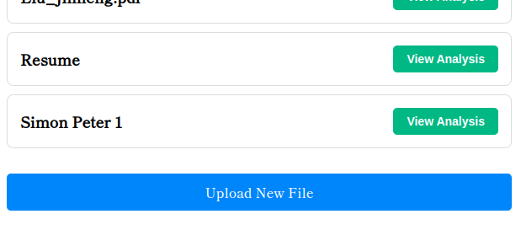
Black & Clickable if not last;
Otherwise Grey and not clickable
Generated

Slide 6
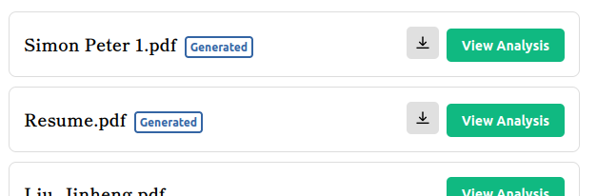

Generated
Simon Peter 1.pdf
Simon Peter 1.pdf
Generated
Created: Jan. 01, 1970 10:00:01; Last Update: Feb. 02, 1970 20:00:01

