Slide 1

MOX 410 Design project Portable Braai with Water Heater
Jared Neil Lakhani 15125344

Slide 2

Problem Statement, Objective and Scope
Background:
Bridging the gap between outdoor life and modernity
During camping activities there is usually no means to heat water
Braaiing generates more heat than necessary to cook food
Use excess heat to for water used in a shower
Problem Statement:
Design a portable Braaiing Apparatus to transfer excess heat of braai to water for a comfortable shower.
Objective:
Conduct a first-order heat transfer analysis and a radiation analysis
Conduct a first-order fluid dynamic analysis of the flow of water through the system
Consider the Ergonomics aspect of the design

Slide 3
Client requirements and design specifications
How client requirements were addressed and converted into design specifications:
1. Water temperature increase of at least 10⁰C
Water temperature at the outlet must have at least a 10⁰C difference from the water temperature of the inlet (at 15⁰C)
How: Braai fuel fully ignited and burning prior to the shower
Water only used after cooking is done and not during the process
Braai fuel must be distributed on all applicable areas of the braai
2. Water source available at normal domestic pressure
A normal hosepipe connector to be used as the inlet and outlet
The hosepipe is the means of transporting the water from the water source to Braaiing Apparatus

Slide 4
Client requirements and design specifications
How client requirements were addressed and converted into design specifications (continued):
3. No electricity available
Heat source generated from braai fuel ie. Charcoal
Braaiing apparatus must be suitable to hold this material, contain the heat generated, and transfer heat generated to water
4. Safety of the users
Maximum weight of 10kg to accommodate the ease of carrying
Braai fuel is contained and out of reach from users
Insulation to be implemented.

Slide 5
Client requirements and design specifications
How client requirements were addressed and converted into design specifications (continued):
5. Suitable for 2 people
Maximum occupy-able area/spacing was considered for ease of carrying
No storage of water is necessary as the water will be used immediately from hosepipe-thus consider heat transfer time
6. Other requirements considered
Ease of storage and storage requirements
Ease of cleaning the apparatus is considered

Slide 6
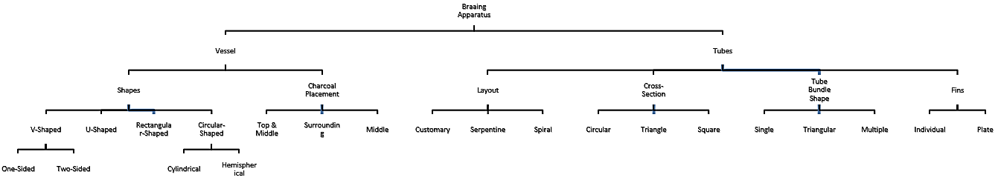
Concept generation and final concept

Slide 7
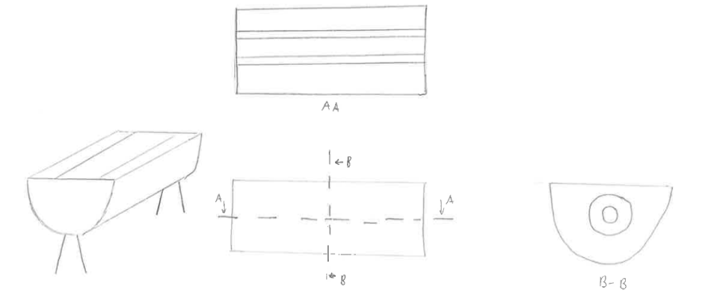
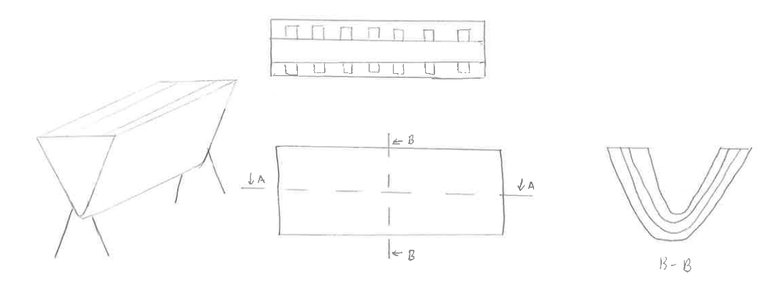
Concept generation and final concept
Braaiing Apparatus Vessel:
Figure 1: Figure of U-Shaped Vessel.
Figure 2: Two-Sided V-Shaped Vessel.
Lighter than other designs due to single longitudinal cylinder
Disadvantage: short time taken for the water to flow through these tubes
Issue with flow rate caused by local losses
Issue with weight due to excess tubes
Coal places at centre of ‘V’ so no issues with heat transfer

Slide 8
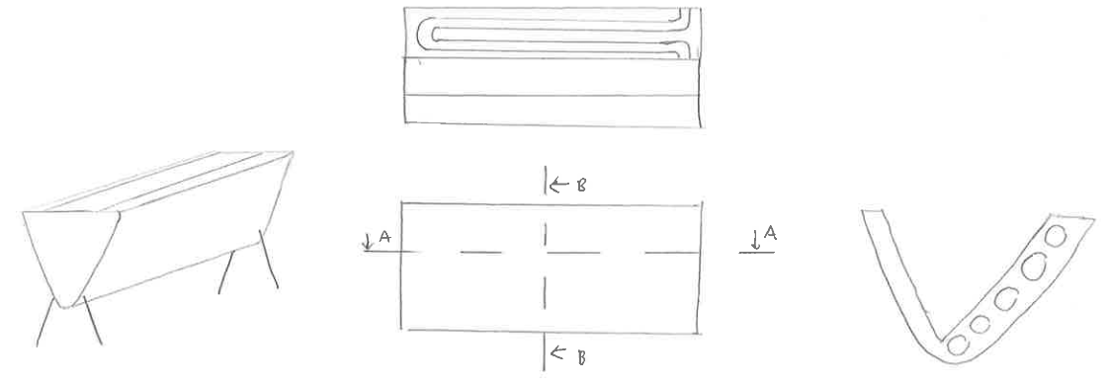
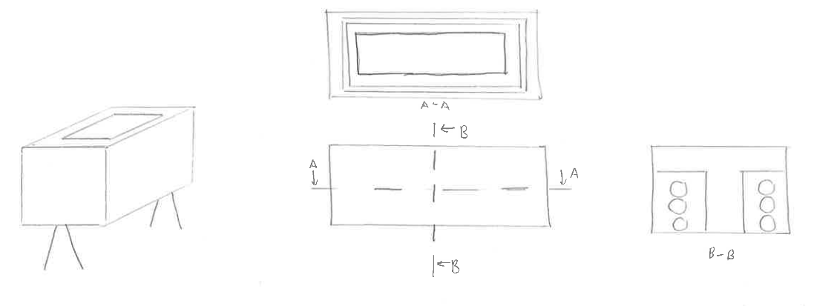
Concept generation and final concept
Braaiing Apparatus Vessel (continued):
Figure 3: One-Sided V-Shaped Vessel.
Figure 4: Rectangular-Shaped Vessel.
Possibly be a lack of heat exchange between charcoal and tubes due to heat flux only on one side
Considered balancing issues
Inspired by ordinary braaiing stand
Charcoals centrally placed
Possible issue: Weight due to numerous tubes utilized

Slide 9
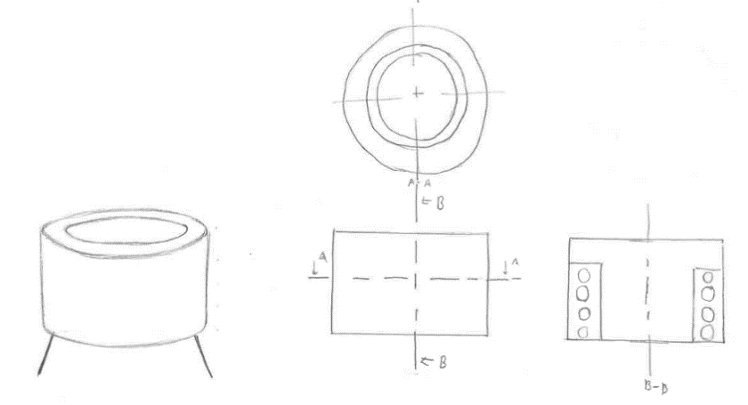
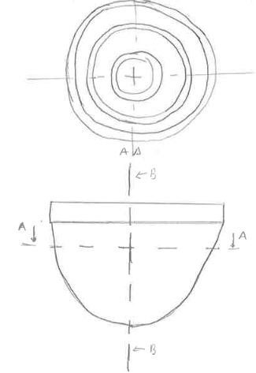
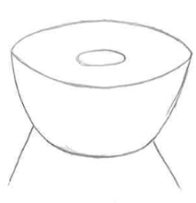
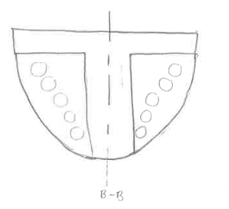
Concept generation and final concept
Braaiing Apparatus Vessel (continued):
Figure 5: Cylindrical Circular-Shaped Vessel.
Figure 6: Hemispherical Circular-Shaped Vessel.
Tubes surround the charcoal placed in the centre, form a spiral around heat source
Possible issue: spirals could cause flow rate difficulties
Identical to circular-shaped vessel
Cylinder replaced by hemisphere to alleviate weighting issues (less tubes are needed)
Possible issue: heat transfer insufficient
Advantage: lower local losses

Slide 10
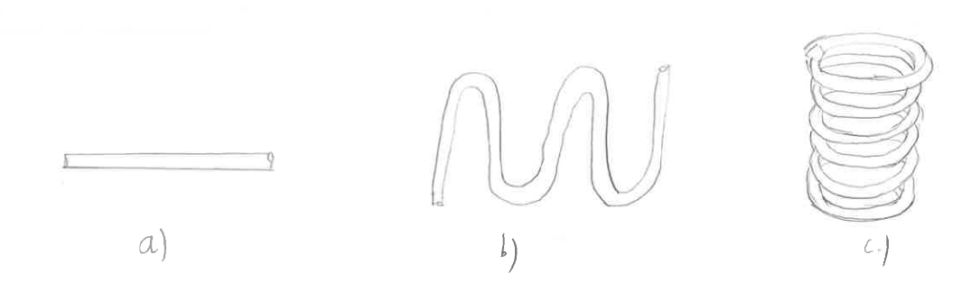
Concept generation and final concept
Tube Layout:
Heat transfer capabilities and thus the compactness of the tubes considered
Choices of tube layout designs:
Figure 7: Tube Layouts: a) Customary; b) Serpentine; c) Spiral
Note: Heat transfer capabilities increase from a) to c) but losses due to friction are amplified in this order as well

Slide 11
Concept generation and final concept
Final Concept Selection:
Outer Vessel
Choice:
Rectangular-Shaped Vessel
Reasons for Choice:
Simplicity of design
Greatest amount of space able to be utilized in storage
Design:
Charcoal placed in centre of apparatus (inner vessel) and top to ensure maximum heat transfer capabilities
Outer vessel made from AISI 304 Stainless Steel
Stainless Steel: fatigue and corrosion resistance and low thermal conductivity and widely available

Slide 12
Concept generation and final concept
Final Concept Selection (continued):
2. Tube Layout
Choice:
Straight tubes
Reason for Choice:
Serpentine or Helical shapes: too complex to implement and losses due to excess friction in the tubes would have resulted
Design:
Tubes encompass the charcoal placed centrally
Tubes touch inner vessel to ensure maximum conduction heat transfer
Pure Copper used: due to high thermal conductivity
Inner diameter: 2cm, Birmingham Wire Gauge Thickness: 18

Slide 13
Concept generation and final concept
Final Concept Selection (continued):
3. Tube Bundle Shape:
Choice:
Multiple thin tubes
Reason for Choice:
Tubing compactness; Increase surface area through which heat transfer occurs
Sufficient heat transfer
Design:
Vertical placement of tubes along the outer wall of the inner vessel
4. Tube Cross-Section:
Choice:
Circular cross section
Reason for Choice:
Ease of manufacturing and cost efficiency

Slide 14
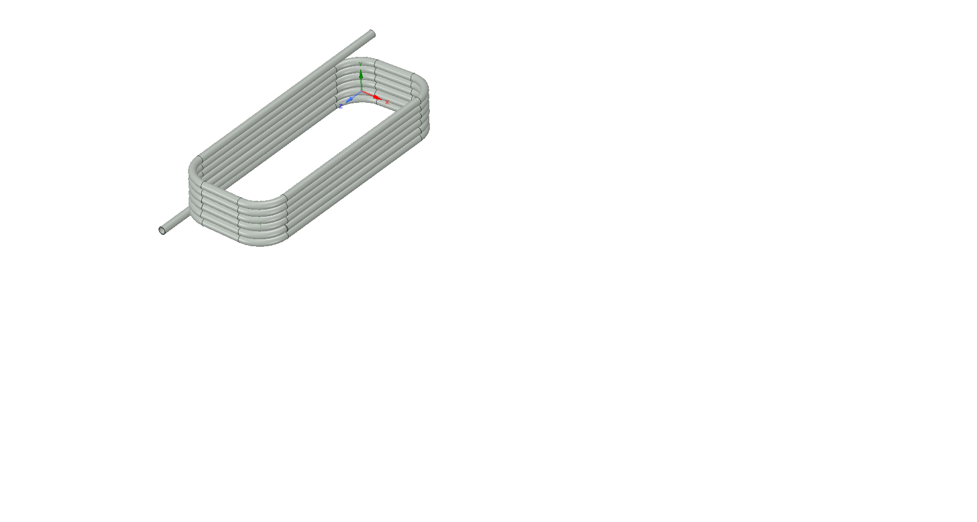
Concept generation and final concept
Final Concept Selection (continued):
Figure 8: Tubing
Notes:
Picture of final design and talk on inlet/outlet, inner vessel, legs and insulation

Slide 15
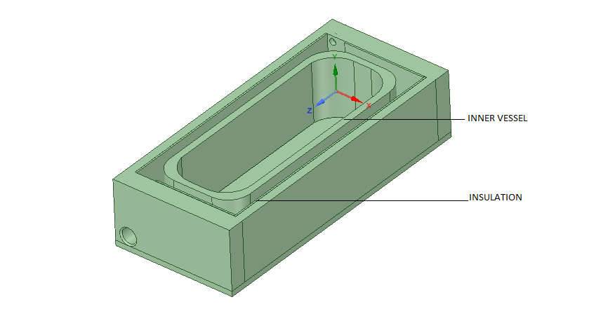
Concept generation and final concept
Final Concept Selection (continued):
Figure 9: Inner Vessel and Insulation
Notes:
Picture of final design and talk on inlet/outlet, inner vessel, legs and insulation

Slide 16
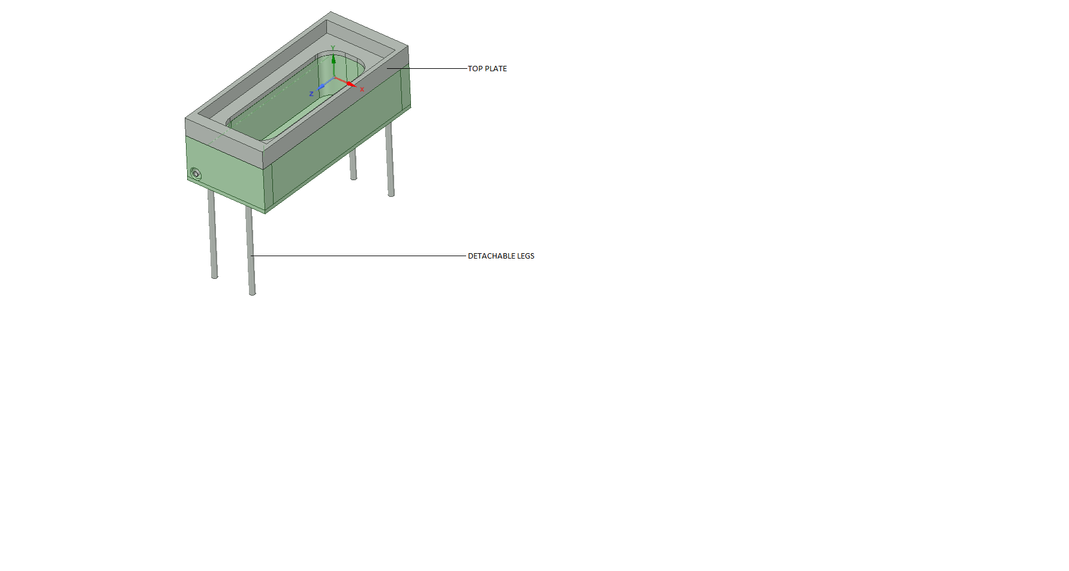
Concept generation and final concept
Final Concept Selection (continued):
Figure 11: Final Braaiing Apparatus
Notes:
Picture of final design and talk on inlet/outlet, inner vessel, legs and insulation

Slide 17
Design Methodology
Assumptions:
Apparatus will only be used only on a flat surface/ground
Apparatus will be stored in non-moist/non-wet environment (at room temperature or dryer)
Apparatus will only be used in customary braaiing environment
Braai fuel will be fully ignited and burning prior to the shower
Steady state, incompressible, constant properties
Tubing has constant wall temperature

Slide 18
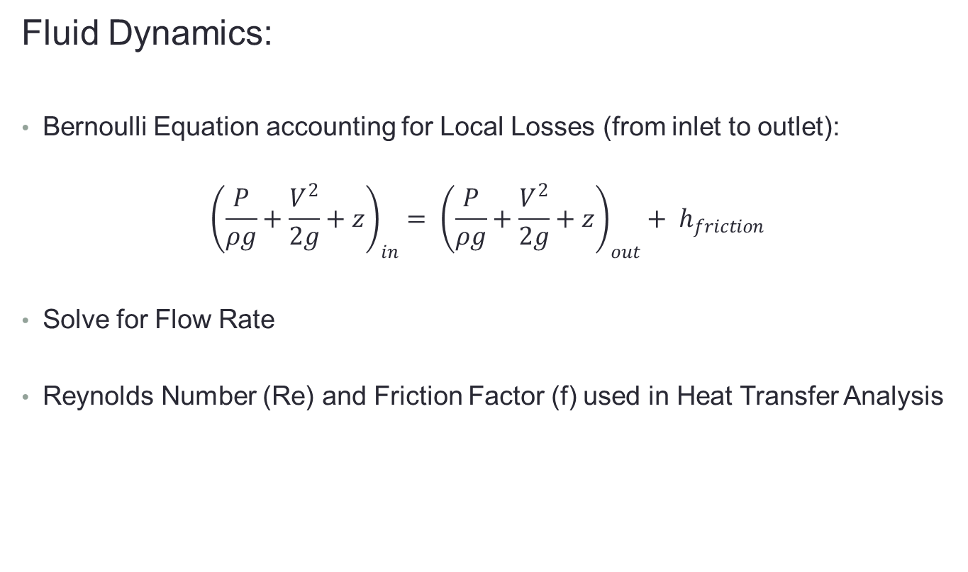
Design Methodology
Fluid Dynamics:
Bernoulli Equation accounting for Local Losses (from inlet to outlet):
$${\left(\frac{P}{ρg}+\frac{V^{2}}{2g}+z\right)}_{in}= {\left(\frac{P}{ρg}+\frac{V^{2}}{2g}+z\right)}_{out}+ h_{friction }$$
Solve for Flow Rate
Reynolds Number (Re) and Friction Factor (f) used in Heat Transfer Analysis

Slide 19
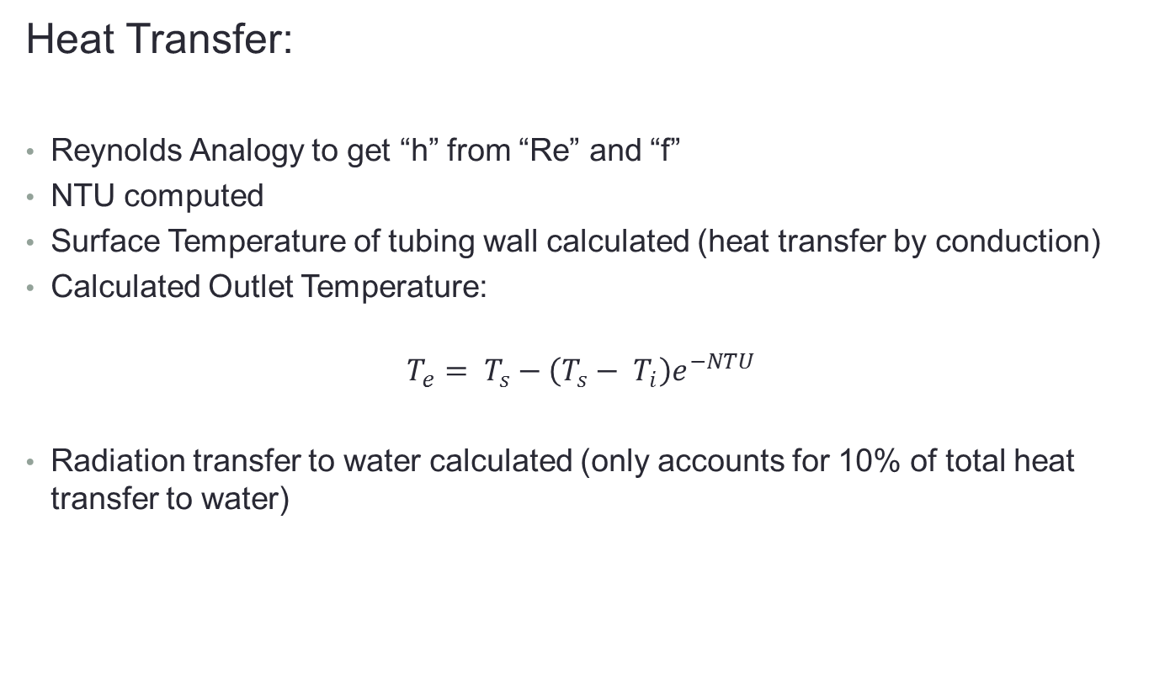
Design Methodology
Heat Transfer:
Reynolds Analogy to get “h” from “Re” and “f”
NTU computed
Surface Temperature of tubing wall calculated (heat transfer by conduction)
Calculated Outlet Temperature:
$$T_{e}= T_{s}−\left(T_{s}− T_{i}\right)e^{−NTU}$$
Radiation transfer to water calculated (only accounts for 10% of total heat transfer to water)

Slide 20
Design Methodology
Other design calculations done:
Entrance Bend Radius
90⁰ Elbows’ Bend Radius
Insulation Thickness

Slide 21
Recommendations
1. A removable top plate implemented instead of permanent welding
Will ensure ease of cleaning, repairing or replacing the copper tubing if need be
2. Means of water storage in apparatus
Will ensure greater time for heat transfer to occur.

Slide 22
Conclusions
Simplistic design concept chosen
Efficiency in all areas
Substantial flow rate in comparison to Municipal standards
Able to achieve an outlet temperature of water 50% greater than required

