Slide 1
Let enjoy with us

Slide 2
Let talk about Ha Noi, Ho Chi Minh City and Ha Long Bay

Slide 3
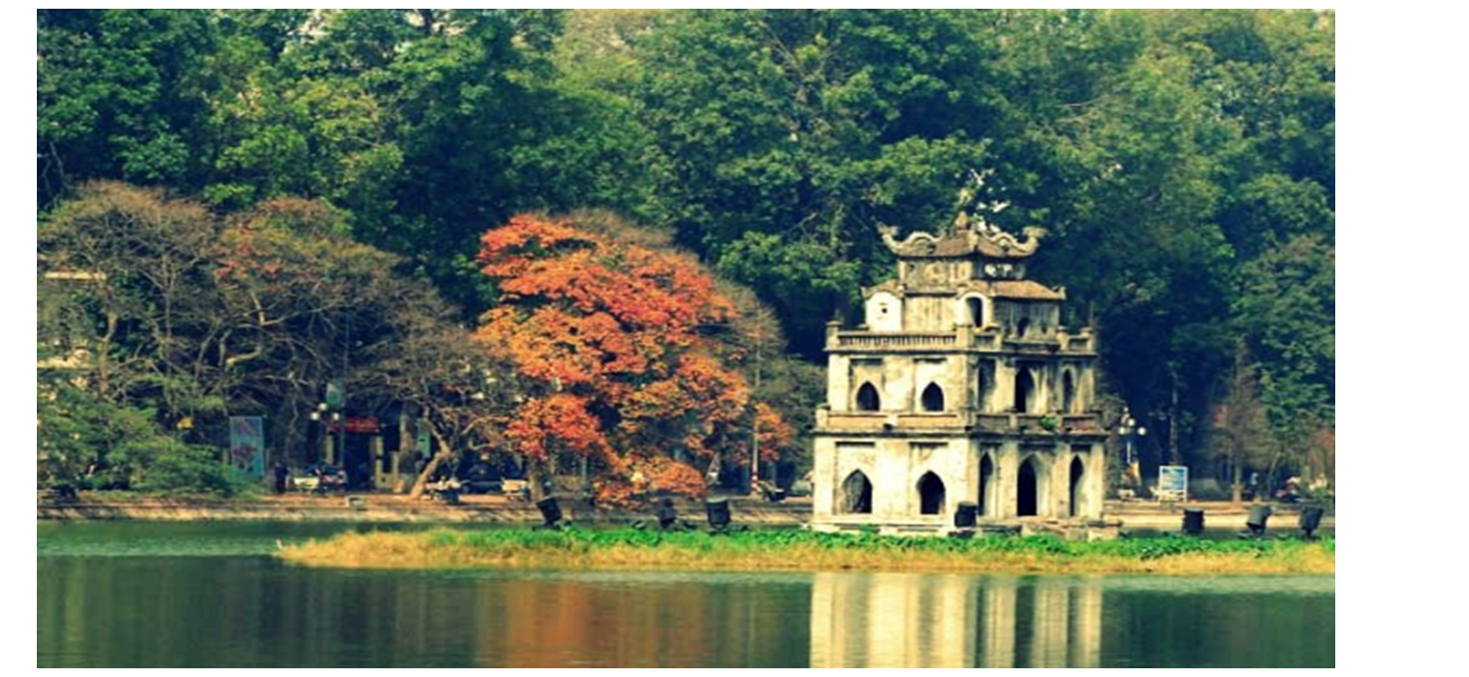
Ha Noi

Slide 4
Ha Noi is the capital of Vietnam. The population of Hanoi is more than 7.82 milion people. It’s beside the Red River. Ha Noi is in the north of Vietnam. Ha Noi has a lake named Hoan Kiem and the Turtle Tower is located on a small island in the middle of the lake.

Slide 5
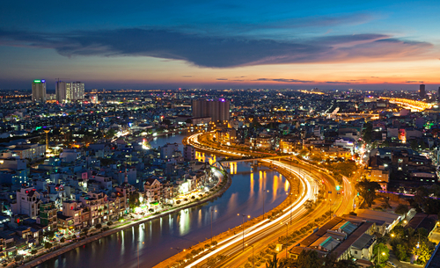
Ho Chi Minh city

Slide 6
About 8 milion people live in Ho Chi Minh city. The Sai Gon River flows across the city. There are many sightseeings in Ho Chi Minh city like: Bitexco Financial Tower, Ben Thanh market, Sai Gon Central Cathedral, Central Post Office,...

Slide 7
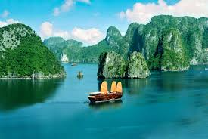
Ha Long Bay

Slide 8
The name Ha Long means “descending dragon”. It has an area of around 1,553 km². Ha Long Bay is a UNESCO World Heritage Site and a popular travel destination in Quang Ninh Pronive.

Slide 9
Thank for watching!

