Slide 1

Experience and risky choices with goals
Notes:
Hello and welcome to my presentation.
Today, I am going to talk about risky decisions with goals in the domain of gains and in the domain of losses.
We want compare risk taking between these domains.
I will start by providing an example for risky decisions with goals. (Auf nächste Seite klicken)

Slide 2
Variablen/ Stimuli
N unterschiedliche Samples aus der Binominalverteilung: 3
Viel Sampler vs. wenig Sampler: 10 vs. 3
Ziehungen aus der Betaverteilung: 100
Stimuli:
Risky: 8 (0.4), 1 (0.6)
Safe: 2 (0.9), 4 (0.1)
Budget: 17 vs. 19
Trials 3
Difficulty: 0.825 vs. 0.352

Slide 3
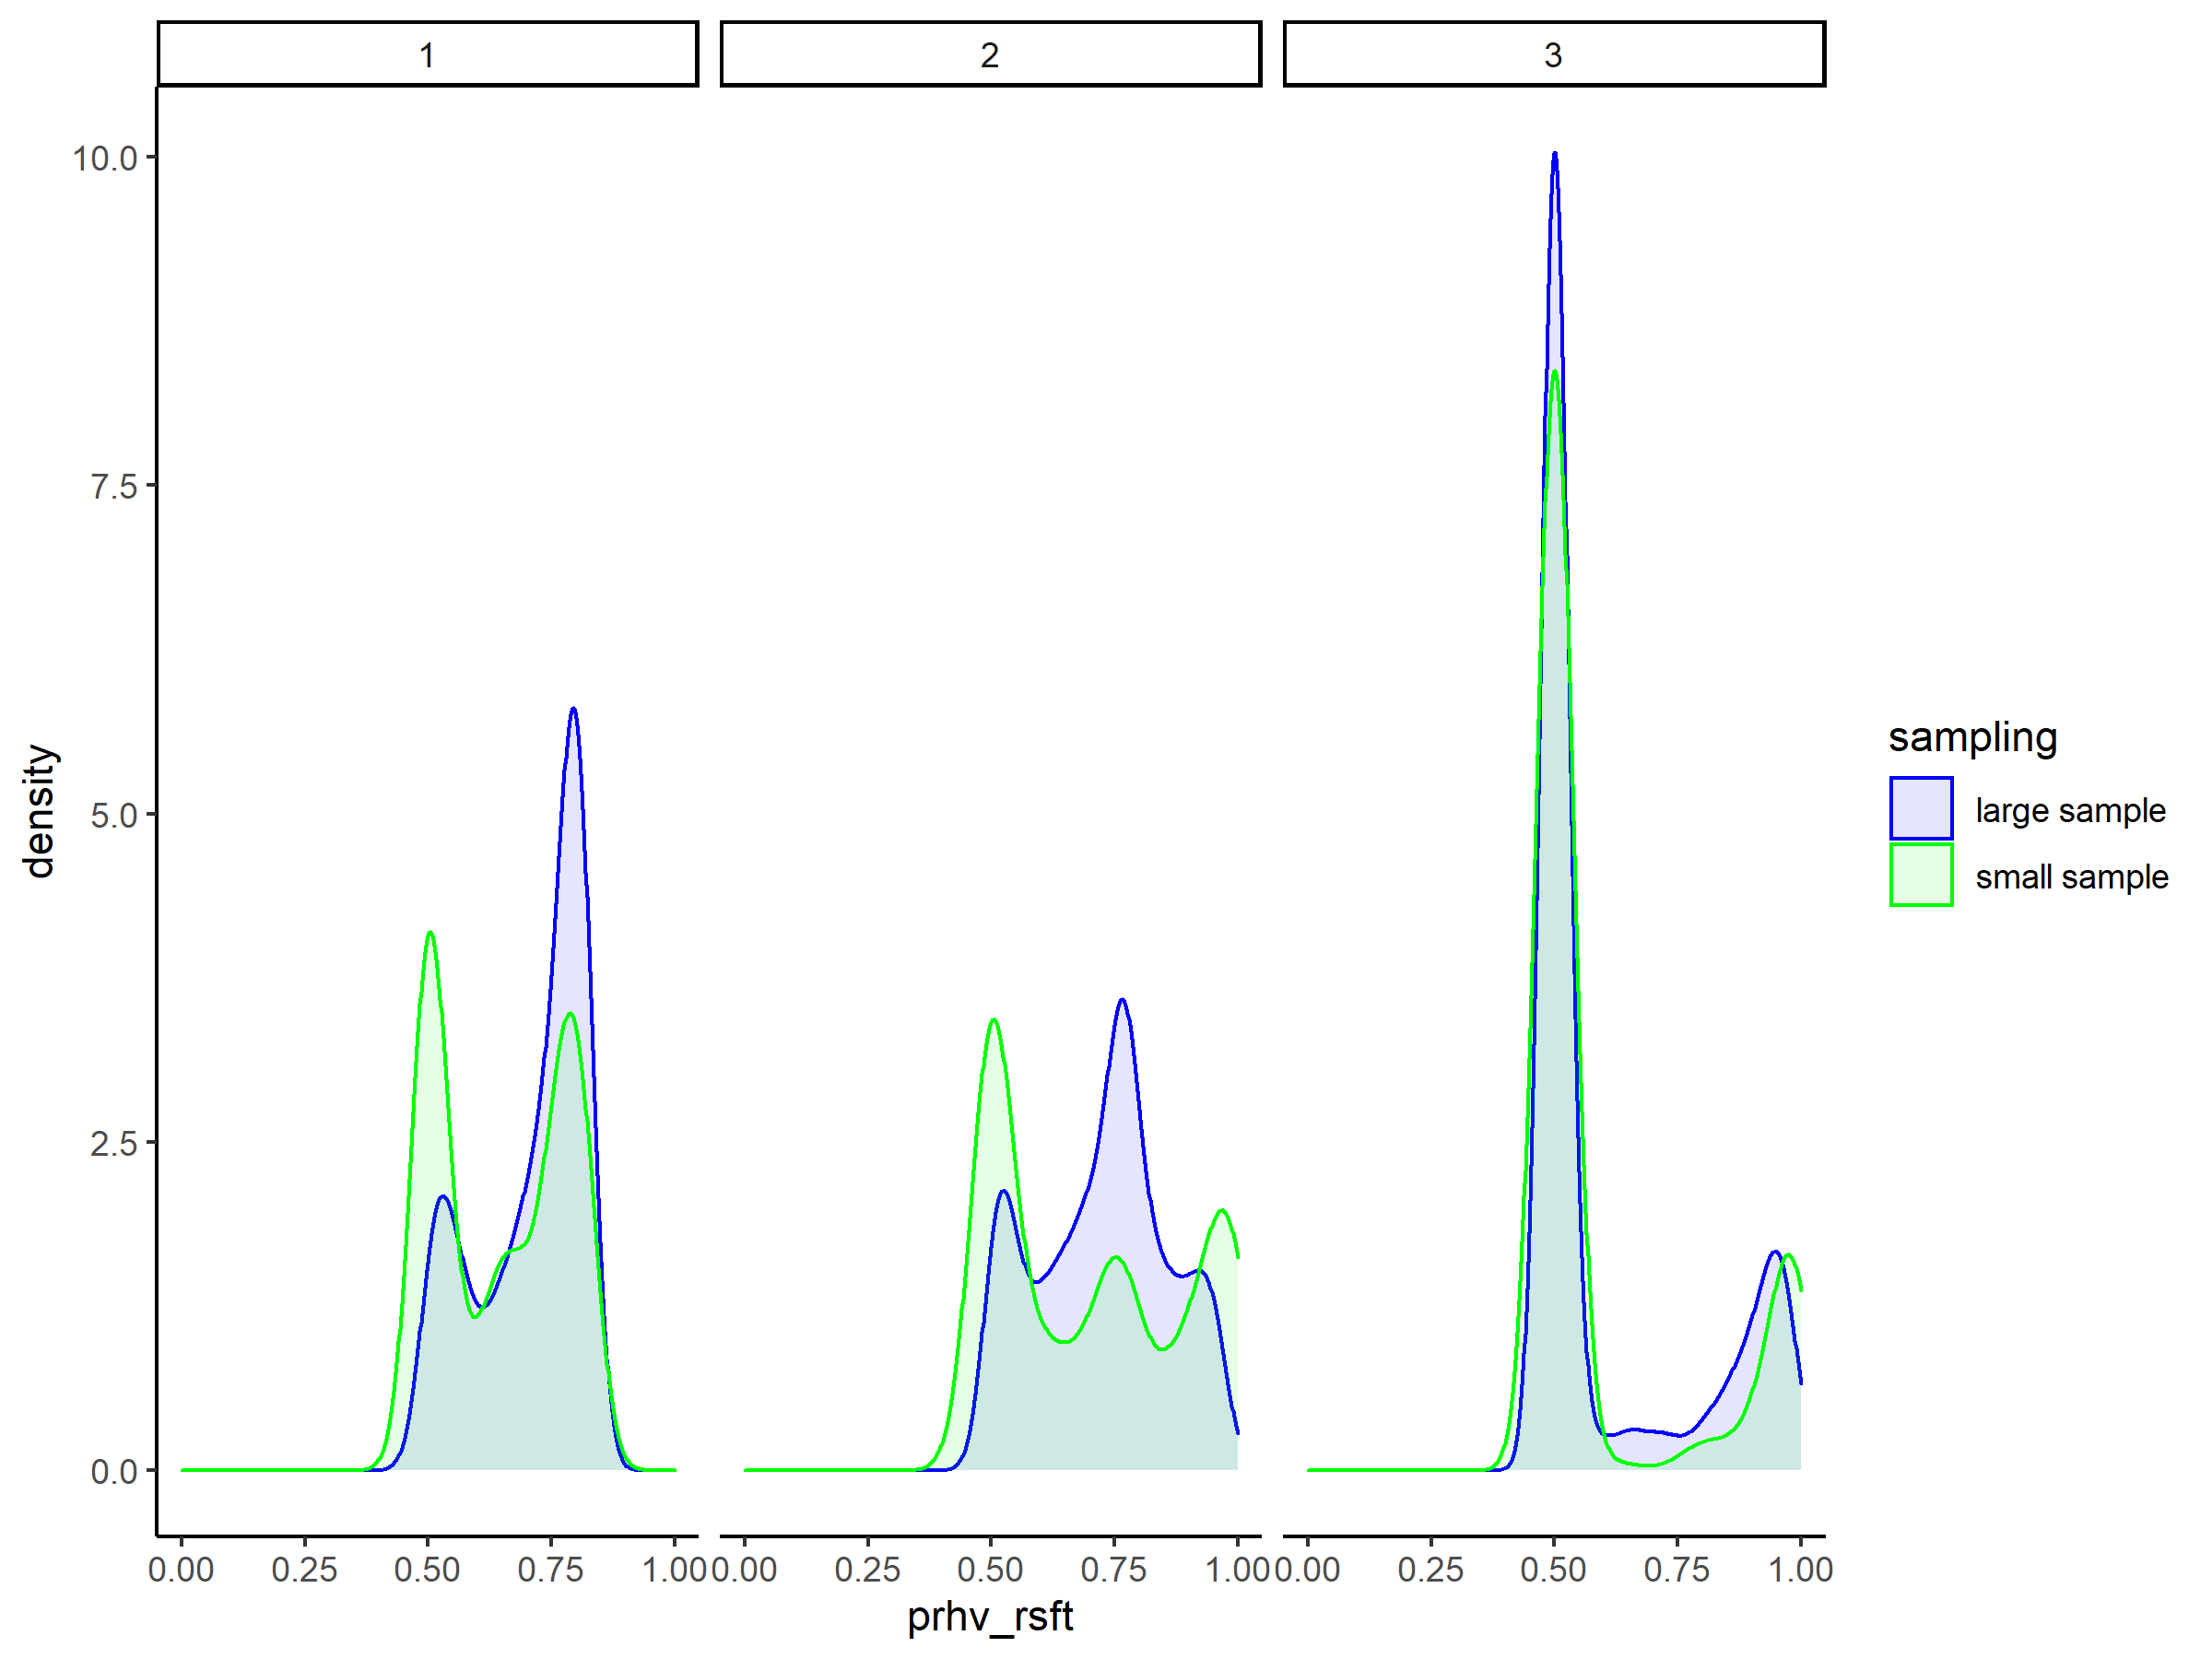
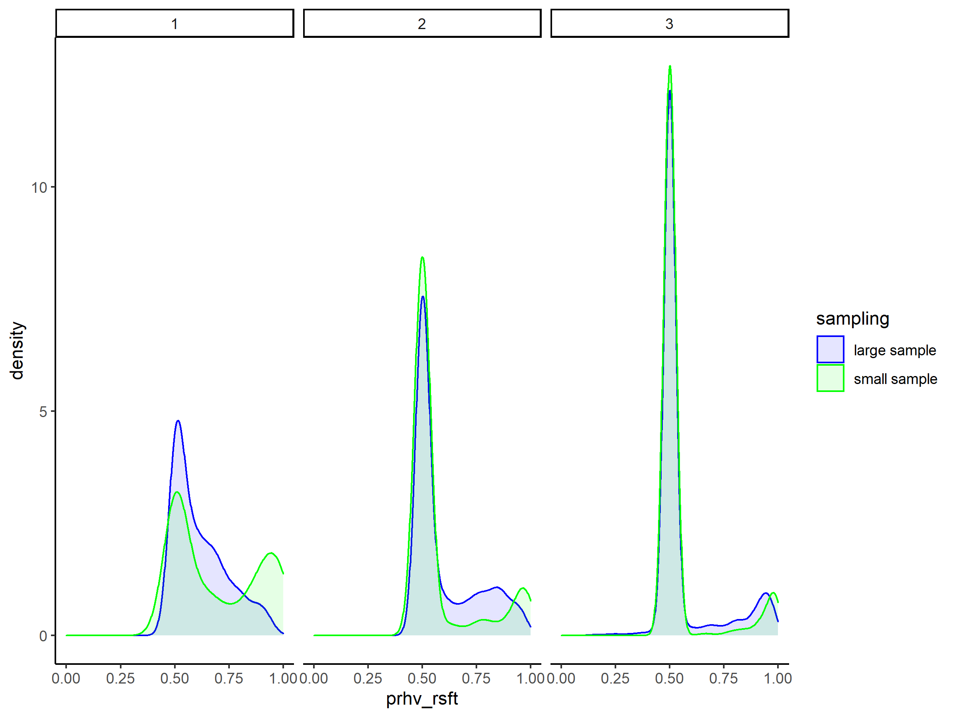
Budget = 17
Budget = 19

