Slide 1

Shifting model for risky choices with goals
Notes:
Hello and welcome to my presentation.
Today, I am going to talk about risky decisions with goals in the domain of gains and in the domain of losses.
We want compare risk taking between these domains.
I will start by providing an example for risky decisions with goals. (Auf nächste Seite klicken)

Slide 2
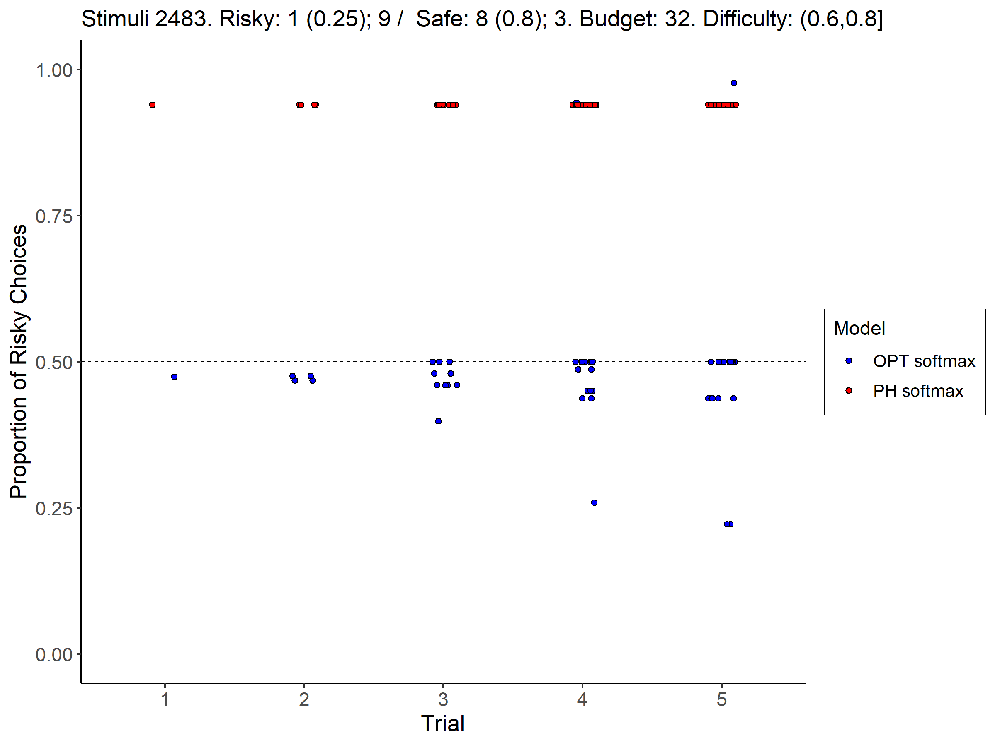
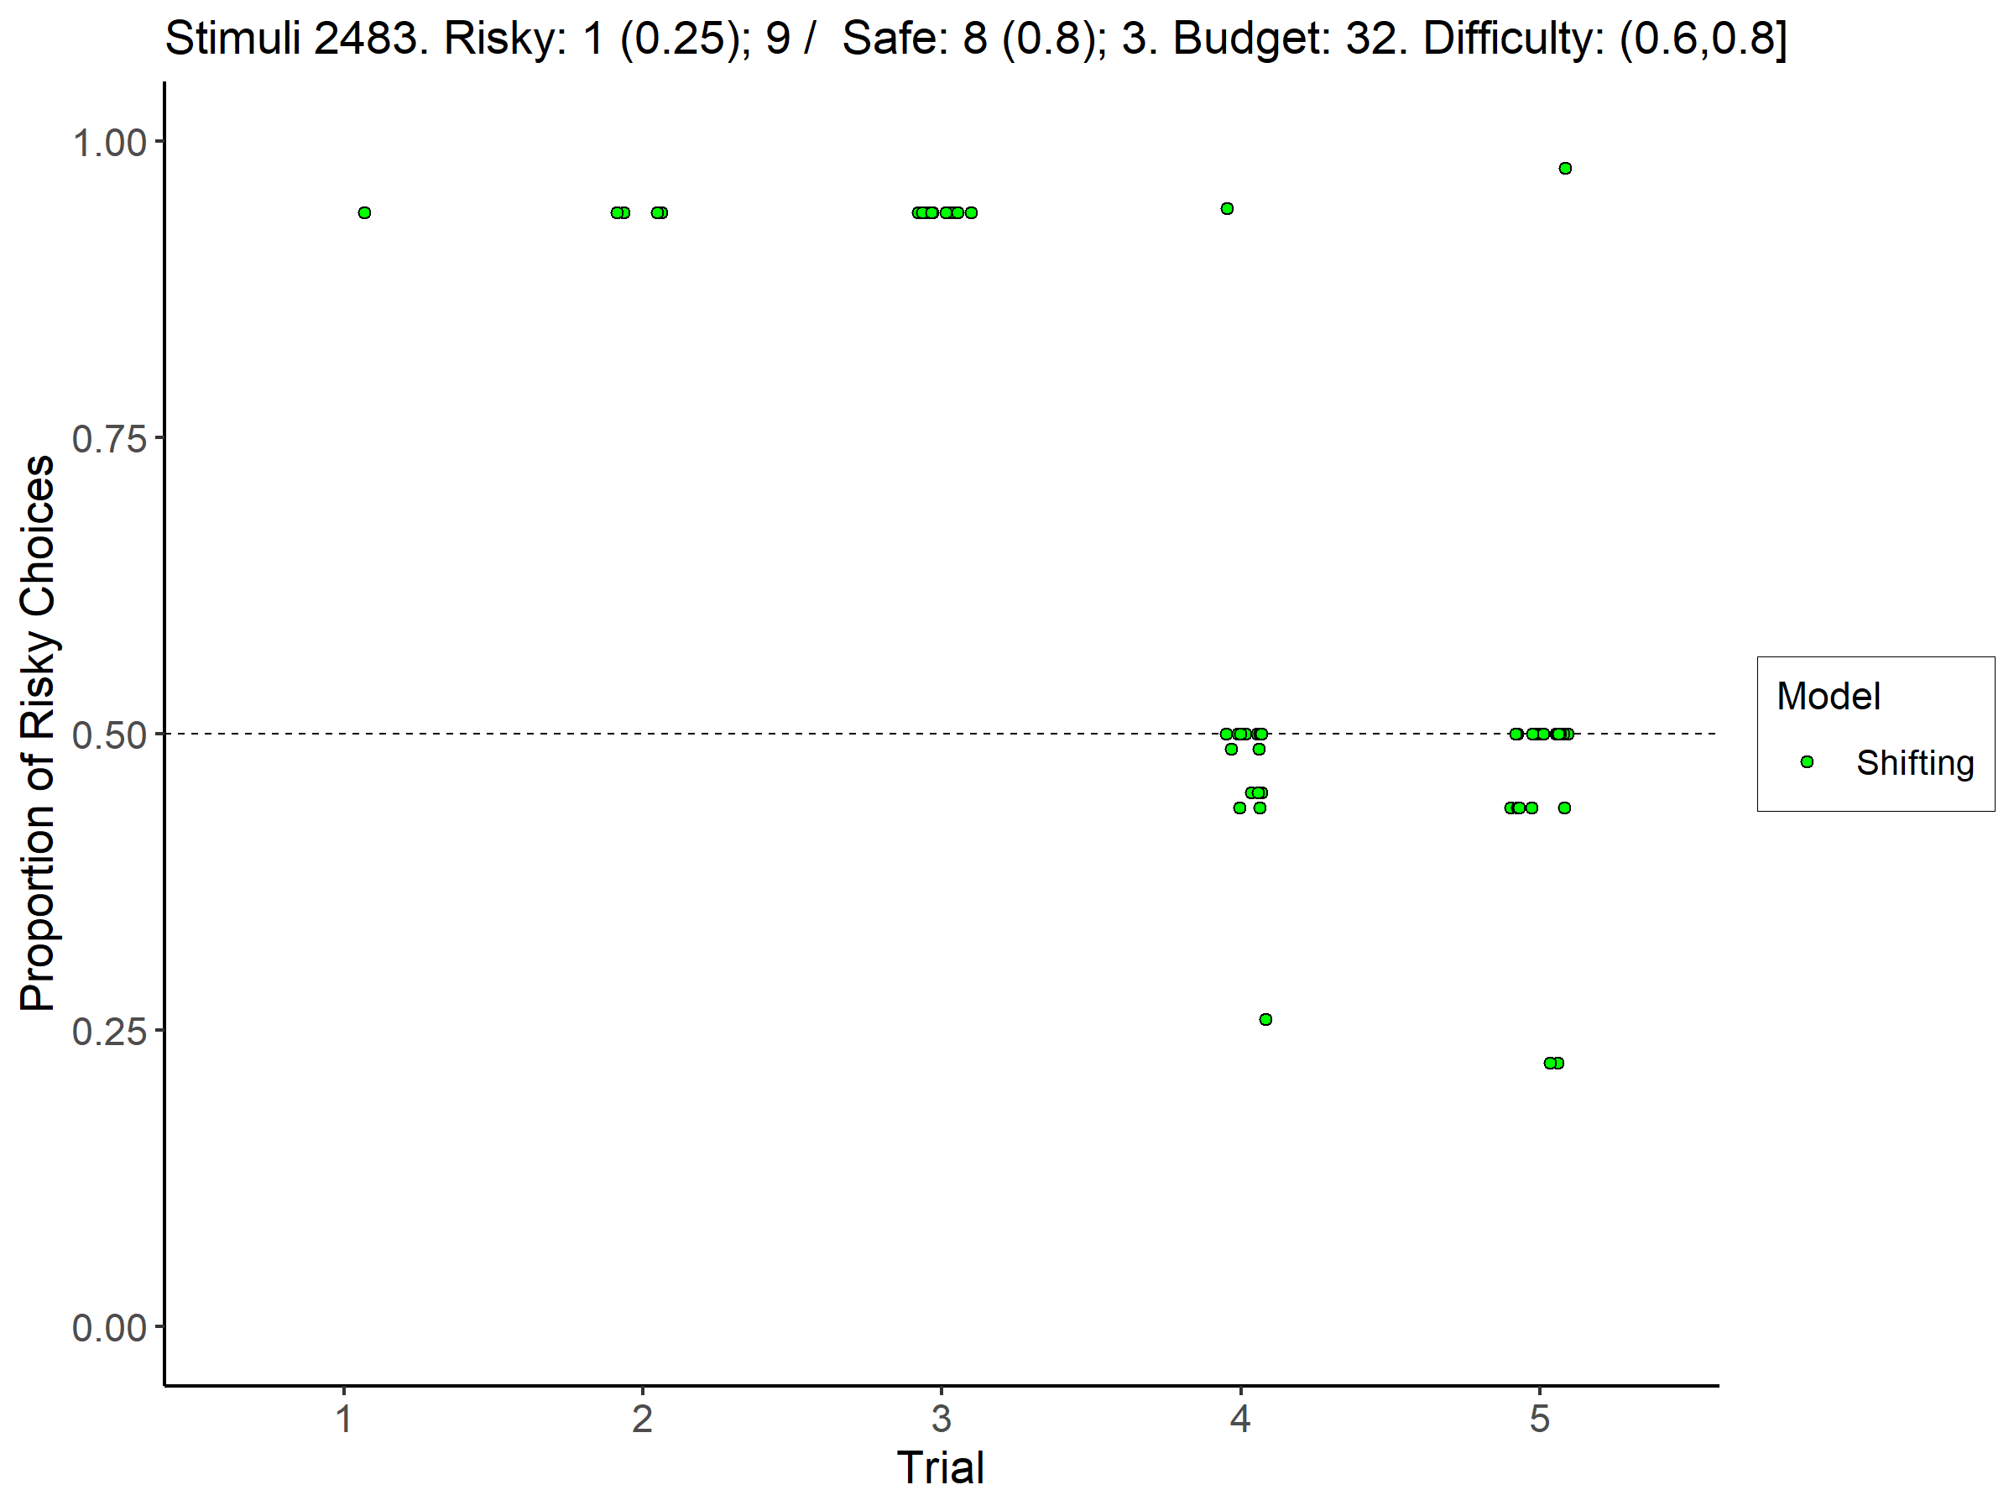
Shifting Model

Slide 3
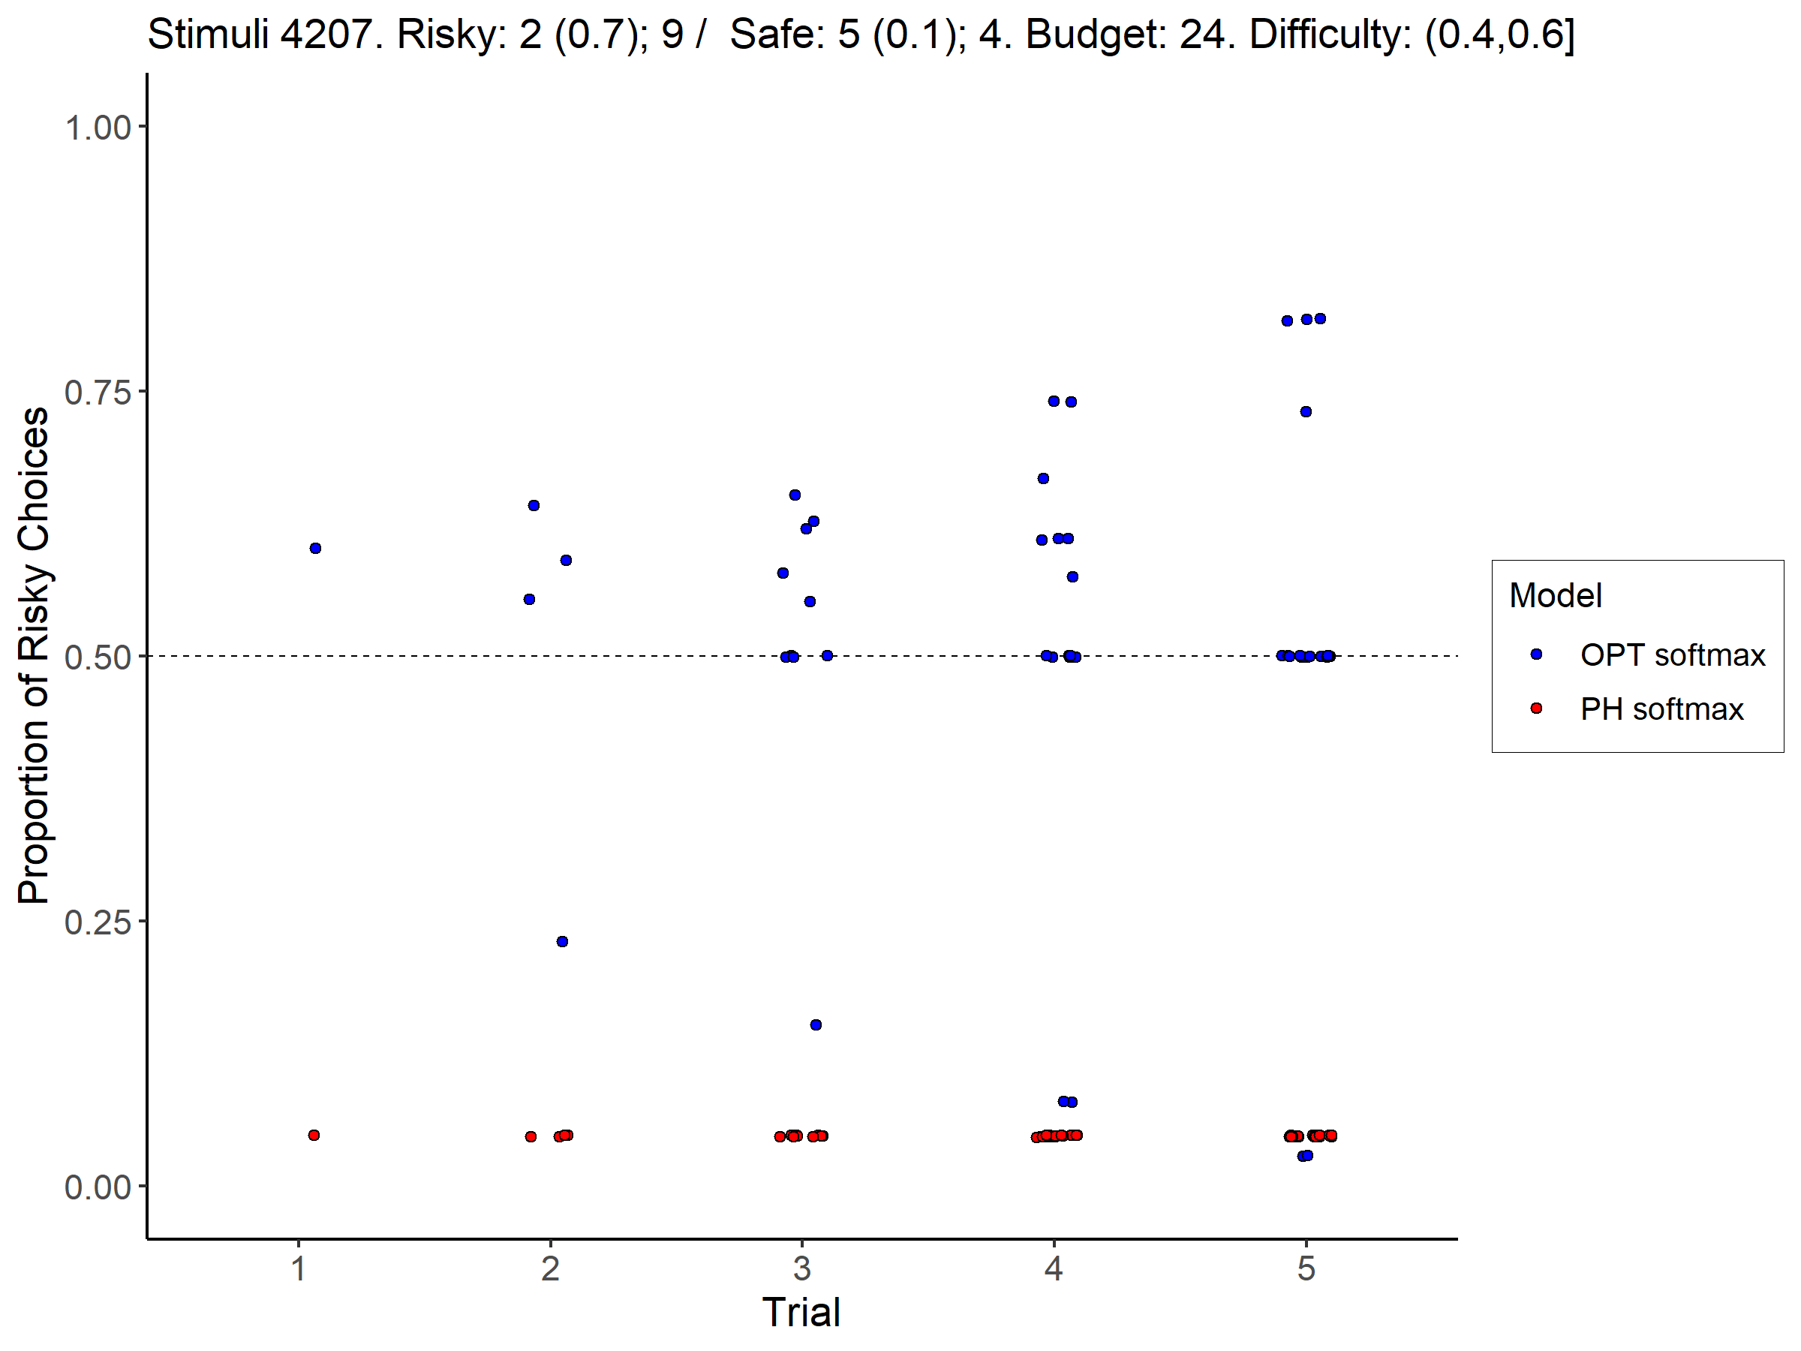
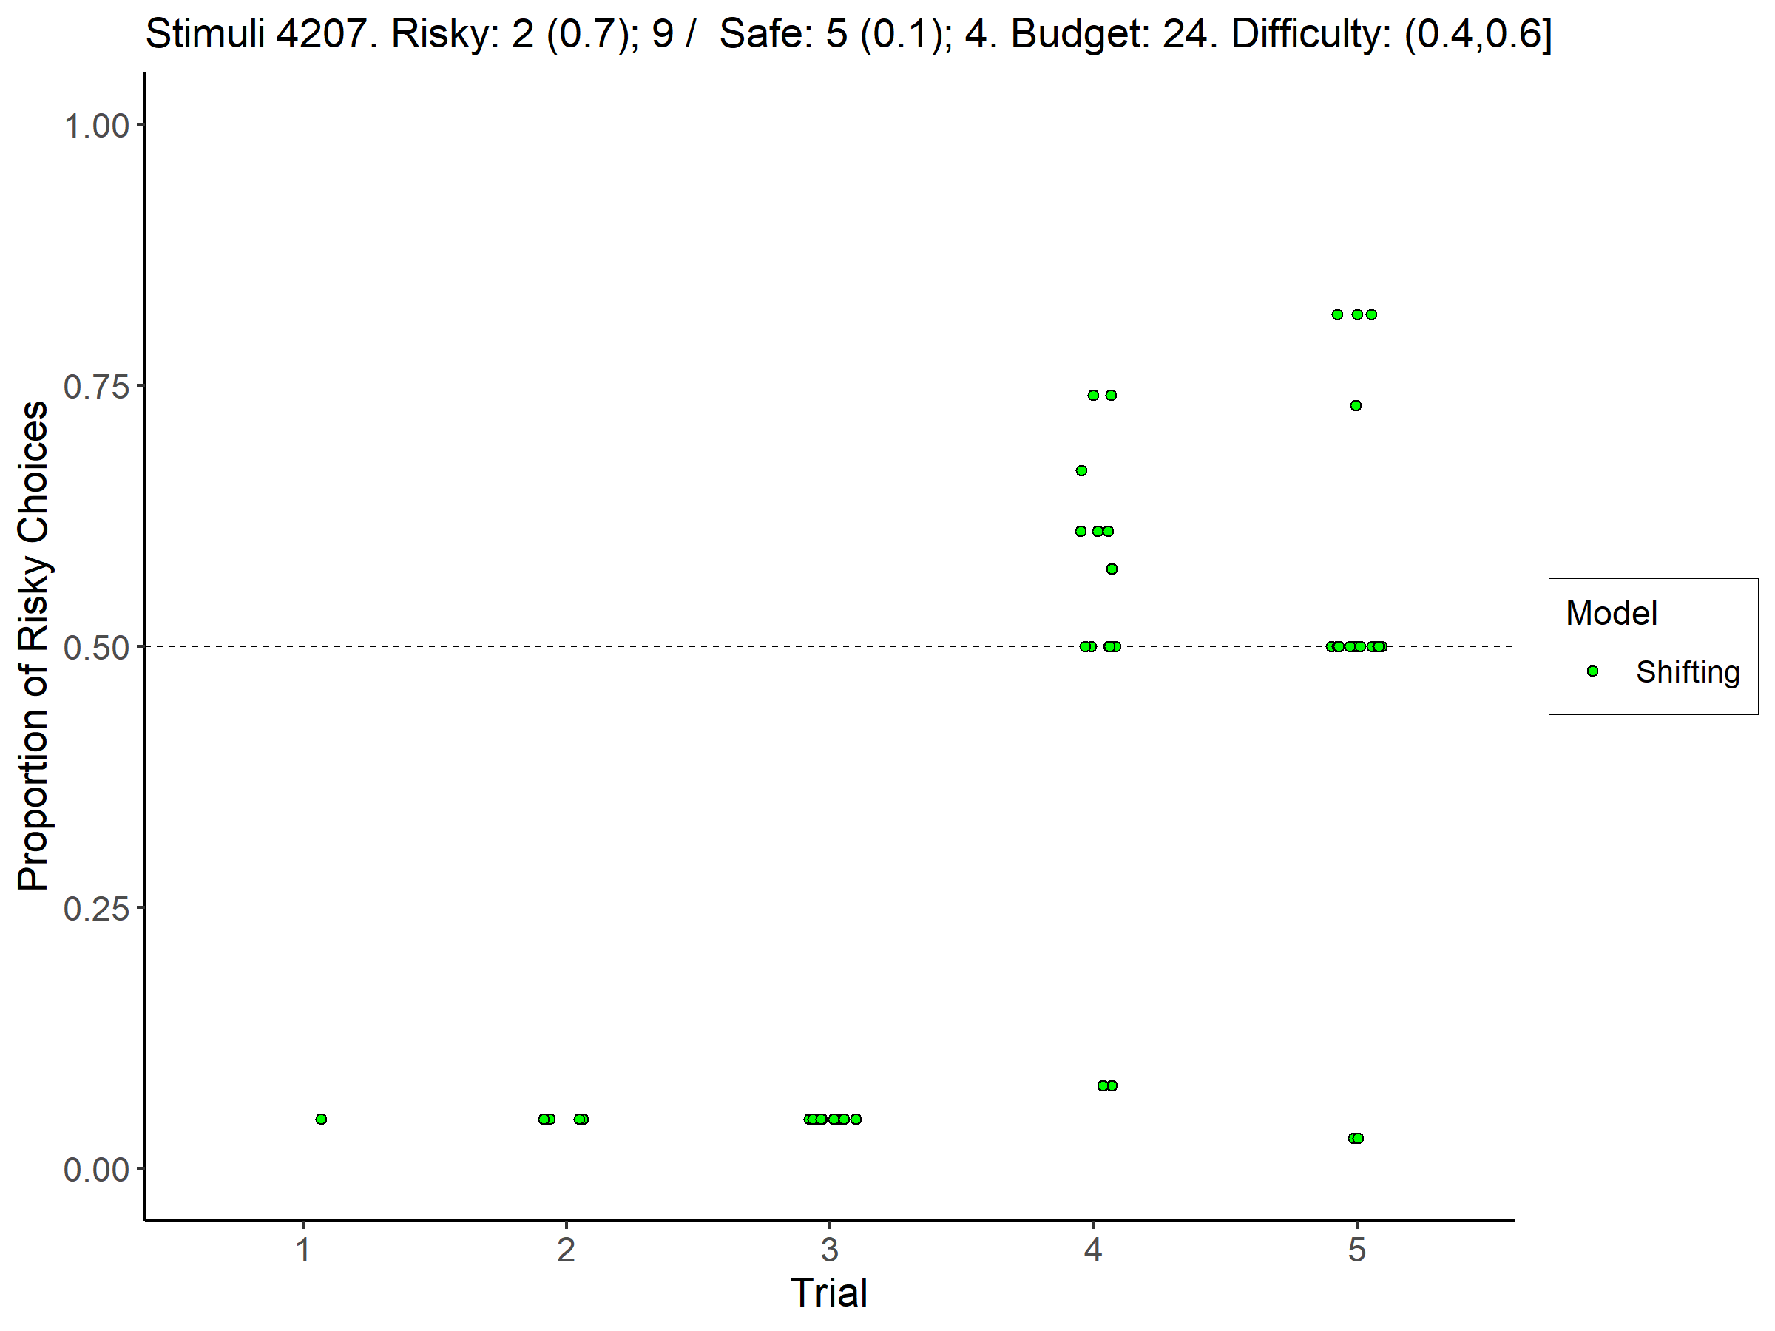
Shifting Model

Slide 4
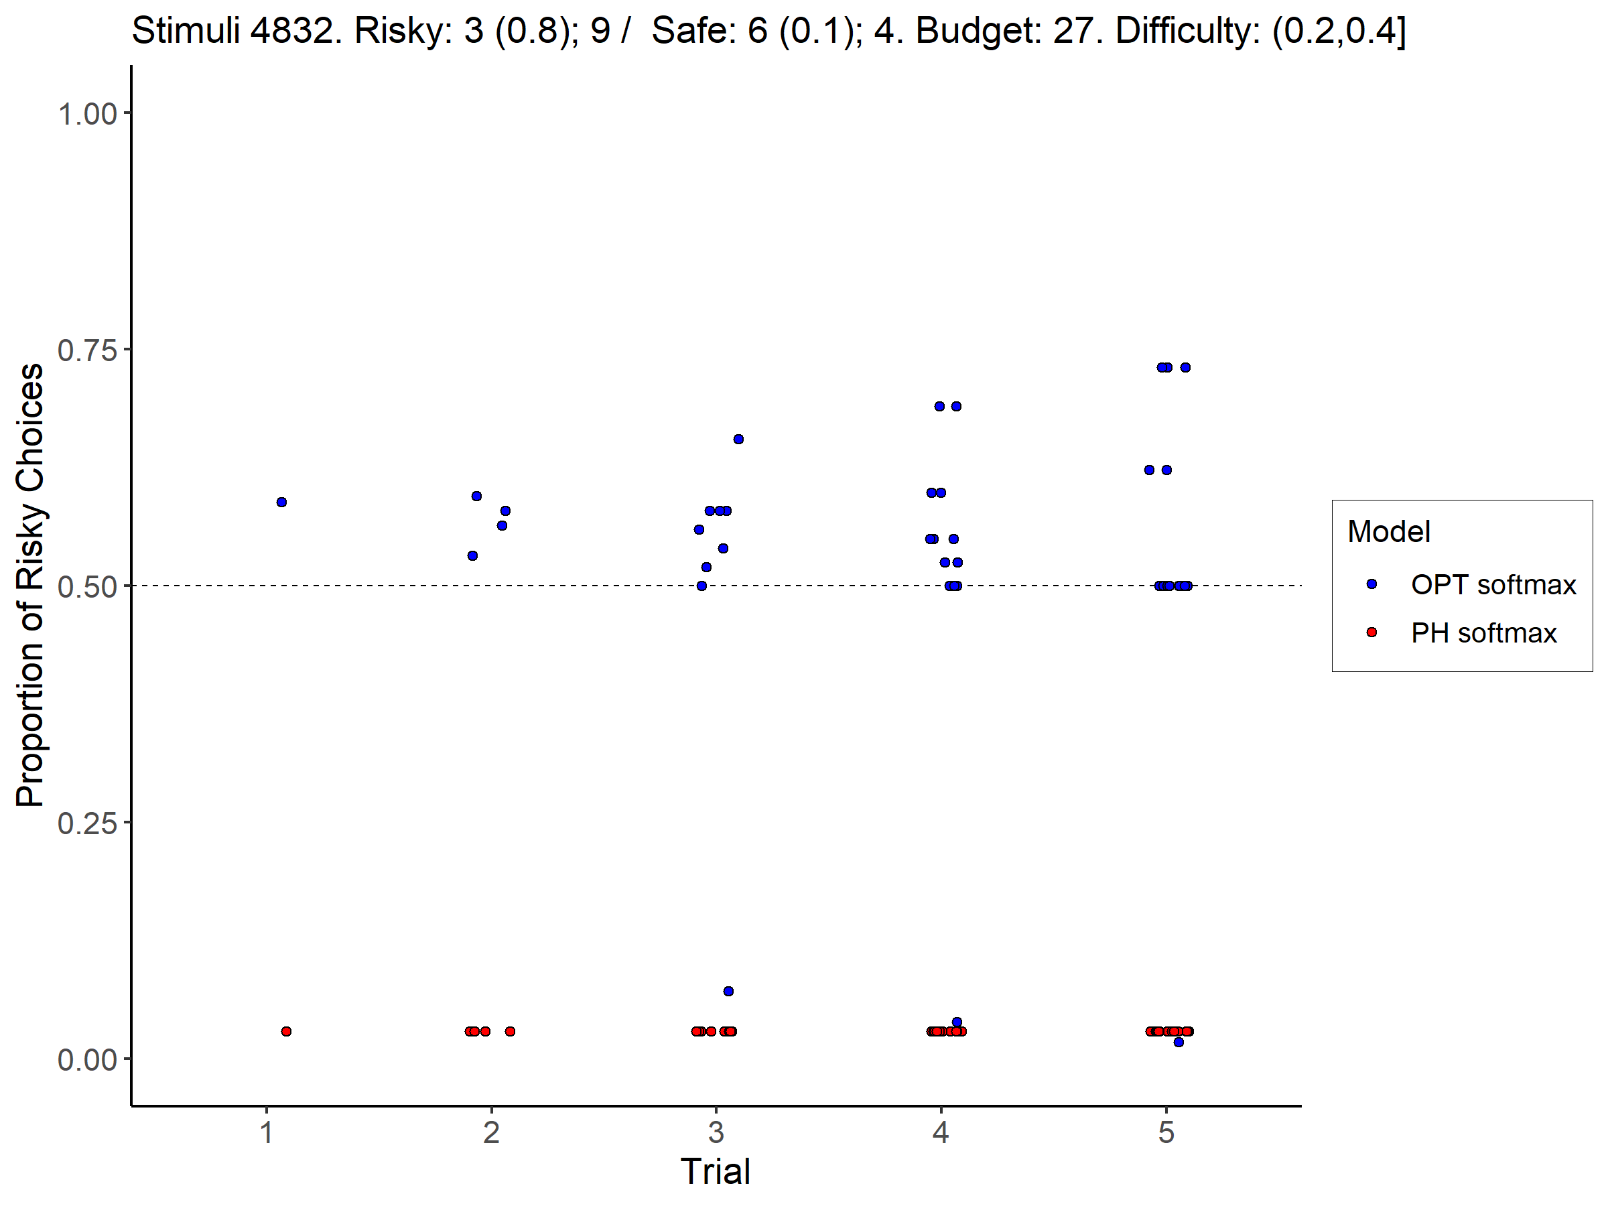
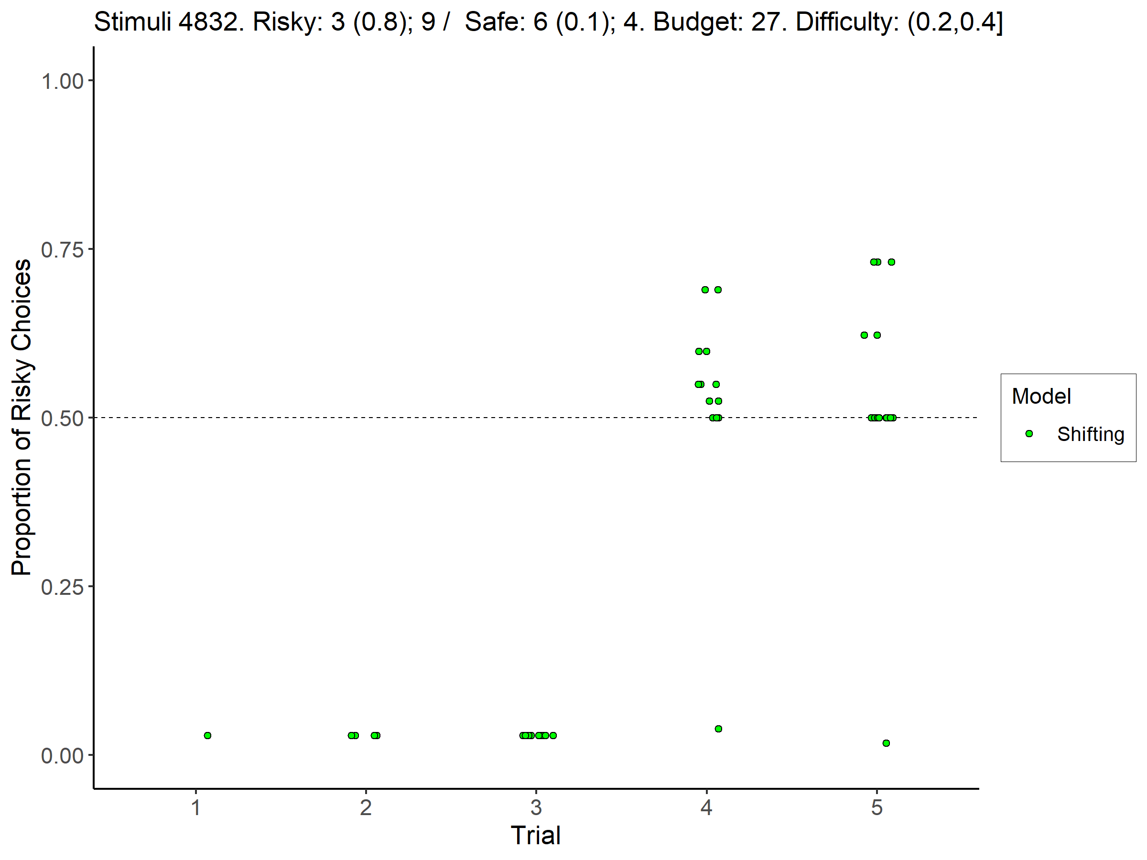
Shifting Model

