Slide 1

What is SQL?
SQL (Structured Query Language) is a domain-specific programming language used for managing and querying relational databases. It serves as a standard way to interact with data stored in a relational database management system (RDBMS). Here's an overview of SQL and its benefits:
What Can SQL do?
SQL can execute queries against a database
SQL can retrieve data from a database
SQL can insert, update and delete records in a database
SQL can create new databases and tables
SQL can create stored procedures in a database
SQL can create views in a database
SQL can set permissions on tables, procedures, and views
In summary, SQL is a powerful and standardized language for managing and querying data in relational databases. Its benefits include data retrieval, modification, integrity, security, scalability, consistency, analysis, interoperability, and structured data storage. These advantages make SQL an essential tool for data management and analysis in a wide range of applications.

Slide 2
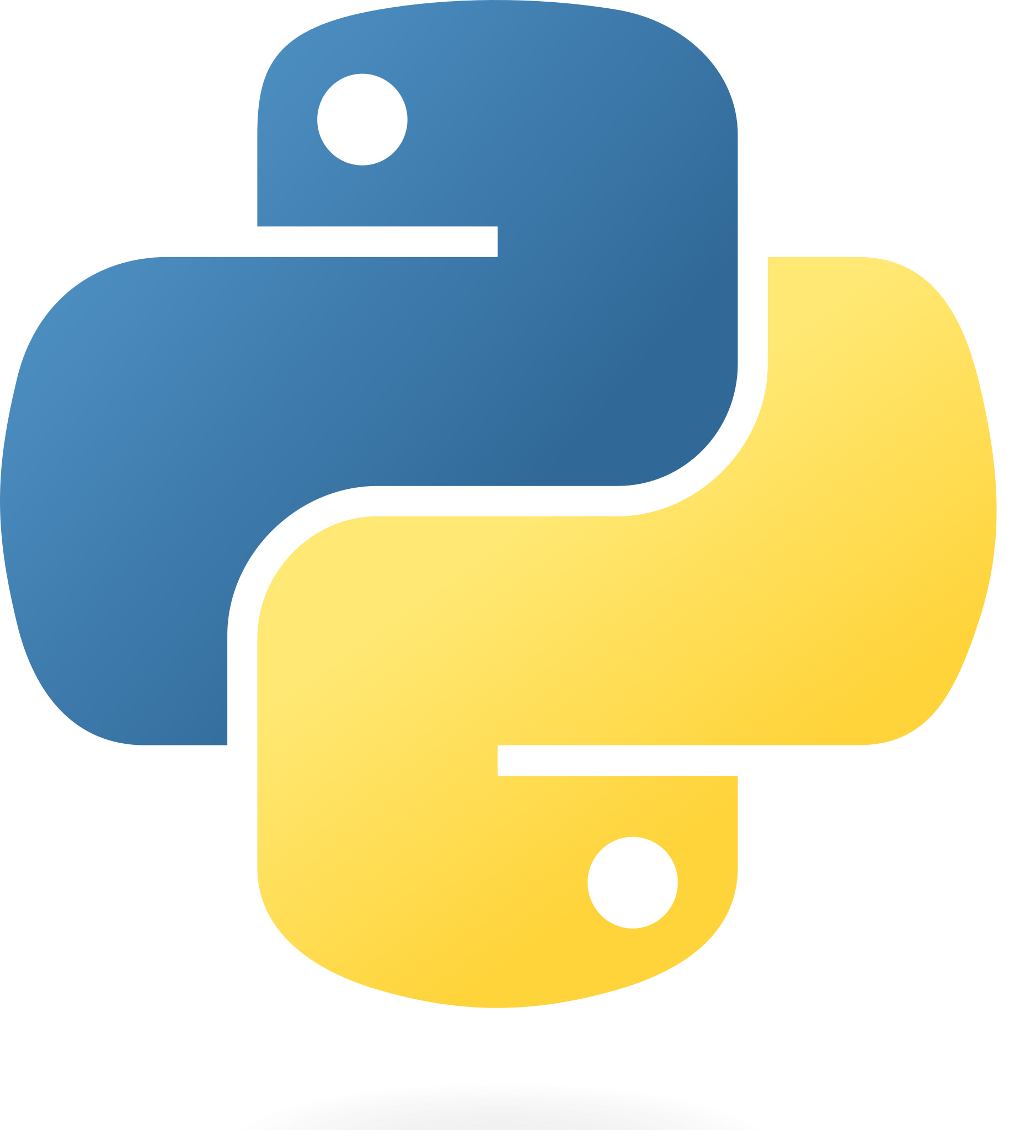
What is Python
Python is a high-level, general-purpose programming language. Its design philosophy emphasizes code readability with the use of significant indentation. Python is dynamically typed and garbage-collected. It supports multiple programming paradigms, including structured, object-oriented and functional programming.
Some Advantages:
Presence of third-party modules: Python has a rich ecosystem of third-party modules and libraries that extend its functionality for various tasks.
Extensive support libraries: Python boasts extensive support libraries like NumPy for numerical calculations and Pandas for data analytics, making it suitable for scientific and data-related applications.
Open source and large active community base: Python is open source, and it has a large and active community that contributes to its development and provides support.
User-friendly data structures: Python offers intuitive and easy-to-use data structures, simplifying data manipulation and management.
Some Disadvantages:
Performance: Python is an interpreted language, which means that it can be slower than compiled languages like C or Java. This can be an issue for performance-intensive tasks.
2.Memory consumption: Python can consume a lot of memory, especially when working with large datasets or running complex algorithms.
Dynamically typed: Python is a dynamically typed language, which means that the types of variables can change at runtime. This can make it more difficult to catch errors and can lead to bugs.

Slide 3
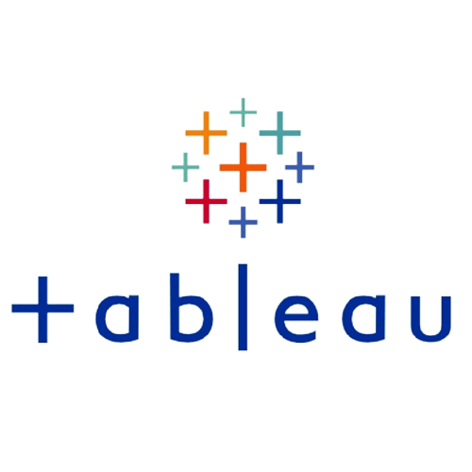
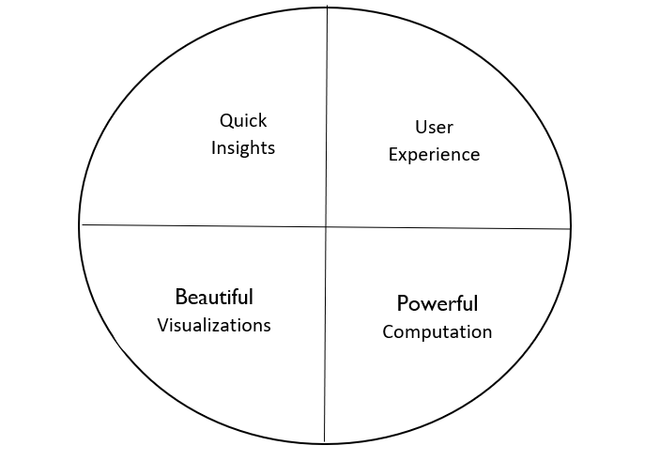
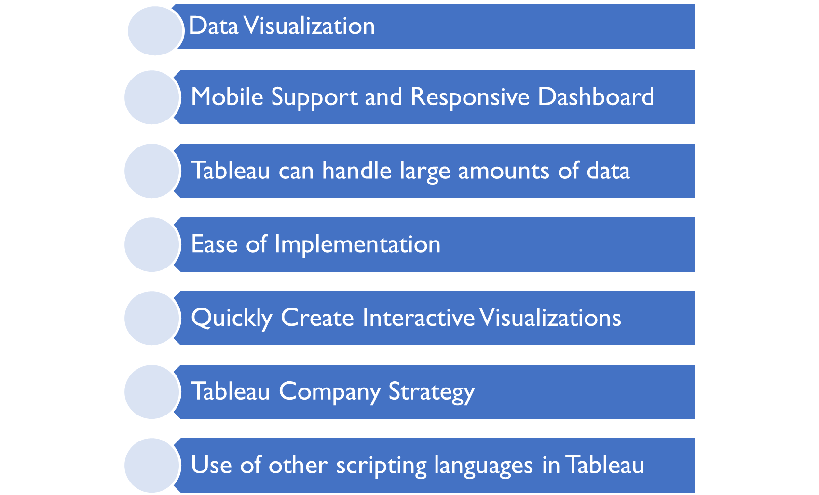
What is Tableau
Tableau Software is an American interactive data visualization software company focused on business intelligence. It was founded in 2003 in Mountain View, California, and is currently headquartered in Seattle, Washington. In 2019 the company was acquired by Salesforce for $15.7 billion
It helps users create different charts, graphs, maps, dashboards, and stories for visualizing and analyzing data, to help in making business decisions. Tableau has a lot of unique, exciting features that make it one of the most popular tools in business intelligence (BI)
Some Benefits:
Tableau's ability to turn data into actionable insights, its user-friendly interface, and its flexibility in data connection and visualization have made it a leading choice for organizations looking to leverage data for decision-making and reporting.

Slide 4
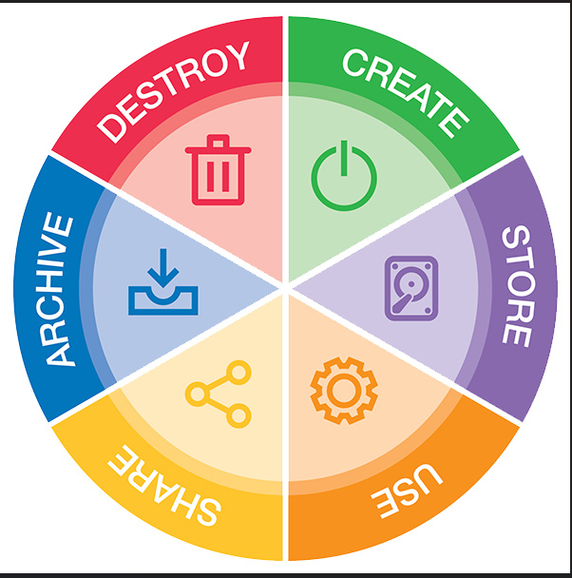
Data Lifecyle
The data life cycle consists of five key stages:
Create: Data is initially generated or collected from various sources, such as sensors, user input, or external systems.
Store: The collected data is ingested into a storage system, organized, and stored for easy access and management.
Use: Data is processed, analyzed, and interpreted to extract insights and support decision-making.
Archive: Data that is no longer actively used but needs to be retained for historical or compliance reasons is securely archived.
Delete: When data is no longer needed, it is securely deleted or disposed of in accordance with data privacy and regulatory requirements.
Spreadsheets are versatile tools in the data lifecycle. They are used to create, store, and analyze data. Spreadsheets can also serve as archives for historical data and facilitate data deletion when necessary. While valuable for many data tasks, they may not be suitable for large-scale or collaborative data management, and organizations often integrate them with more robust data systems.

Slide 5
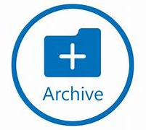
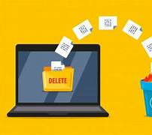
Lifecycle stages that were not used in my project
My project involved copying a dataset and creating other tabs based on this data. The data was analyzed and appropriate charts were produced to provide insights based on the effect of energy demand on the environment. The data used was partially deleted in order to highlight demand over various factors. However, there was no need to archive/delete data at this stage as the project was relatively new and not large enough.
Dataspace can utilize offerings such as cloud-based archive, encrypted network drives, external hard drives. All of these can have a retention period specified as to when data can be deleted according to data protection policies.

