Slide 1

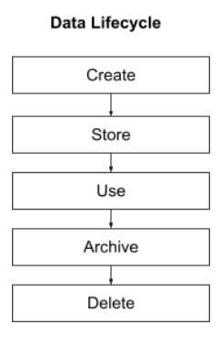
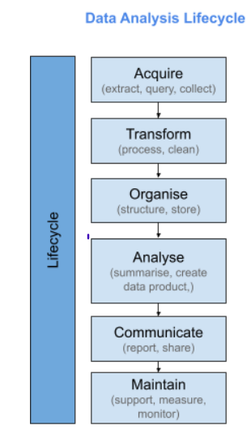
Data Lifecyle
Before undertaking a data-related project, particularly one that involves managing the data lifecycle, begin by defining project objectives and identifying key stakeholders, including data owners and IT teams. The data for the project can be collated by conducting surveys, what projects are involved and where in terms of globally or regionally. Financial and other valuable data can be extracted from project management of companies involved.
If data was changed then this new data would need to be updated on the existing data source to allow it to reflect on current visualizations that were set up. This would allow management to view the latest information.
In this project, I have been involved in the Acquire/Transform/Organise/Analyse/and Communicate stages of the data analysis lifecycle. The company Dental Pharama have supplied me with data in the form of an excel file which has been imported into Tableau. The file was transformed by cleaning and formatting where appropriate initially. Appropriate charts, tables and insights were created based on management communication and analysis. The data was organised and shared online via an encrypted website for those users who need access to it remotely.
This project is a crucial component of the broader data lifecycle, operating in specific stages like
data generation, ingestion, storage, processing, analysis, visualization, interpretation, archiving, and disposal.
Tasks within this project, such as data analysis, engineering, or visualization, play a key role in advancing the overall data lifecycle. The project's role is shaped by its distinct objectives, emphasizing specific stages and aligning with organizational goals in the field of data management.

Slide 2
Requirements for the project
Objective:
Recap Client Meeting & Goal Identification
Key Highlights:
Client Meeting:
Comprehensive discussion with the client.
Careful documentation of identified goals.
Visualization Planning:
Translation of client goals into actionable steps.
Development of a detailed blueprint and mock-up
Next Steps:
Create a dashboard using the above data
Steps to Ensure Business Needs are Met:
Interactive Dashboard for Managers:
Align the design with client goals and ensure user-friendly features for efficient data access.
2. Testing Process:
Conduct personal & collaborative testing and refine based on collected feedback to ensure alignment with end-users' expectations.
3. Online Publication:
Securely publish for authorized manager access and Implement version control for a seamless user experience.
4. Training and Support:
Provide managers with effective training sessions and establish a support system to address initial challenges.
Enhance the dashboard with hover-over mini charts, city labels on maps for precise locations, and color coordination for clearer data interpretation.

