Slide 1
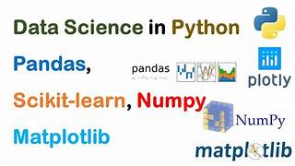
Project Lifecycle
Brief Introduction:
Python and Pandas play a crucial role in the data lifecycle by enabling efficient data acquisition, analysis, and visualization.

Slide 2
LifeCycle
Section 1
Project Integration in the Data Lifecycle
Data Sources: Utilized various sources
CSV, XLXS and JSON
Data Collection Methods:
Downloading, extracting & web scraping
To update the original data, contact and inform the Borough Council and Horticultural Website based on my analysis.
Understanding who the data is for (public, internal, or confidential) and identifying its owner in the data source list impacts the creation of data management policies and access controls.
Tree Data:
  Publicly Available (Council Website)
  Ownership: Borough Council
Common Names:
  Publicly Accessible (Horticultural Website)
  Ownership: Horticultural
Environment:
  Internal Data (Council's Assets Database)
  Ownership: Borough Council

Slide 3
Requirements
Section 2
The requirements create a framework for evaluating Tree Brochure, Environment Report, & Public Tree Data initiatives. Essential data specifics:
Tree Brochure: Trees Data, Common Names
Environment Report: Environmental Data
Public Tree Data: Detailed information
The data quality help the council assess data support for each initiative, serving as a roadmap for determining practicality and viability based on existing resources.
Data limitations | Impact | Challenge
Null values | Represent undefined data | Biased or incomplete insights
Missing values | Gaps in data affecting completeness | Hindrance to comprehensive analysis
Duplicates | Overrepresentation, skewing analyses | Misleading analyses, inefficient resource use

Slide 4
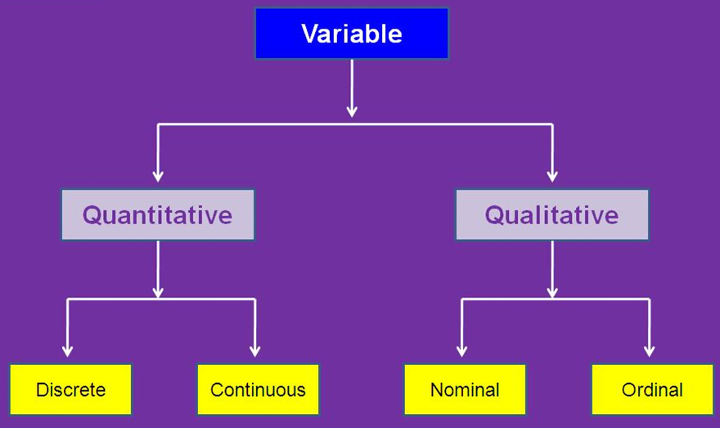
Qualitative
Nominal was easy to identify because of no order
Ordinal was a bit challenging because it’s based on rank/order, it was easy to identify dates but the stages required further inspection for trees age, mature, middle aged, juvenile etc.
I resolved the problem by researching, closely inspecting the data and observing for patterns
Quantitative:
Discrete and Continuous were easy to identify because the first is for whole numbers and the second is for decimals
Binary
Used for only two options
Yes/No True/False 0/1

Slide 5
Quality
Section 3
Evaluating Data Quality
Data Evaluation Methods
Descriptive Stats:
  Use pandas series for float data
Float vs. Int Identification:
  Check unique values with pandas series
Duplicated Data Detection:
  Utilize pandas series value counts
Missing Values Handling:
  Identify and remove using DataFrame.isnull()
Filtering Technique:
  Use DataFrame filtering for missing values
  Mask function selects the required data
Data quality is vital for the council to meet initiative requirements. Using effective data evaluation methods ensures accurate and complete information, enhancing data reliability to support key initiatives and contribute to overall success.
Risks
Mismatched data: May lead to inaccuracies
Web scraping: Ethical grey area with potential legal consequences.

Slide 6
Challenges
File Reading and Compatibility:
Loading data from different file formats (Excel, CSV, JSON), using pandas coding was tricky
Data Cleaning and Preprocessing:
Perform necessary cleaning and preprocessing to handle outliers by using boxplot & scatterplot ensuring data quality
Data Type Inconsistency:
Identifying mismatched data types in columns between files may lead to issues, It's important to convert data types appropriately
Identifying duplicates in the datasets
Missing data:
Carefully address missing or conflicting data between files
Risks
When gathering data from various sources, analysts face risks like data inconsistency, incompleteness, and quality issues. Security & privacy concerns may emerge. Legal and compliance risks and timeliness are also critical. Technical compatibility issues and reliance on external providers add further complexities. Analysts need to navigate these risks adeptly to maintain the reliability and integrity of the acquired data.

