Slide 1
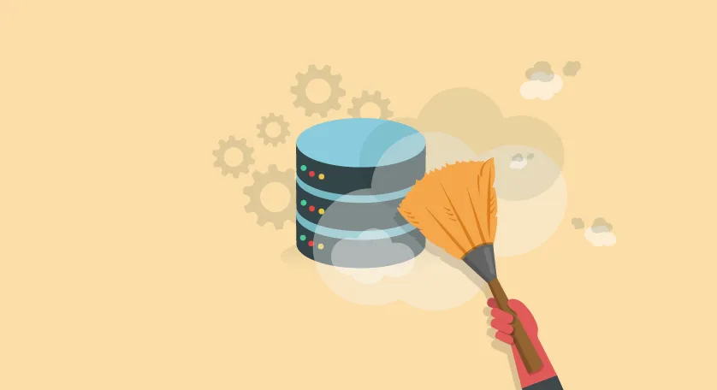
Data Analysis Lifecycle
Acquire
Transform
Organise
Analyse
Communicate
Maintain

Slide 2
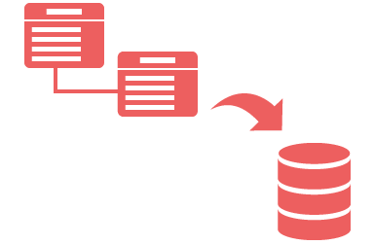
  Emphasize active participation in this project:
    Transform & Organise (load data in database)
    Acquire (Data sets received & cleaned from Melanie)
    Analyze (Single & multi table queries. Created new computed column to help with queries)
Data Preparation by Oliver (Social Manager)
Acquired interaction dataset (posts, comments, users).
Cleaned and formatted data into three CSV files.
ERD (Entity Relationship Diagram):
Grasp database structure. Identify Primary & Foreign keys
Visualize relationships.
Sustaining Analysis: Updated Data & Maintenance
Automate data updates and schedule regular executions for efficiency. Clear documentation and script version control support systematic changes. This ensures sustainable, seamless, and consistent analysis, adapting to evolving data for continuous insights, guaranteeing longevity and reliability.
In this project, I integrated ERD, SQLite, & Magic into the broader data lifecycle. Starting with a clear understanding of data relationships through ERD, we utilize SQLite for efficient data management and queries. The inclusion of Magic further enhances our data analysis process, making insights more accessible. Together, these elements play a crucial role in various stages of the data lifecycle, from collection to analysis

Slide 3
Requirements
Issues
Loading Data
How many posts have comments
Ranking days by ViewCount percentage, high to low using the expression CAST
The wording of the questions eg,
“Who are the top 10 users who comment the most”? Show the following fields:
user id, num of comments, user rep, order by num of posts desc
I did the query 2 times because ordering was strange.
OLIVER (Social Media Manager)
Ask Oliver if he prefers any changes or refinements in how the questions are framed
Discuss with Oliver to understand his feature-related questions & ask if it will be useful
Avoid using Jupyter Notebook as it won’t make sense
Ask if he would like to try a user-friendly reports or visualizations using tools like Excel or Tableau
Analyze requirements
I reviewed the requirements by accessing the spreadsheet, carefully reading the instructions. The "Action" column (Column B) outlines the steps I intended to accomplish, with each action corresponding to a query. In Column C, there are hints to assist with the process. I utilized the Jupyter notebook, referring to the requirement sheet for guidance. I transferred the questions from the requirement sheet to the notebook and utilized provided links for additional support.

Slide 4


Tools
The chosen tools are fitting for the project, aligning well with its requirements and supporting all stages of the Data Analysis Lifecycle.
Tools | Purpose/Functionality
SQLite | Managed relational database system serving as the file system.
Pandas | Handled reading, writing, manipulating and complexities of the relational database. Facilitates set operations for efficiency.
SQL Magic | Enables the direct integration of SQL queries into Jupyter code cells, simplifying the interaction with the relational database.
SQLite OVER PostgreSQL
SQLite was used over PostgreSQL for simplicity in querying a relational database, and its integration with Python. The limited data types in SQLite were not a challenge for the project, and the focus on set SQL queries made it a practical choice.
Benefits for IT Organizations Adopting Relational Database Technologies:
Relational databases, with standardized SQL, scalability, and resilient transaction properties, ensure data integrity, security, and efficiency

Slide 5

Quality
Data Source (CSV Files)
Posts
Comments
Users
The source data was organized into three CSV files (posts, comments, and users). The data fit into the database tables, making a simple and natural structure. This made it easy to create the Entity-Relationship Diagram (ERD), simplifying how to organize and analyze the data in the database.
Inconsistencies & Issues within data
The data has already been processed into 3 clean data files ready for this project & had minimal inconsistencies.
load data from the csv files into SQLite database
Remove duplicated rows
SQL is case insensitive & Pandas is case sensitive. Resolved this by making all of the text uppercase

Slide 6
Data Definitions: Adequacy for Task Assistance
The definitions of the data in the three CSV files (Comments, Users, and Posts) were clear, making it easy to understand. Each file had well-defined columns, like user ID, creation date, location etc providing a straightforward structure for analysis. This clarity enhances the usability of the dataset for extracting valuable insights.
Concern about Data Quality
Review dataset for issues
Contact data providers for clarification
Collaborate with data experts and team members
Use data profiling tools for analysis
Check available documentation for insights
Apply data cleaning techniques
Document steps taken and changes made
Continuously monitor data quality
Discuss concerns with supervisors & team for effective data quality management

Slide 7
Security, Ethics & Legislation
The data has personal details like DisplayName, location, ProfileImage, additional details in ‘AboutMe’ column.
This requires extra measures for privacy protection.
Analytical techniques may accidentally reveal identities, so caution is needed.
Ethical use involves fair and transparent data handling.
Check for applicable legislation and strictly follow laws on data privacy and protection.
For further information on security, ethics, privacy, and legislation within the UK, refer to the ICO website.
The ICO is the UK's data protection regulator, providing essential information on data protection, privacy rights, and GDPR compliance. The GDPR in the UK establishes rules for handling personal data, emphasizing consent, respecting rights, ensuring security, and holding organizations accountable for data processing.
Explore more on GDPR and data protection on the ICO website:
https://ico.org.uk/for-organisations/uk-gdpr-guidance-and-resources/accountability-and-governance/guide-to-accountability-and-governance/accountability-and-governance/data-protection-by-design-and-default/

