Slide 1




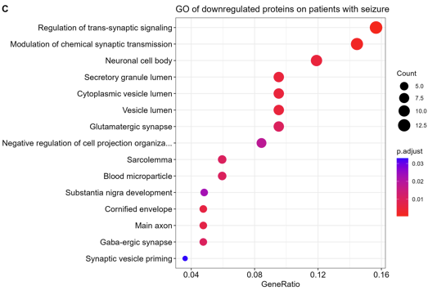

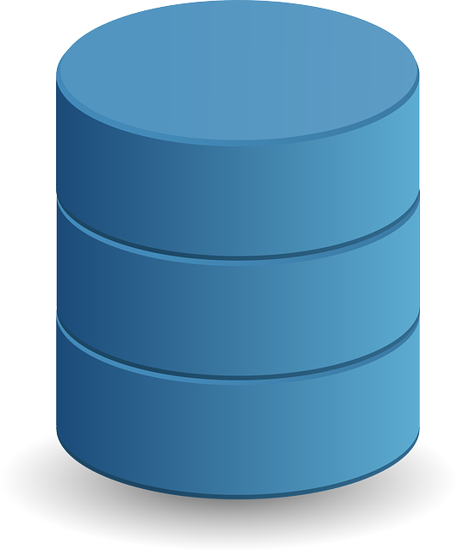
List of genes
Database
annotation
Statistical difference
between pathways

