Slide 1
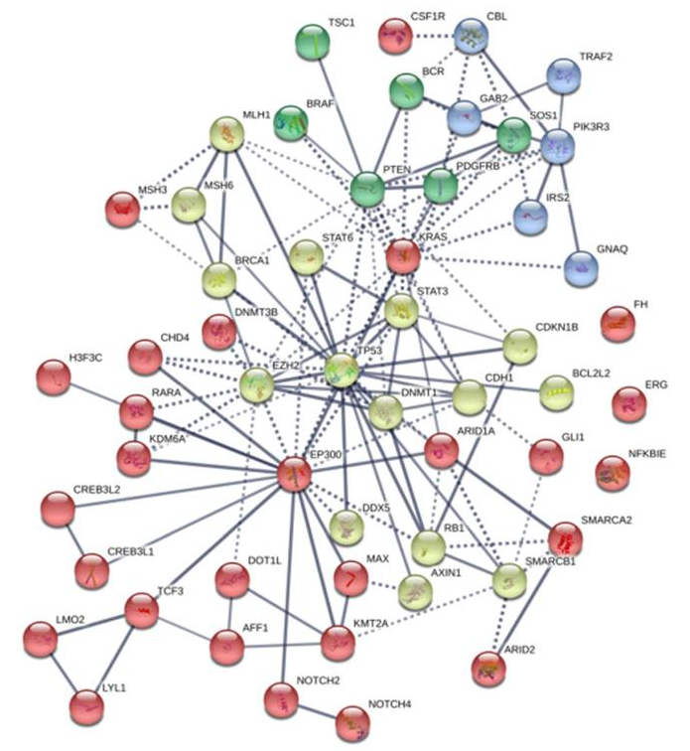
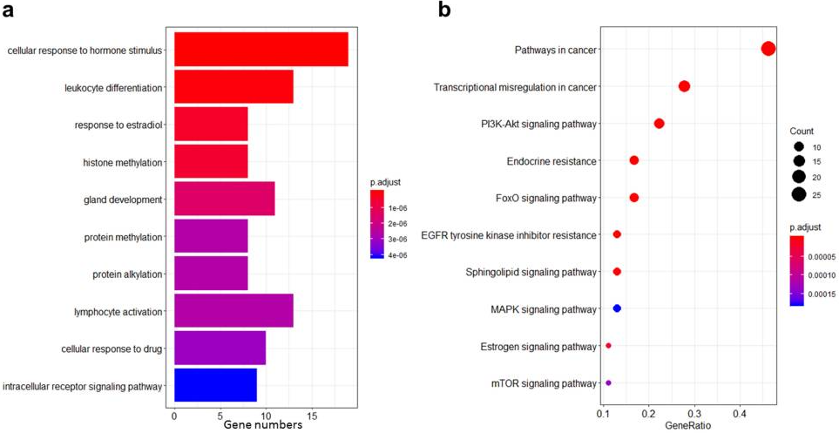
??????
Int J Med Sci. 2021; 18(12): 2532–2544.

Slide 2


Pathway analysis
Group A
Group B
Group C
Group D

Slide 3
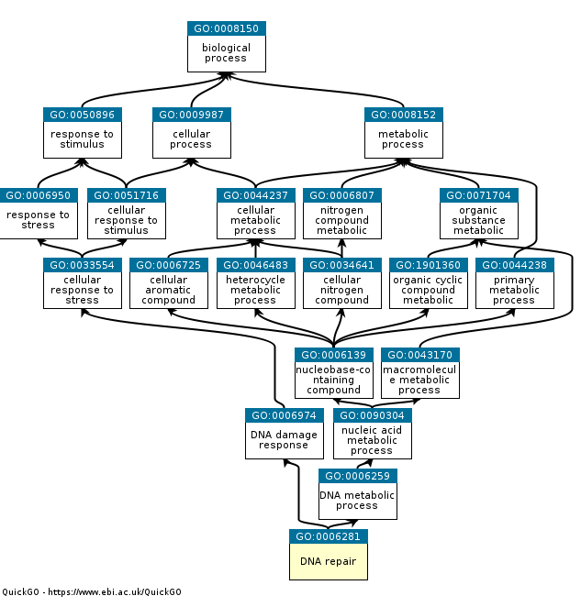
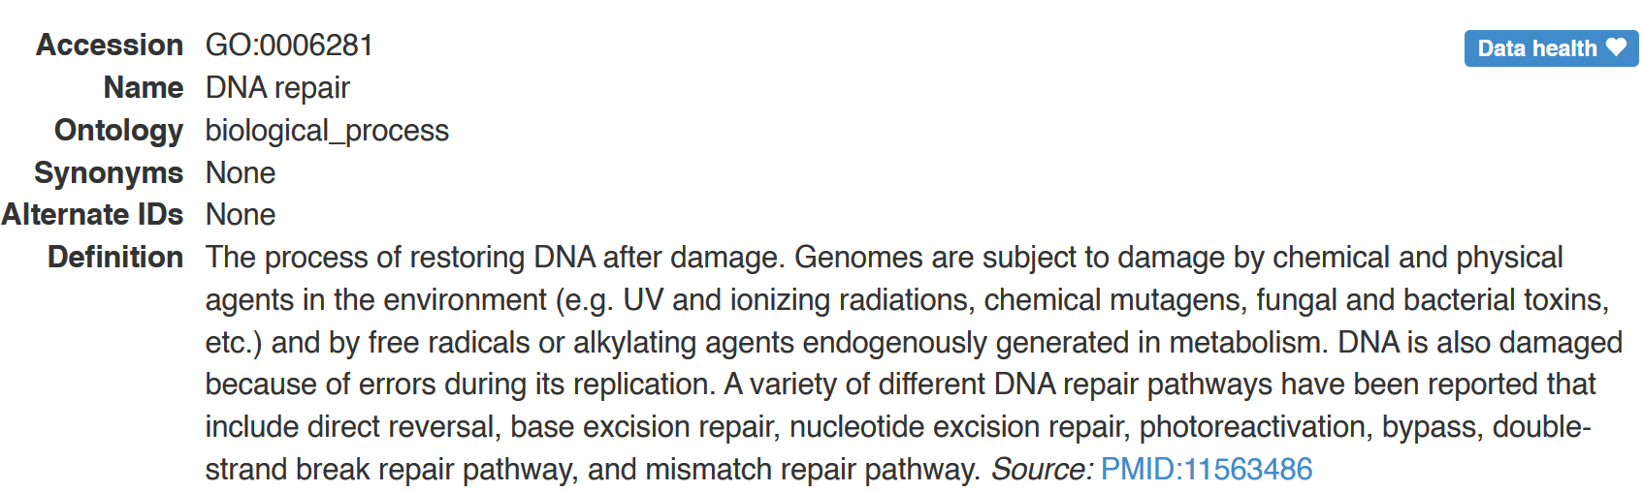
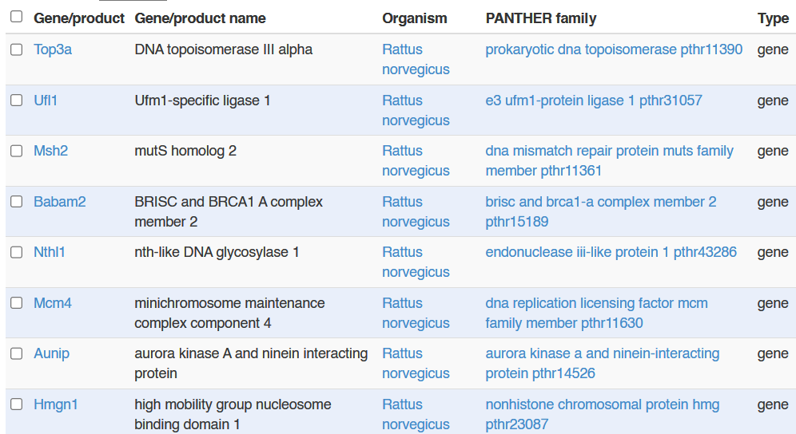

Slide 4




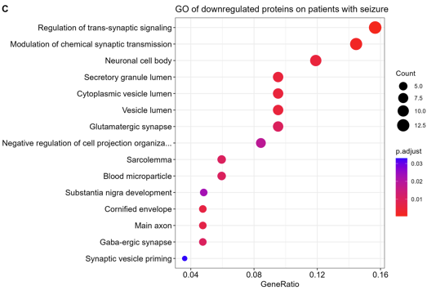

List of genes
Database
annotation
Statistical difference
between pathways

Slide 5

Formal representation of a body of knowledge within a given domain
MF: Molecular function
CC: Cellular component
BP: Biological process
Characteristic gene sets that can be linked to specific metabolic capacities and other phenotypic features
Manually curated and peer-reviewed pathway database related with genes
Manually curated and peer-reviewed pathway database related with genes

Slide 6
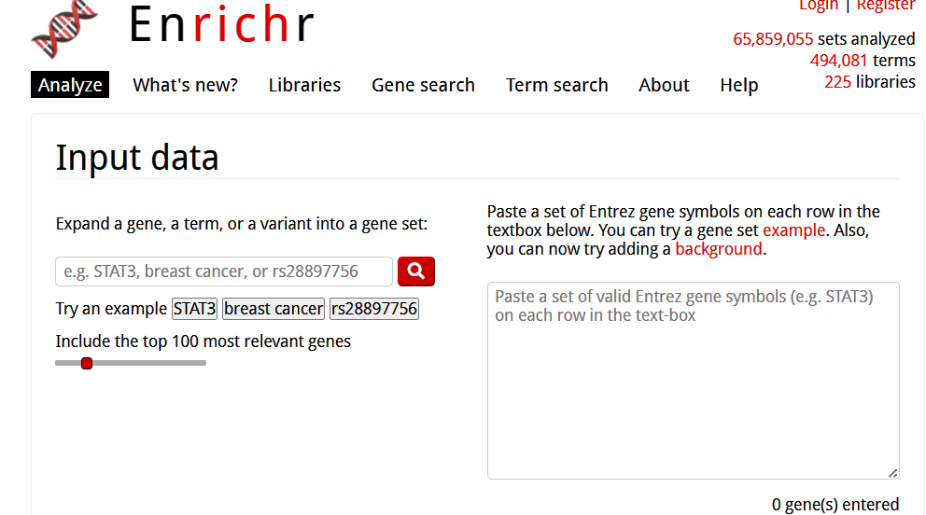
https://maayanlab.cloud/Enrichr/

Slide 7
Universe (Background)
Our interested gene
A B C D E F G H I J K L M N O
1 2 3 4 5 6 7 8
A B C D E F G H I
1 2 5 6 8 9
Gene set
Set
Alphabet (A-Z)
Number (0-10)
Alphabet | Interested gene | Not interested genes
In set
Not in set

Slide 8
Universe (Background)
Our interested gene
A B C D E F G H I J K L M N O
1 2 3 4 5 6 7 8
A B C D E F G H I
1 2 5 6 8 9
Gene set
Set
Alphabet (A-Z)
Number (0-10)
Alphabet | Interested gene | Not interested genes
In set | 9
Not in set

Slide 9
Universe (Background)
Our interested gene
A B C D E F G H I J K L M N O
1 2 3 4 5 6 7 8
A B C D E F G H I
1 2 5 6 8 9
Gene set
Set
Alphabet (A-Z)
Number (0-10)
Alphabet | Interested gene | Not interested genes
In set | 9 | 17 (J K L M N … Z)
Not in set

Slide 10
Universe (Background)
Our interested gene
A B C D E F G H I J K L M N O
1 2 3 4 5 6 7 8
A B C D E F G H I
1 2 5 6 8 9
Gene set
Set
Alphabet (A-Z)
Number (0-10)
Alphabet | Interested gene | Not interested genes
In set | 9 | 17 (J K L M N … Z)
Not in set | 6

Slide 11
Universe (Background)
Our interested gene
A B C D E F G H I J K L M N O
1 2 3 4 5 6 7 8
A B C D E F G H I
1 2 5 6 8 9
Gene set
Set
Alphabet (A-Z)
Number (0-10)
Alphabet | Interested gene | Not interested genes
In set | 9 | 17 (J K L M N … Z)
Not in set | 6 | 2
Fisher’s p-value = 0.022 -> significantly overrepresented

Slide 12
Universe (Background)
Our interested gene
A B C D E F G H I J K L M N O
1 2 3 4 5 6 7 8
A B C D E F G H I
1 2 5 6 8 9
Gene set
Set
Alphabet (A-Z)
Number (0-10)
Number | Interested gene | Not interested genes
In set
Not in set

Slide 13
Universe (Background)
Our interested gene
A B C D E F G H I J K L M N O
1 2 3 4 5 6 7 8
A B C D E F G H I
1 2 5 6 8 9
Gene set
Set
Alphabet (A-Z)
Number (0-10)
Number | Interested gene | Not interested genes
In set | 6
Not in set

Slide 14
Universe (Background)
Our interested gene
A B C D E F G H I J K L M N O
1 2 3 4 5 6 7 8
A B C D E F G H I
1 2 5 6 8 9
Gene set
Set
Alphabet (A-Z)
Number (0-10)
Number | Interested gene | Not interested genes
In set | 6 | 4 (3 4 7 10)
Not in set

Slide 15
Universe (Background)
Our interested gene
A B C D E F G H I J K L M N O
1 2 3 4 5 6 7 8
A B C D E F G H I
1 2 5 6 8 9
Gene set
Set
Alphabet (A-Z)
Number (0-10)
Number | Interested gene | Not interested genes
In set | 9 | 4 (3 4 7 10)
Not in set | 9

Slide 16
Universe (Background)
Our interested gene
A B C D E F G H I
J K L M N O
1 2 3 4 5 6 7 8
A B C D E F G H I
1 2 5 6 8 9
Gene set
Set
Alphabet (A-Z)
Number (0-10)
Number | Interested gene | Not interested genes
In set | 9 | 4 (3 4 7 10)
Not in set | 9 | 6
Fisher’s p-value = 0.4564 -> not significantly overrepresented

Slide 17
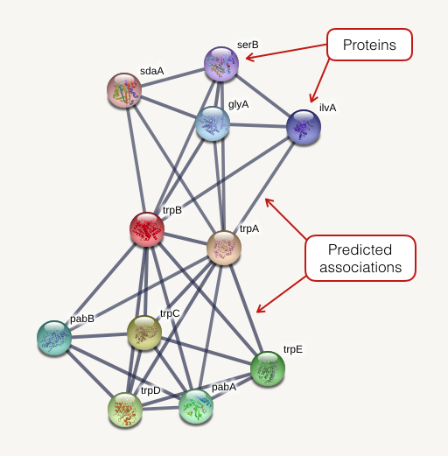
http://version10.string-db.org/help/getting_started/

Slide 18
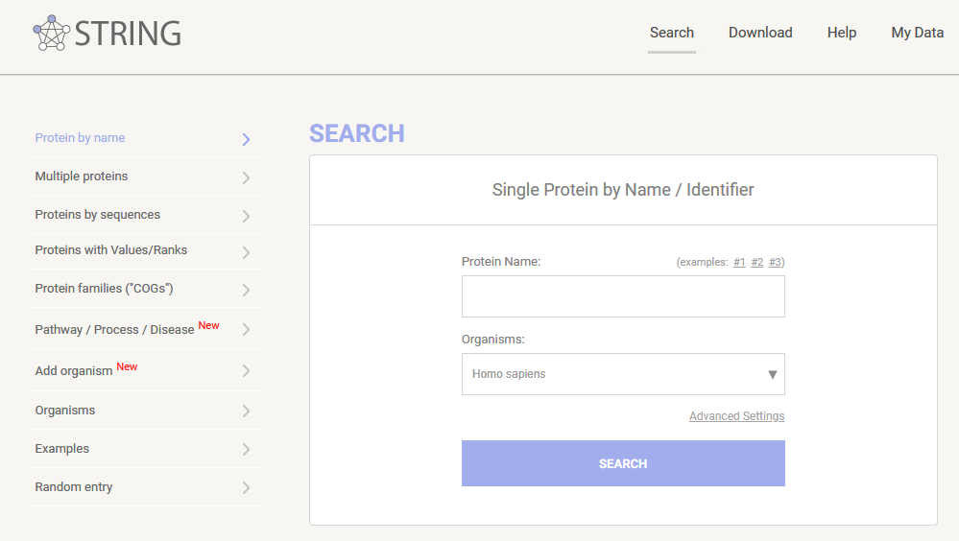
https://string-db.org/

