Slide 1


Introduction to R Kittinun Leetanaporn M.D.

Slide 2

What is R?
Statistical language for computing.
Provide a variety of statistical framework and graphic techniques.
Mainly used by statisticians and data scientist
Epidemiology
Bioinformatics
Economics/Finance
Best of all: It’s free!
Notes:
oral., inject, suppo

Slide 3
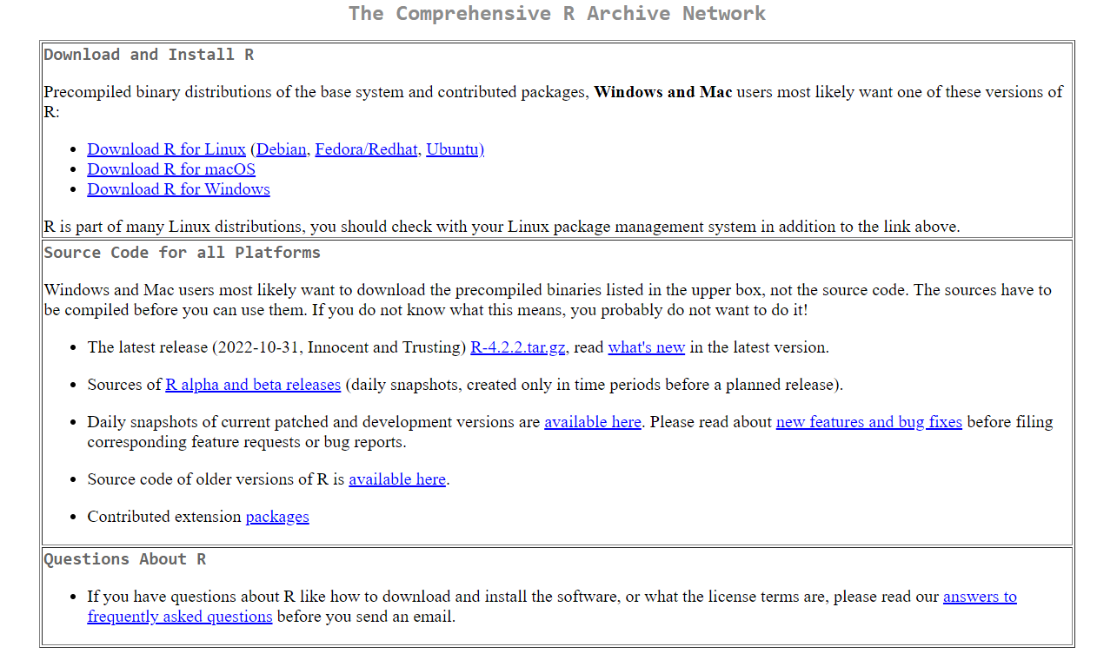
Download R
https://cran.r-project.org/index.html
Notes:
oral., inject, suppo

Slide 4
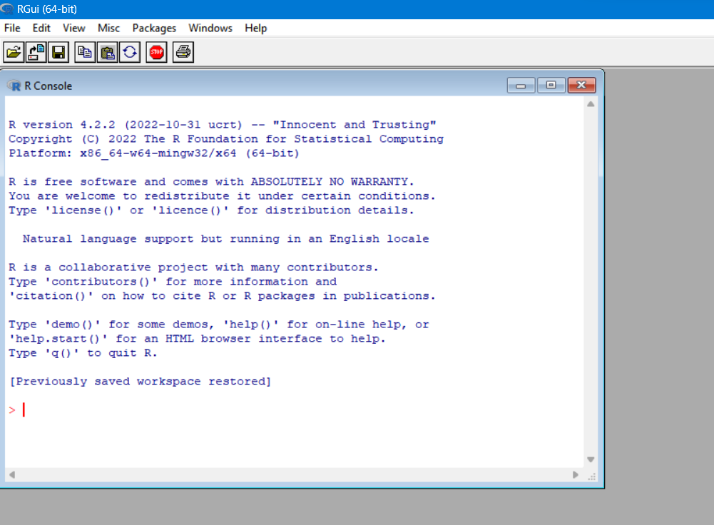

Native R
This is a native R application
We don’t usually used this software natively due to many limitations
Integrated development environment (IDE)
Notes:
ให้ลองเล่นแปปนึง

Slide 5
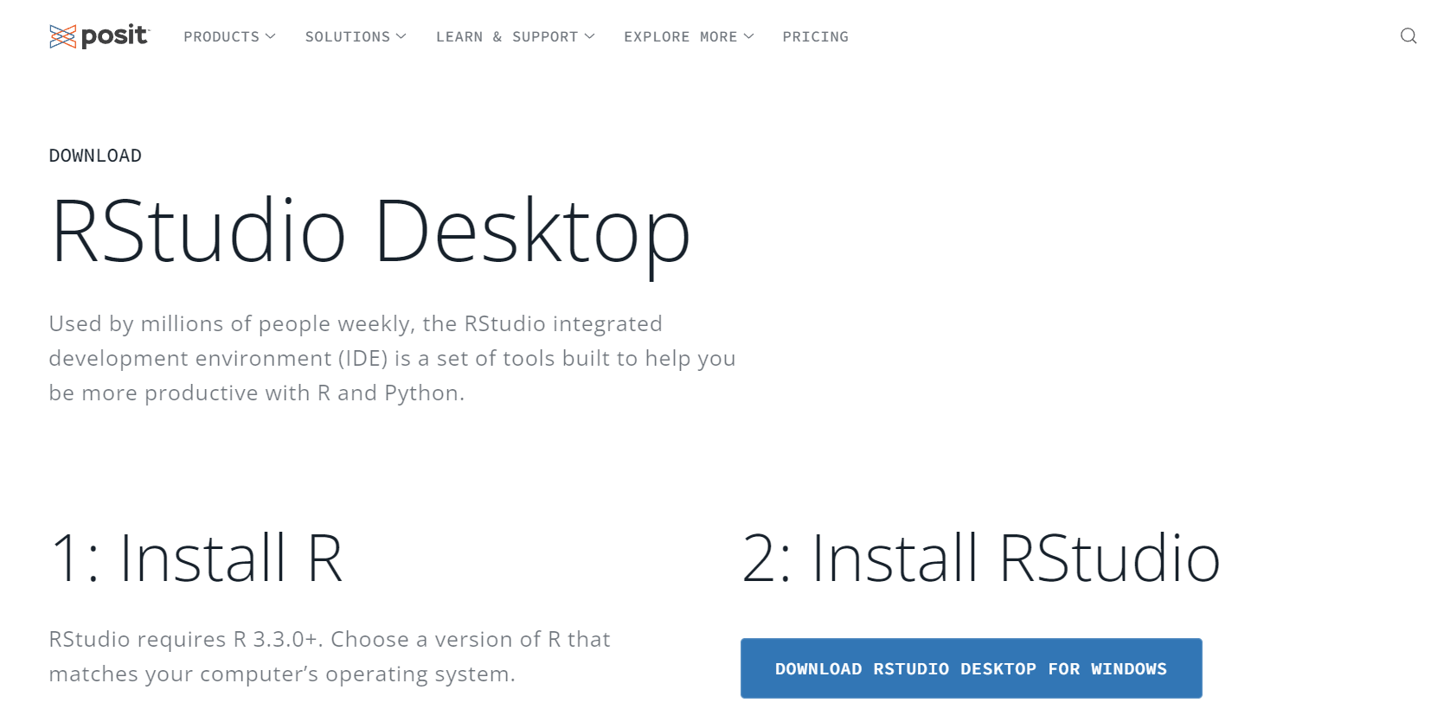
RStudio
Developed by Posit team
Integrated Developing Environment (IDE)
Can be used in conjunction with other language
Python
C
Javascript
https://posit.co/download/rstudio-desktop/
Notes:
oral., inject, suppo

Slide 6
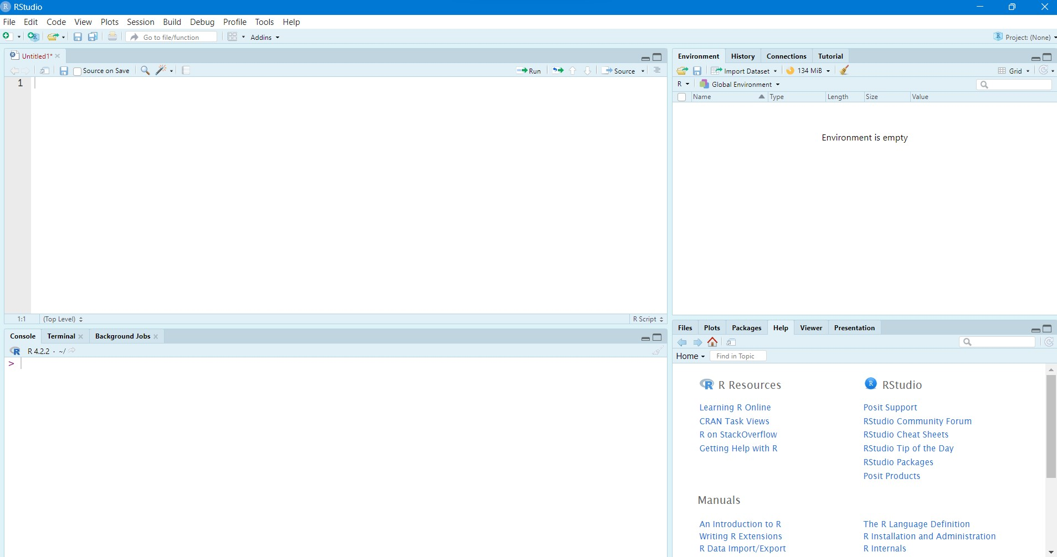
RStudio
Text editor
Environment
R console (native R)
Help/Output
Notes:
oral., inject, suppo

Slide 7
Basic R: R operator
3+2
## [1] 5
3-2
## [1] 1
3*2
## [1] 6
3/2
## [1] 1.5
3^2
## [1] 9
log(3)
## [1] 1.098612
sqrt(3)
## [1] 1.732051
3==3 # ตรวจสอบว่าข้อมูลเหมือนกันหรือไม่
## [1] TRUE
R can operate many mathematical operations
Also include matrix operations

Slide 8
Basic R: Variable assignment
x <- 2 x
## [1] 2
y <- 3 y
## [1] 3
x+y
## [1] 5
x*y
## [1] 6
hellothisisRNAseqworkshop <- (x+y)^(x-y) # สามารถตั้งชื่ออะไรก็ได้ตราบใดที่ไม่เว้นวรรค hellothisisRNAseqworkshop
## [1] 64
class(x) # เราสามารถเช็คชนิดของตัวแปรได้โดยใช้ function class()
## [1] "numeric"
We use <- or = to assign variables in R

Slide 9

Try it yourself
Mr. A drive a car at 80 mph for 3 h, what is his distance?
s = vt
Assign velocity to v
Assign time to t
Find s
Introduce yourself
Assign yourname to variable name
Say yourname!
Hint: use cat(“Hello my name is “, name)

Slide 10
Basic R: Types of variable
Type | Example | Explanation
numeric/double | 1, 2.3, 5 | จำนวนจริง รวมทศนิยม
integer | 1, 2, 3 | จำนวนเต็ม เป็น subset ของ numeric
complex | 1i | จำนวนเชิงซ้อน
character | “สวัสดี”, “Hello world” | ตัวอักษร ต้องอยู่ในเครื่องหมาย ” ”
factor | “a”, “b”, “c” | คล้าย character แต่มีจำนวนตัวแปรจำกัด
logical | TRUE, FALSE | ตามหลักตรรกศาสตร์

Slide 11
Basic R: More variables storage
y <- c(1,2,3,4) y
## [1] 1 2 3 4
z <- list(c(1,2,3), 4, c("hello world", "I love R")) # เก็บข้อมูลในรูปแบบ list z
## [[1]] ## [1] 1 2 3 ## ## [[2]] ## [1] 4 ## ## [[3]] ## [1] "hello world" "I love R“

Slide 12
Basic R: subset
x <- c("a","b","c","d") x[3] # subset โดยระบุตำแหน่ง
## [1] "c“
x[1:3] # subset หลายตำแหน่ง
## [1] "a" "b" "c“
x[c(1,3)] # subset หลากหลายตำแหน่งแบบจำเพาะ
## [1] "a" "c“
y <- list(c(1,2,3), c("a","b","c")) y[1] # subset list ตามตำแหน่ง (จะได้ list ย่อยออกมา)
## [[1]] ## [1] 1 2 3
y[[1]] # ดึงข้อมูลที่อยู่ใน list ออกมา
## [1] 1 2 3

Slide 13
Basic R: More variables storage
Type | Example | Explanation
Vector | c(1,2,3) | Multiple variables of the same type
List | list(1, c(1,3,4), “Hello”) | Multiple variables of different types
Dataframe | data.frame(x=3, y=2) | Table

Slide 14
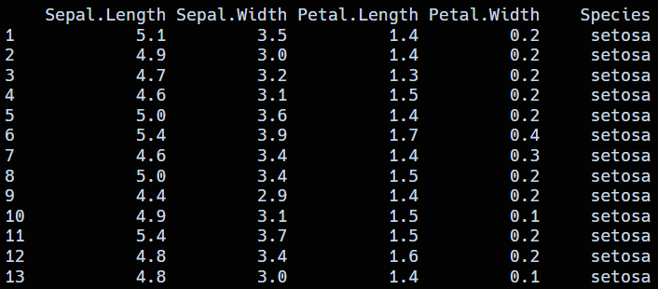
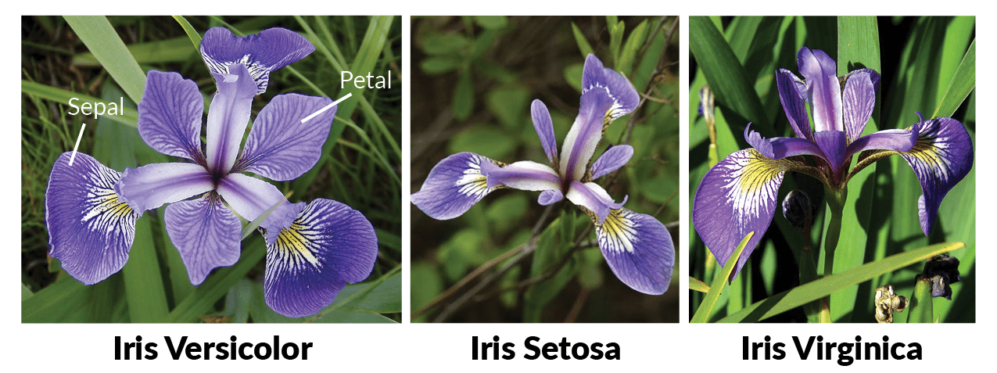
Basic R: Matrix and dataframe
Column
2 x 2 table, like a spreadsheet in excel
Main structure that we deal with data in R
We can:
Subset
Summarize
Visualizae
etc.
Matrix vs Dataframe
Matrix contains only one data type
Dataframe can have multiple data types
Rows
Notes:
ลองให้พิมพ์ iris

Slide 15
Basic R: subset
Column
Subsetting a dataframe
iris[1, 4]
Rows

Slide 16
Basic R: subset
Column
Subsetting a dataframe
iris[1, 4]
iris["Species"]
Rows

Slide 17
Basic R: subset
Column
Subsetting a dataframe
iris[1, 4]
iris["Species"]
Rows
iris[["Species"]]
iris$Species

Slide 18
Basic R: Function
A set of commands to perform a specific task
Base R function
Packages
Our own function
Anatomy of function
Name
Arguments
find_mean <- function(x, y) {
(x + y)/2
}
find_mean(2, 3)
Body

Slide 19
Basic R: Base R function
Vector functions
max(c(1,2,4,5,5,68)) # find max value
## [1] 68
min(c(1,4,5,6,-20)) # find min value
## [1] -20
mean(c(1,2,3,4)) # find mean
## [1] 2.5
median(c(1,2,5,3,4)) # find median
## [1] 3
unique(c(1,1,1,1,2,2,4,5,5,6,7,8)) # display only unique values
## [1] 1 2 4 5 6 7 8
length(c(1,1,1,1,2,2,4,5,5,6,7,8)) # display only unique values
## [1] 12

Slide 20
Basic R: Base R function
Dataframe/Matrix functions
dim(iris) # Number of rows and columns
head(iris, 5) # First 5 rows
tail(iris , 5) # Last 5 rows
rowMeans(iris[-5]) # Find mean for each rows
colMeans(iris[-5]) # Find mean for each column
rownames(iris) # rows names
colnames(iris) # columns names
summary(iris) # overall data
Need help?
Try type ? in front of the function and run
?tail

Slide 21
Try it yourself
What is the data in the row 2 and column 4 of iris data?
How many types of flower in this data?
Hint: subset Species column and use unique()
What is the max Sepal.Length?
Hint: subset Sepal.Length column and use max()
What is the min Sepal.Width?
Hint: subset Sepal.Width column and use mean()
I want to know the overall picture of the data!
Hint: try summary()

Slide 22
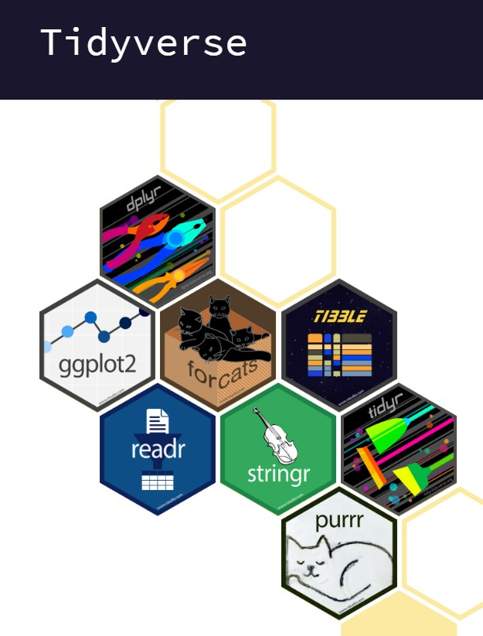
Tidyverse
Tools for manipulating data esp. dataframe
A little less flexible than base R, but much easier.
This is not base R functions. So, we have to install package first
install.packages(“tidyverse”)
library(tidyverse)
Much improved code readability

Slide 23

Tidyverse: dplyr
A set of tools to manipulate a dataframe
glimpse(iris)
iris %>% select(Species)
iris %>% select(2)
iris %>% filter(Species == "virginica")
iris %>% filter(Species == "setosa" & Sepal.Length == 5.4)
iris %>% filter(Sepal.Length == 5.1 | Sepal.Length == 4.9)
iris %>%
filter(Species == "setosa") %>% select(Sepal.Length)
iris %>% arrange(Sepal.Length)
iris %>% arrange(desc(Sepal.Length))

Slide 24
Tidyverse: dplyr
Customizable data summarization
By group
iris %>% group_by(Species) %>% arrange(desc(Sepal.Length))
Data summary
iris %>% group_by(Species) %>% summarize(Sepal.Length = sum(Sepal.Length), Sepal.Width = sum(Sepal.Width))

Slide 25
Try it yourself
What is the data in the row 2 and column 4 of iris data?
How many types of flower in this data?
Hint: select() Species column and use unique()
What is the max Sepal.Length?
Hint: select() Sepal.Length column and use max()
Rearrange data from min to max for each species?
Hint: group_by() then arrange()
What is the mean Sepal.Length and Sepal.Width of each species?
Hint: group_by() then summarize()

Slide 26

Tidyverse: ggplot2
Tools for visual representation of the data
Anatomy of ggplot()
Data
ggplot(data = data,
aes(x = x, y = y, col = col, fill = fill)) + geom_xxx() + theme_xxx()
Aesthetic
Type of plot
Theme

Slide 27
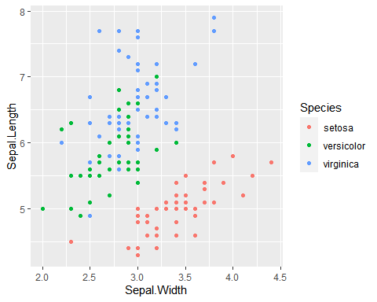
Tidyverse: ggplot2
Scatterplot
Plot data as dots
ggplot(df, aes(x = Sepal.Width, y = Sepal.Length, col = Species)) + geom_point()

Slide 28
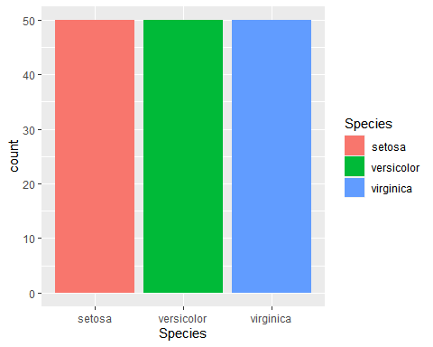
Tidyverse: ggplot2
Barchart
Count column number
ggplot(df, aes(x = Species, fill = Species)) + geom_bar()

Slide 29
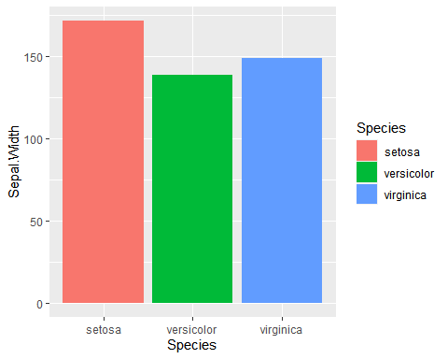
Tidyverse: ggplot2
Column chart
Take y values from x axis
ggplot(df, aes(x = Species, y = Sepal.Width, fill = Species)) + geom_col()

Slide 30
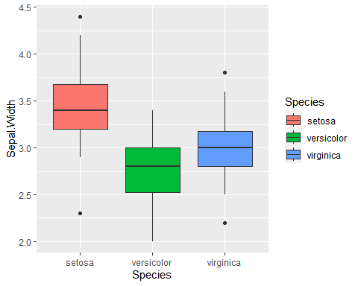
Tidyverse: ggplot2
Boxplot
Box plot
ggplot(df, aes(x = Species, y = Sepal.Width, fill = Species)) + geom_boxplot()

Slide 31
Differential Gene Expression Kittinun Leetanaporn M.D., Pongsakorn Choochuen M.D.

Slide 32
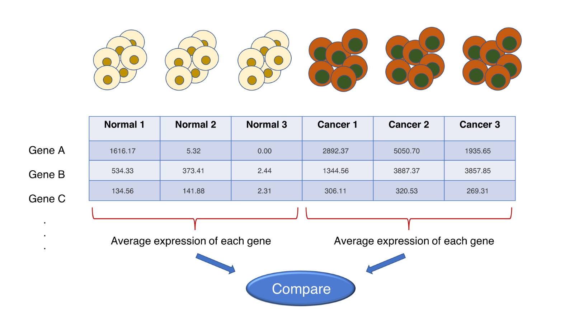
DGE: Overview

Slide 33
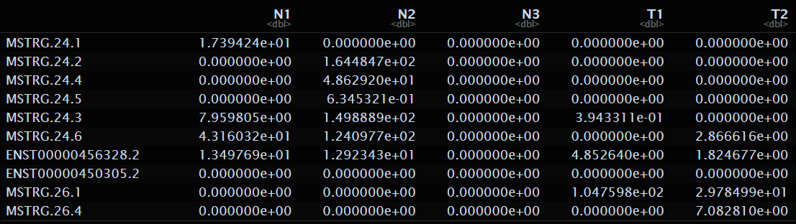
DGE: Overview
Fit the model

Slide 34
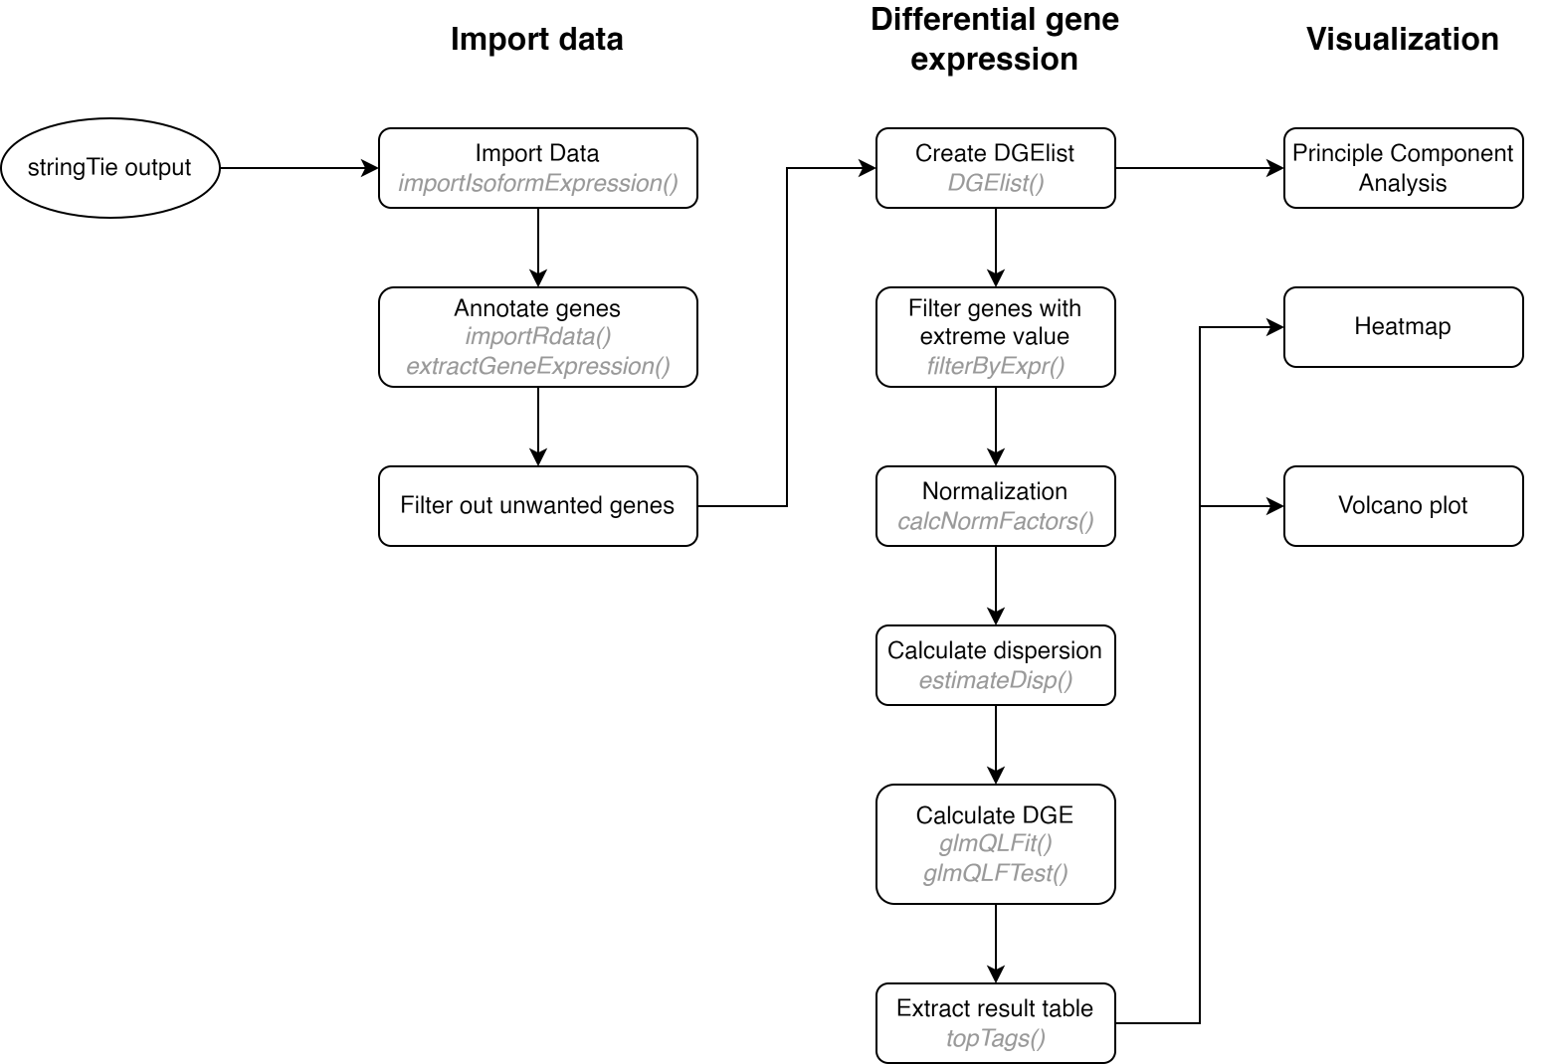
DGE: Workflow

Slide 35
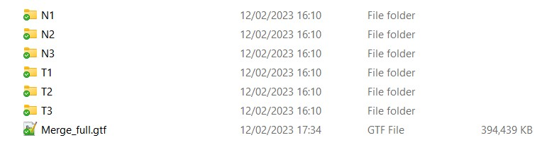
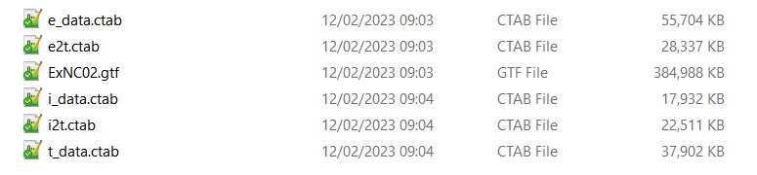
DGE: Import Data

Slide 36
DGE: Import Data
stringTie_quant <- importIsoformExpression( parentDir = "./Source/bladder", addIsofomIdAsColumn = FALSE, readLength = 150 )
stringTie_quant$counts

Slide 37
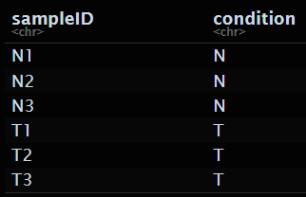
DGE: Import Data
design <- data.frame( sampleID = colnames(stringTie_quant$abundance), condition = gsub(".{1}$", "", colnames(stringTie_quant$abundance)) # Remove number )

Slide 38
DGE: Import Data
switch_analyze_Rlist <- importRdata( isoformCountMatrix = stringTie_quant$counts, isoformRepExpression = stringTie_quant$abundance, designMatrix = design, isoformExonAnnoation = "./Source/bladder/BCaMerge.gtf", )
names(switch_analyze_Rlist)

Slide 39
DGE: Import Data
switch_analyze_Rlist <- importRdata( isoformCountMatrix = stringTie_quant$counts, isoformRepExpression = stringTie_quant$abundance, designMatrix = design, isoformExonAnnoation = "./Source/bladder/BCaMerge.gtf", )
names(switch_analyze_Rlist)

Slide 40
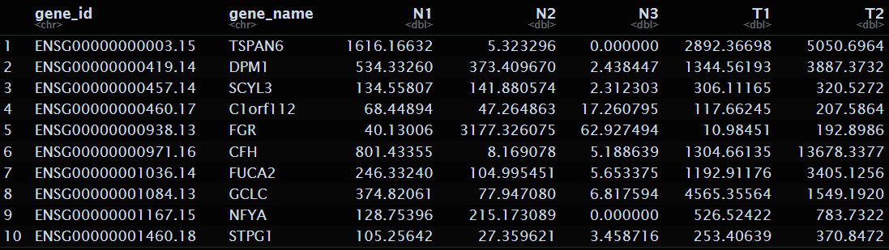

DGE: Import Data
gene_count <- extractGeneExpression( switch_analyze_Rlist, extractCounts = TRUE # set to FALSE for abundances )
dim(gene_count)

Slide 41
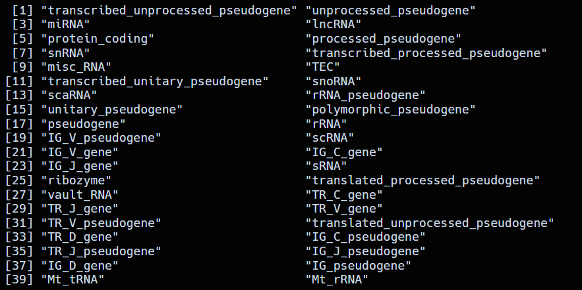
DGE: Filter out unwanted genes
rtracklayer::import()
V38.gtf <- rtracklayer::import("./Source/gencode.v38.annotation.gtf")
unique(V38.gtf$gene_type)

Slide 42
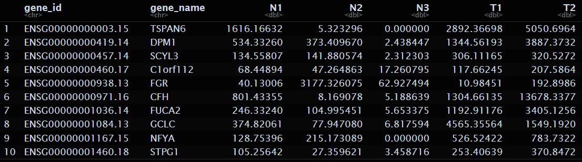

DGE: Filter out unwanted genes
gene_count_no_lncRNA <- gene_count %>% filter(!(gene_name %in% unique(lncRNA)))
head(gene_count_no_lncRNA, 10)
dim(gene_count_no_lncRNA)

Slide 43
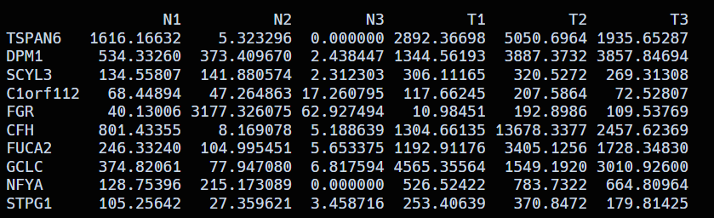
DGE: Filter out unwanted genes
count_matrix <- gene_count_no_lncRNA %>% distinct(gene_name, .keep_all = TRUE) %>% # Remove duplicate gene_name column_to_rownames("gene_name") %>% select(-gene_id) %>% as.matrix

Slide 44
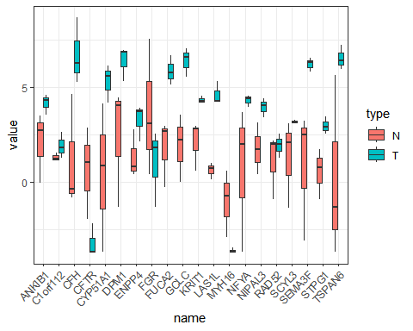
DGE: Filter out unwanted genes
count_matrix %>% edgeR::cpm(log=TRUE) %>% head(20) %>% t %>% as.data.frame() %>% rownames_to_column("type") %>% tidyr::pivot_longer(-type) %>% mutate(type = gsub("\\d", "", type)) %>% ggplot(aes(x = name, y =value, fill = type)) + geom_boxplot() + theme_bw() + theme(axis.text.x = element_text(angle = 45, vjust = 1, hjust=1))

Slide 45
DGE: Workflow

Slide 46
DGE: Workflow

Slide 47
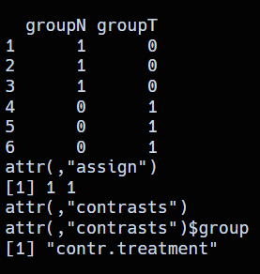
DGE: Performing DGE
library(edgeR) colnames(count_matrix)
## [1] "N1" "N2" "N3" "T1" "T2" "T3"
group <- design$condition diff_design <- model.matrix(~0+group) diff_design
y = m₁x + m₂x + b

Slide 48

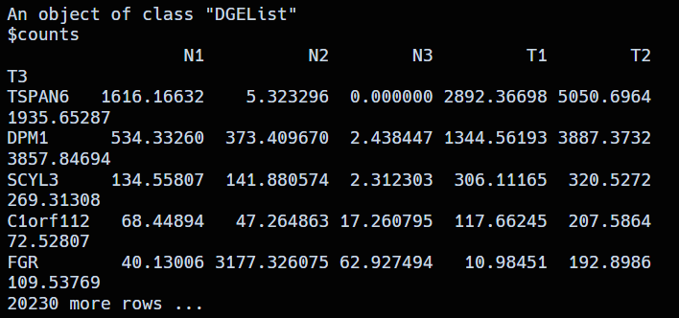
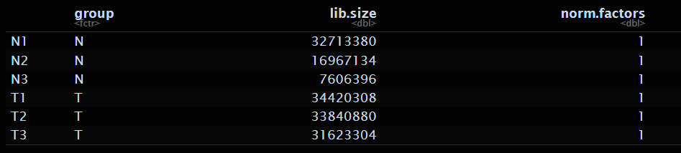
DGE: Quality Control
dge <- DGEList(counts=count_matrix, group=group) keep <- filterByExpr(dge, group=group,min.count=2, min.prob=0.5) dge <- dge[keep,]

Slide 49
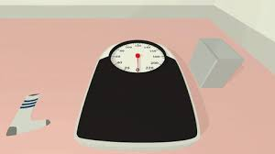
DGE: Quality Control
Normalization
Each gene and sample was run on different condition: chemical solution, temperature etc. -> minor variation even within the same run
This technical variation is called Batched Effect
We cannot compare each samples that come from different baseline directly
So, we have to perform normalization to “normalize” this effect

Slide 50
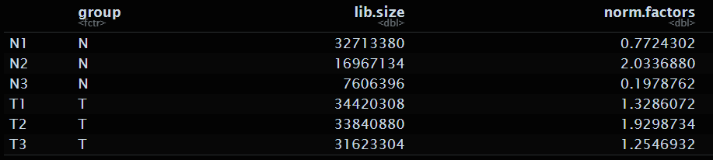
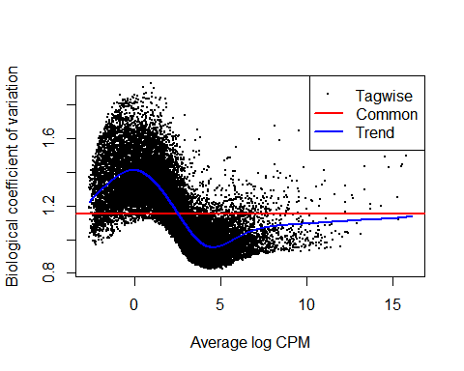
DGE: Quality Control
# Calculate normalization factor genexp <- calcNormFactors(dge) # GLM Common dispersion genexp <- estimateGLMCommonDisp(dge, diff_design) # Estimate GLM trended dispersions genexp <- estimateGLMTrendedDisp(genexp, diff_design) # Tagwise dispersion of each gene genexp <- estimateGLMTagwiseDisp(genexp, diff_design) plotBCV(genexp)

Slide 51
DGE: Fit the model
Fit the model
fit <- glmQLFit(genexp, diff_design)
genediff <- glmQLFTest(fit, contrast=c(-1,1))
# All genes
all_gene <- topTags(genediff, n = Inf, p.value = 1, adjust.method = "fdr")
# Only significant value
sig_gene <- topTags(genediff, n = Inf, p.value = 0.05, adjust.method = "fdr", sort.by = "logFC")

Slide 52
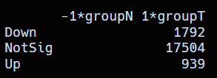
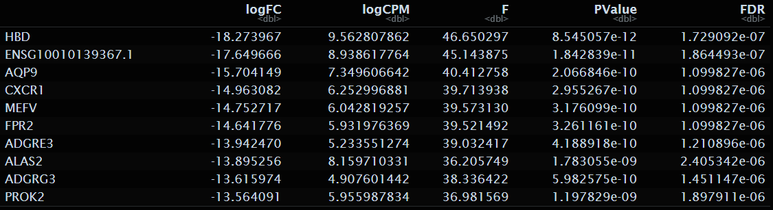
DGE: Fit the model
Fit the model
# Total differentiated gene
summary(decideTests(genediff))
sig_gene$table

Slide 53
DGE: Workflow

Slide 54
DGE: Workflow

Slide 55

Visualization: PCA
Principal Component Analysis
Dimensional Reduction Technique
Reduce from n of gene dimension to n of samples dimension
Useful for data exploration and finding batch effects
Requirements
Normalized samples +- centered
No missing data
From: https://stats.stackexchange.com/questions/2691/making-sense-of-principal-component-analysis-eigenvectors-eigenvalues

Slide 56
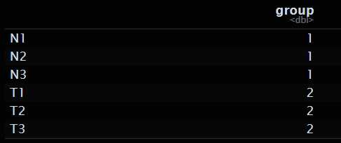
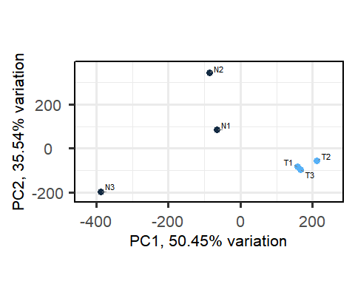
Visualization: PCA
library(PCAtools)
# Calculate log-counts-per-million logcpm <- cpm(dge, prior.count = 2, log = TRUE) # Create a metadata table metadata <- data.frame(row.names = colnames(logcpm), group = c(rep(1,3), rep(2,3))) # Perform PCA analysis pc <- pca(logcpm, metadata = metadata, removeVar = 0.1)
## -- removing the lower 10% of variables based on variance
# Create PCA plot biplot(pc, colby = "group")

Slide 57
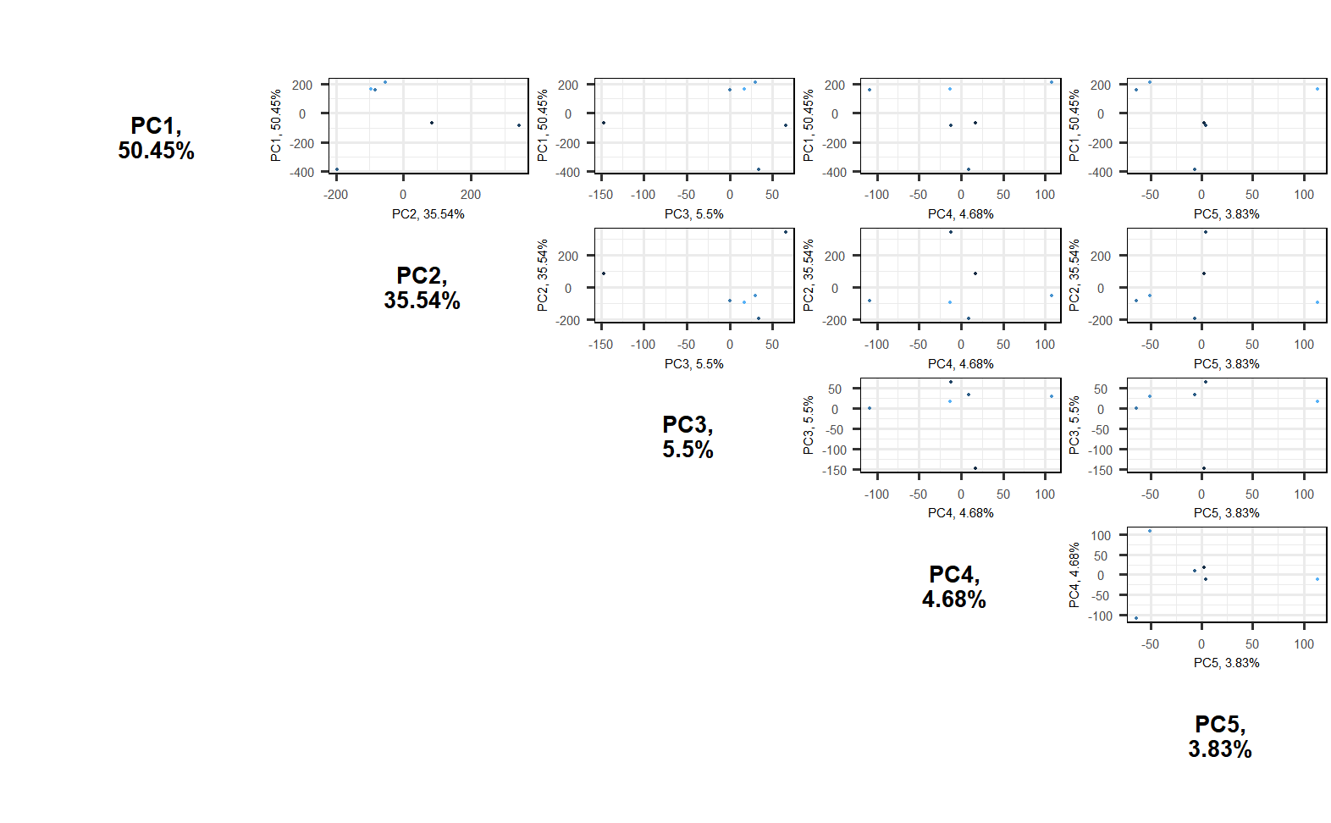
Visualization: PCA
pairsplot(pc)

Slide 58
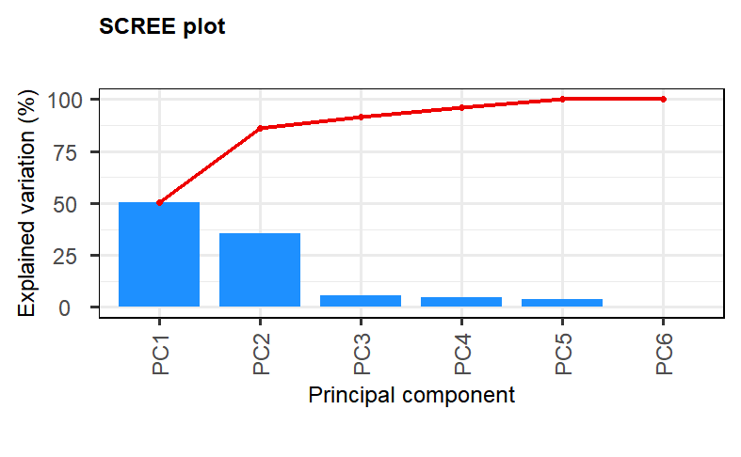
Visualization: PCA
screeplot(pc)

Slide 59
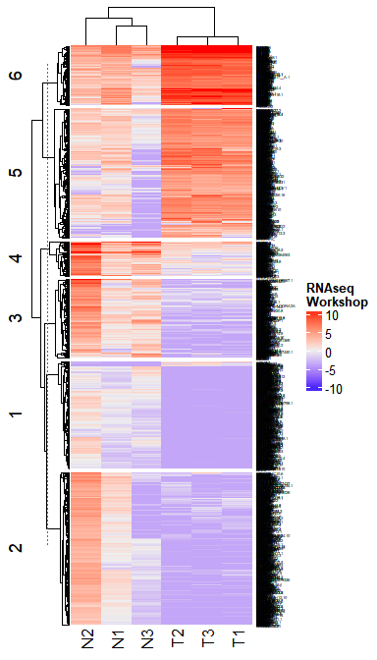
Visualization: Heatmap
library(ComplexHeatmap)
# Filter only significant DEGs gene (from EdgeR) DEGGene <- logcpm[rownames(sig_gene$table),] Heatmap(DEGGene, row_km = 6, name = "RNAseq\nWorkshop", row_names_gp = gpar(fontsize = 3))

Slide 60
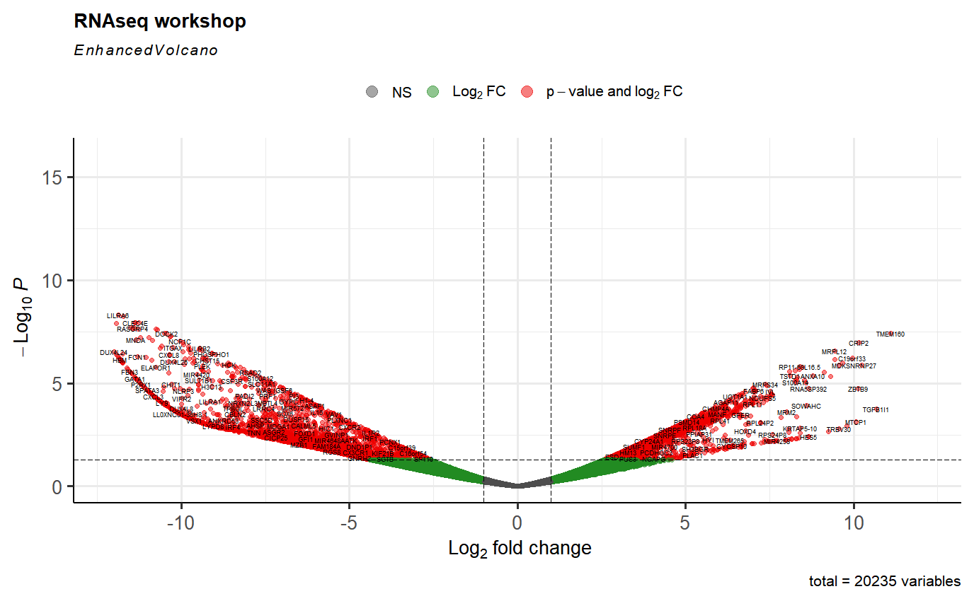
Visualization: Volcano plot
library(EnhancedVolcano) # Create Volcano plot EnhancedVolcano(all_gene$table, lab = rownames(all_gene$table), x = "logFC", y = "PValue", xlim = c(-12, 12), labSize = 2.0, pCutoff = 0.05, title = "RNAseq workshop", max.overlaps = 50)

