Slide 1
Systems Biology:
SBML and Antimony
Jannis Uhlendorf

Slide 2
Modelling standards in SB
Overview:
1. XML
2. SBML
3. Antimony

Slide 3
Modelling standards in SB
Overview:
1. XML
2. SBML
3. Antimony

Slide 4
XML
The eXtensible Markup Language (XML)
is a flexible, machine-readable
data representation format.

Slide 5
What is XML?
<math
xmlns="http://www.w3.org/1998/Math/MathML">
<apply>
<divide/>
<apply>
<times/>
<ci> uVol </ci>
<ci> MKKK_P </ci>
</apply>
<apply>
<plus/>
<ci> KK2 </ci>
<ci> MKKK_P </ci>
</apply>
</apply>
</math>
...
<!-- this is a comment -->
<head>
<title>Theoretical Biophysics</title>
</head>
<body>
<div id="nav"><div align="center">
<p>&nbsp;</p>
</div>
<ul>
<li> <a href="index.php">Home</a></li>
<li><a href="inde..teaching">Teaching</a>
<ul>
<li><a href="inde...L">L</a></li>
<li><a href="inde...S">S</a></li>
</ul>
...
Stores textual information
One of the few standards out there
Machine-readable, but also human-readable
The format can be user-defined

Slide 6
XML elements
XML element with start end end tag
  (a tag starts with < and ends with >)
empty XML element
<message>
Hello World
</message>
<message/>

Slide 7
XML elements
XML element with content as element
XML element with content as attribute
<message sender=”Jannis”>
<content>Hello World</content>
</message>
<message sender=”Jannis” content=”Hello World”/>

Slide 8
XML has a tree structure
Nesting of XML elements
<bookshelf location="hallway" >
<color>blue </color>
<book title="Momo" author="Michael E" >
<p>In old, old times, when the ...</p>
</book>
<book title="Pippi Longst" author="Astrid L" >
<p>At the end of a little ...</p>
</book>
</bookshelf>
Notes:
Mention what means well-formed

Slide 9
Right and wrong
Well-formed
Not well-formed
<bookshelf location="hallway" >
<color>blue </color>
</bookshelf>
<bookshelf location="hallway" >
<color>blue
</bookshelf>
</color>

Slide 10
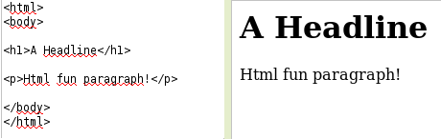
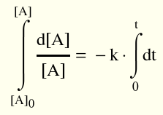
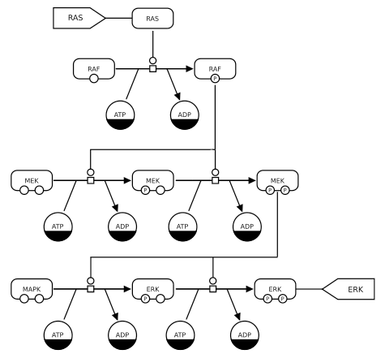
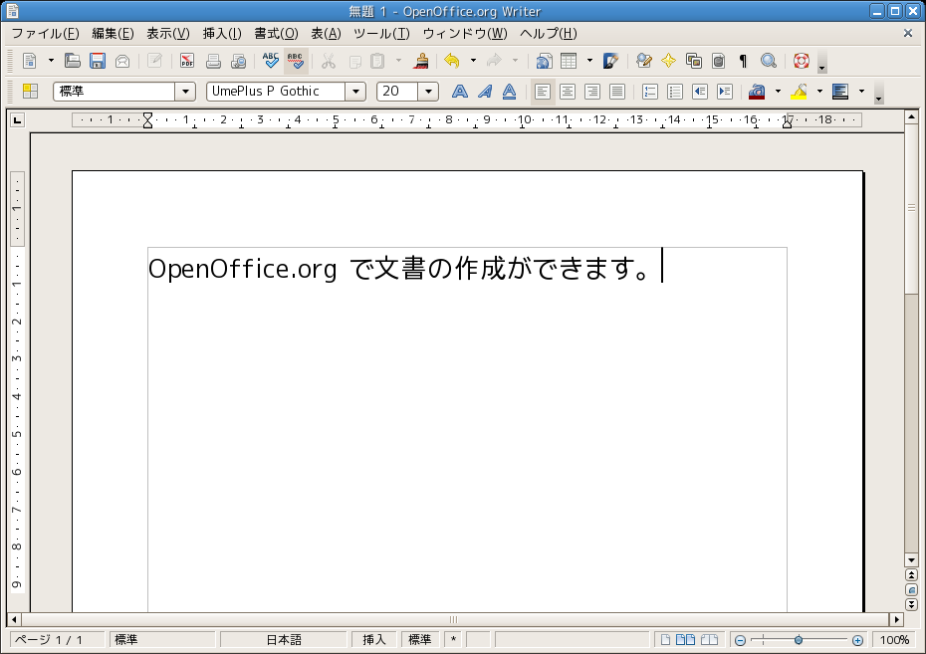
There are many XML- based formats
XHTML
MathML
SVG
Openoffice / MS Office (ODS/XML)

Slide 11
There are several biochemical XML-based formats
SBML
  Dynamic is described by reaction kinetics
CellML
  Similar to SBML, but its framework is more generic
BioPax
  Exchange of biological pathway data
PSI-MI
  Focuses on molecular interactions

Slide 12
Overview:
1. XML
2. SBML
3. Antimony

Slide 13
SBML
The Systems Biology Markup Language (SBML)
is an XML-based format for
expressing biochemical reaction networks.

Slide 14

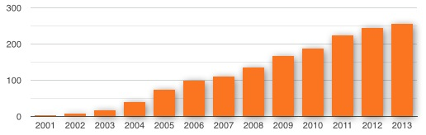

SBML software and models
> 250 software tools support SBML:
Raise of the amount of
SBML tools over the
last decade
> 1000 available SBML models

Slide 15
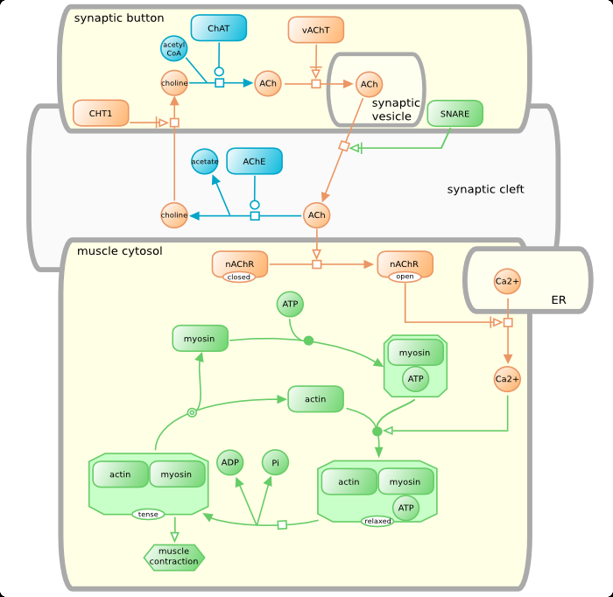
Data in Systems Biology

Slide 16
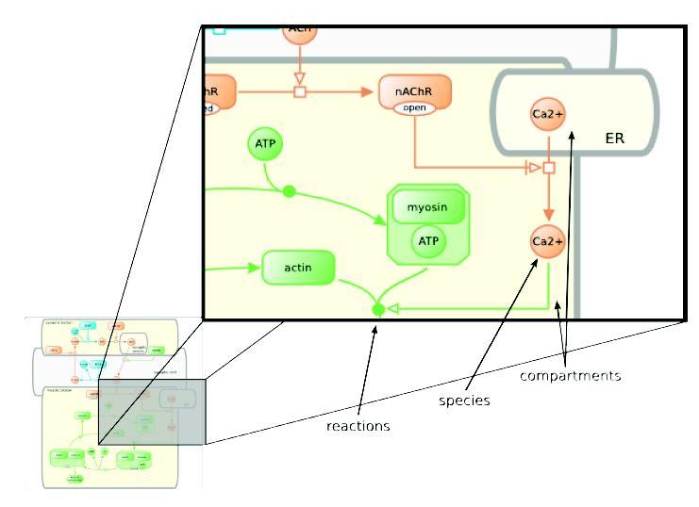
Data in Systems Biology

Slide 17
SBML structure
Document
(root element)
Model
Compartment
Species
Reaction

Slide 18
SBML structure specials
- biological elements are modelled as XML Elements:
<species id="ATP" initialConcentration="3" />
- nested structure: A Reaction holds a Kinetic Law, which
holds the kinetic Parameters
- references within the structure: Species participating in
Reactions are adressed via SpeciesReferences

Slide 19
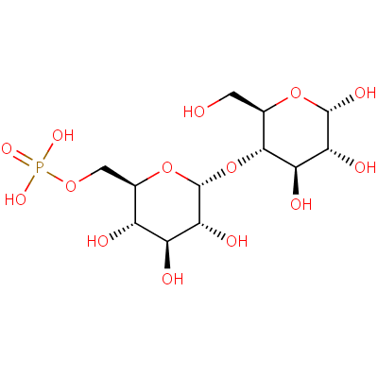
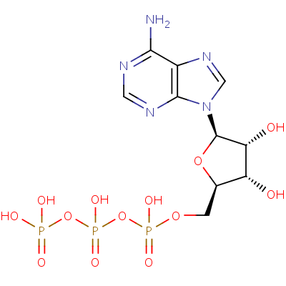
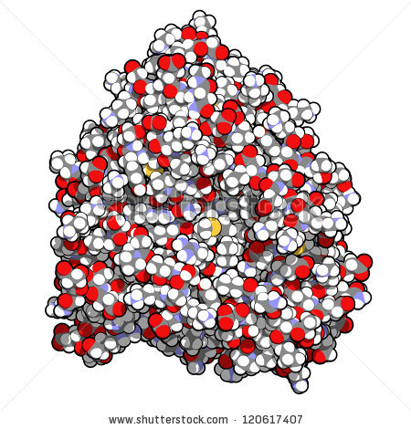
SBML elements
Species
A pool of (biochemical) entities that participate in reactions, for instance ATP or Glucose 6-phospate.
<listOfSpecies>
<species compartment="cytosol" id="ES" initialAmount="0" name="ES"/>
<species compartment="cytosol" id="P" initialAmount="0" name="P"/>
<species compartment="cytosol" id="S" initialAmount="1e-20" name="S"/>
<species compartment="cytosol" id="E" initialAmount="5e-21" name="E"/>
</listOfSpecies>

Slide 20
SBML elements
Reaction
A reaction can describe a transformation, a transport, or a binding process of one or more species.
<listOfReactions>
<reaction id="veq">
<listOfReactants>
<speciesReference species="E"/>
<speciesReference species="S"/>
</listOfReactants>
<listOfProducts>
<speciesReference species="ES"/>
</listOfProducts>
</reaction>
</listOfReactions>
E+S↔ES
Reactions can contain a mathematical function that describes the kinetics of the reaction.

Slide 21
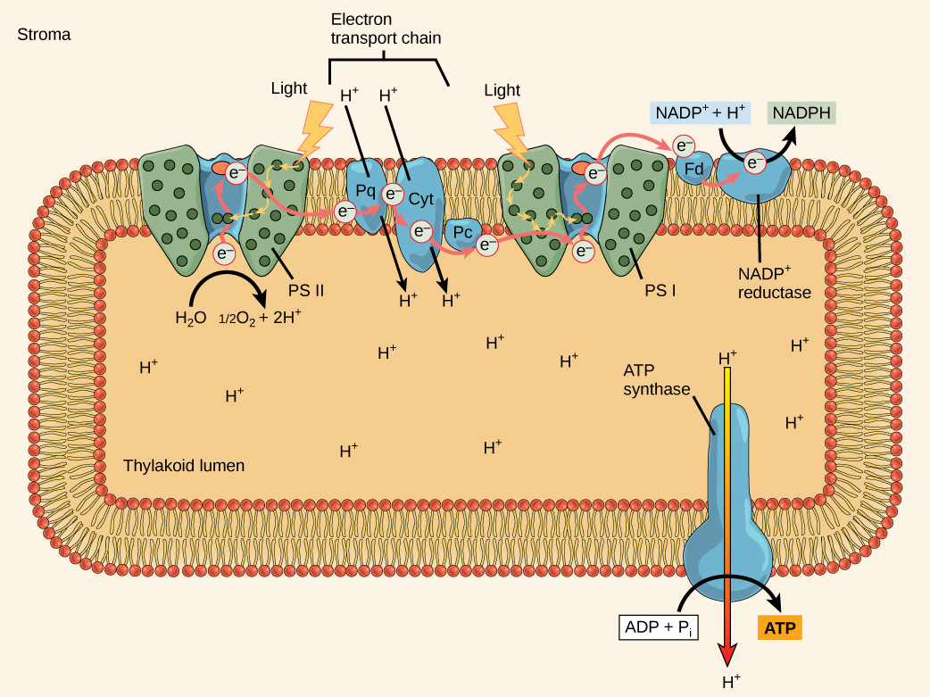
SBML elements
Compartment
A container that has a defined size (volume or area in case of membranes), for instance the cytosol or cell membrane.
Each species in a model must be located in one compartment.
<listOfCompartments>
<compartment id="cytosol" size="1e-14"/>
</listOfCompartments>
Source: philschatz.com

Slide 22
SBML elements
Unit Definition
A unit of measurement that can either overwrite the default unit or it is used in an expression of quantities in a model.
<listOfUnitDefinitions>
<unitDefinition id="per_second">
<listOfUnits>
<unit kind="second" exponent="-1"/>
</listOfUnits>
</unitDefinition>
</listOfUnitDefinitions>

Slide 23
SBML elements
Parameter
Generic constants and variables, e.g. the temperature.
<listOfParameters>
<parameter id="kon" value="1000000" units="mol_per_second"/>
<parameter id="koff" value="0.2" units="per_second"/>
</listOfParameters>
Global Parameter
      accessible in the whole model
Local Parameter
      valid only in one reaction

Slide 24
SBML elements
Event
Events are triggered when a certain condition is satisfied (e.g. a species concentration reaches a predefined threshold).
<listOfEvents>
<event id="reset" name="Reset event">
<trigger>
<math xmlns="http://www.w3.org/1998/Math/MathML">
<apply>
<geq/>
<csymbol encoding="text"
definitionURL=”http://www.sbml.org/symbols/time” />
<cn type="integer"> 25 </cn>
</apply>
</math>
</trigger>
</event>
</listOfEvents>

Slide 25
SBML elements – Overview
Root elements (children of model):
Function Definitions
Unit Definitions
Compartments
Species
Parameters
Initial Assignments
Rules
Constraints
Reactions
Events

Slide 26
SBML example
<?xml version="1.0" encoding="UTF-8"?>
<sbml xmlns="http://www.sbml.org/sbml/level2/version1" version="1" level="2" >
<model id="model" >
<listOfCompartments >
<compartment size="1" id="GO 0005623" name="cell" >
</listOfCompartments >
<listOfSpecies >
<species initialConcentration="1" compartment="GO 0005623" id="ATP" name="ATP" >
<species initialConcentration="1" compartment="GO 0005623" id="NADH" name="NADH" >
<species initialConcentration="2" compartment="GO 0005623" id="ADP" name="ADP" >
<species initialConcentration="2" compartment="GO 0005623" id="NADPH" name="NADPH" >
<species initialConcentration="1" compartment="GO 0005623" id="enzyme" name="2.7.1.86" >
</listOfSpecies >
<listOfReactions >
<reaction id="R00105" name="ATP NADH 2 phosphotransferase" >
<listOfReactants >
<speciesReference species="ATP" >
<speciesReference species="NADH" >
</listOfReactants >
<listOfProducts >
<speciesReference species="ADP" >
<speciesReference species="NADPH" >
</listOfProducts >
<listOfModiers >
<modierSpeciesReference species="enzyme" >
</listOfModiers >
</reaction >
</listOfReactions >
</model >
</sbml>
ATP + NADH ↔ ADP + NADPH

Slide 27
SBML example
<?xml version="1.0" encoding="UTF-8"?>
<sbml xmlns="http://www.sbml.org/sbml/level2/version1" version="1" level="2" >
<model id="model" >
<listOfCompartments >
<compartment size="1" id="GO 0005623" name="cell" >
</listOfCompartments >
<listOfSpecies >
<species initialConcentration="1" compartment="GO 0005623" id="ATP" name="ATP" >
<species initialConcentration="1" compartment="GO 0005623" id="NADH" name="NADH" >
<species initialConcentration="2" compartment="GO 0005623" id="ADP" name="ADP" >
<species initialConcentration="2" compartment="GO 0005623" id="NADPH" name="NADPH" >
<species initialConcentration="1" compartment="GO 0005623" id="enzyme" name="2.7.1.86" >
</listOfSpecies >
<listOfReactions >
<reaction id="R00105" name="ATP NADH 2 phosphotransferase" >
<listOfReactants >
<speciesReference species="ATP" >
<speciesReference species="NADH" >
</listOfReactants >
<listOfProducts >
<speciesReference species="ADP" >
<speciesReference species="NADPH" >
</listOfProducts >
<listOfModiers >
<modierSpeciesReference species="enzyme" >
</listOfModiers >
</reaction >
</listOfReactions >
</model >
</sbml>
ATP + NADH ↔ ADP + NADPH

Slide 28
SBML example
<?xml version="1.0" encoding="UTF-8"?>
<sbml xmlns="http://www.sbml.org/sbml/level2/version1" version="1" level="2" >
<model id="model" >
<listOfCompartments >
<compartment size="1" id="GO 0005623" name="cell" >
</listOfCompartments >
<listOfSpecies >
<species initialConcentration="1" compartment="GO 0005623" id="ATP" name="ATP" >
<species initialConcentration="1" compartment="GO 0005623" id="NADH" name="NADH" >
<species initialConcentration="2" compartment="GO 0005623" id="ADP" name="ADP" >
<species initialConcentration="2" compartment="GO 0005623" id="NADPH" name="NADPH" >
<species initialConcentration="1" compartment="GO 0005623" id="enzyme" name="2.7.1.86" >
</listOfSpecies >
<listOfReactions >
<reaction id="R00105" name="ATP NADH 2 phosphotransferase" >
<listOfReactants >
<speciesReference species="ATP" >
<speciesReference species="NADH" >
</listOfReactants >
<listOfProducts >
<speciesReference species="ADP" >
<speciesReference species="NADPH" >
</listOfProducts >
<listOfModiers >
<modierSpeciesReference species="enzyme" >
</listOfModiers >
</reaction >
</listOfReactions >
</model >
</sbml>
ATP + NADH ↔ ADP + NADPH

Slide 29
SBML example
<?xml version="1.0" encoding="UTF-8"?>
<sbml xmlns="http://www.sbml.org/sbml/level2/version1" version="1" level="2" >
<model id="model" >
<listOfCompartments >
<compartment size="1" id="GO 0005623" name="cell" >
</listOfCompartments >
<listOfSpecies >
<species initialConcentration="1" compartment="GO 0005623" id="ATP" name="ATP" >
<species initialConcentration="1" compartment="GO 0005623" id="NADH" name="NADH" >
<species initialConcentration="2" compartment="GO 0005623" id="ADP" name="ADP" >
<species initialConcentration="2" compartment="GO 0005623" id="NADPH" name="NADPH" >
<species initialConcentration="1" compartment="GO 0005623" id="enzyme" name="2.7.1.86" >
</listOfSpecies >
<listOfReactions >
<reaction id="R00105" name="ATP NADH 2 phosphotransferase" >
<listOfReactants >
<speciesReference species="ATP" >
<speciesReference species="NADH" >
</listOfReactants >
<listOfProducts >
<speciesReference species="ADP" >
<speciesReference species="NADPH" >
</listOfProducts >
<listOfModiers >
<modierSpeciesReference species="enzyme" >
</listOfModiers >
</reaction >
</listOfReactions >
</model >
</sbml>
ATP + NADH ↔ ADP + NADPH

Slide 30
Overview:
1. XML
2. SBML
3. Antimony

Slide 31
Antimony
Human readable and human writable model definition language
Allows conversion to and from SBML
Antimony
SBML
A -> B;
<?xml version="1.0" encoding="UTF-8"?>
...
<listOfCompartments>
<compartment id="default_compartment" spatialDimensions="3" size="1" constant="true"/>
</listOfCompartments>
<listOfSpecies>
<species id="A" compartment="default_compartment"/>
<species id="B" compartment="default_compartment"/>
</listOfSpecies>
<listOfReactions>
<reaction id="_J0”>
<listOfReactants>
<speciesReference species="A" stoichiometry="1" constant="true"/>
</listOfReactants>
<listOfProducts>
<speciesReference species="B" stoichiometry="1" constant="true"/>
</listOfProducts>
...

Slide 32
Antimony
Compartments
  compartment c1;
Species
  species ATP in c1;
  ATP = 10;
Reaction
  Glucose + ATP → Glucose-6P; k1*Glucose*ATP
Events
  E1: at (time>50): ATP=0

