Slide 1


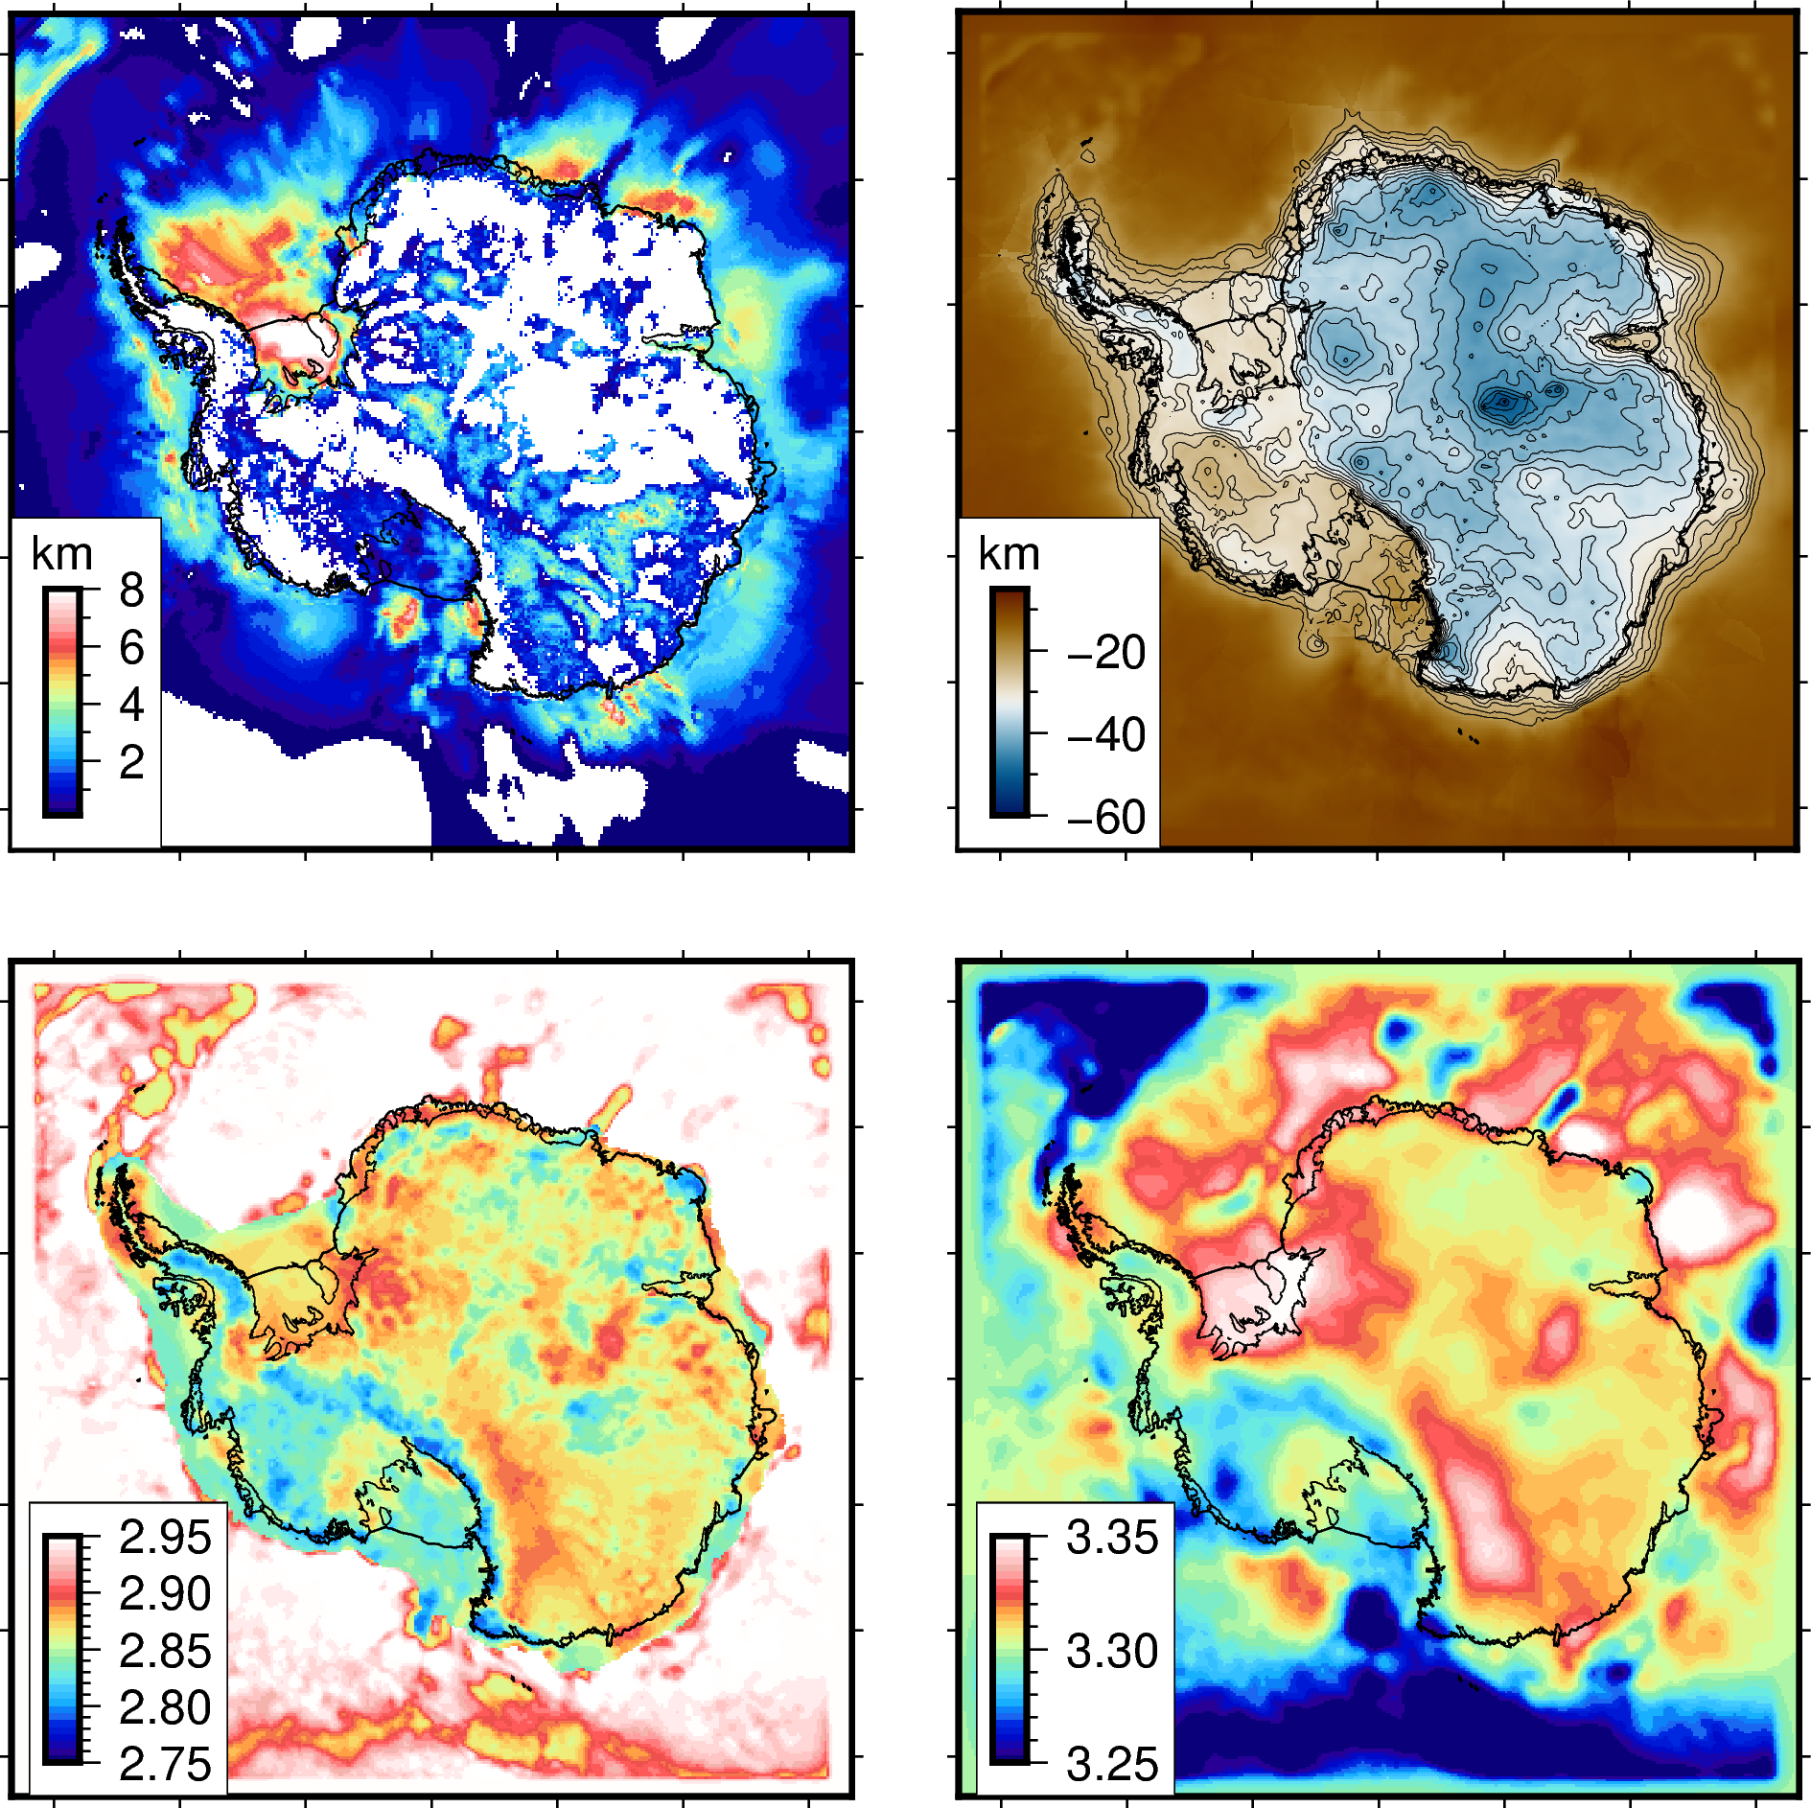
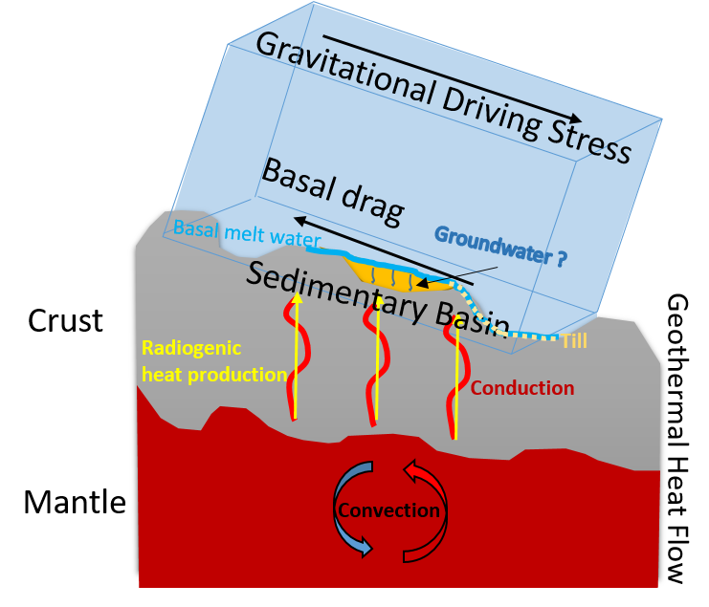
Antarctic crust heterogeneity and its influence on solid earth-cryosphere interactions
Lu Li* and Alan Aitken
School of Earth Sciences, The University of Western Australia
Get poster in here!
lu.li@research.uwa.edu.au
Sedimentary basin thickness
Moho
Crust
density
Mantle
density
1. Use Gravity inversion to resolve the most representative models of Antarctic crustal structure
2. Understand basal conditions and processes for ice-sheet flow

