Slide 1
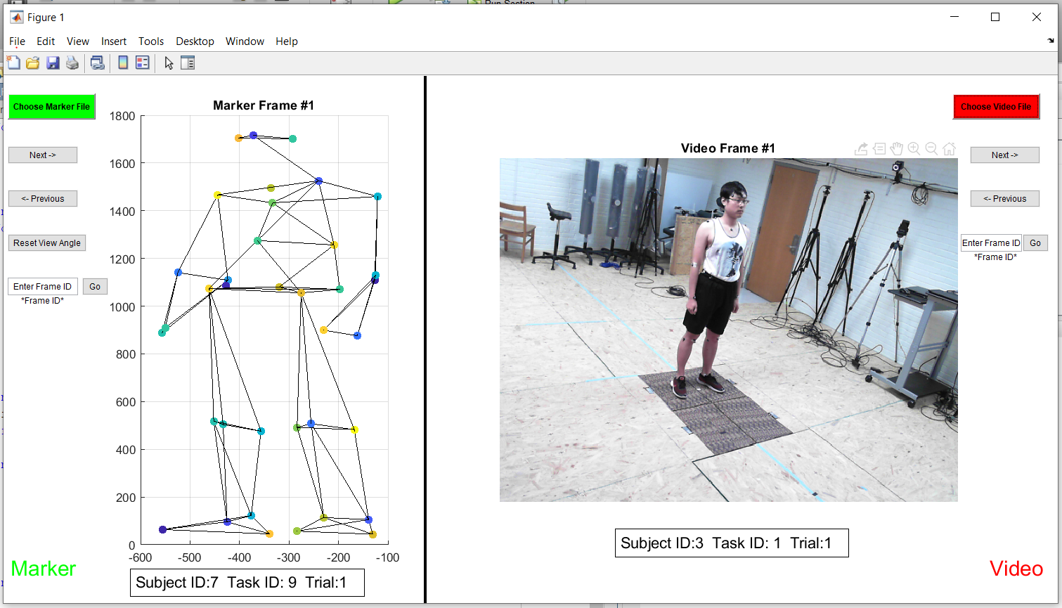
Load data
The frame ID in the loaded trial
Go to next frame
Go to previous frame
Click to restore view angle
Go to entered frame
Complete trial informatoin

Slide 2
