Slide 2
Paper Outline
Section 1 three parts
Mathematics of PINQ
Implementation of PINQ
Applications of PINQ
Section 2 review the definition of differential privacy, and presenting supporting mathematics that are necessary for end-to-end analysis of our computations.
Section 3 detail PINQ’s design and implementation, as well as some advanced features and security challenges.
Section 4 develop a sequence of applications written against PINQ to demonstrate its ease of use and generality, culminating in(以…收场) a visualization tool for web search queries.
Section 5 conclude with closing comments and directions for further research.

Slide 3
Data aggregation
Data aggregation is the compiling of information from databases with intent to prepare combined datasets for data processing.数据聚合是对数据库中的信息进行编制，其目的是为数据处理过程准备合并的数据集合。
The source information for data aggregation may originate from public records and criminal databases. The information is packaged into aggregate reports and then sold to businesses, as well as to local, state, and government agencies. This information can also be useful for marketing purposes.
Various reports of information are provided by database aggregators. Individuals may request their own consumer reports [which contain basic biographical information such as name, date of birth, current address, and phone number]. Employee background check reports, [which contain highly detailed information such as past addresses and length of residence, professional licenses, and criminal history], may be requested by eligible and qualified third parties. Not only can this data be used in employee background checks, but it may also be used to make decisions about insurance coverage, pricing, and law enforcement. Privacy activists argue that database aggregators can provide erroneous information.

Slide 4
ABSTRACT & Keywords
We report on the design and implementation of the Privacy Integrated Queries (PINQ) platform for privacy-preserving data analysis.
PINQ provides analysts with a programming interface to unscrubbed (未清洗的) data through a SQL-like language.
At the same time, the design of PINQ’s analysis language and its careful implementation provide formal guarantees of differential privacy for any and all uses of the platform.
PINQ’s unconditional structural guarantees require no trust placed in the expertise or diligence of the analysts, substantially broadening the scope for design and deployment of privacy-preserving data analysis, especially by non-experts.
PINQ的无条件结构化保证无需建立在分析人员的专业知识和努力的信赖基础上，它可以大幅度地为设计和部署，尤其是由非专业人士进行的受隐私保护的数据分析拓宽范围。
Anonymization(匿名化), confidentiality(机密性), differential privacy, LINQ

Slide 5
1. INTRODUCTION
This work presents a platform for interactive(交互式) data analysis against(针对) live data which enforces(执行) one of the strongest known unconditional privacy guarantees: differential privacy.
Differential privacy requires that computations be formally indistinguishable when run with and without any one record, almost as if each participant had opted out of(决定从…退出) the data set.
The platform comprises(包含) a declarative programming language(声明式编程语言) in which all written statements provide differential privacy, and an execution environment(执行环境) carefully implemented to respect the formal requirements of differential privacy.

Slide 6
The important feature of this approach is that the privacy guarantees are provided by the platform itself; they(privacy guarantees) require no privacy sophistication on the part of(就…而言) the platform’s users.
平台本身保证隐私，用户方面不要求多么严谨精密。
This is unlike many prior instances of privacy research that rely heavily on expert(专家的，需专门知识或技术的) design and analysis to create analyses, and expert evaluation to properly vet(审查) proposed approaches. In such a mode, non-expert analysts are unable to express themselves clearly or convincingly(有说服力的), and non-expert providers are unable to verify or interpret(验证或解释) their privacy guarantees.
Here the platform itself serves as a common basis for trust, even for analysts and providers with no previous experience with privacy, or even with each other.

Slide 7
Advantage
Our advantage over prior platforms is differential privacy;
its robust guarantees are compatible with many declarative operations and permit end-to-end analysis of such programs.既能兼容许多声明性操作，也允许这些程序的端到端分析。
Its guarantees hold in the presence of arbitrary prior knowledge and for arbitrary subsequent behavior, simplifying the attack model and allowing realistic, incremental deployment.
Its formal nature also enables(实现) unexpected new functionality, including the use of groupby and join on sensitive attributes, the analysis of text and unstructured binary data, modular(模块化) algorithm design (i.e. without whole-program knowledge), and analyses integrating(集成的) multiple independent data sources.
Perhaps most importantly, differential privacy requires no assumptions about the semantics(语义) of the underlying records(底层记录); analysts will be able to write analyses directly against even the most sensitive and subtle(敏感的) of data sets, in their raw form, without concern of disclosure.

Slide 8
Disadvantage
The main restriction of our approach is that analysts can only operate on the data from a distance(远程操作): the operations are restricted to declarative transformations and aggregations; no source or derived(派生) data are ever returned to the analysts.
This restriction is not entirely unfamiliar to many analysts, who are unable to personally inspect large volumes of data. Instead, they write computer programs to distill(提取) the data to manageable aggregates, on which they base further analyses.
While the proposed platform introduces a stricter boundary between analyst and data, it is not an entirely new one.

Slide 9
1.1 An Overview of PINQ
1.1.1 Mathematics of PINQ
1.1.2 Implementation of PINQ
1.1.3 Applications of PINQ
1.2 Related Work
1.3 Contributions

Slide 10
1.1 An Overview of PINQ
We have implemented a prototype(原型) of our proposed architecture (架构) in a platform we call Privacy Integrated Queries.
The implementation is based around C#’s LINQ language, a well-integrated declarative language extension to .NET.
Data providers can use PINQ to wrap arbitrary LINQ data sources with a specified privacy allotment for each analyst.
Analysts write arbitrary C# programs using PINQ data sources as if they were using unprotected LINQ data sources.
PINQ’s restricted language and run-time checks ensure that the provider’s differential privacy requirements are respected, no matter how an analyst uses these protected data sets.
Notes:
wrap a with b 用b把a包起来

Slide 11
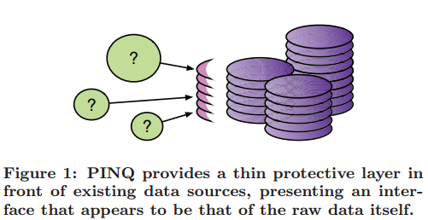
Notes:
raw data 原始[未处理]数据

Slide 12
PINQ is designed as a thin layer in front of an existing analysis engine; it(PINQ) does not manage data or execute queries. Instead, it supplies differentially private implementations of common transformations and aggregations written in LINQ, executed by the LINQ providers of the underlying data sets.
This approach substantially simplifies our implementation(实现), but also allows a large degree of flexibility in its deployment(部署): a data source only needs a LINQ interface to support PINQ.

Slide 13
1.1.1 Mathematics of PINQ
Differential privacy requires (that) an outcome of a computation be almost as likely with and without any one input record; we defer the quantitative form(定量形式) of the definition for now.
Computations with this guarantee behave, from the point of view of each participant, as if their data were never used.
It is a very strong requirement, in part because it makes no assumptions about prior knowledge or the data’s semantics.
It is also realizable(可实现的); the simplest example is noisy counting: releasing of the number of records in a data set perturbed by symmetric exponential (Laplace) noise. Many other simple aggregations have similarly accurate randomized analogs.
Notes:
as if 连词，与their data were never used一起做behave的表语

Slide 14
We can significantly extend the set of differentially-private computations by introducing(引入) transformations of data sets.
We provide an analysis of the “stability” of many relational transformations, showing that small changes to their inputs always result in relatively(相应的) small changes to their outputs.
A differentially-private analysis applied to transformed data masks small changes in the transformation’s output, and so mask small changes in its inputs as well.
The composed transformation and analysis will provide differential privacy. Such transformations can be composed arbitrarily, propagating (扩大) differential privacy guarantees to their source data.

Slide 15
Finally, a sequence of differentially-private computations also provides differential privacy; the privacy depletions(隐私损耗) are at worst additive, and consequently can be tracked on-line.
Analysts may pose query after query, folding their outcomes into subsequent(随后的) queries, without compromising(使…受损) our ability to describe and constrain end-to-end privacy properties(端到端隐私属性？？？).

Slide 16
1.1.2 Implementation of PINQ
We have implemented PINQ as a capability-based system. PINQ allows data providers to wrap LINQ data sources in protected objects with an encoded differential privacy limit, where the objects are implemented to assess the differential privacy properties of queries(评估查询的差分隐私性能) and respect the imposed limit(遵从采取的限制条件).
This assessment is triggered by any aggregation, is traced through the transformations used in the query, and compared to the current limits of the participating data sources. 这种评估由任一聚合过程触发，通过查询中的变换进行跟踪，并与参与数据源的当前限制进行了比较。
If the assessment passes, the effective limits are decremented(递减), and the query executed against the source LINQ provider, returning via PINQ’s differentially-private implementations. 若评估通过，有效限制会逐渐递减，并且由源LINQ提供者执行的查询会经由PINQ的差分隐私实现返回。

Slide 17
We stress that PINQ represents a very modest code base(代码库); in its current implementation it is only 613 lines of C# code.
The assessment logic, following the math, is uncomplicated.
The aggregations must be carefully implemented to provide differential privacy, but these are most often only a matter of post-processing the correct aggregate (e.g. adding noise).
PINQ must also ensure that the submitted queries conform(符合) to our mathematical model for them.
LINQ achieves substantial power by allowing general C# computations in predicates(断言) of Where, functions of Select, and other operations.
PINQ restricts(制约) and shepherds(引导) these computations to mitigate the potential for exploitation of side channels(减缓两侧通道的开发可能？).

Slide 18
1.1.3 Applications of PINQ
Programming with PINQ is done through the declarative LINQ language, in an otherwise unconstrained C# program.
The analyst is not given direct access to the underlying data; instead, information is extracted(获得) via PINQ’s aggregations.
In exchange for this indirection(间接性), the analysis is allowed to operate on unmasked, unaltered, live records.

Slide 19
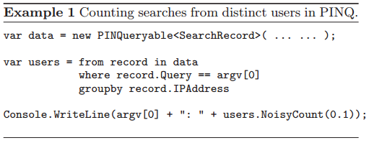
With a few important exceptions, programs written with PINQ look almost identical to their counterparts in LINQ.
The analysts assembles an arbitrary query from permitted transformations, and specifies the accuracy for aggregations.
Example 1 contains a C# PINQ fragment for counting distinct IP addresses issuing searches for an input query phrase.

Slide 20
We will develop this example into a more complex search log visualization application showcasing several of PINQ’s advantages over other approaches: rich data types, complex transformations, and integration into higher level applications, among many others. The full application is under one hundred lines of code and took less than a day to write.
We have written several other examples of data analyses in PINQ, including k-means clustering, perceptron classification, and contingency table measurement. These examples are relatively easy adaptations of existing approaches [3, 4].
We have also implemented association rule mining in PINQ, exhibiting many interesting trade-offs; different approaches to measuring the same quantity (in the absence of noise) can lead to strikingly different results, of incomparable quality.
Notes:
perceptron classification 感知分类
contingency table measurement 列联表评价

Slide 21
1.2 Related Work
There has been a volume of research on privacy-preserving data analysis, resulting in many distinct approaches and almost as many distinct definitions of privacy. Although we can reproduce many – but not all – of these results in PINQ, its contribution is not in the existence of such reproductions, but rather it is in the manner in which they are reproduced. Each instance of prior work required substantial effort by expert researchers in design, analysis, and implementation. Those written in PINQ do not.

Slide 22
Several platforms for interactive data access(交互数据访问) have been proposed, ranging from simple remote access(远程访问), to query auditing schemes(查询审计计划)^{[5]}, to the closely related Secure Queries ^{[6].}
Our main departure from these prior works lies in our aim of providing formal end-to-end differential privacy guarantees under arbitrary use; we are unaware of any existing analysis platform providing such guarantees. 提供形式化的端到端差异隐私保证

Slide 23
Publication is one alternative to interactive data access, in which data sets are scrubbed(擦洗), perturbed(扰动), aggregated(聚集), suppressed(隐瞒), and otherwise altered(修改) to mask specific information.
Unfortunately, sanitization(卫生处理) is neither easy to do, nor even to define; research in the area has yet to stabilize on robust definitions that come without known vulnerabilities(脆弱点) [7, 8, 9].
Furthermore, these approaches intentionally(有意地) contort(扭曲) the data before release, requiring the analyst to understand this (often intentionally secret) process before they can make valid statistical inferences.
In contrast, analyses in PINQ are run against raw source data, producing results that are exactly correct up to a well defined (and small) additive error.

Slide 24
The cryptography community uses the phrase “privacy preserving data mining”, see [10], but for cryptographically secure function evaluation, which(privacy preserving data mining) reveals the result of the computation but no further information about the inputs other than what the result may imply.“隐私保护数据挖掘”揭示了计算结果，却除了结果所能反映出的没有更多的输入信息。
This definition sidesteps the important issue of what results are safe to release.
Even simple counts accurately reported disclose information given prior knowledge or repeated use. Our concern in this paper is not only that a security breach might occur but that sensitive information may be directly disclosed even by faithful and secure execution of the computation.

Slide 25
Information Flow Control^{[11]} tracks the flow of sensitive information through general computation.
Such analysis has a binary description of dependence; either a computation depends on an input or it does not.
Statistical analyses and aggregations are typically handled by a trusted de-classifier, using many inputs and yet treated as if it depends on none.
Differential privacy appears to generalize(推广) Information Flow Control’s notion of dependence to a more fine-grained(精细的) and partial(部分的) notion of dependence.
PINQ provides a formal tool for declassification in such a context.

Slide 26
PINQ leans heavily on prior work on differential privacy. Many works have developed differentially-private computations, and informed the design and implementation of PINQ.
Their main practical shortcoming lay in their requirement(必要条件) (like other work) that analysts and providers themselves establish that an implementation provides differential privacy. Furthermore, they do not provide any of the necessary tools for analysts to produce new differentially-private algorithms.
Going forward, we would like to base our privacy guarantees on trusted components rather than reproving results from first principles, and thereby avoid the possibility of getting the algorithms, proofs, or implementations incorrect.

Slide 27
1.3 Contributions
PINQ’s main contribution is to supply the functionality of differential privacy to its users, both analysts and providers, through tools that do not require privacy expertise to use.
PINQ factors(将…分解成因子) often-complex privacy reasoning(推理，论证) into a small, transparent, and trustworthy substrate(底层物质); it(PINQ) removes the responsibility for such reasoning from the analyst or provider, and simplifies an analysis’ path from design to deployment.

Slide 28
Assembling(装配，组合) this platform requires several important steps, from privacy theory, to language design, to implementation.
Theoretically, we reproduce several important meta-results(元结果) about properties of differential privacy and introduce the use of transformation stability reasoning(转换稳定性推论) to differential privacy.
The language design draws substantially(本质上取自) from LINQ, but requires careful adaptation to support differential privacy: methods like Join must be adapted, and new methods like Partition must be introduced for effective and efficient use.
Finally, the implementation of a platform like PINQ has subtle issues(存在细微的问题) both to support flexible and efficient deployment and to constrain exploits that indirectly leak information. 支持灵活有效的部署和限制导致信息间接泄露的运用。

Slide 29
Applications written using PINQ can safely perform many computations that reasonable privacy experts have previously consider dangerous:
grouping by sensitive identifiers,
joining protected tables,
operating on binary data or text,
integrating multiple data sets,
execution without whole program knowledge,
among several others.
These important features have long been anathema(n.令人讨厌的事物) to privacy technology, but are now available with formal privacy guarantees.

Slide 30
This surprising flexibility(即上文safely perform many computations) comes from differential privacy.
By moving away from ad hoc(临时的) and intuitional(直观的) approaches to privacy we not only provide formal end-to-end guarantees, but a formal basis for expanding the space of computations.
While the point of PINQ is not specifically to promote differential privacy, it(the point of PINQ) is the only privacy definition we know that supports resilience(弹性) to prior knowledge, secure composition, and transformation logic, among several other properties.
If other privacy definitions establish the properties PINQ requires, its core ideas should lead to trusted platforms supporting their privacy guarantees as well.

Slide 31
As well as a useful platform in itself, we hope that PINQ’s existence leads to a different approach to privacy research.
Rather than conduct and publish research using ad hoc definitions, inaccessible proofs, and casual implementation, a large volume of research could derive privacy properties through common primitives with public implementations.
Although much research may not be expressible with PINQ, and although PINQ is unlikely to be the final word in trustworthy privacy platforms, it demonstrates the feasibility of such a principled approach to privacy research.

Slide 32
2. MATHEMATICAL FOUNDATIONS
2.1 Differential Privacy
2.1.1 Data Types
2.2 Aggregations: Noisy Counts
2.2.1 Other Primitive Aggregations
2.3 Stable Transformations
2.3.1 Stable Transformations
2.4 Composition
2.4.1 Sequential Composition
2.4.2 Parallel Composition
2.5 A Privacy Calculus

Slide 33
We now develop some supporting mathematics for PINQ.
the privacy definition we use, differential privacy,
several properties necessary to expose a programmatic interface to data.
the data types we can support,
common differentially-private aggregations,
how several transformations of the data sets impact privacy,
how privacy guarantees of multiple analyses compose.
All of our conclusions are immediate consequences of differential privacy, rather than additional assumptions or implementation details.

Slide 34
2.1 Differential Privacy
Differential privacy is a relatively new privacy definition.
Differential privacy does not attempt to guarantee the prevention of data disclosures, privacy violations, or other bad events; instead, it guarantees that participation in the data set is not their(bad events) cause.
The definition of differential privacy requires that a randomized computation yield nearly identical(相同的) distributions over outcomes when executed on nearly identical input data sets.
Treating the input data sets as multisets of records over an arbitrary domain and using ⊕ for symmetric difference(对称差):

Slide 35
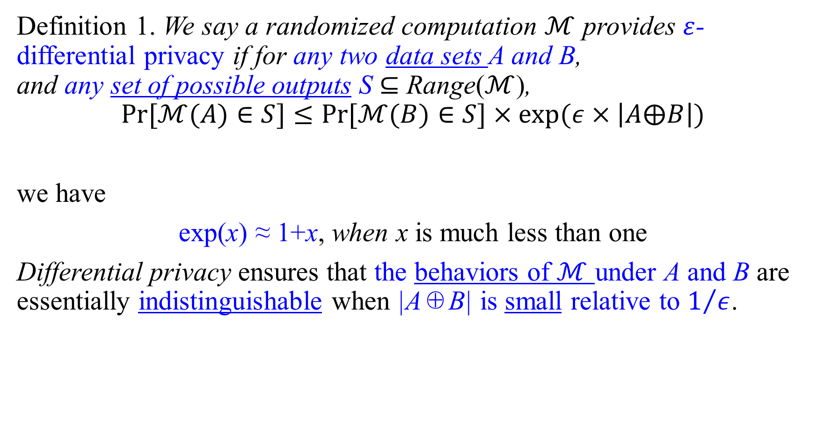
Definition 1. We say a randomized computation $ℳ$ provides $ε$-differential privacy if for any two data sets A and B, and any set of possible outputs S ⊆ Range($ℳ$), $$Pr[ℳ(A)∈S]≤Pr[ℳ(B)∈S]×exp⁡(ε×\left|A⨁B\right|)$$
we have
exp(x) ≈ 1+x, when x is much less than one
Differential privacy ensures that the behaviors of $ℳ$ under A and B are essentially indistinguishable when |A⊕B| is small relative to $1/ε$.
Notes:
relative to 和…比较起来，相对于

Slide 36
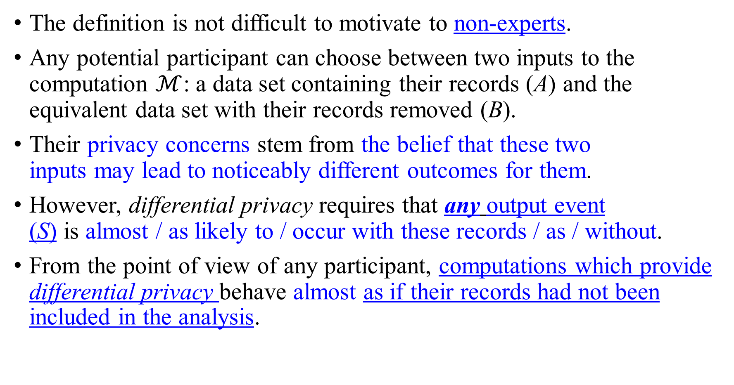
The definition is not difficult to motivate to non-experts.
Any potential participant can choose between two inputs to the computation $ℳ$: a data set containing their records (A) and the equivalent data set with their records removed (B).
Their privacy concerns stem from the belief that these two inputs may lead to noticeably different outcomes for them.
However, differential privacy requires that any output event (S) is almost / as likely to / occur with these records / as / without.
From the point of view of any participant, computations which provide differential privacy behave almost as if their records had not been included in the analysis.
Notes:
stem from 来自， 起源于， 由…造成; 出于;

Slide 37
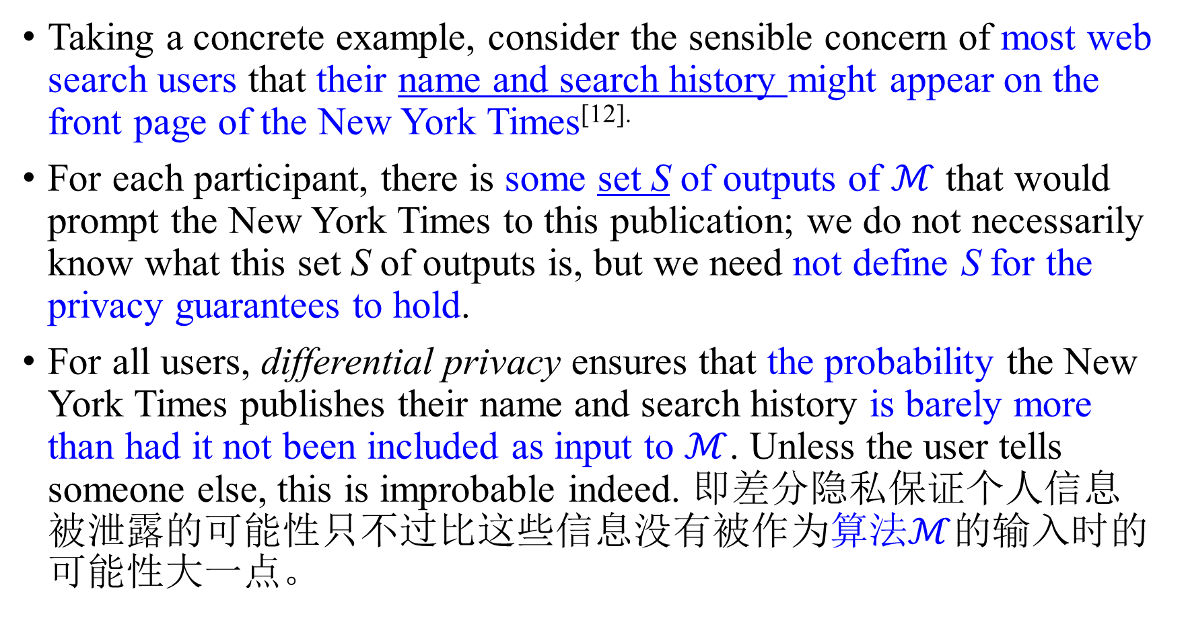
Taking a concrete example, consider the sensible concern of most web search users that their name and search history might appear on the front page of the New York Times^{[12].}
For each participant, there is some set S of outputs of $ℳ$ that would prompt the New York Times to this publication; we do not necessarily know what this set S of outputs is, but we need not define S for the privacy guarantees to hold.
For all users, differential privacy ensures that the probability the New York Times publishes their name and search history is barely more than had it not been included as input to $ℳ$. Unless the user tells someone else, this is improbable indeed. 即差分隐私保证个人信息被泄露的可能性只不过比这些信息没有被作为$算法ℳ$的输入时的可能性大一点。

Slide 38
One important distinction between differential privacy and most other definitions is that it only bounds the change in probability of an event S; it does not discuss the probability of the event itself. The event may be possible or even likely.
Nonetheless, it is inappropriate to charge the mechanism with mishandling a participant’s data if the disclosure would have been as likely to occur even without these records.

Slide 39
2.1.1 Data Types
Differential privacy relies only on the assumption that the data sets are comprised of records, and is most meaningful when there are few records for each participant.
It(Differential privacy) requires no assumptions about the types of the underlying records.
Its(Differential privacy’s) privacy guarantees are not a consequence of classifying(划分) attributes as sensitive or non, nor perturbing the source data, nor suppressing(抑制) values that are scarce or sensitive.

Slide 40
Independence of data type is a very liberating property. We needn’t worry about customizing(定制) privacy guarantees for different domains, misclassifying(误判) attributes as insensitive, or overlooking (忽视) sensitive combinations of insensitive attributes.
We can provide meaningful guarantees for unstructured data, like free text and binary data that have previously vexed(争论不休的，（指问题等）棘手的) sensitivity classification. We can even support mutable records, replacing each record with a timeline of its(mutable records’) contents.
Furthermore, by ignoring entirely the records’ semantics we can provide guarantees for arbitrary functions of them(records). This property is fundamental to allowing analysts to write their own ad-hoc analyses, rather than choose from a set of pre-screened(预筛选过的) computations over declassified attributes.

Slide 41
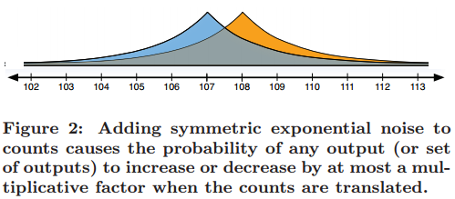
2.2 Aggregations: Noisy Counts
The simplest differentially-private aggregation (from [1])
releases the number of records in a data set,
is perturbed by symmetric exponential (Laplace) noise,
density function p(x) ∝ exp(-|x|), as in Figure 2.

Slide 42
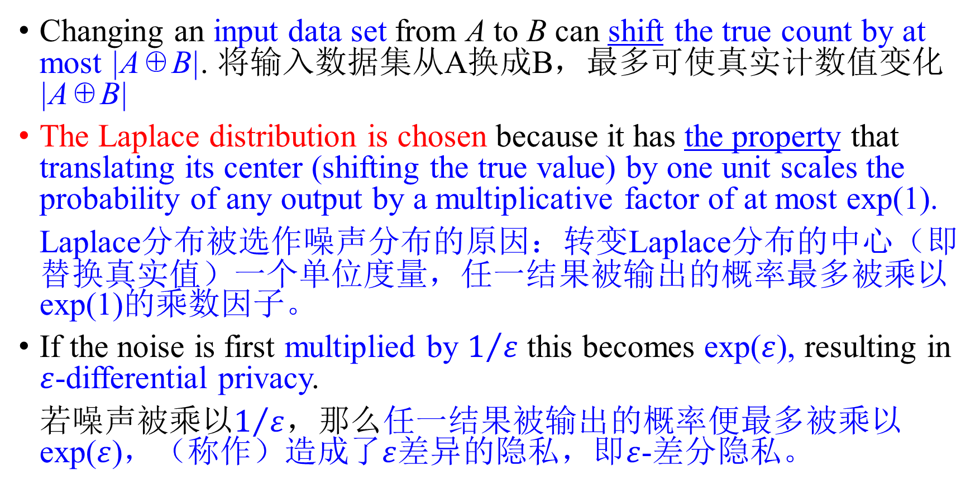
Changing an input data set from A to B can shift the true count by at most |A⊕B|. 将输入数据集从A换成B，最多可使真实计数值变化|A⊕B|
The Laplace distribution is chosen because it has the property that translating its center (shifting the true value) by one unit scales the probability of any output by a multiplicative factor of at most exp(1).
Laplace分布被选作噪声分布的原因：转变Laplace分布的中心（即替换真实值）一个单位度量，任一结果被输出的概率最多被乘以exp(1)的乘数因子。
If the noise is first multiplied by $1/ε$ this becomes exp($ε$), resulting in $ε$-differential privacy.
若噪声被乘以$1/ε$，那么任一结果被输出的概率便最多被乘以exp($ε$)，（称作）造成了$ε$差异的隐私，即$ε$-差分隐私。

Slide 43
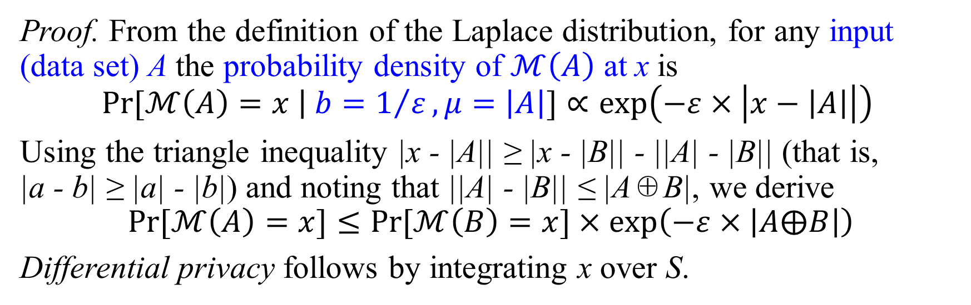
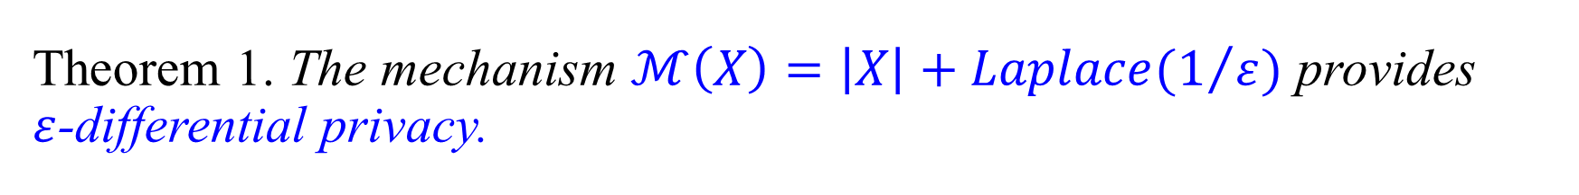
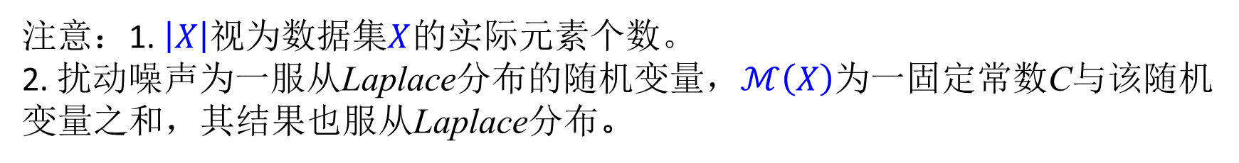
Theorem 1. The mechanism $ℳ\left(X\right)=\left|X\right|+Laplace(1/ε)$ provides $ε$-differential privacy.
Proof. From the definition of the Laplace distribution, for any input (data set) A the probability density of $ℳ\left(A\right)$ at x is
$$Pr[ℳ\left(A\right)=x \left| b=1/ε,μ=\left|A\right|\right.]∝exp\left(−ε×\left|x−\left|A\right|\right|\right)⁡$$
Using the triangle inequality |x - |A|| ≥ |x - |B|| - ||A| - |B|| (that is, |a - b| ≥ |a| - |b|) and noting that ||A| - |B|| ≤ |A⊕B|, we derive
$$Pr[ℳ\left(A\right)=x]≤Pr[ℳ\left(B\right)=x]×exp\left(−ε×\left|A⨁B\right|\right)$$ Differential privacy follows by integrating x over S.
注意：1. $\left|X\right|$视为数据集$X$的实际元素个数。
2. 扰动噪声为一服从Laplace分布的随机变量，$ℳ\left(X\right)$为一固定常数C与该随机变量之和，其结果也服从Laplace分布。

Slide 44

The Laplace distribution has exponential tails in both directions, and the probability that the error exceeds $t/ε$ in either direction is exponentially small in t. The released counts are very likely to be close to the true counts.

Slide 45
2.2.1 Other Primitive Aggregations
There are many other mechanisms that provide differential privacy; each paper on the subject typically contains several. To date(迄今为止) each has privacy established as above, by written mathematical proof based on intended behavior(计划的行为). While this is clearly an important step in developing such a computation, the guarantees are only as convincing as the proof is accessible and the implementation is correct.这些机制提供的隐私保证仅仅只能使人信服这些证明的可行性和实现的正确性。
Our goal is to enable the creation of as many differentially-private computations as possible using only a few primitive components, whose mathematical properties and implementations can be publicly scrutinized and possibly verified. 仅用少量的原始组件就可以创造尽可能多的满足差分隐私的计算，这些（差分隐私计算的）数学性质和实现可能被公开地审查和核实。
While we shouldn’t preclude(排除) the introduction(引入) of novel(异常的) primitives, they should be the exceptional, rather than default, approach to designing differentially-private algorithms.
Notes:
To date 迄今为止；到目前为止；直到现在

Slide 46
2.3 Stable Transformations
Rather that provide access to a set of fixed aggregations, with limited potential for creative use, we intend to supply analysts with a programming language they can use to describe new and unforeseen computations.
Most of the power of PINQ, and one of its main contributions, lies in arming the analyst with a rich set of transformations to apply to the data set before differentially-private aggregations.
PINQ的强大，以及它的主要贡献之一在于，在进行差分隐私的聚合之前就用一组已应用到数据集的丰富的转换来装配分析人员。
We start by identifying a general parameter of transformations that allows us to bound the privacy implications of arbitrary sequences of such transformations.首先我们确定一个转换的一般参数，该参数能使我们对该转换的任一序列的隐私结果限定边界。
Notes:
unforeseen 未预见到的，无法预料的

Slide 47
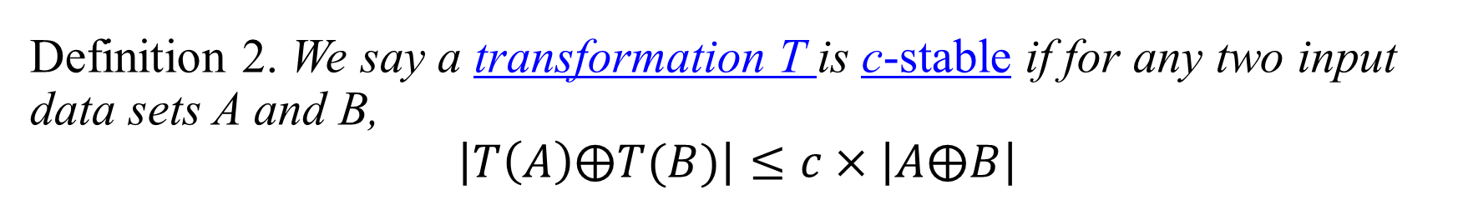
Definition 2. We say a transformation T is c-stable if for any two input data sets A and B, $$\left|T\left(A\right)⨁T(B)\right|≤c×\left|A⨁B\right|$$
Transformation stability will play a central role in PINQ. Transformations with bounded stability constants propagate(蔓延，传递) differential privacy guarantees made of their outputs back to their inputs, diminished(减少) by their stability constant.

Slide 48
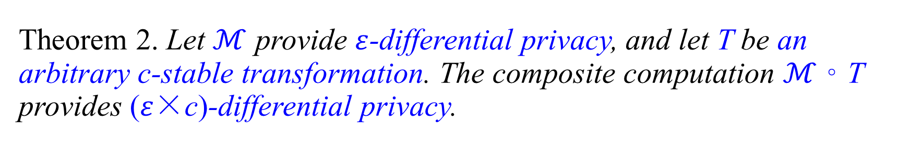
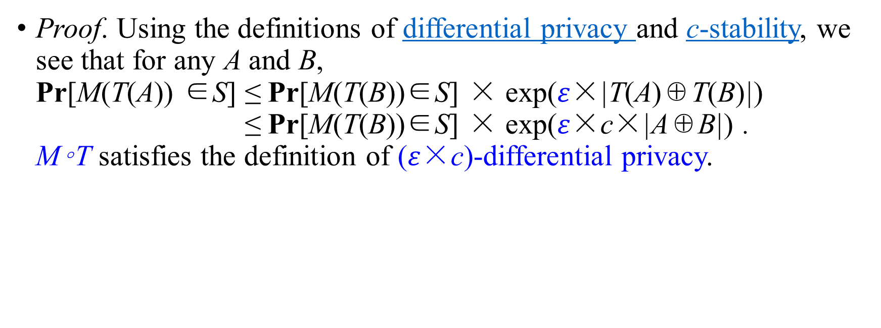
Theorem 2. Let $ℳ$ provide $ε$-differential privacy, and let T be an arbitrary c-stable transformation. The composite computation $ℳ$◦ T provides ($ε$×c)-differential privacy.
Proof. Using the definitions of differential privacy and c-stability, we see that for any A and B, Pr[M(T(A)) ∈S] ≤ Pr[M(T(B))∈S] × exp($ε$×|T(A)⊕T(B)|) ≤ Pr[M(T(B))∈S] × exp($ε$×c×|A⊕B|) . M◦T satisfies the definition of ($ε$×c)-differential privacy.

Slide 49
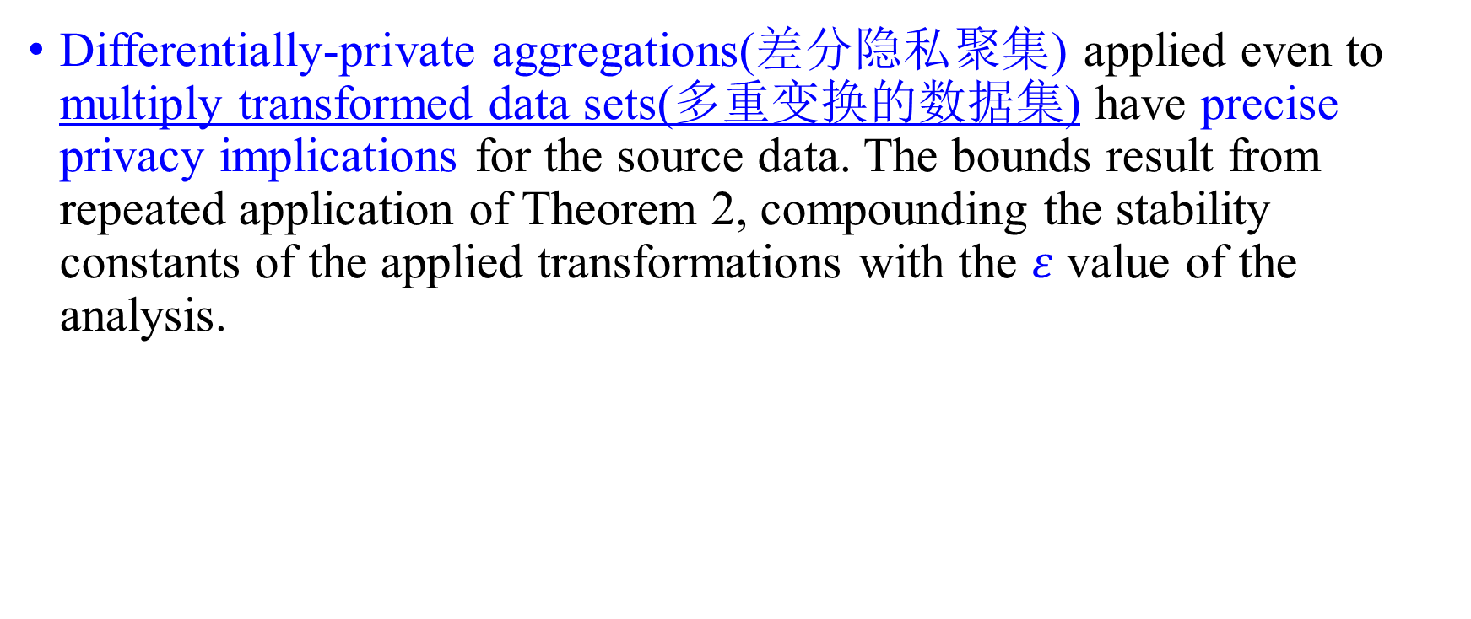
Differentially-private aggregations(差分隐私聚集) applied even to multiply transformed data sets(多重变换的数据集) have precise privacy implications for the source data. The bounds result from repeated application of Theorem 2, compounding the stability constants of the applied transformations with the $ε$ value of the analysis.

Slide 50
Remark. An early form of transformation can be seen in the first differentially-private algorithms for counts over arbitrary subsets of the domain. The subset of interest could be specified by the analyst, and the noised count returned.
Transformations intend to separate more formally what the analyst can do freely (e.g. restrict the data set) from the operations that have cost (e.g. measuring counts with noise).
This flexibility allows us to introduce new transformations, and allows the analysts to combine the transformations as they require, reflecting their interests and expertise.
Notes:
Transformations intend to separate more formally what the analyst can do freely from the operations that have cost.

Slide 51
2.3.1 Stable Transformations
We now discuss four of the transformations that PINQ supports, Where, Select, GroupBy, and Join, to see what sort of stability bounds to expect. There are many other operations that PINQ supports, drawn from LINQ, but this set is largely representative of the issues faced.

Slide 52
Where takes as input a predicate and returns the subset of the data satisfying the predicate. The stability of Where is one, as the addition or deletion of a source record can change the result by at most the presence of that element.
Select takes and applies a function mapping each source record to a new record, of a possibly different type. Select commonly extracts columns from a relational database, but is substantially more general. The stability of Select is one, as each source record results in exactly one output record.

Slide 53
GroupBy takes a function mapping records to key values, and results in a list of groups: for each observed key, the group of records that map to that key. GroupBy is more complicated than the previous two transformations [in that(the previous two transformations) the addition or deletion of an input record can change an output record], not simply adding or deleting it, resulting in a symmetric difference of two. However, this is the largest change that can occur, and the stability constant is two. We stress that the output of a GroupBy operation is a protected list of groups of elements(受保护的元素组列表), rather than a list of protected groups of elements(而不是受保护元素组的列表); to achieve the latter we must wait until the special Partition operator of Section 3.5
Join takes two data sets, key selection functions for each, and returns the list of all pairs of elements whose keys match. Unrestricted, a Join has the ability to multiply input records, so that a single input record can influence an arbitrarily large number of output records, implying unbounded stability.

Slide 54
Instead, we will use a restricted form of Join, in which each input data set is first grouped by its join keys, and the list of groups are then joined using their group keys.
The result is a compact representation of the output of the original Join, as each pair of groups could in principle be expanded to their full Cartesian product. Much more importantly, however, the arrangement of the output data bundles records so that we can apply stability mathematics. Each input record participates in at most one pair of groups, and as with GroupBy the stability constant is at most two.
This structural restriction on Join limits the information that can be extracted(提取) privately, by insisting that each join key result in a single record and, for example, contribute at most one to a NoisyCount no matter how large the group.
Nonetheless, without the pre-grouping privacy bounds simply do not exist, and Join would not be available (and has not been, in prior work). Moreover, the enforced grouping does not interfere with many common tasks such as the use of Join to link unique identifiers between data sets.

Slide 55
Remark. Join introduces the practical matter(现实问题) that transformations may have multiple inputs, and an applied analysis reveals information about both of its sources. This is uncomplicated unless the inputs derive from common data. Even so, a single change to a data set in common(公共数据集) induces a bounded change in each of the transformation’s inputs, and a bounded change in its output (i.e. the stabilities add)
Notes:
practical matter 现实问题

Slide 56
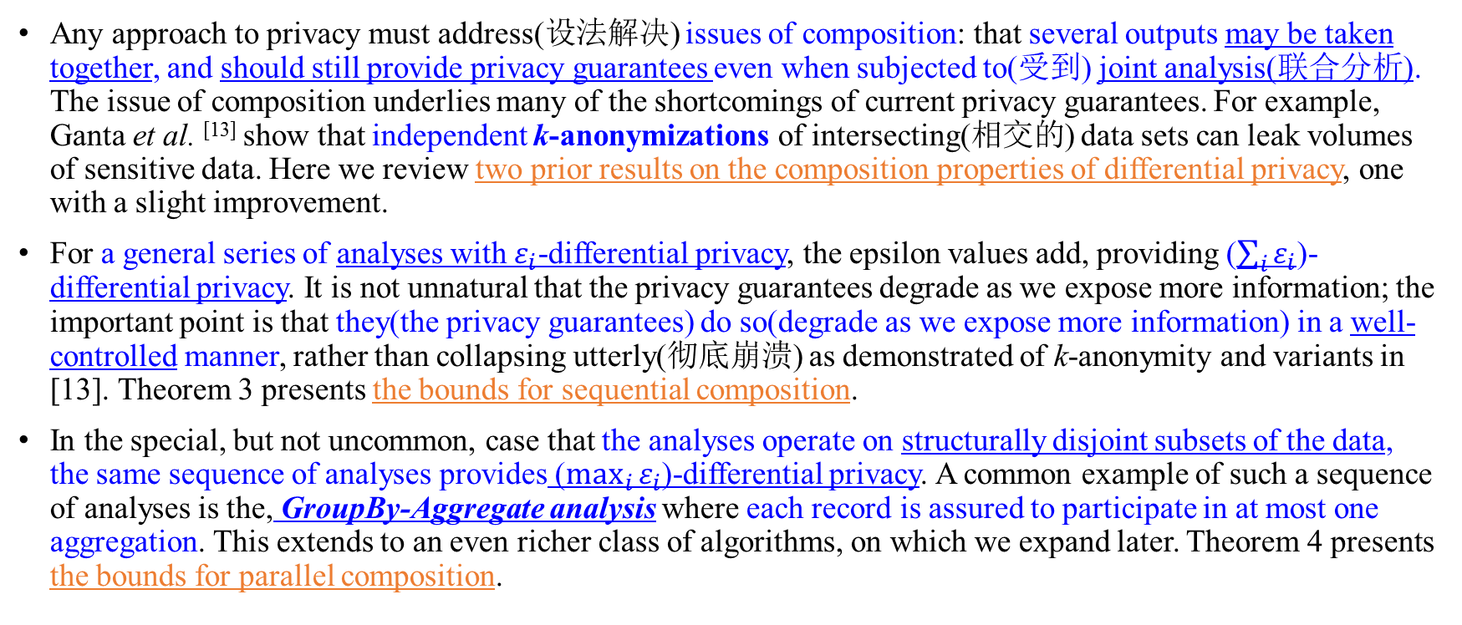
2.4 Composition(组成方式)
Any approach to privacy must address(设法解决) issues of composition: that several outputs may be taken together, and should still provide privacy guarantees even when subjected to(受到) joint analysis(联合分析). The issue of composition underlies many of the shortcomings of current privacy guarantees. For example, Ganta et al. ^{[13]} show that independent k-anonymizations of intersecting(相交的) data sets can leak volumes of sensitive data. Here we review two prior results on the composition properties of differential privacy, one with a slight improvement.
For a general series of analyses with $ε_{i}$-differential privacy, the epsilon values add, providing ($\sum_{i}{ε_{i}}$)-differential privacy. It is not unnatural that the privacy guarantees degrade as we expose more information; the important point is that they(the privacy guarantees) do so(degrade as we expose more information) in a well-controlled manner, rather than collapsing utterly(彻底崩溃) as demonstrated of k-anonymity and variants in [13]. Theorem 3 presents the bounds for sequential composition.
In the special, but not uncommon, case that the analyses operate on structurally disjoint subsets of the data, the same sequence of analyses provides ($\max_{i}{ε_{i}}$)-differential privacy. A common example of such a sequence of analyses is the, GroupBy-Aggregate analysis where each record is assured to participate in at most one aggregation. This extends to an even richer class of algorithms, on which we expand later. Theorem 4 presents the bounds for parallel composition.
Notes:
Underline v 位于或存在于（某物）之下; 构成…的基础（或起因）; [经]构成优先于…的财政要求;

Slide 57
2.4.1 Sequential Composition
Any sequence of computations that each provide differential privacy in isolation(孤立状态下) also provide differential privacy in sequence. Importantly, this is true not only when they are run independently, but even when subsequent computations can incorporate(合并) the outcomes of the preceding computations.
Notationally, we explicitly(明确地) index each computation by the preceding outcomes, allowing them(outcomes) to vary arbitrarily as a function of these values. We still require each computation satisfy differential privacy with respect to their input data.

Slide 58
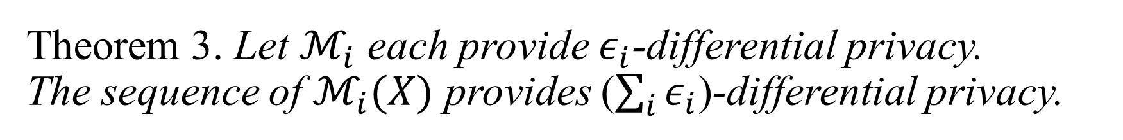
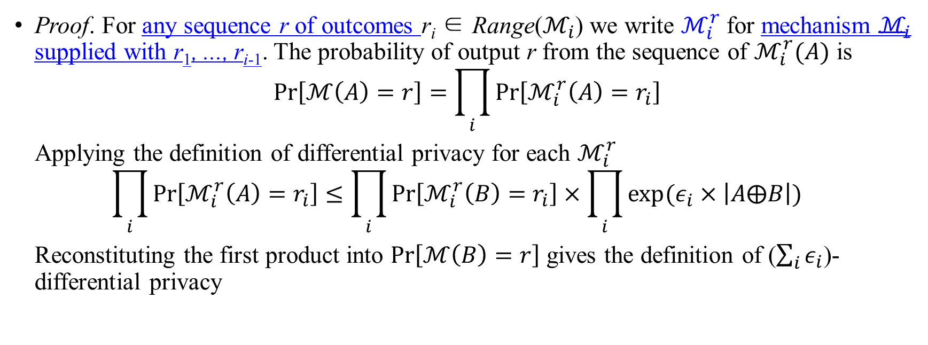
Theorem 3. Let $ℳ_{i}$ each provide $ε_{i}$-differential privacy. The sequence of $ℳ_{i}(X)$ provides ($\sum_{i}{ε_{i}}$)-differential privacy.
Proof. For any sequence r of outcomes r_{i} ∈ Range($ℳ_{i}$) we write $ℳ_{i}^{r}$ for mechanism $ℳ_{i}$ supplied with r₁, ..., r_{i-1}. The probability of output r from the sequence of $ℳ_{i}^{r}(A)$ is
$$\operatorname{Pr}\left[ℳ\left(A\right)=r\right]=\prod_{i}{Pr⁡\left[ℳ_{i}^{r}\left(A\right)=r_{i}\right]}$$
Applying the definition of differential privacy for each $ℳ_{i}^{r}$
$$\prod_{i}{Pr⁡\left[ℳ_{i}^{r}\left(A\right)=r_{i}\right]}≤\prod_{i}{Pr⁡\left[ℳ_{i}^{r}\left(B\right)=r_{i}\right]}×\prod_{i}{exp⁡(ε_{i}×\left|A⨁B\right|)}$$ Reconstituting the first product into $\operatorname{Pr}\left[ℳ\left(B\right)=r\right]$ gives the definition of ($\sum_{i}{ε_{i}}$)-differential privacy
Sequential composition is crucial for any privacy platform that expects to process more than one query. Privacy definitions that are not robust to sequential composition, and there are several, should be viewed with some skepticism(持怀疑态度).
Notes:
Remark. Theorem 3 has been previously observed for indistinguishability in [14], and our proof here is identical

Slide 59
2.4.2 Parallel Composition
While general sequences of queries accumulate privacy costs additively, when the queries are applied to disjoint subsets of the data we can improve the bound.
Specifically, if the domain of input records is partitioned into disjoint sets, independent of the actual data, and the restrictions of the input data to each part are subjected to(经受，受到) differentially-private analysis, the ultimate privacy guarantee depends only on the worst of the guarantees of each analysis, not the sum.

Slide 60
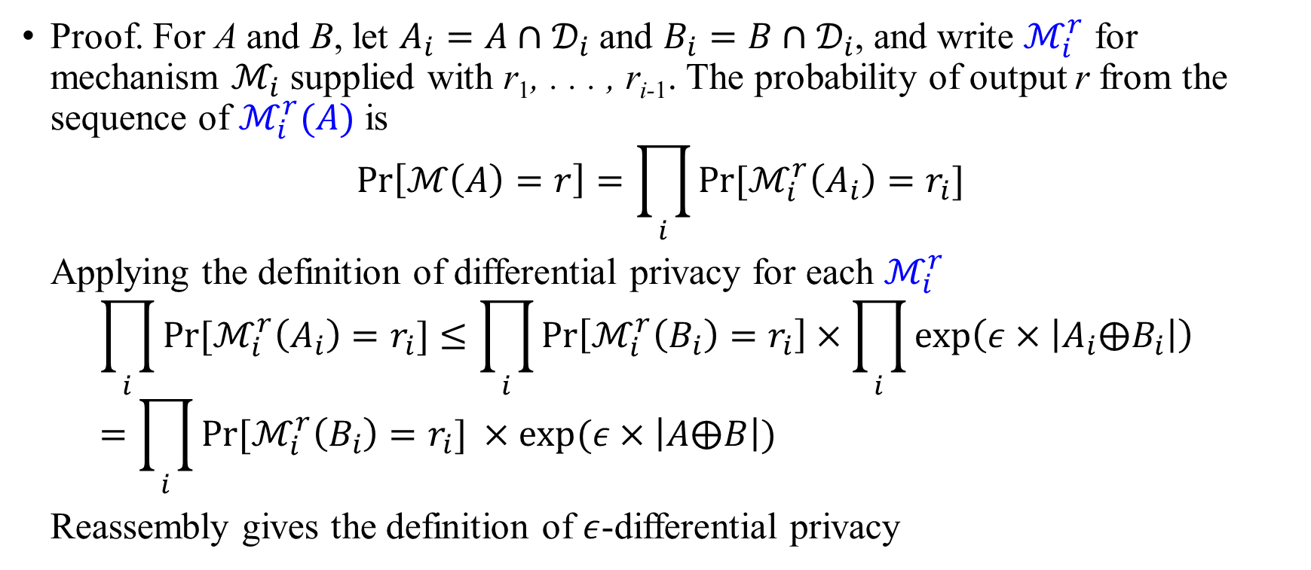
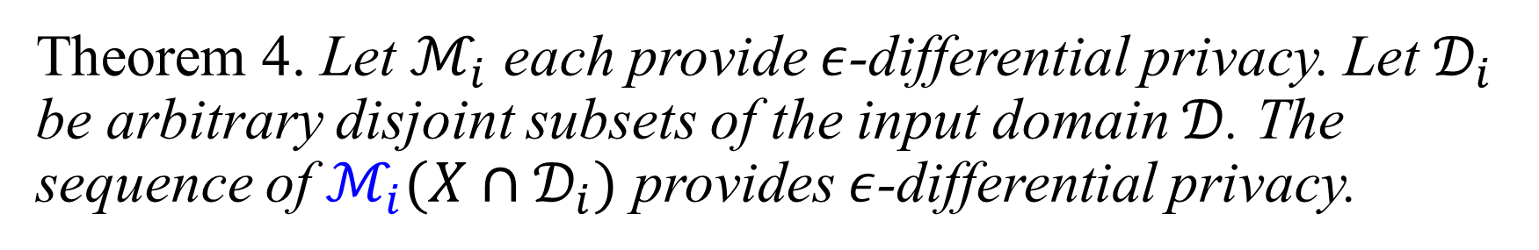
Theorem 4. Let $ℳ_{i}$ each provide $ε$-differential privacy. Let $𝒟_{i}$ be arbitrary disjoint subsets of the input domain $𝒟$. The sequence of $ℳ_{i}(X∩𝒟_{i})$ provides $ε$-differential privacy.
Proof. For A and B, let $A_{i}=A∩𝒟_{i}$ and $B_{i}=B∩𝒟_{i}$, and write $ℳ_{i}^{r}$ for mechanism $ℳ_{i}$ supplied with r₁, . . . , r_{i-1}. The probability of output r from the sequence of $ℳ_{i}^{r}(A)$ is
$$\operatorname{Pr}\left[ℳ\left(A\right)=r\right]=\prod_{i}{Pr⁡[ℳ_{i}^{r}\left(A_{i}\right)=r_{i}]}$$
Applying the definition of differential privacy for each $ℳ_{i}^{r}$ $$\prod_{i}{Pr⁡[ℳ_{i}^{r}\left(A_{i}\right)=r_{i}]}≤\prod_{i}{\operatorname{Pr}\left[ℳ_{i}^{r}\left(B_{i}\right)=r_{i}\right]}×\prod_{i}{\exp\left(ε×\left|A_{i}{⨁B}_{i}\right|\right)}=\prod_{i}{Pr⁡[ℳ_{i}^{r}\left(B_{i}\right)=r_{i}] }×exp(ε×\left|A⨁B\right|)$$
Reassembly gives the definition of $ε$-differential privacy

Slide 61
Whereas sequential composition is critical for any functional privacy platform, parallel composition is required to extract(获得) good performance from a privacy platform.
Realistic analyses require aggregates and computation on different subpopulations. Although such operations can be analysed as sequential composition, the privacy guarantee would scale with the number of subpopulations analysed.
Leveraging parallel composition, the privacy costs are fixed, independent of the number of total queries, and thus permitting relatively thorough information at a modest privacy cost.
Remark. Theorem 4 has been previously observed for the addition of noise to disjoint subpopulation counts in [1]. However, the privacy definition used (indistinguishability) introduces a factor of two in the analogous theorem, and the factors compound with each invocation of the reasoning. Our slightly altered privacy definition allows us to apply the theorem arbitrarily without increase in the bound.

Slide 62
2.5 A Privacy Calculus
The theorems of this section enable a rich privacy calculus, allowing us to bound the privacy implications of arbitrary sequences of arbitrary queries composed of permitted transformations and aggregations. Importantly, we can do this reasoning in an on-line fashion.
Queries which arrive in sequence have their epsilon values accumulate; queries applied in parallel require us to track only the maximum.
This simplicity(简明扼要) allows us to avoid burdening the analyst with(施加…负担) the responsibility of correctly or completely describing the mathematical features of their query.
Even for researchers familiar with the mathematics (e.g. the author) the reasoning(推理) process can be quite subtle(微妙的) and error-prone(易错的). Fortunately, it can be automated, the subject of Section 3.
Notes:
burden sb with sth

Slide 63
3. PINQ IMPLEMENTATION
PINQ is built atop C#’s Language Integrated Queries. LINQ is a recent language extension to the .NET framework for integrating declarative access to data streams (using a language very much like SQL) into arbitrary C# programs.
Central to LINQ is the IQueryable<T> type, a generic sequence of records of type T. An IQueryable admits transformations such as Where, Select, GroupBy, Join, and more, returning new IQueryable objects over possibly new types.
PINQ’s implementation centers on a PINQueryable<T> generic type, wrapped around an underlying IQueryable<T>. This type supports the same methods as an IQueryable, but with implementations ensuring that the appropriate privacy calculations are conducted before any execution is invoked.
We stress that PINQ does not supply the execution engine. Instead, a PINQueryable renders(呈递) all of its operations to LINQ statements executed by the underlying IQueryable, allowing substantial flexibility in deployment.

Slide 64
3.1 Data Types and Control Flow
The central type in PINQ is the PINQueryable<T>, a protected list of objects of type T. The type T can be arbitrary.
Each PINQueryable is comprised of an unprotected data set (an IQueryable), and a second new data type, a PINQAgent, responsible for accepting or rejecting increments(增长，增量) to epsilon.
A PINQueryable supports aggregations and transformations.
Aggregations test the associated PINQAgent to confirm that the increment to epsilon is acceptable before they(aggregations) execute.
Transformations result in new PINQueryable objects with a transformed data source and a new PINQAgent, (transformations are) containing transformation-appropriate logic to forward epsilon requests to the agents of its source PINQueryable data sets.

Slide 65
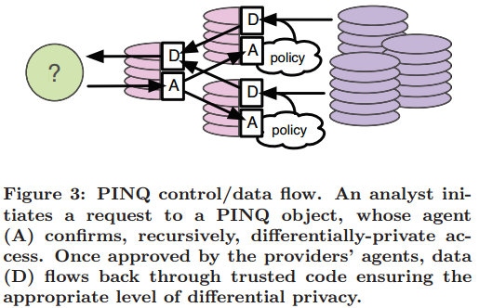

Slide 66
The PINQAgent interface has one method, Alert(epsilon), invoked before executing any differentially-private aggregation with the appropriate vale of epsilon, to confirm access.
For PINQueryable objects wrapped around raw data sets, the PINQAgent is implemented by the data provider based on its(raw data sets) privacy requirements, either from scratch(从头开始) or using one of several defaults (e.g. decrementing a per-analyst budget).
对于由原始数据集围绕而成的PINQueryable实体，数据提供者基于对原始数据集的隐私要求对PINQAgent进行了实现。
For objects resulting from(由…引起) transformations of other PINQueryable data sets, PINQ constructs a PINQAgent which queries the PINQAgent objects of the transformation’s inputs with transformation-appropriate scaled values of epsilon.
对于由其他PINQueryable数据集的转换产生的实体， PINQ 构建了PINQAgent。 PINQAgent利用适当转换的epsilon值查询在转换中输入的PINQAgent 实体。
These queries are be forwarded recursively(递归地), with appropriate values of epsilon, until all source data have been consulted. The process is sketched in Figure 3.

Slide 67
3.2 Differential Privacy Policies
Data providers dictate(规定) privacy requirements in PINQ by supplying objects that implement the PINQAgent interface, containing arbitrary code to mediate access to their data.
数据提供者通过提供实现了PINQAgent 接口的实体来规定PINQ的隐私要求，包括能间接获取他们数据的任意代码。
Before any aggregation is performed using protected data, PINQ will invoke the Alert method of the associated PINQAgent objects with the pending privacy decrement, epsilon.
在使用受保护的数据进行聚集之前，PINQ会调用相关的含未知隐私消损量epsilon 的PINQAgent 实体的Alert方法。
Each PINQAgent is expected to respond with a boolean value, either accepting or rejecting the request.

Slide 68
PINQ’s main role is as a privacy enforcement mechanism(隐私强制机制); it’s role is not to decide who should have access to what type of data, but to enforce these decisions once they are made.
Our intent is that the provider should be able to determine how much access any individual should have to a data set before they need to construct a PINQueryable protecting it.
对一个数据集来说，在数据提供者需要构建一个能保护数据集的PINQueryable 之前，任何个体对该数据集进行多少次访问，这是数据提供者自己能够决定的。
After the provider identifies the analyst and determines their level of access, they can then construct a simple PINQAgent to enforce these limits.

Slide 69
As examples, a privacy policy may call for different levels of access for different roles: external analysts may have a fixed budget to draw against, while internal analysts have unfettered(不受限制的), but logged(笨拙的), access.
Or, if the analyst requests a less sensitive view, perhaps with certain columns stripped or groupings applied, the policy may permit finer detail and more access, in the form of more lenient PINQAgent objects.
The decision of which constraints to apply can and should be made before the PINQueryable is first constructed, using a PINQAgent only to enforce these decisions.

Slide 70
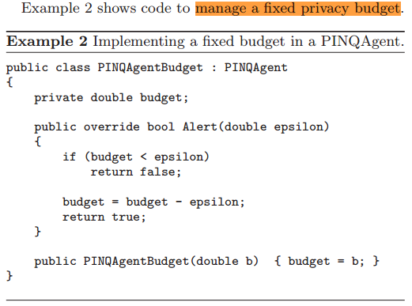

Slide 71
Several other PINQAgent implementations exist in PINQ, ranging from enforcing a budget(强制规定预算) as above, to rate limiting information extraction by introducing artificial time delays(引入人工延时来限制信息提取速率), to simply calculating and logging the depletions of privacy(简单的计算和记录隐私损耗).
Providers are free to implement custom agents as needed, but are encouraged to perform as much privacy reasoning(隐私推理) as possible before constructing the agent.
PINQ’s use of differential privacy as a common currency(广为接受的看法) provides unambiguous semantics to all of the participants, but restricts the richness of the information (that) the PINQAgent has available to it at run time. This restriction is intentional.
PINQ intends to be a lightweight capability-based system, and its implementation is simplified by narrowing its focus.
Moreover, several operations (e.g. Sections 3.5 and 3.6) are based on the assumption that differential privacy is fungible(可替代的): once an amount of differentially-private access is authorized, that access can be used arbitrarily, as the analyst sees fit.

