Slide 1
VICIOUS
ESPORTS · TEAM PLATFORM
VICIOUS · SINGLE ROSTER EDITION
Stop guessing.
Start winning your matches.
A professional-grade roster, stats and prep workspace —
built for the player who takes the game seriously.
INDIVIDUALS · SINGLE ROSTER
Confidential sales material · Built for esports orgs, coaches & competitive players

Slide 2
01 · WHAT THIS IS
Your personal command center for one competitive roster.
Everything you need to track performance, prepare for opponents and improve — in one place.
01
02
03
One Roster, Fully Owned
Real Match Data
Pre-Match Prep
Your players, your matches, your stats, your scouting notes. Private to you, organized like a pro team would.
Log results, drafts, maps, heroes/agents and KDA — and watch trends emerge automatically as you play.
Scout opponents, study past meetups, and walk into your next match knowing exactly what works.
VICIOUS · Esports Team Platform
02 / 16
V I C I O U S

Slide 3
02 · WHY ONE ROSTER MATTERS
Most players lose matches before they start.
Memory, group chats and screenshots don't scale past a few weeks of competitive play.
▸ You forget which comps actually work for your line-up
▸ You can't see your real win-rate by map, mode or opponent
▸ Scouting an opponent means scrolling through Discord history
▸ Improvement feels invisible — there's nothing to point at
73%
2.4×
of amateur players can't recall their last 5 drafts accurately
improvement rate when prep is structured vs. ad-hoc
1 roster
is all it takes to start playing like an organized team
VICIOUS · Esports Team Platform
03 / 16
V I C I O U S

Slide 4
03 · WHAT YOU GET
One roster. Eight workspaces. Zero spreadsheets.
RST
EVT
MTH
OPP
Roster
Events
Matches
Opponents
Players, roles, contact, status.
Tournaments, scrims, VOD reviews.
Full results with maps and modes.
Linked head-to-head history.
HRO
MAP
DFT
STA
Heroes / Agents
Maps
Draft / B&P
Stats
Pick-rates, win-rates, comps.
Side, mode and map performance.
What you ban, pick and beat.
Personal & team trends over time.
VICIOUS · Esports Team Platform
04 / 16
V I C I O U S

Slide 5
04 · FEATURES INCLUDED
Everything below ships with a single roster — no add-ons, no upsells.
Roster & attendance
Match logging
Opponent profiles
Add players, set roles, track availability for every event.
Capture maps, modes, score, result and notes in under 60 seconds.
Link every match to an opponent and see your true H2H history.
Hero / agent stats
Map analytics
Draft / B&P insights
Pick-rate, win-rate and synergy across your last N matches.
Side win-rate, attack vs. defense, mode-by-mode performance.
What gets banned, what wins, what loses — over time.
Player comparisons
Filters & timeframes
Dark / light themes
Stack two players head-to-head on any metric.
Slice by event, opponent, patch, map or window.
Built for late-night prep sessions and bright cafés alike.
VICIOUS · Esports Team Platform
05 / 16
V I C I O U S

Slide 6
05 · PERFORMANCE & PREP
From 'we'll figure it out' to 'we've prepared for this'.
▸ Walk into matches with a plan, not a vibe
▸ Identify your weakest map and fix it
▸ Spot the comps your opponent loses to
▸ Catch your own bad habits before they cost you
▸ Build a season narrative you can actually review
Match win-rate by preparation depth (illustrative)
No prep
42
Quick scout
54
Structured prep
67
Platform prep
78
VICIOUS · Esports Team Platform
06 / 16
V I C I O U S

Slide 7
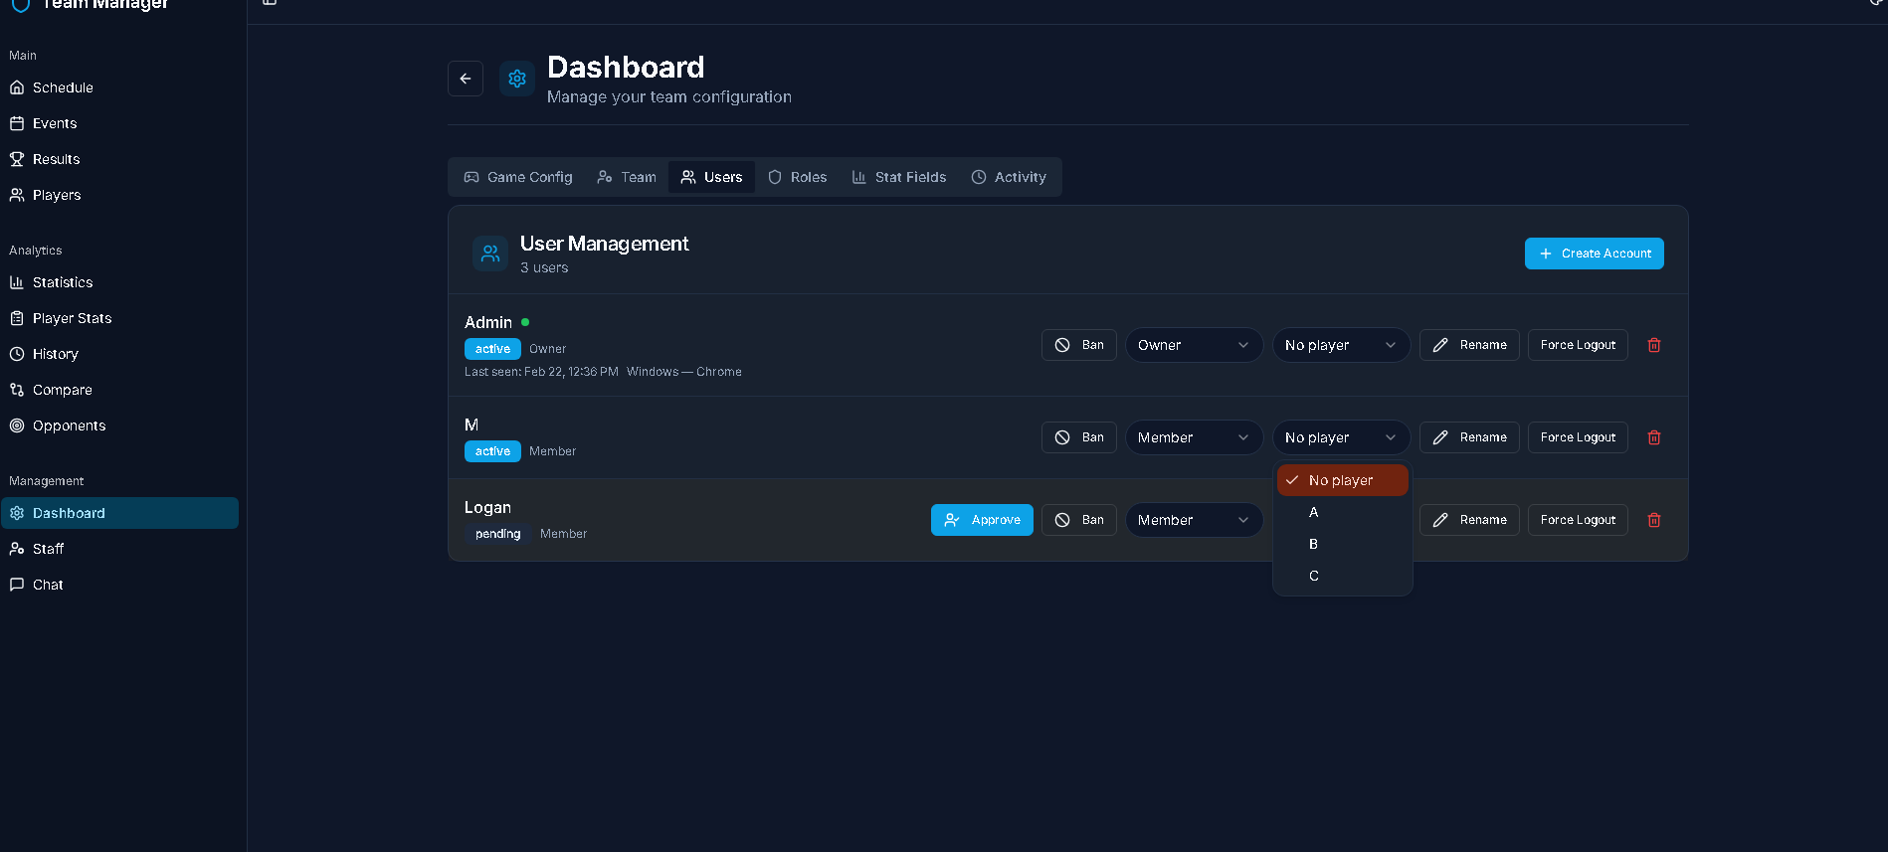
06 · HOW IT LOOKS
Built like a pro tool. Designed to be readable in a war room.
▸ Dark, premium UI
▸ Information-dense without being noisy
▸ Keyboard-friendly entry
▸ Fast filters across every view
▸ Mobile-friendly for live events
Dashboard · live product view
VICIOUS · Esports Team Platform
07 / 16
V I C I O U S

Slide 8
07 · HOW IT WORKS
Four steps from sign-up to your first informed match.
STEP 01
STEP 02
STEP 03
STEP 04
Create roster
Log matches
Review insights
Prep & repeat
Add your players, set roles and your competitive game.
Drop in results, maps, drafts and notes as you play.
Trends, comps and matchup data appear automatically.
Use the data to plan your next match and tighten the loop.
VICIOUS · Esports Team Platform
08 / 16
V I C I O U S

Slide 9
08 · EXAMPLE USE CASE
A solo competitive player preparing for an online cup.
Two weeks of prep. One roster. A measurable outcome.
Day 1
Sets up roster, imports last 10 scrim results.
Day 3
Identifies a 31% win-rate on Mode X — flags it for practice.
Day 7
Scouts cup opponents — spots a recurring ban pattern.
Day 10
Drafts three counter-comps in the planner.
Cup day
Wins 4 / 5 best-of-threes. 2 of them on Mode X.
VICIOUS · Esports Team Platform
09 / 16
V I C I O U S

Slide 10
09 · PRICING
One price per roster. Pick the plan that matches your game.
MOST POPULAR
Lite
Standard
Premium
Free Fire, Fortnite, Apex, PUBG, EAFC, Rocket League, eFootball, Deadlock, TrackMania, fighting games
Dota 2, CS:GO, LoL, Mobile Legends, Honor of Kings, TFT, CrossFire, CoD Mobile, The Finals, Brawl Stars
Valorant, Overwatch, Rainbow Six Siege, Call of Duty, Marvel Rivals
$8 USD / month per roster
$20 USD / month per roster
$40 USD / month per roster
▸ 3 months: $18 (save 25%)
▸ 6 months: $31 (save 35%)
▸ All features included
▸ Cancel anytime
▸ 3 months: $45 (save 25%)
▸ 6 months: $78 (save 35%)
▸ All features included
▸ Cancel anytime
▸ 3 months: $90 (save 25%)
▸ 6 months: $156 (save 35%)
▸ All features included
▸ Cancel anytime
Website-only access (no roster analytics): $40 USD / month flat.
VICIOUS · Esports Team Platform
10 / 16
V I C I O U S

Slide 11
10 · MANUAL VS. PLATFORM
What changes when you stop using spreadsheets and notes apps.
Capability
Spreadsheets / Notes
Single Roster Plan
Match history
Manual entry, often forgotten
Logged in under a minute, searchable
Opponent scouting
Scrolling old chats
Linked H2H profiles auto-built
Hero / map insights
Calculated by hand (rarely)
Win-rate, pick-rate ready instantly
Draft analysis
Effectively impossible
Bans, picks and counters over time
Sharing with coach
Screenshots in Discord
Clean read-only view (with add-on)
VICIOUS · Esports Team Platform
11 / 16
V I C I O U S

Slide 12
11 · FAQ & OBJECTIONS
The honest answers to what most buyers ask first.
Is one roster really enough for me?
Do I need to be on a team?
Yes — if you only play one game competitively with one line-up, one roster covers everything.
No. Many users are solo competitive players using the roster as their personal record.
Will it work for my game?
Can I export my data later?
If your game has matches, maps/modes and characters/heroes, the templates already fit.
Yes. Your data stays yours; export is supported.
What if I outgrow it?
How long until I see value?
You can upgrade to the Organizations plan and bring all your data with you.
Most users get useful insights after logging 8–10 matches — usually within the first week.
VICIOUS · Esports Team Platform
12 / 16
V I C I O U S

Slide 13
12 · WHY NOW
Every match you play unprepared is data you'll never get back.
▸ Your competition is already tracking — quietly
▸ Patches change the meta faster than memory can keep up
▸ Off-season is the cheapest time to build the habit
▸ You don't need a team to play like one
< 1 min
to log a match in the platform
8–10 games
until insights become actionable
VICIOUS · Esports Team Platform
13 / 16
V I C I O U S

Slide 14
13 · ZERO-RISK START
We make it easy to try, easy to stay, easy to leave.
01
02
03
04
Cancel anytime
Your data is yours
Migrate up later
Live support
No long-term contracts or hidden fees.
Export anytime in standard formats.
Move to Organizations plan with no data loss.
Real humans answer real questions.
VICIOUS · Esports Team Platform
14 / 16
V I C I O U S

Slide 15
VICIOUS
TAKE THE NEXT STEP
Buy one roster.
Start playing like a team of one.
Sign up, set up your roster in under five minutes,
and log your first match tonight.
START FREE TRIAL
BOOK A 15-MIN DEMO
Replace the buttons with your real URLs in Canva.

Slide 16
VICIOUS
Talent wins games.
Data wins seasons.
VICIOUS · Run your roster like a pro.
hello@yourdomain.com · yourdomain.com · @yourhandle

