Slide 1
VICIOUS
ESPORTS · TEAM PLATFORM
VICIOUS · ORGANIZATION EDITION
Run your esports org
like a professional team.
A unified roster, analytics and scouting platform —
built for organizations, coaches and managers.
ORGANIZATIONS · MULTI-ROSTER PLATFORM
Confidential sales material · Built for esports orgs, coaches & competitive players

Slide 2
01 · THE PROBLEM
Most esports orgs run on group chats and gut feel.
The data exists. It's just trapped in screenshots, DMs and a coach's head.
▸ Each roster tracks things differently — or not at all
▸ Match history lives in chat, not in a system
▸ Scouting is restarted from scratch every event
▸ Coaching staff can't see what management sees
▸ Performance reviews are vibes, not numbers
< 20%
5+ tools
of amateur orgs keep structured match data
the average org juggles per roster
0
single source of truth for performance — until now
VICIOUS · Esports Team Platform
02 / 19
V I C I O U S

Slide 3
02 · TODAY'S WORKFLOW IS LEAKING VALUE
Where time, knowledge and competitive edge get lost.
Information silos
Manual aggregation
Lost institutional knowledge
Coaches, analysts and managers see different data — or none.
Hours per week spent rebuilding spreadsheets from scratch.
Players leave; their match history leaves with them.
Inconsistent stats
Slow scouting
No accountability loop
Each game tracked with its own ad-hoc template.
Opponent prep restarts before every event.
No clear way to measure if interventions worked.
VICIOUS · Esports Team Platform
03 / 19
V I C I O U S

Slide 4
§ 01
PLATFORM
One platform.
Every roster, every game, every match.
V I C I O U S

Slide 5
03 · PLATFORM OVERVIEW
A single workspace for every roster your org runs.
ROS
ANL
SCT
ORG
Roster Management
Analytics
Scouting
Org Controls
Multi-roster structure, players, roles, contracts, attendance.
Hero, map, mode, draft and player performance over time.
Opponent profiles auto-built from your match history.
Roles, permissions, audit trail and access by team.
VICIOUS · Esports Team Platform
05 / 19
V I C I O U S

Slide 6
04 · MULTI-ROSTER STRUCTURE
Built around how real esports orgs are organized.
Organization
Main · Game A
Academy · Game A
Roster · Game B
Roster · Game C
Players · Roles · Stats
Players · Roles · Stats
Players · Roles · Stats
Players · Roles · Stats
Game-aware templates, contracts, attendance and per-player history.
Game-aware templates, contracts, attendance and per-player history.
Game-aware templates, contracts, attendance and per-player history.
Game-aware templates, contracts, attendance and per-player history.
VICIOUS · Esports Team Platform
06 / 19
V I C I O U S

Slide 7
05 · GAME TEMPLATES & STATS STRUCTURE
Standardized data, customized per game.
Every game gets a template that captures the right metrics out of the box.
Hero shooters
Tactical FPS
MOBAs
Heroes, roles, maps, modes, comps, KDA
Agents, sides, maps, rounds, eco, plant/defuse
Heroes, lanes, picks, bans, objectives, KDA
Battle royale
Sports / arcade
Custom
Squad, drop, placement, kills, rotations
Score, mode, possession, custom KPIs
Define your own template per roster
VICIOUS · Esports Team Platform
07 / 19
V I C I O U S

Slide 8
06 · ANALYTICS & SCOUTING
Turn every match into intelligence — automatically.
▸ Player & team trends across patches
▸ Map and mode win-rates by side
▸ Hero / agent picks, bans and counters
▸ Opponent H2H built automatically
▸ Draft phase analysis with priorities
Coverage by analysis dimension (illustrative)
Player performance
95
Map / mode trends
92
Hero / agent meta
88
Draft / B&P
85
Opponent profiles
90
VICIOUS · Esports Team Platform
08 / 19
V I C I O U S

Slide 9
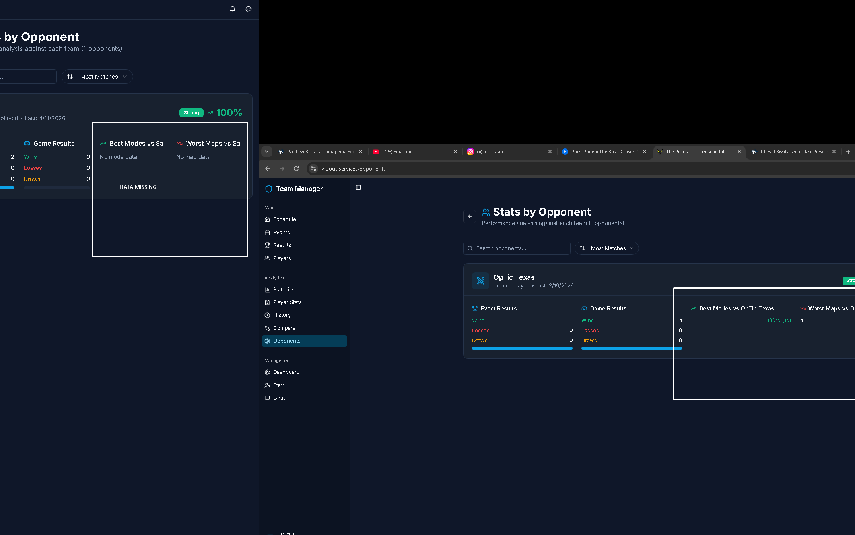
07 · OPPONENT INSIGHTS
Walk into every match knowing what they do — and what they don't.
▸ Auto-built opponent profiles from your match history
▸ Most-picked heroes / agents and ban tendencies
▸ Map preferences and side win-rates
▸ Patterns by stage, time of day, day of week
▸ Notes from coaches and analysts on the same record
VICIOUS · Esports Team Platform
Opponent profile · live product view
09 / 19
V I C I O U S

Slide 10
08 · DRAFT / MAP / HERO ANALYSIS
Three of the highest-leverage signals in competitive play.
Draft / B&P
Map performance
Hero / agent meta
What gets banned first, what your roster wins on, and the comps you should target — by opponent.
Side, mode and map win-rates. Identify your strongest pool and your weakest gap.
Personal pick-rates vs. real win-rates. Stop riding heroes that aren't actually working.
VICIOUS · Esports Team Platform
10 / 19
V I C I O U S

Slide 11
§ 02
OPERATE
Run the org.
Manage rosters, staff and access.
V I C I O U S

Slide 12
09 · TEAM MANAGEMENT
The everyday workflows your coaches and managers actually do.
ATT
EVT
VOD
Attendance
Event planning
VOD references
Per event, per player, with reasons and trends.
Tournaments, scrims, VOD reviews — all linked to results.
Attach links and notes directly to the match.
CHT
PLR
RPT
Internal chat
Player profiles
Performance reports
Light context where work actually happens.
Roles, status, contact, performance in one place.
Generate weekly / monthly read-outs in seconds.
VICIOUS · Esports Team Platform
12 / 19
V I C I O U S

Slide 13
10 · SCALING ACROSS STAFF & TEAMS
Your org can grow without your spreadsheets multiplying.
STEP 01
STEP 02
STEP 03
STEP 04
Add a roster
Invite staff
Standardize data
Roll up to org
New game, new line-up — set up in minutes from a template.
Coaches, analysts, managers, with per-roster access.
Same metrics, same definitions, every team.
Aggregate across rosters for leadership read-outs.
VICIOUS · Esports Team Platform
13 / 19
V I C I O U S

Slide 14
11 · SECURITY & ACCESS
Granular control over who sees what — by role, by roster.
01
02
03
04
Role-based access
Per-roster scope
Audit visibility
Data ownership
Owner, manager, coach, analyst, player — distinct permissions.
Limit a coach to their roster; managers see across.
Track key changes, additions and removals.
Your data, your export, your retention controls.
VICIOUS · Esports Team Platform
14 / 19
V I C I O U S

Slide 15
12 · WHY THIS MATTERS COMPETITIVELY
What changes for the org once the platform is in place.
Capability
Today (manual)
With the Platform
Cross-roster visibility
None — every roster is its own island
Unified org view across all rosters
Match history
Lost when players leave
Persistent, searchable, owned by the org
Scouting
Restarted every event
Auto-built from your own match history
Performance review
Anecdotal, vibes-based
Quantified, consistent, comparable
Onboarding new staff
Months of context-building
Hours — the data is already there
VICIOUS · Esports Team Platform
15 / 19
V I C I O U S

Slide 16
13 · ROI FRAMING
What organizations consistently get back.
8–12h
100%
of analyst / coach time saved per roster, per month
of match history retained when players move on
3×
1
faster opponent prep vs. manual scouting
single source of truth for the entire org
VICIOUS · Esports Team Platform
16 / 19
V I C I O U S

Slide 17
14 · PRICING
Per-roster pricing tiered by game. Scales linearly across your org.
RECOMMENDED
Lite
Standard
Premium
Free Fire, Fortnite, Apex, PUBG, EAFC, Rocket League, eFootball, Deadlock, TrackMania, fighting games
Dota 2, CS:GO, LoL, Mobile Legends, Honor of Kings, TFT, CrossFire, CoD Mobile, The Finals, Brawl Stars
Valorant, Overwatch, Rainbow Six Siege, Call of Duty, Marvel Rivals
$8 USD / month per roster
$20 USD / month per roster
$40 USD / month per roster
▸ 3 months: $18 per roster (save 25%)
▸ 6 months: $31 per roster (save 35%)
▸ Unlimited staff seats per roster
▸ All org features included
▸ 3 months: $45 per roster (save 25%)
▸ 6 months: $78 per roster (save 35%)
▸ Unlimited staff seats per roster
▸ All org features included
▸ 3 months: $90 per roster (save 25%)
▸ 6 months: $156 per roster (save 35%)
▸ Unlimited staff seats per roster
▸ All org features included
Website-only access (no roster analytics): $40 USD / month flat, org-wide.
VICIOUS · Esports Team Platform
17 / 19
V I C I O U S

Slide 18
VICIOUS
MOVE YOUR ORG FORWARD
Bring every roster
into one professional system.
Pilot the platform with one roster. Roll it out across the org
once your staff has felt the difference.
START AN ORG PILOT
BOOK A 30-MIN WALKTHROUGH
Replace the buttons with your real URLs in Canva.

Slide 19
VICIOUS
Built for orgs
that play to win.
VICIOUS · The command center for multi-game esports orgs.
hello@yourdomain.com · yourdomain.com · @yourhandle

