Slide 1
From History and Into the Future – An Overview of US Energy Market with Shiny
-- WEI lIU

Slide 2
Content
Motivation
Data Source
Shiny App
Overview
History Data Analysis
Projection Data Analysis
Conclusion

Slide 3
Motivation
Are we running out of energy?
How do we fill the gap when coal is going down?
How is the renewable energy doing? Will it replace the fossil fuels?
Will we be energy independent in the future?

Slide 4
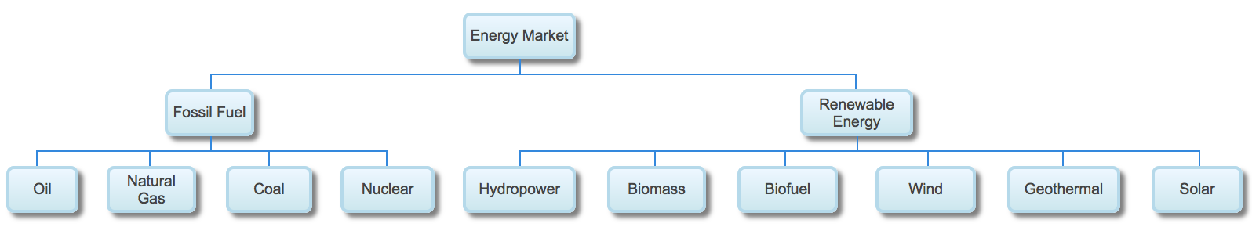
Background

Slide 5
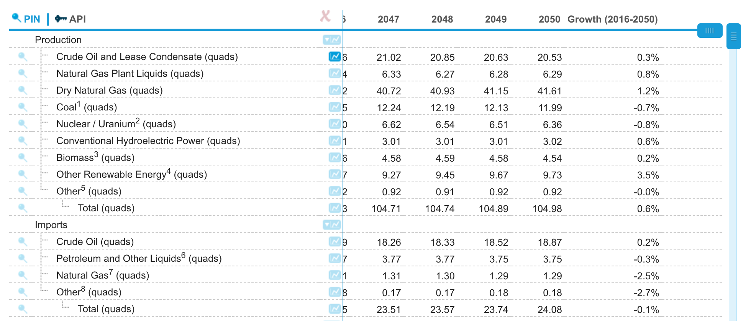
Data Gathering
Data Source: EIA (US Energy Information Administration)
Source: https://www.eia.gov/outlooks/aeo/data/browser/#/?id=1-AEO2017&cases=ref2017&sourcekey=0

Slide 6
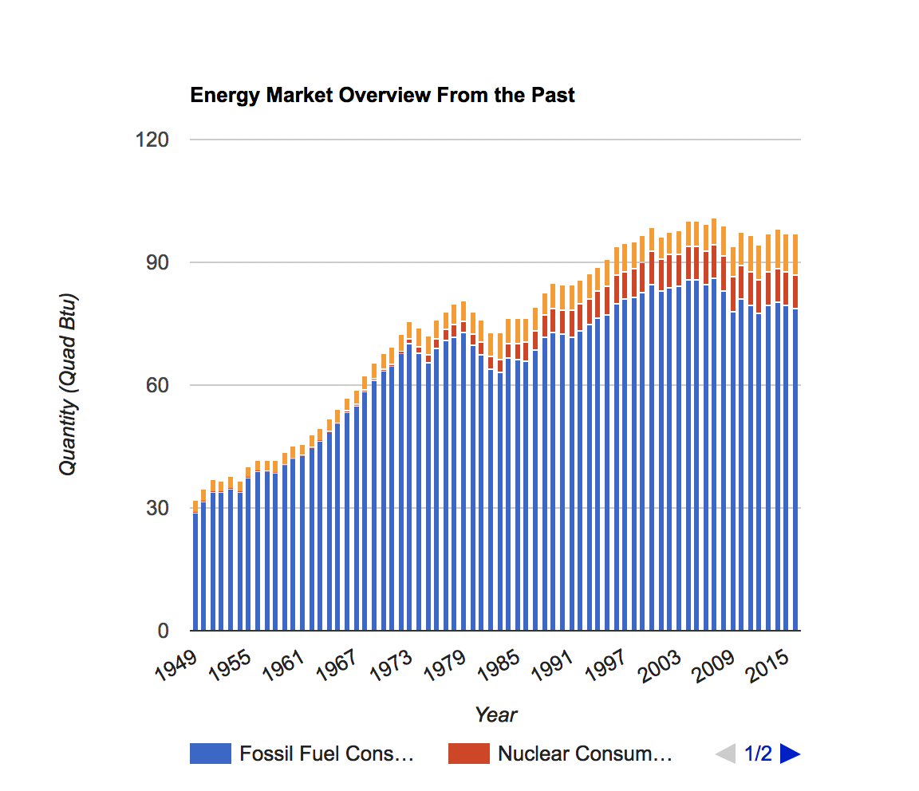
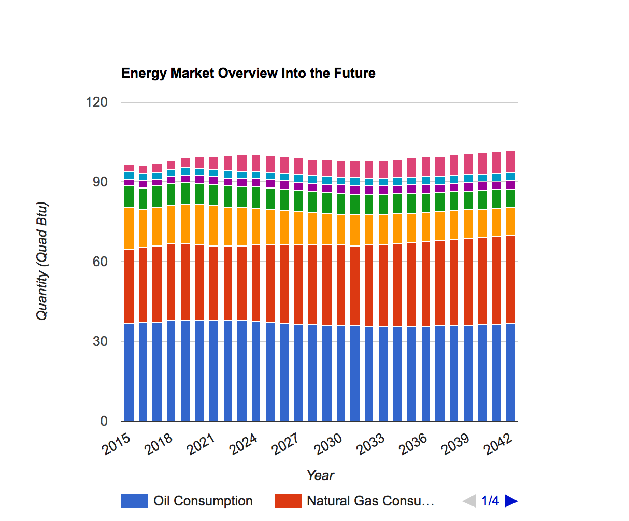
Data Gathering

Slide 7
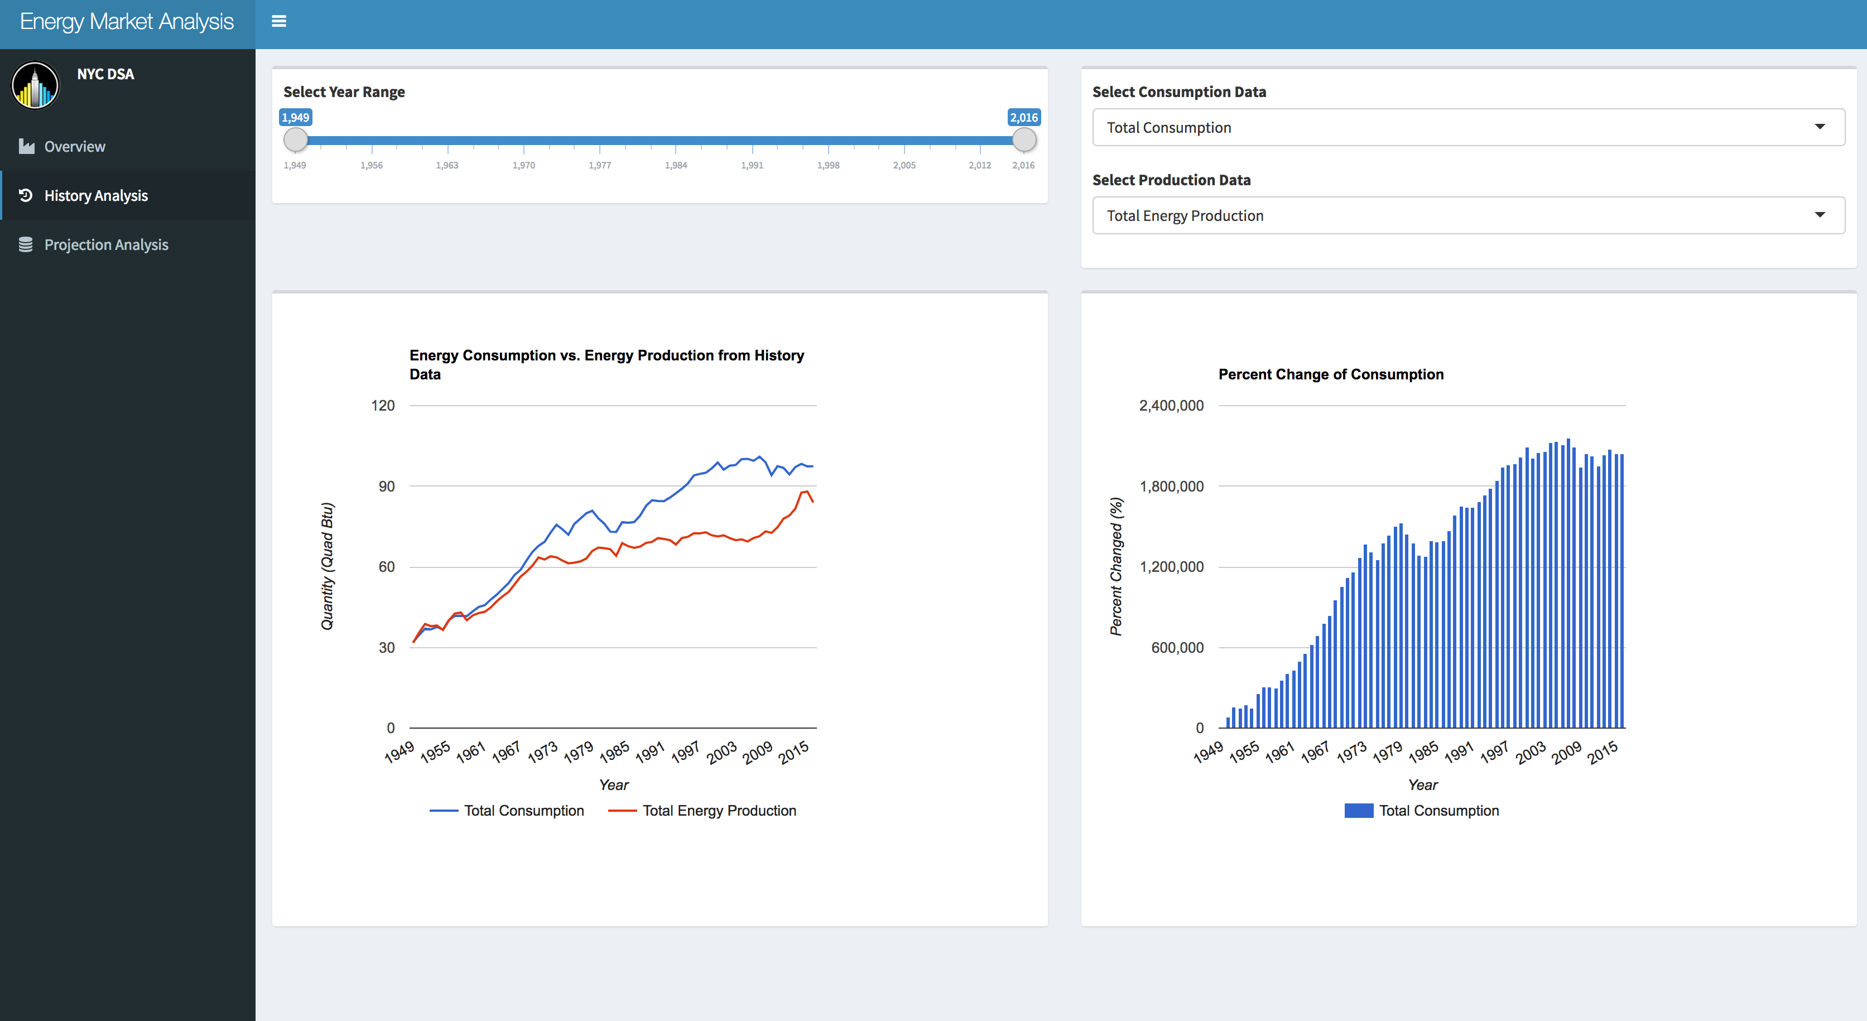
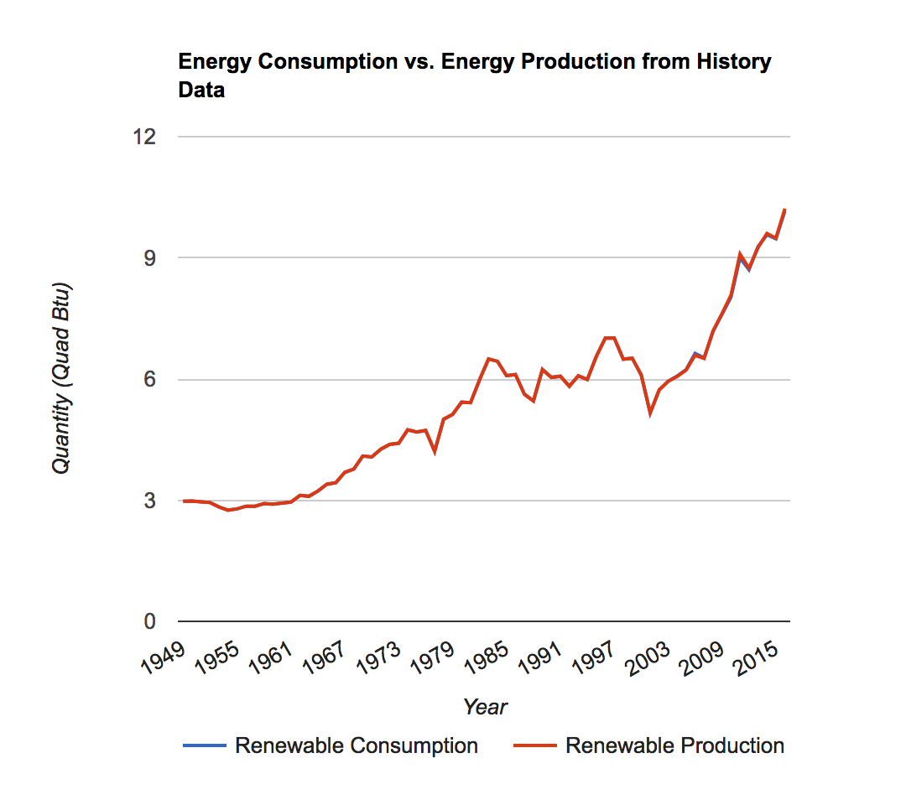
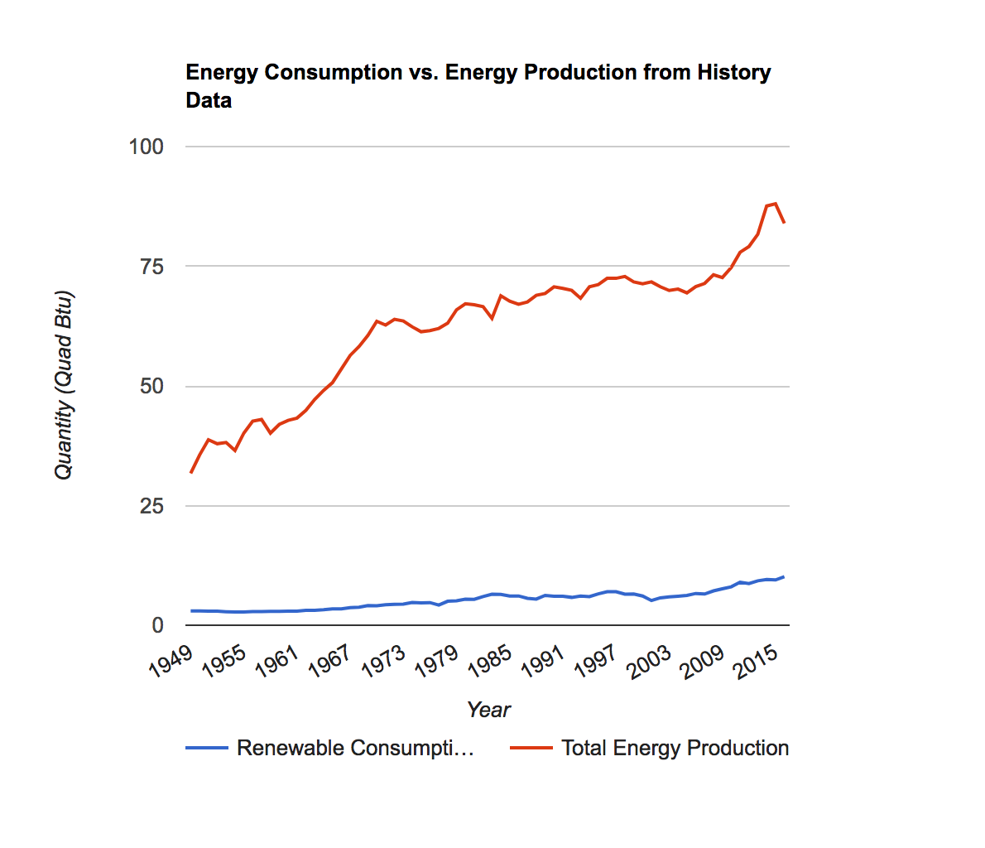
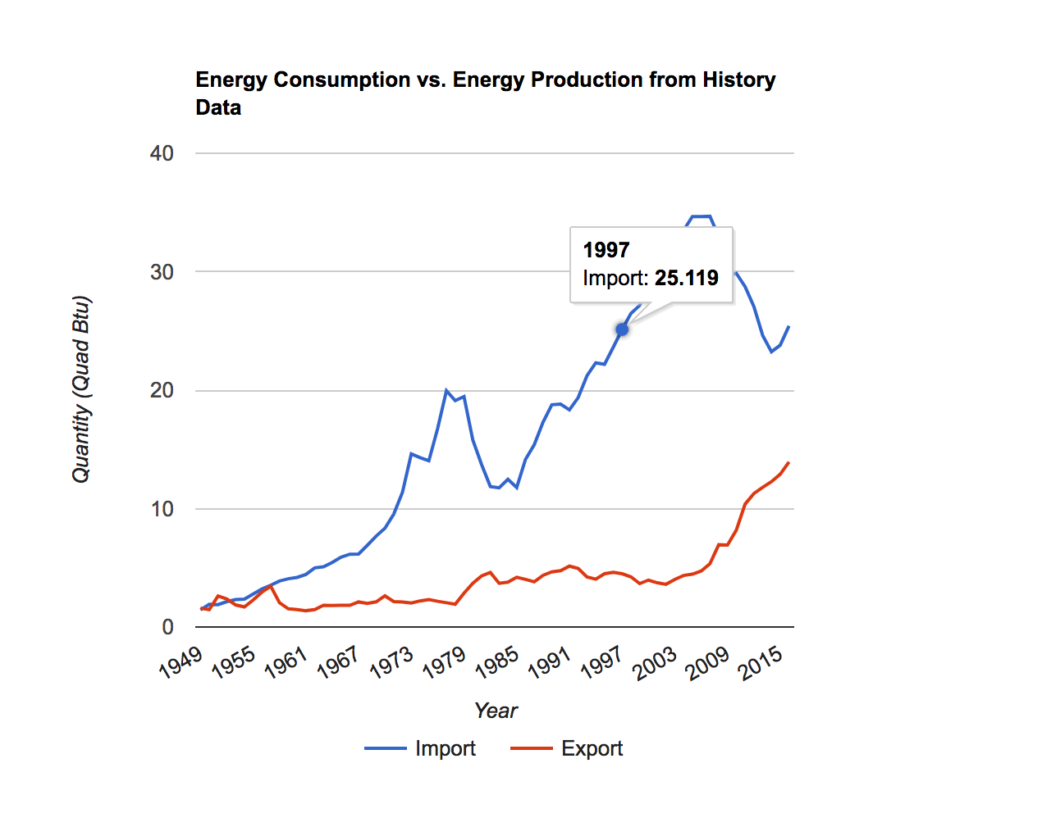
History Data Analysis

Slide 8
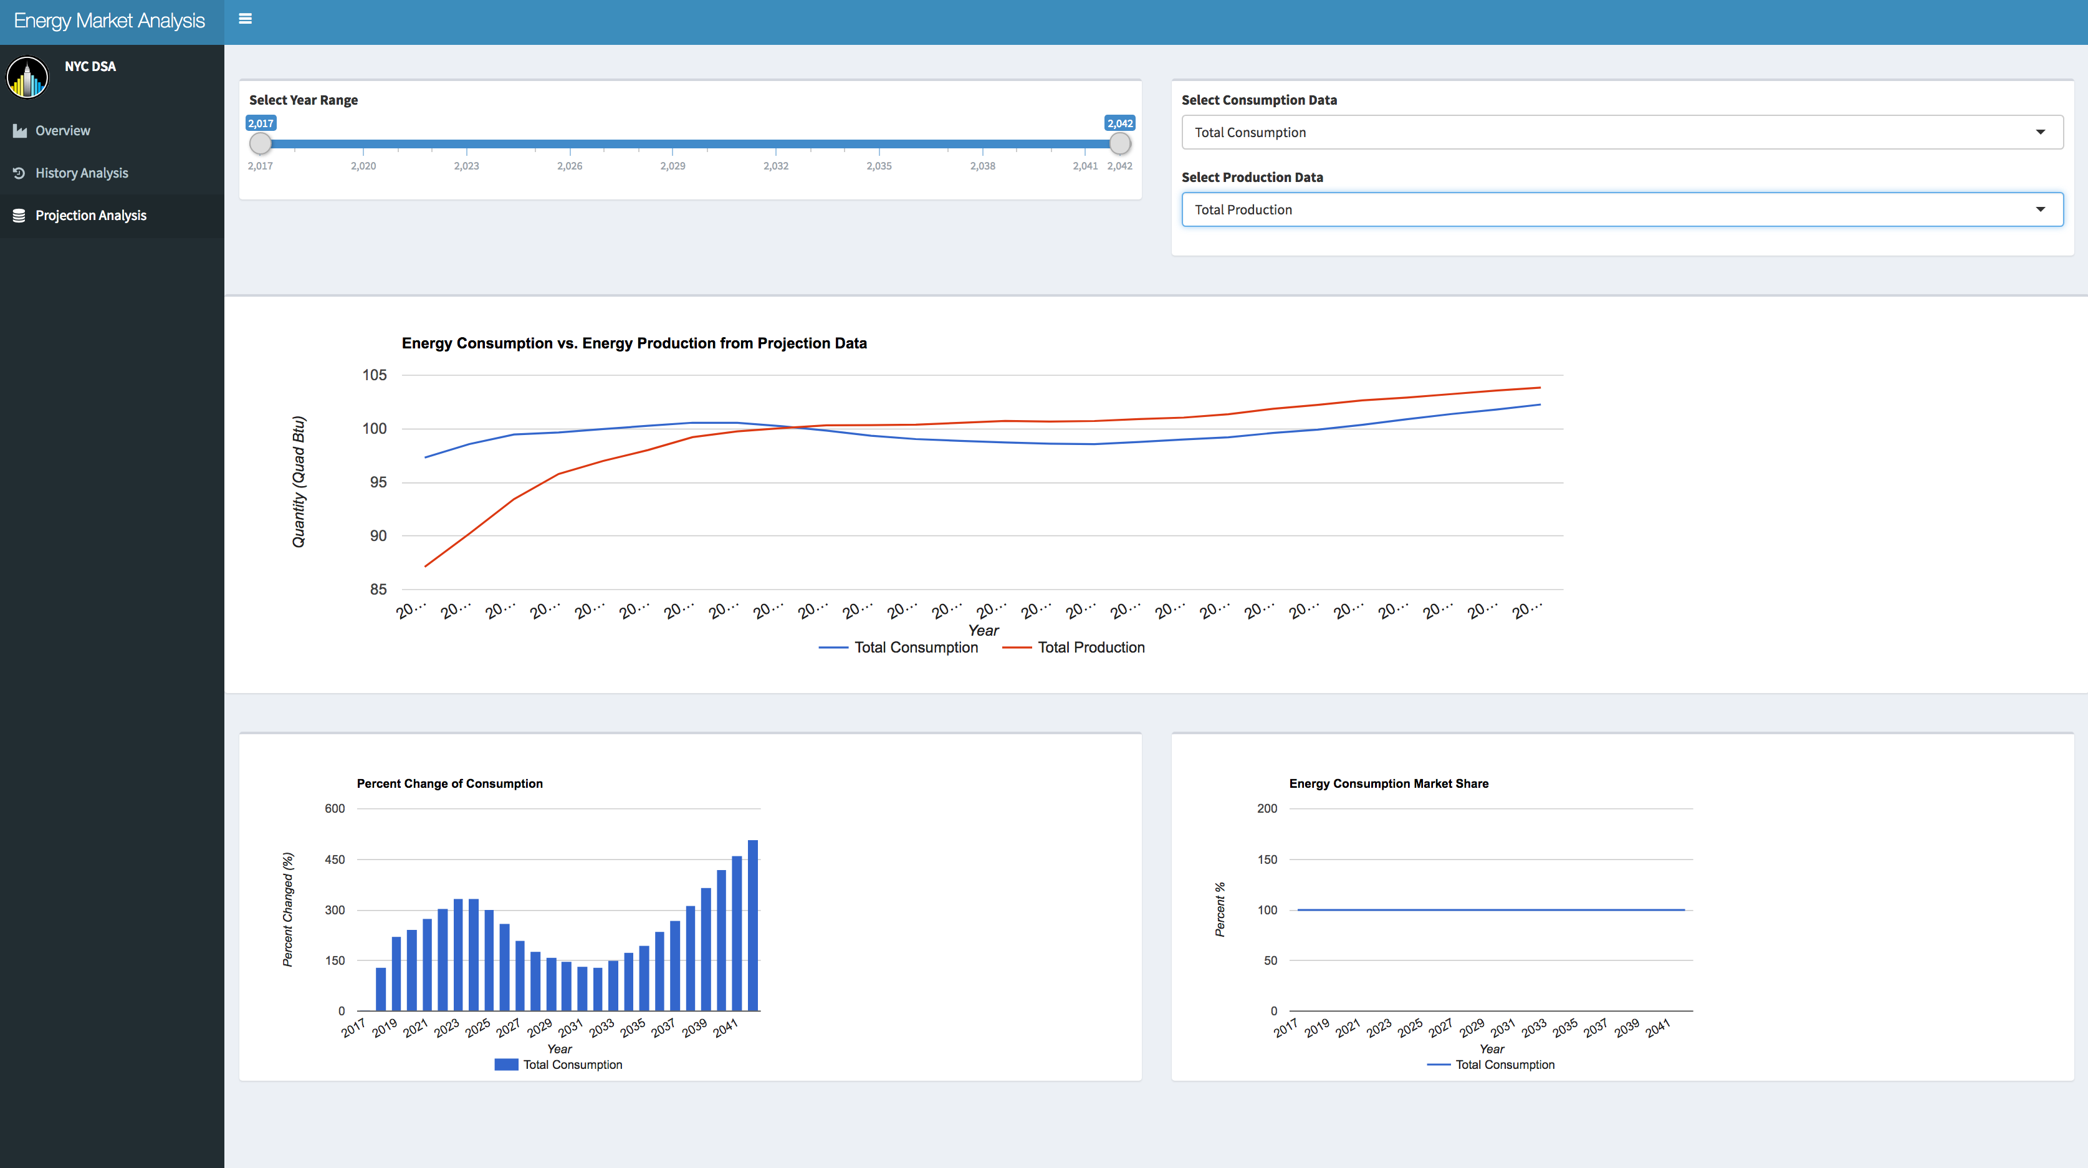
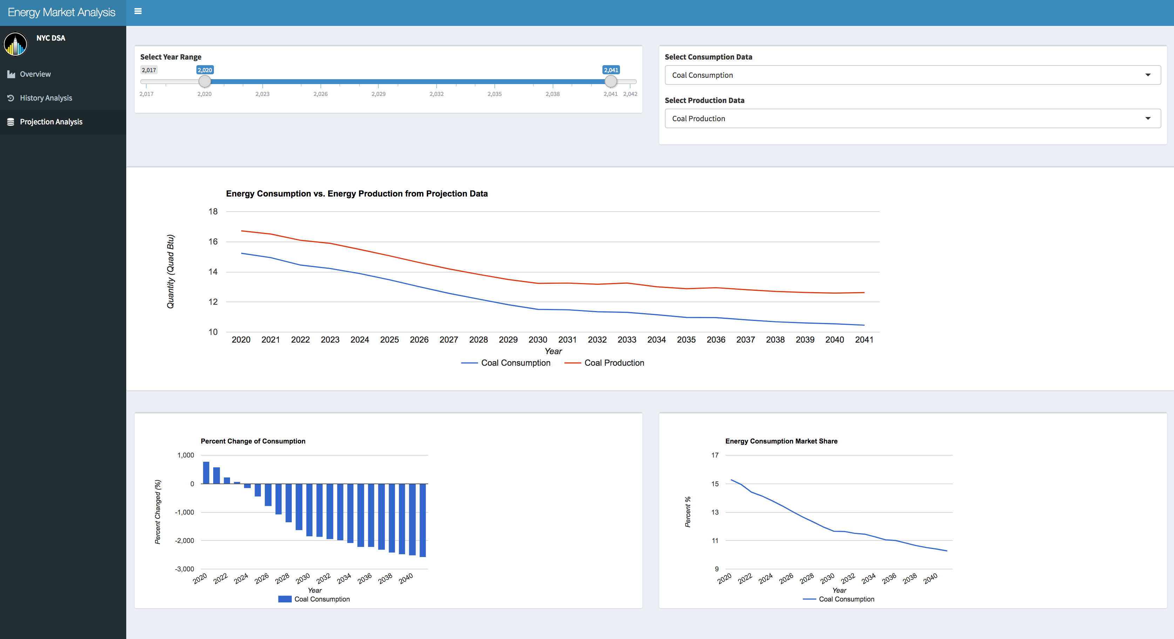
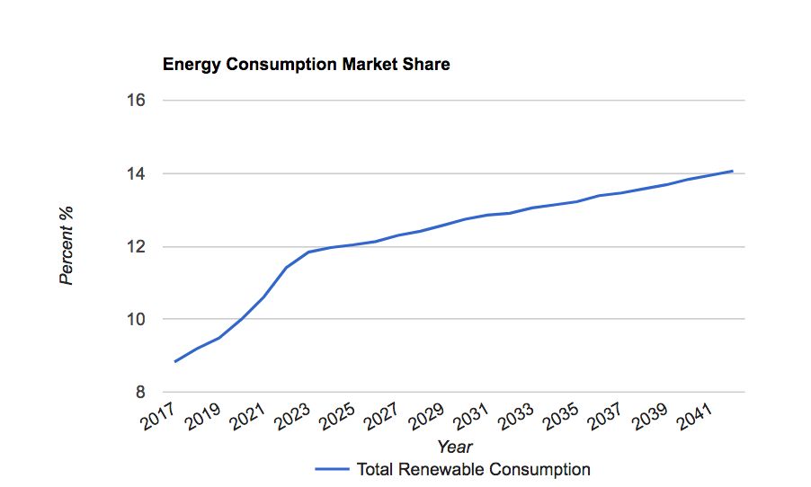
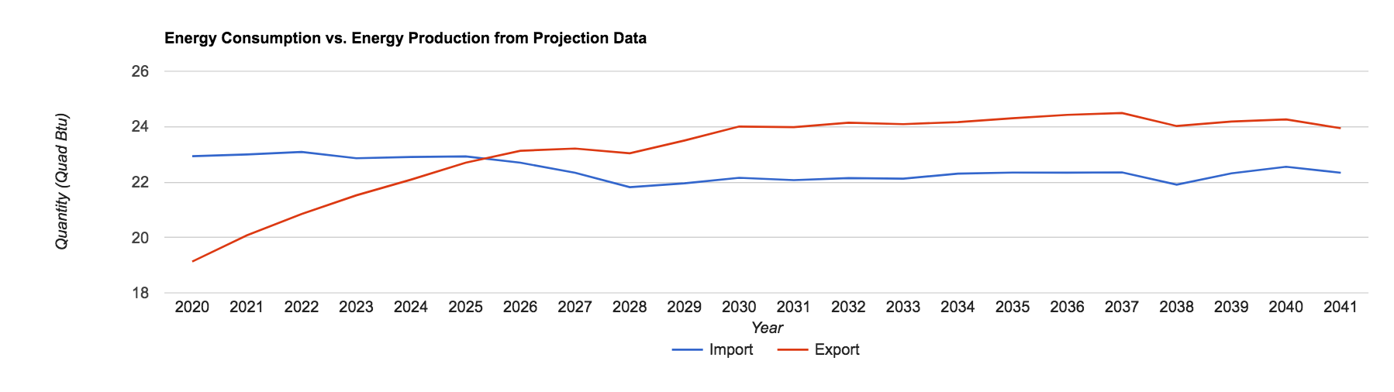
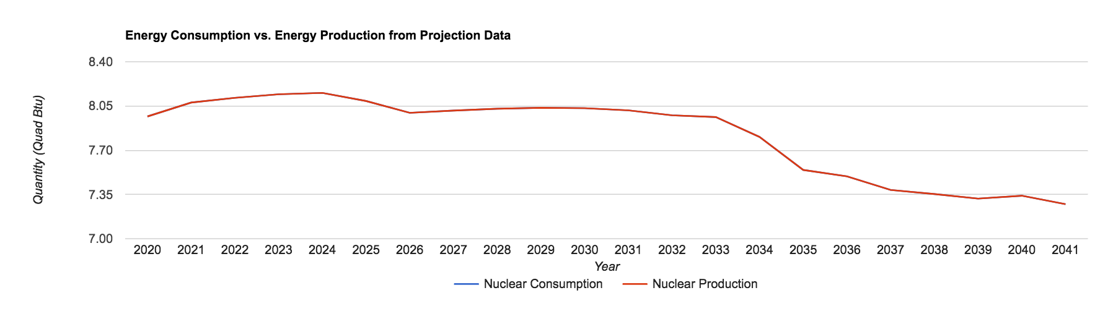
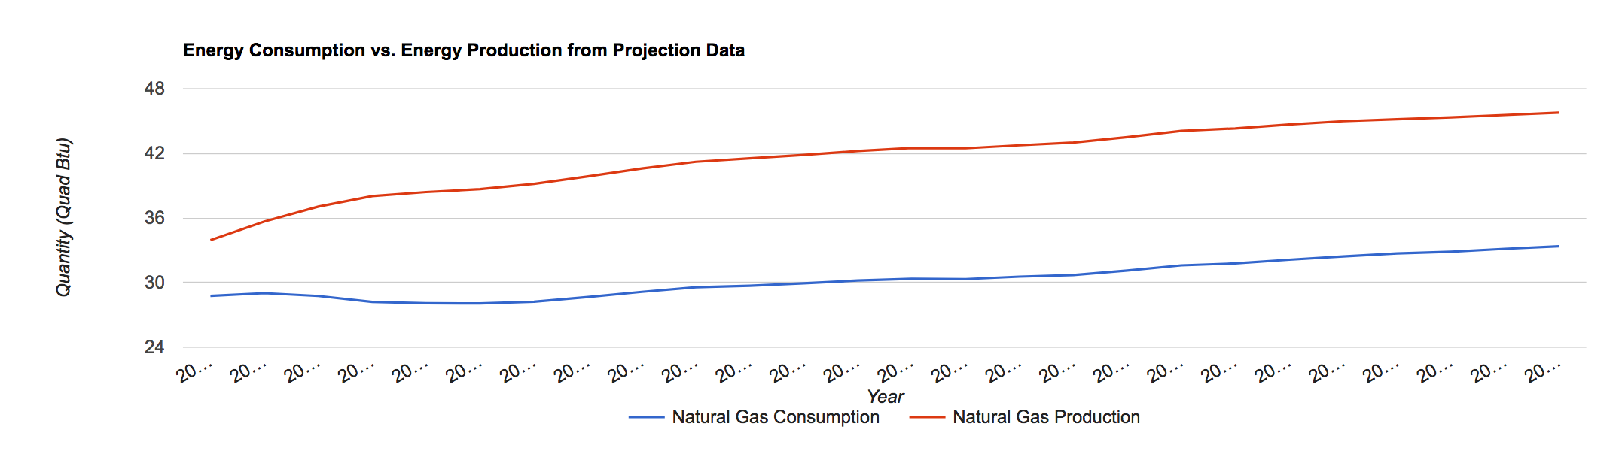
Projection Data Analysis

Slide 9
Conclusion
Are we running out of energy?
How do we fill the gap when coal is going down?
How is the renewable energy doing? Will it replace the fossil fuels?
Will we be energy independent in the future?

Slide 10
Thank You!

