Slide 1
Transformers
A dry run

Slide 2
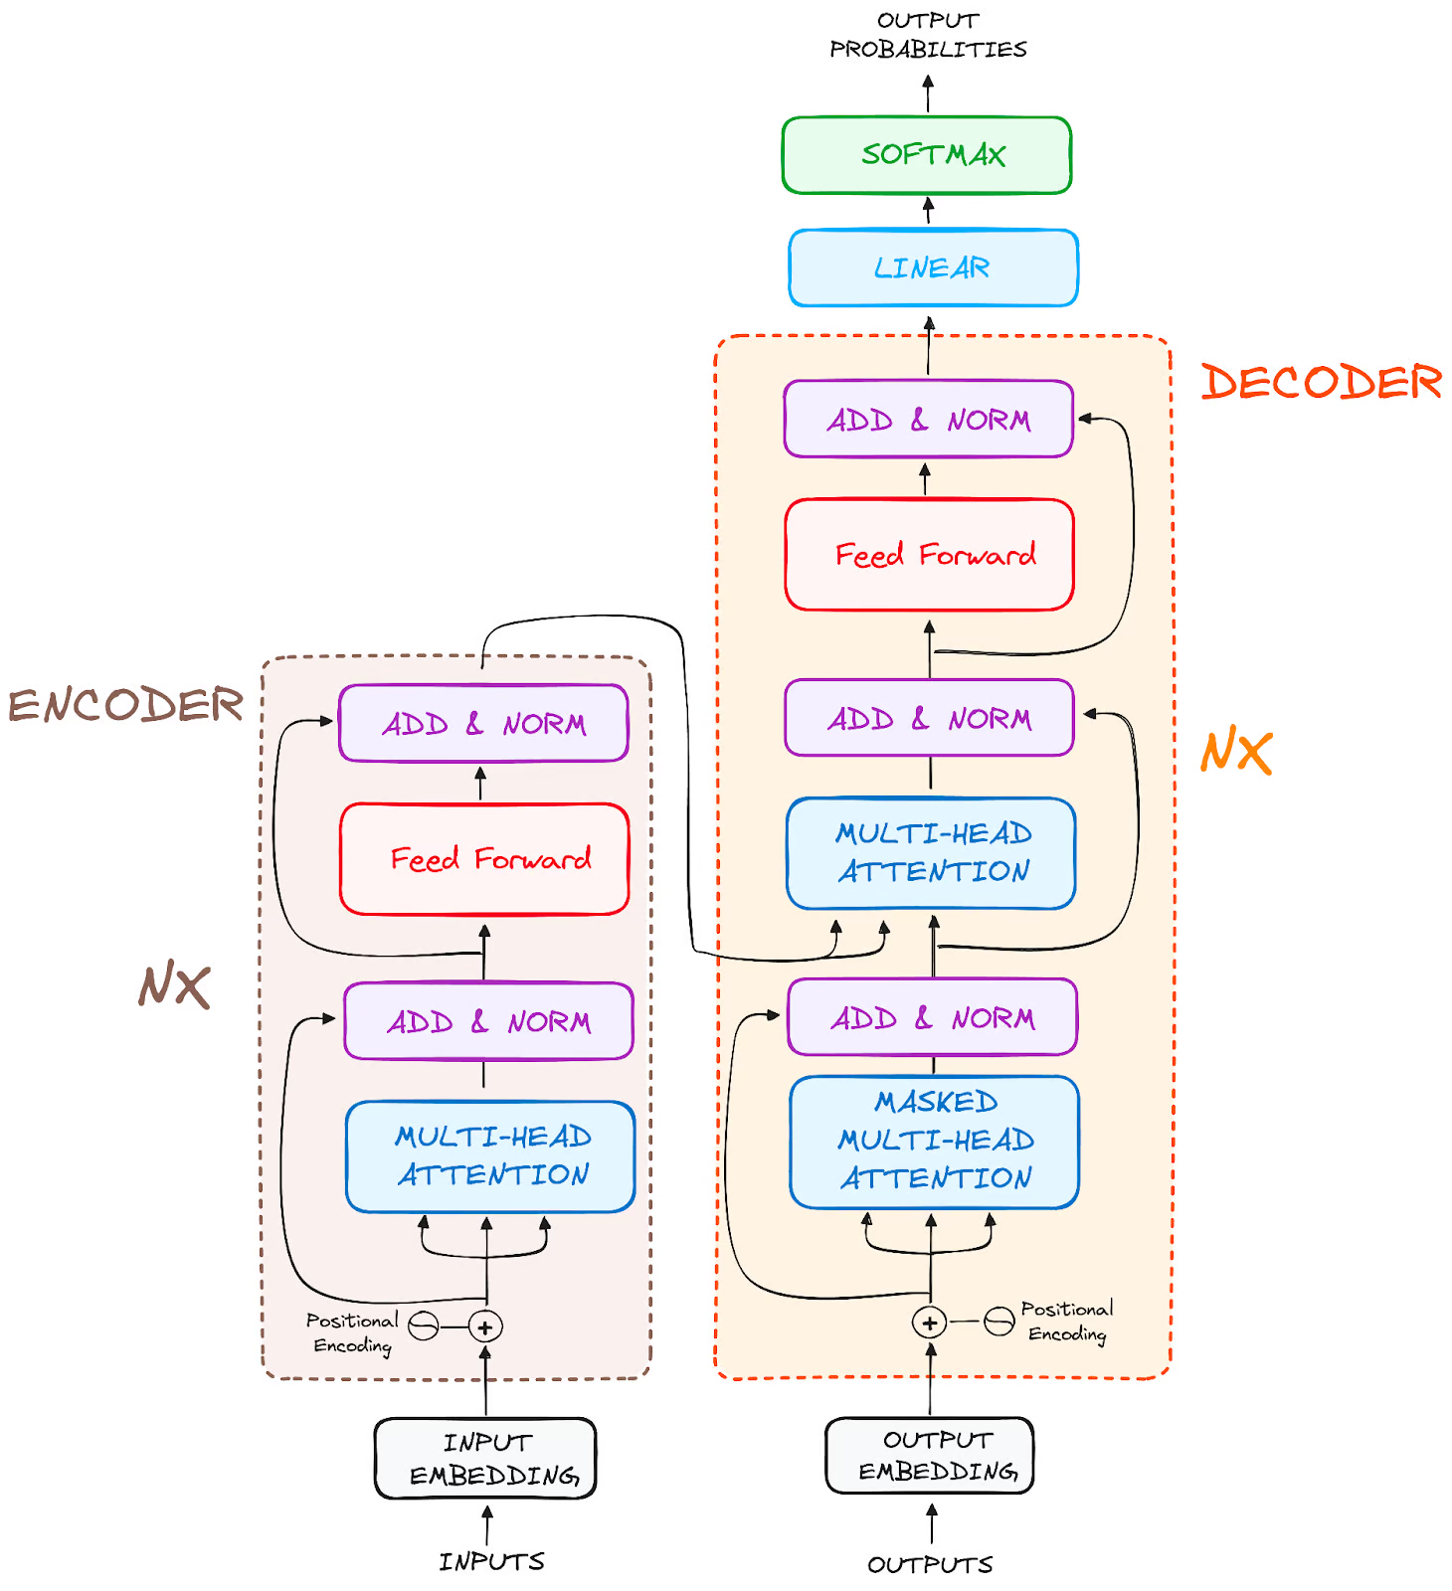

Slide 3
Basic Overview
Load the pretrained model into memory
Initialize the Tokenizer
The tokenizer is usually encoded and converted text into a format that the model can process (i.e. tokens).
Provide input to the transformer
Forward Pass
The sample input undergoes a forward pass through the model. This involves passing the tokenized input through the various layers (such as attention, feed-forward layers, etc.) of the transformer model.

Slide 4
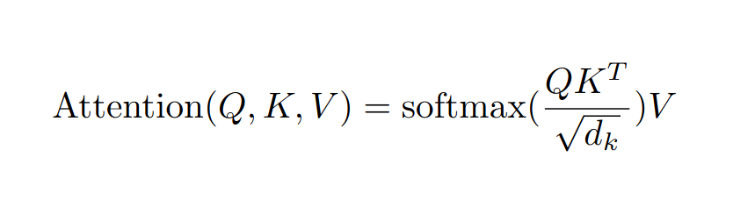
Attention in Transformers
Transformers use a mechanism called self-attention to process input data.
The idea behind attention is that, when processing a word (or token) in a sequence, the model should consider the relationship of that word with all other words in the sequence, not just the previous or next word.
This allows the model to "attend" to relevant parts of the input sequence, regardless of distance between them.

Slide 5
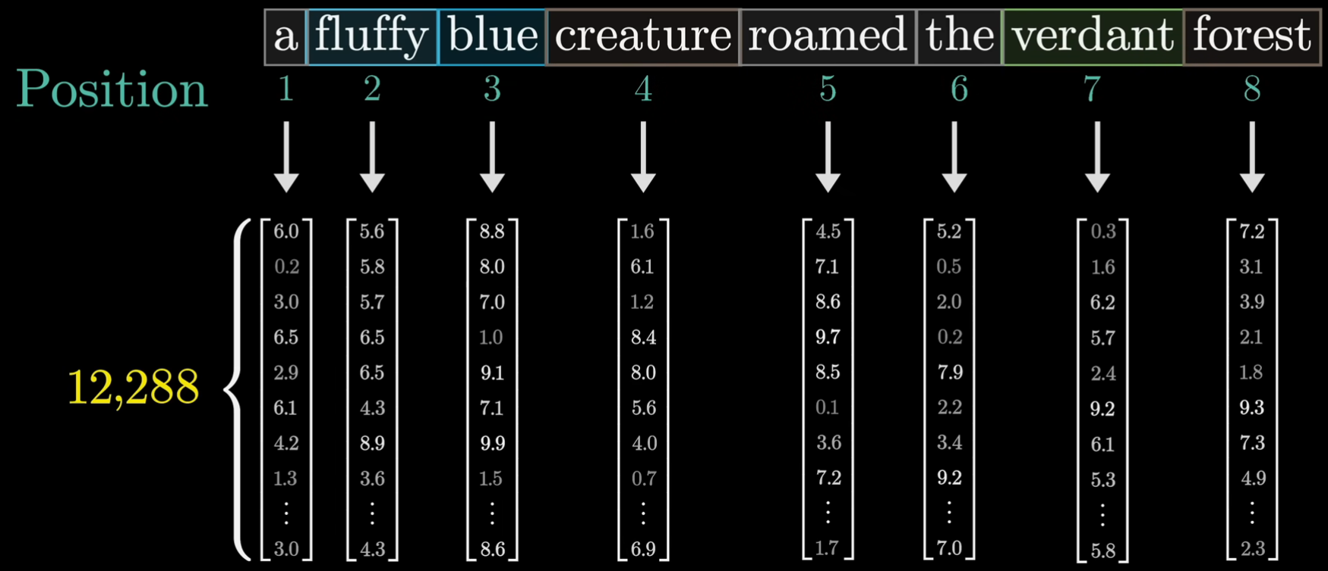
Embeddings

Slide 6
How attention is calculated
Query (Q), Key (K), and Value (V) are the core components of the attention mechanism.
Each word's embedding is transformed into three different vectors (Q, K, V) using learned weight matrices.
The learned weight matrices are parameters that the model adjusts during training to better understand and process the data.
These weights help the model capture patterns, relationships, and dependencies within the input data.
For each word in the sequence we calculate the Q, K and V vectors using the embeddings
Q=Embedding×WQ​
K=Embedding×WK
V=Embedding×WV
Query (Q) represents the word's "question" or focus — which other words should it pay attention to?
Key (K) represents the "answer" to the query — how relevant is this word to the others?
Value (V) used to find the focus after finding out what words are important

Slide 7
Attention Scores
To decide how much attention one word should pay to another, we calculate the attention score.
The attention score is the dot product between the Query vector of the current word and the Key vectors of all words in the sequence.
Mathematically, for word i in the sequence, the attention score with word j is:
Attention Score(i,j)=Qi​⋅Kj​
The attention score is a scalar value, which indicates how much focus word i should give to word j

Slide 8
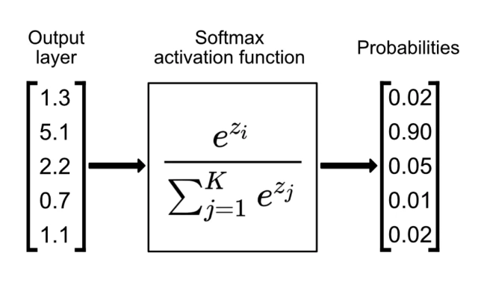
Softmax
Softmax is a function that converts the scores into a probability distribution (i.e., all scores add up to 1).
So in the context of our embeddings, softmax takes a vector as an input and outputs a embedding vector whose entries add up to 1
By applying softmax we ensure that words with higher attention scores get more focus, but all words in the input contribute in some way to our final embedding.

Slide 9
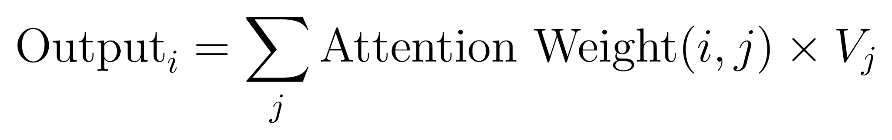
Weighted Sum of Values
Final step is to compute a weighted sum of the Value vectors using the attention weight which gives the output for each word in the sequence.
I.e for a given sequence this is the end state of a particular embedding after being infused with the context of the words in the entire input.
After calculating the weighted sum, we get a new vector for each word. This new vector is the "contextualized" representation of the word, taking into account the relationships with other words in the sequence.
These contextualized vectors are passed through the remaining layers of the transformer (like feed-forward networks, etc.) to produce the final output.

Slide 10
Example run

Slide 11
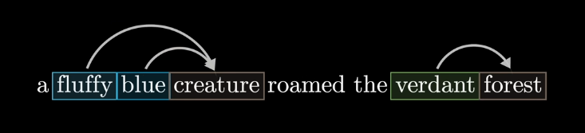
Example
Suppose we take this sentence and a case where the only update we want on this sentence is that the adjectives update the meaning of the nouns

Slide 12
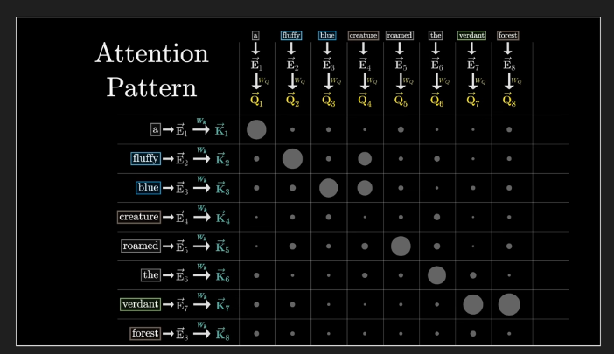
Single headed attention
For our case we will be considering a single headed attention pattern as opposed to the real world multi-headed attention pattern where tens or hundreds of attention heads are running in parallel

Slide 13
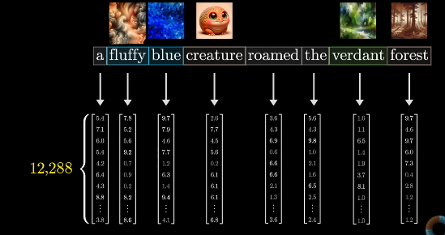
The Encoder
The encoder generates high dimensional vector embeddings for each word that tell basically tell you “what the word is” and “where it exists in the context”

Slide 14
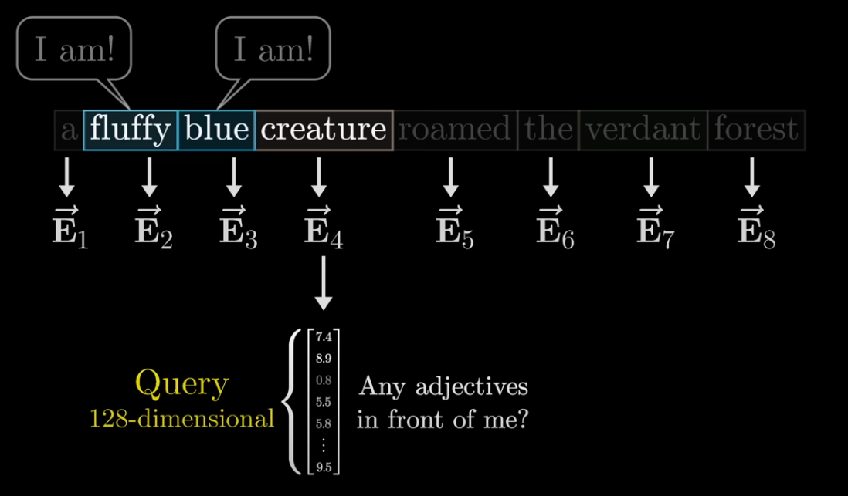
Query vector
A “question” encoded as a vector with a much smaller dimension is generated as the ‘query’ for that word for that token

Slide 15
Query vector
The query vector is generated by multiplying a certain matrix (labelled as Wq) by the generated embedding for the word.
The entries of this matrix are the ‘parameters’ of the model and for a real model with multi headed attention heads it would be much more complex to parse

Slide 16
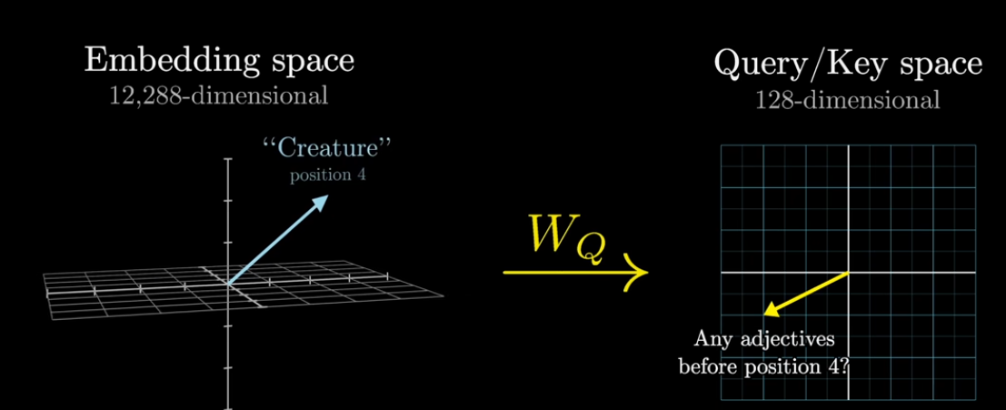
Wq
For our example we are going to suppose that the Wq matrix maps the nouns from the embedding space to certain directions in a smaller query space that somehow ‘encodes’ the notion of looking for adjectives

Slide 17
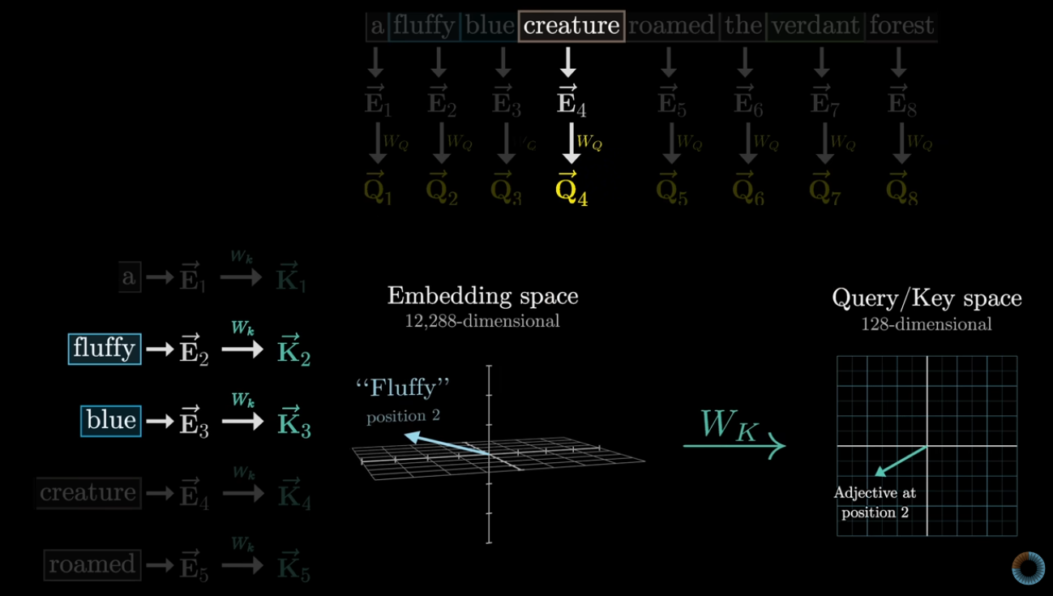
Wk
There is also a key matrix that does a similar thing by mapping the “answers to the query” to a smaller key space.

Slide 18
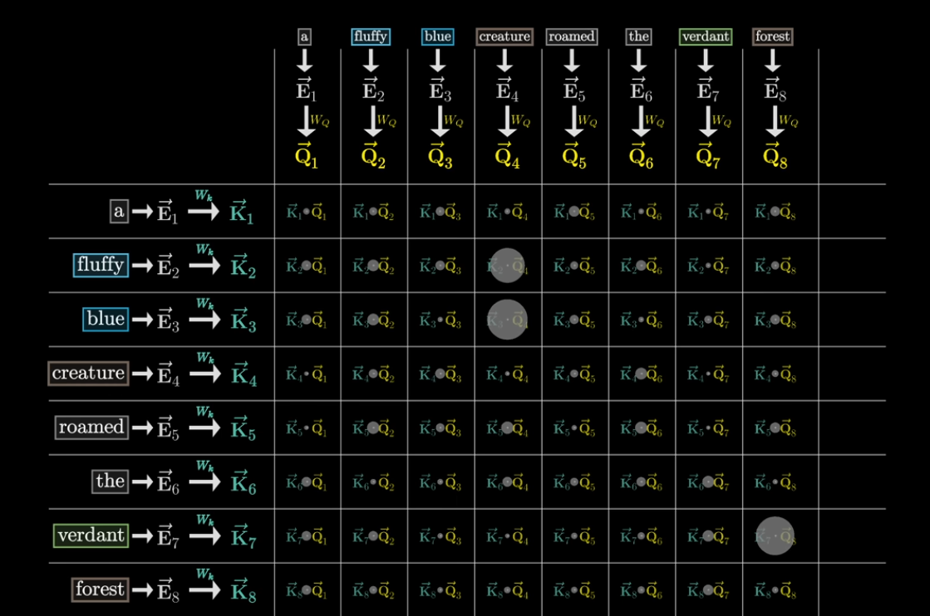
Wk • Wq
The dot product of the Query and the Key matrices lets us measure how close or similar the generated mappings are for all the queries and the keys.
In the example you can see how the values of fluffy and blue “attend to” the value of creature

Slide 19
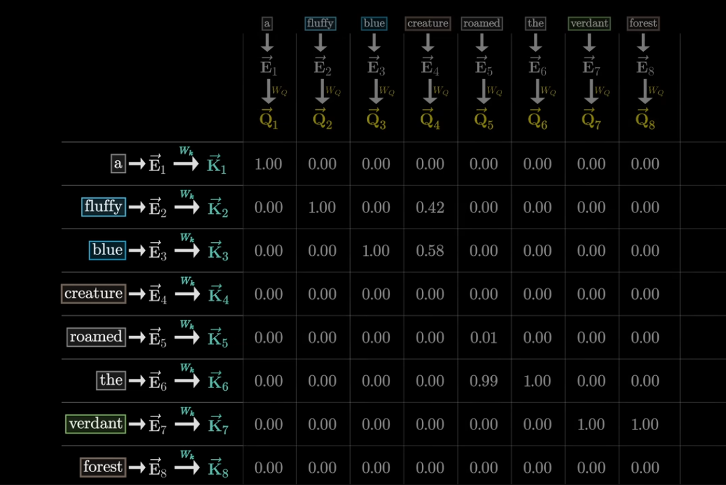
Softmax
A softmax operation is performed to normalise the generated vectors so that the generated dot products add up to 1.00, to represent how the probabilities of the similarities add up to 1.0.

Slide 20
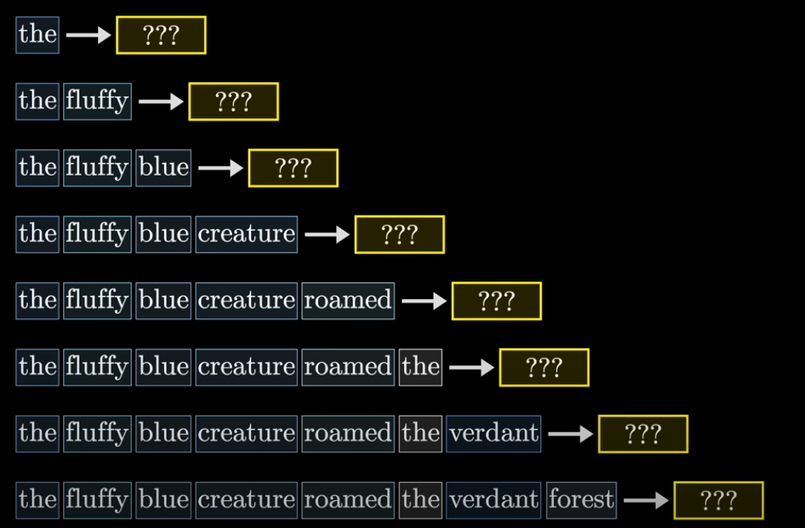
Masking
When tuning the weights for the model, to make the process more efficient, we can have the model predict the next token for each sub-sequence in the given passage. To make it guess what the next word could be while processing each sequence. This makes the whole process much more efficient as it runs multiple times (for each subsequence) in the same sequence allowing for better tuning overall.

Slide 21
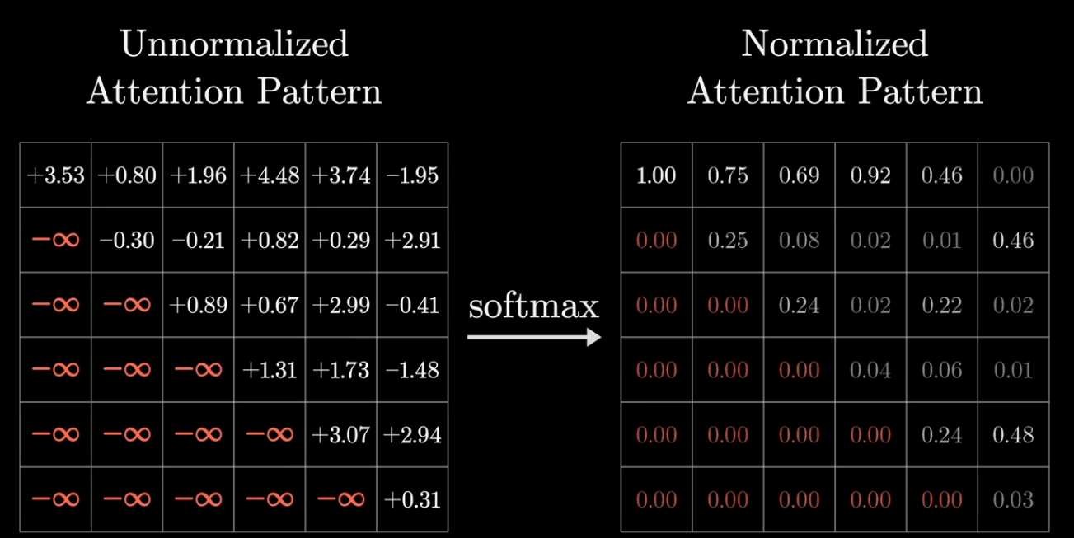
Masking
For this purpose, we don’t want the later words/tokens to influence the values for the previous tokens, as it would give away the value for the “guess” therefore we apply a sort of a mask on the values so that when the softmax is applied, it normalises to 0.0

Slide 22
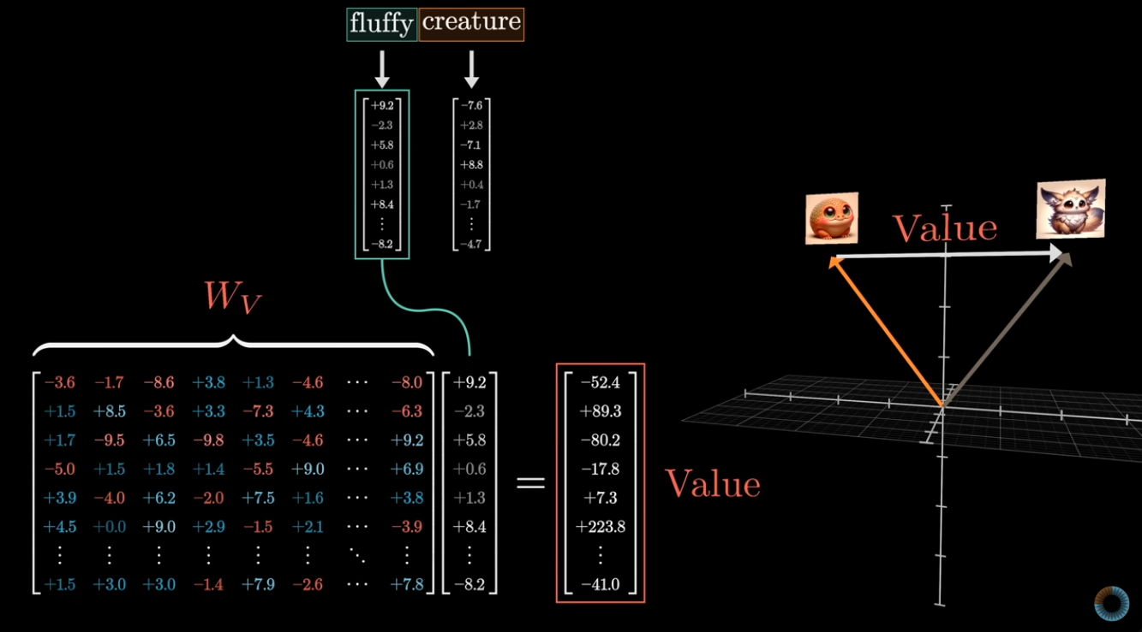
The value matrix
To now update the value of the embeddings so that they reflect the changes due to the adjectives. We now take another value matrix Wv and multiply it by the adjective to get the value to add to the noun it describes, to transform it in the embedded space and reflect the meaning of the adjective

Slide 23
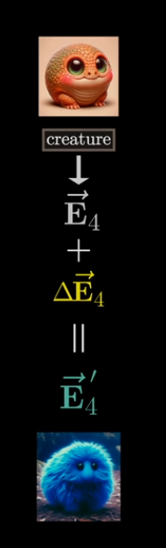
Finishing up
The final computed values let us “transform” the meaning of creature by applying the values of blue and fluffy.
This wraps up the process for the single attention head. For a real world model this same process is repeated over tens of attention heads simultaneously to allow better and complete updates to the meaning of words.
This describes the entire process for a self-attention head (that is used in GPT models)

