Slide 1


Pure-Gemma Evolution Matrix
Agentic Workflows for Python Test Generation
Politecnico di Torino
Johnprice Osagie · Matteo Gastaldello · Erestina Vreto
Large Language Models for Software Engineering (2025 / 2026)

Slide 2
POLITECNICO DI TORINO
Tech Stack
Large Language Models for Software Engineering · Group Project
— 2 —
Architecture
Orchestration
LangGraph: Stateful multi-agent workflows and complex logic routing.
LLM Backend
Google Vertex AI / AI Studio: Testing across Gemma family (1B to 31B parameters).
Execution & Data
Execution
Custom Instrumentation: AST parsing for fine-grained tracking.
Multi-process isolation with hardware kill-switches (for API rate limits).
Data Engineering
Results Pipeline: 265-row matrix using pandas across 8 models, 11 architectures, and 4 strategies.
Politecnico di Torino · Large Language Models for Software Engineering · 2025 / 2026

Slide 3
POLITECNICO DI TORINO
Dataset
Large Language Models for Software Engineering · Group Project
— 3 —
The "Hardest" Logic Subset
Targeting Pure Reasoning
Isolated a 25-task subset from HumanEval consisting of purely algorithmic challenges (no I/O, no network calls).
The Final Range
Selected tasks 139 to 163, representing the most mathematically and logically complex problems in the dataset.
Why EvalPlus (Breaking Memorization)
Beyond Standard Tests
Vanilla HumanEval only has ~7 simple tests. LLMs often "memorize" these standard solutions. EvalPlus is an evolution of HumanEval with up to 700+ tests per task .
Massive Amplification
EvalPlus augments this with ~80× more test cases per task.
HumanEval/140 — fix_spaces(text)
Goal: Replace single spaces with '_' and groups of >2 spaces with '-'.
# Examples:
"Example 1" -> "Example_1"
" Example 3" -> "_Example-3"
HumanEval/143 — words_in_sentence(s)
Goal: Return only words whose length is a prime number.
# Examples:
"This is a test" -> "is"
"lets go for swimming" -> "go for"
Politecnico di Torino · Large Language Models for Software Engineering · 2025 / 2026

Slide 4

POLITECNICO DI TORINO
Prompting Techniques
Large Language Models for Software Engineering · Group Project
— 4 —
Experimental Setup
Strategies
Zero-shot: Plain task description, no example
Few-shot: 2 solved HumanEval examples as priming
CoT: Chain-of-Thought — "Let's think step by step"
SCoT: Structured CoT — reasoning → plan → code
Implementation & Goals
Routed via apply_reasoning_style() in prompts.py
Goal: Isolate prompting impact vs. agent architecture
Key Findings
4B: Few-shot dominates performance
27B / 4-31B: SCoT provides significant boost
12B: Hurt by CoT — verbose but inaccurate
Observations & Constraints
Parameters & Output
4B: Cleanest code blocks, lowest parser error
27B+: Prose preamble requiring regex stripping
Temp: Deterministic vs Probabilistic/”Creative”
Experimental Control
Standardized system prompt for multi-agent fairness
Ablation: Prompt change alone → +6% PR delta
Identified Risks
Few-shot: Risk of example leakage/over-fitting
CoT: Risk of hallucinated reasoning justifications
Prompting ≠ replacement for agent feedback loops
Politecnico di Torino · Large Language Models for Software Engineering · 2025 / 2026

Slide 5
POLITECNICO DI TORINO
Agents Overview
Large Language Models for Software Engineering · Group Project
— 5 —
Baseline
Single LLM call without iterative loops. Used as the Control Condition.
Generation
Specialized patterns for code synthesis. Agents: Swarm, Atomic Swarm, CoA, SOA.
Validation
Quality gates and error correction. Agents: Consensus, Self-Healing, Actor-Critic.
Adversarial
Competitive debugging and edge-case discovery. Agents: Adversarial, Competitive.
Hybrid
Integrated pipelines combining generative reasoning with automated validation.
System Framework
Common state managed by LangGraph StateGraph
Conditional edges transition on test pass / fail
Max iteration cap (5–10 rounds) prevents infinite loops
Matrix: 5 models × 11 agents × 4 prompts = 220 configs
Pseudocode — main feature
Pseudocode — main feature
# baseline.py — control condition
def run(task, model):
return model.generate(task.prompt)
Politecnico di Torino · Large Language Models for Software Engineering · 2025 / 2026

Slide 6

POLITECNICO DI TORINO
Generation: Swarm, Atomic Swarm, CoA, SoA
Large Language Models for Software Engineering · Group Project
— 6 —
Swarm
N parallel generators with voting.
Aggregation: Vote, test-filtering, or LCS.
Optimal N: N=10 for small model variance.
Atomic Swarm
Workers + unit tests.
Token Premium: Swarm cost scales O(N).
CoA
Sequential (Planner → Coder → Tester → Fixer).
Error Compounding: Sequential hallucination risk.
SoA
Multi-turn collab (Architect, Coder, Reviewer).
Pseudocode — Main Implementation Patterns
# Swarm
def swarm(task, model, N=10):
cands = [model.generate(task.prompt)
for _ in range(N)]
final = aggregate(cands,
strategy="dedupe+compose")
return final
# Atomic Swarm
def atomic_swarm(task, model):
base = model.generate(task.prompt +
" // typical case")
edge = model.generate(task.prompt +
" // edge case")
type_c = model.generate(task.prompt +
" // type/invalid")
return merge([base, edge, type_c])
# CoA (Chain of Analysis)
def coa(task, mgr, worker):
dims = mgr.analyze(task.prompt)
suite = ""
for d in dims:
suite += worker.generate(
task.prompt + f" // focus: {d}")
return suite
# SOA (Service-Oriented)
def soa(task, orch, spec):
specs = orch.identify(task.prompt)
tests = []
for s in specs:
tests.append(spec.generate(
task.prompt + f" // exp: {s}"))
return combine(tests)
Politecnico di Torino · Large Language Models for Software Engineering · 2025 / 2026

Slide 7
POLITECNICO DI TORINO
Validation: Consensus, Self-Healing, Actor-Critic
Large Language Models for Software Engineering · Group Project
— 7 —
Consensus
3 proposers + 1 judge model
Judge ranks candidates on correctness + clarity
Highest performance ceiling
Self-Healing
Cycle: generate → test → feedback → regenerate
Max 5 rounds; early abort on no-change
Most token-efficient strategy
Actor-Critic
Dynamic duo: Tester defends, Hacker breaks
Hacker targets candidate failure points
Excellent for surfacing edge-case blind spots
Pseudocode — Main Implementation Patterns
# Consensus
def consensus(task, proposers, judge):
cands = [p.generate(task.prompt)
for p in proposers]
return judge.select(cands,
criteria="correctness")
# Self-Healing
def self_heal(task, model, rounds=5):
code = model.generate(task.prompt)
for _ in range(rounds):
if passes(code): return code
errs = run(code)
code = model.generate(p, errors=errs)
return code
# Actor-Critic
def actor_critic(task, actor, critic):
code = actor.generate(task.prompt)
for _ in range(3):
fb = critic.review(code)
if fb == "PASSED": return code
code = actor.generate(p, feedback=fb)
return code
Politecnico di Torino · Large Language Models for Software Engineering · 2025 / 2026

Slide 8
POLITECNICO DI TORINO
Adversarial, Competitive & Hybrid
Large Language Models for Software Engineering · Group Project
— 8—
Adversarial
Tester defends, Hacker breaks
Hacker proposes inputs that fail the candidate
Useful for surfacing edge-case blind spots
Competitive
Two generators judged head-to-head
Strength: explicit quality signal at every step
Weakness: errors compound; Critic must outrank Actor
Hybrid
Swarm population followed by Self-Healing
Aggregation: majority vote / test-based / LCS
Token cost: linear in N (dominant expense)
Risk: correlated hallucinations across workers
Pseudocode — Main Implementation Patterns
# Adversarial
def adversarial(task, hacker, tester):
mutated = hacker.mutate(task.source)
tests = tester.generate(task.prompt_for(mutated))
res = run_tests(mutated, tests)
caught = (res.failed > 0 or res.errors > 0)
return {"mutated": mutated, "caught": caught}
# Competitive
def competitive(task, models):
gens = {m: m.generate(task.prompt) for m in models}
scores = {}
for m, code in gens.items():
m_res = run_tests(task.source, code)
scores[m] = m_res.functional_correctness * 100
return {"winner": argmax(scores)}
def hybrid(task, gen_model, evolve_model):
# Diverse variations (swarm)
pop = [gen_model.generate(task.prompt + f" // v{i}") for i in range(2)]
# Evolve into final solution
best = evolve_model.generate("Merge:\n" + "\n---\n".join(pop))
return best
Politecnico di Torino · Large Language Models for Software Engineering · 2025 / 2026

Slide 9
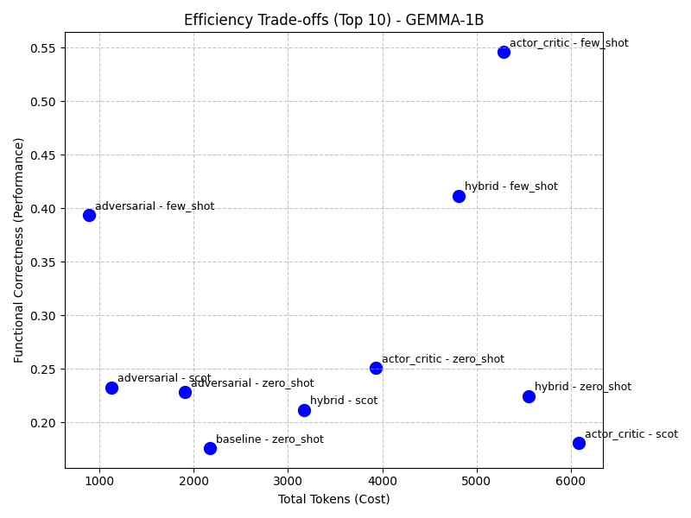
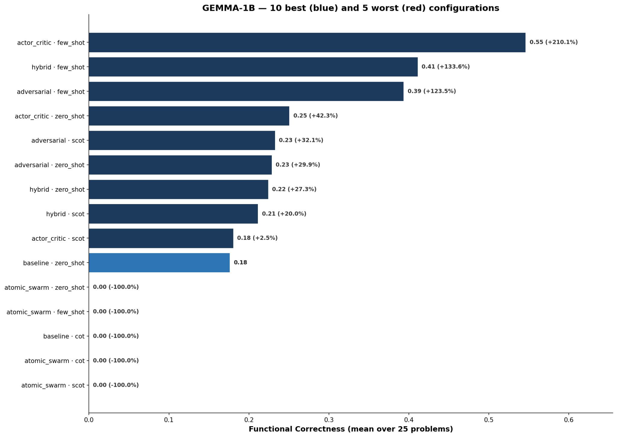
POLITECNICO DI TORINO
Results — Gemma-1B
Large Language Models for Software Engineering · Group Project
— 9 —
Considerations:
Top Performer: actor_critic + few_shot Achieves 54.6% Pass Rate (3x increase over the zero_shot baseline).
Few-Shot is essential: because of the lack of abstraction, providing concrete examples is critical for structuring code correctly.
Architectural Limits Overly fragmented multi-agent workflows (e.g., atomic_swarm, coa) overwhelm the model, collapsing to 0% accuracy.
Token Consumption Trade-off Consumes ~2.5x more tokens (~5300 vs ~2160), but completely triples the success rate.
Politecnico di Torino · Large Language Models for Software Engineering · 2025 / 2026

Slide 10
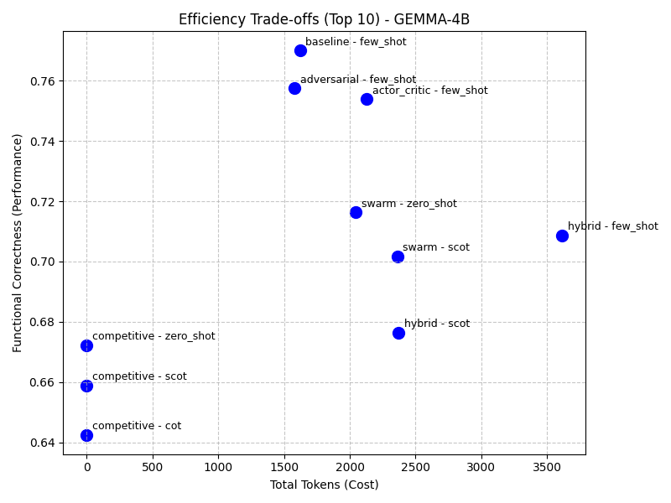
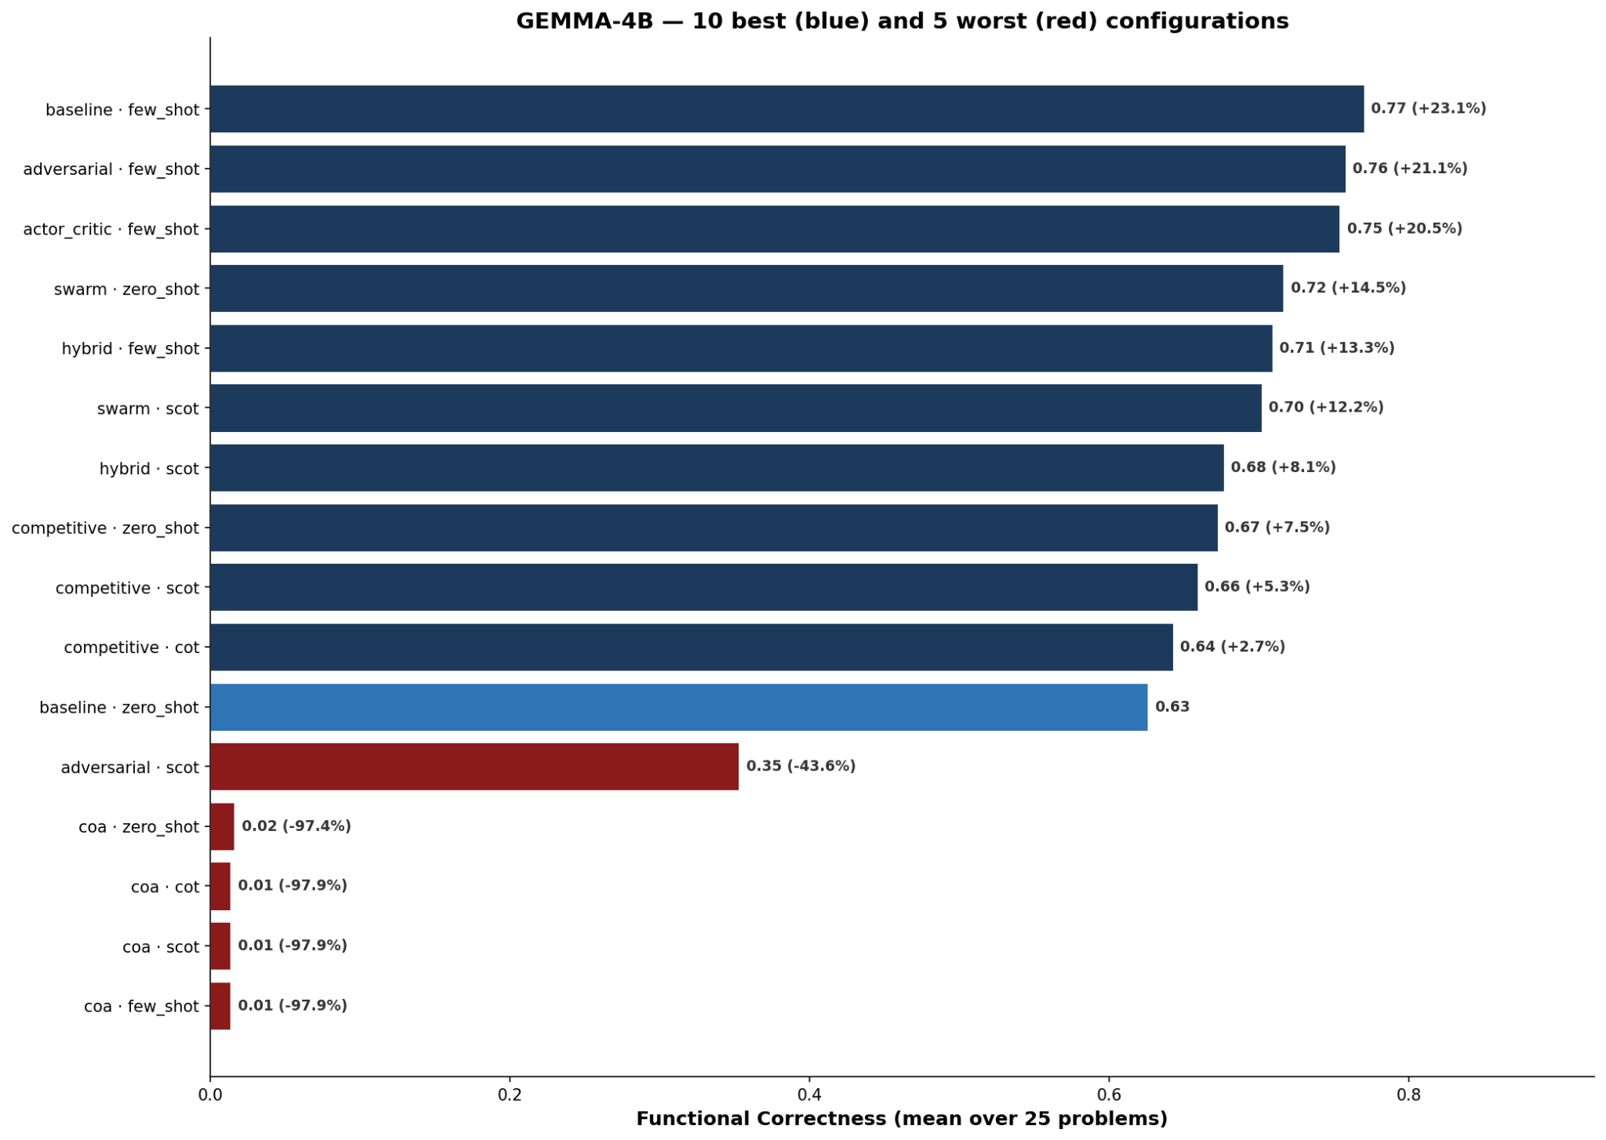
POLITECNICO DI TORINO
Results — Gemma–4B
Large Language Models for Software Engineering · Group Project
— 10 —
Considerations:
Simplicity Wins: baseline + few_shot Peak accuracy at 77.0% (+15% over zero_shot).
actor_critic and adversarial approaches are competitive (~75%) but introduce unjustifiable system overhead.
Chain of Abstraction (CoA) workflows fail entirely (~1.3%). Forcing a 4B model to write and translate pseudo-code destroys context.
Providing examples actually reduces token usage (~1620 vs ~2527). The model avoids hallucinations and writes concise code.
Politecnico di Torino · Large Language Models for Software Engineering · 2025 / 2026

Slide 11
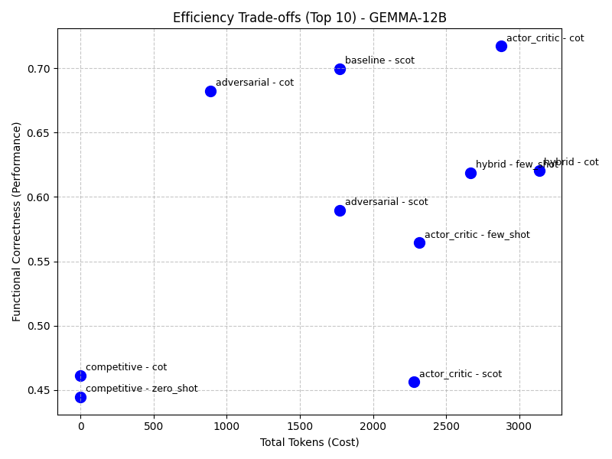
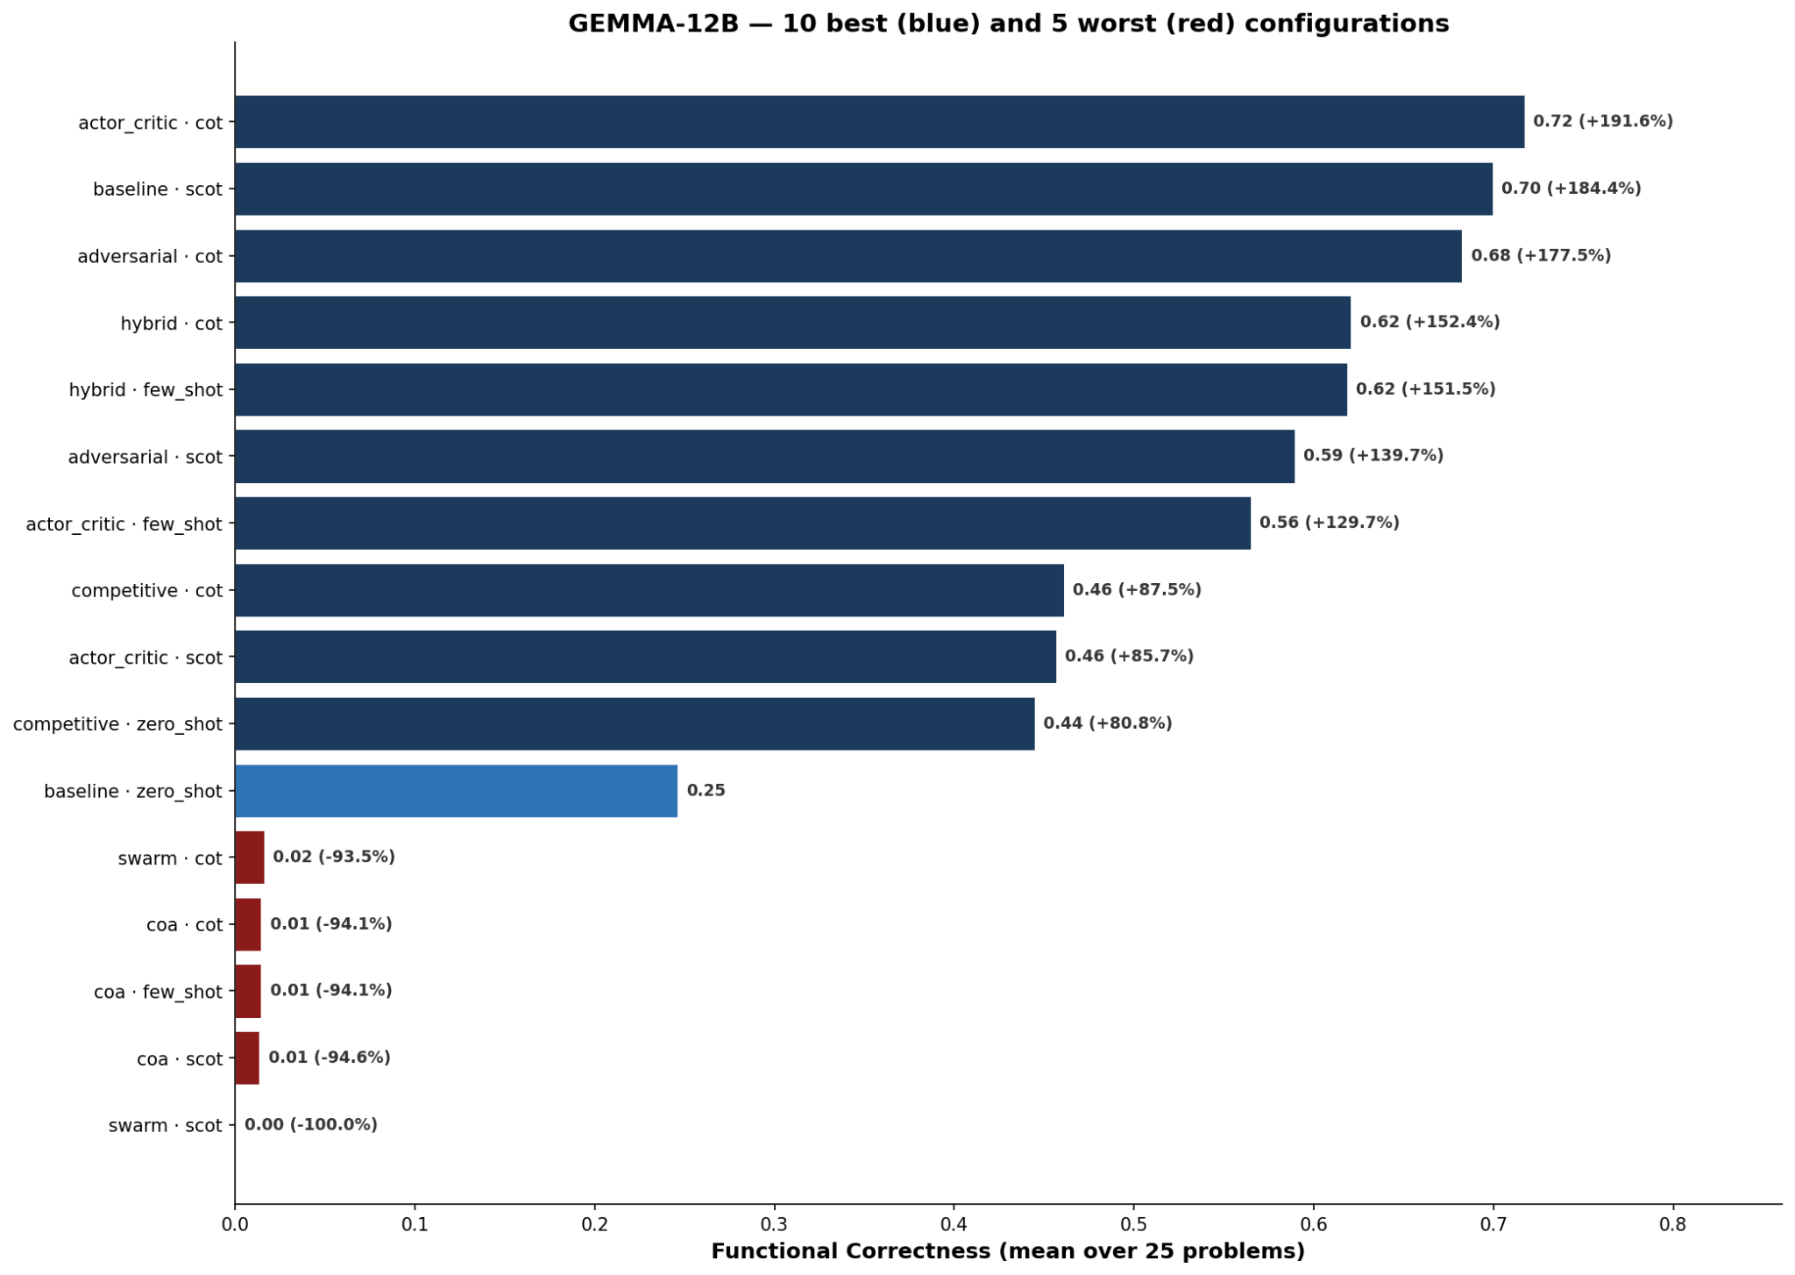
POLITECNICO DI TORINO
Results — Gemma-12B
Large Language Models for Software Engineering · Group Project
— 11 —
Considerations:
Size Isn't Everything: zero_shot baseline severely underperforms at just 24.6%.
CoT: actor_critic + cot Forcing the model to "think aloud" (Chain of Thought) jumps accuracy to 71.7% (nearly a 3x jump).
Heavy Abstraction Fails Complex multi-agent architectures (swarm) or pseudo-code translation (coa) overwhelm the 12B model, collapsing to ~0-1.6% accuracy.
Efficiency: adversarial + cot Achieves a 68.2% accuracy while using only ~891 tokens—costing almost exactly the same as the weak baseline.
Politecnico di Torino · Large Language Models for Software Engineering · 2025 / 2026

Slide 12
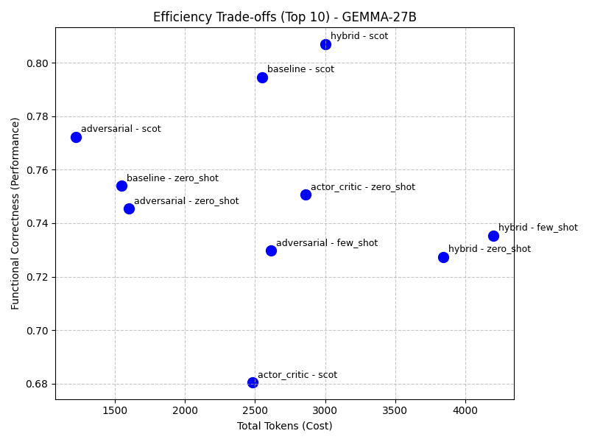
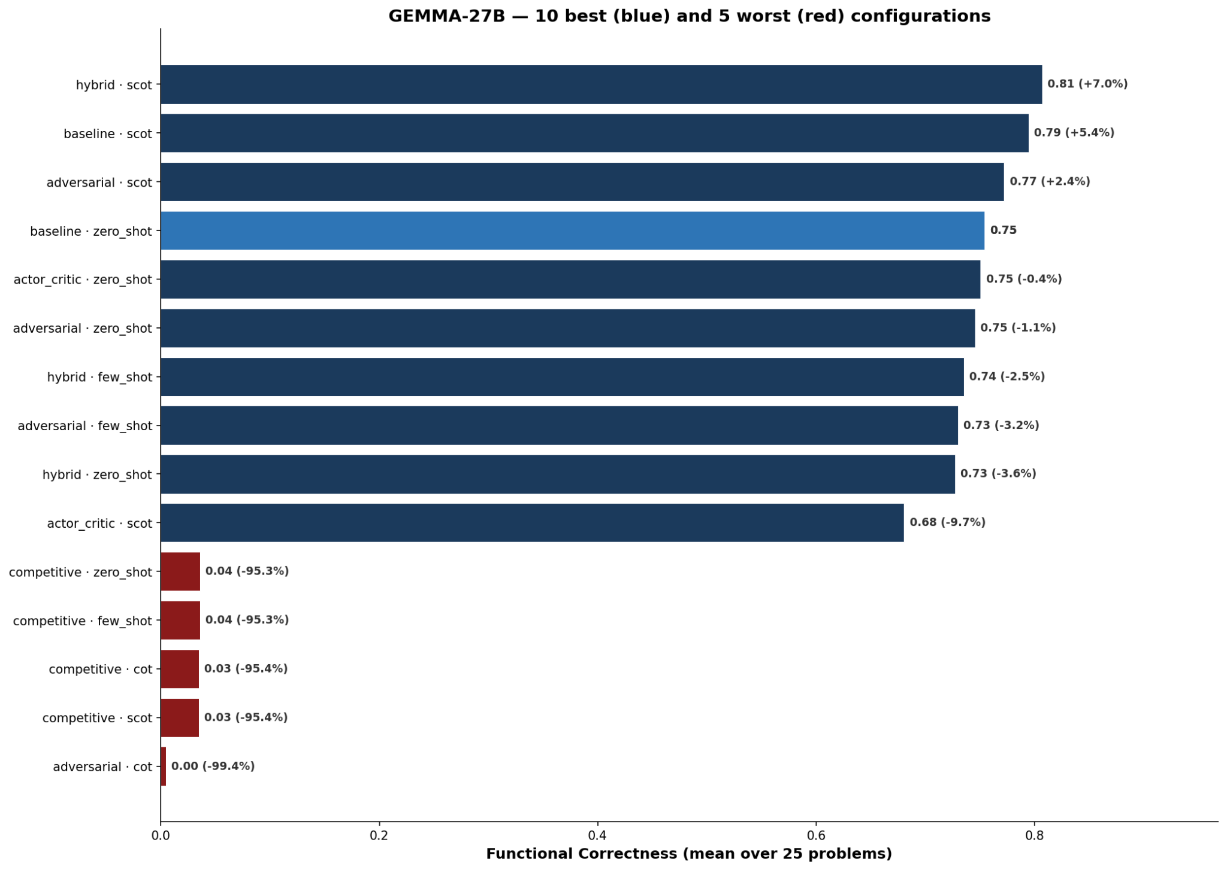
POLITECNICO DI TORINO
Results — Gemma-27B
Large Language Models for Software Engineering · Group Project
— 12 —
Considerations:
Massive out-of-the-box performance (zero_shot baseline is 75.4%). Heavy multi-agent systems add marginal gain while doubling token costs.
Self-Correction: The top 3 overall strategies rely entirely on SCoT. Model is able to review and fix its own code.
adversarial:scot achieves a 77.2% accuracy while consuming fewer tokens than the raw baseline (~1224 vs ~1547).
Forcing the model into a competitive multi-agent environment crashes accuracy to ~3.4%. The model gets lost trying to follow the rules of the debate.
Politecnico di Torino · Large Language Models for Software Engineering · 2025 / 2026

Slide 13
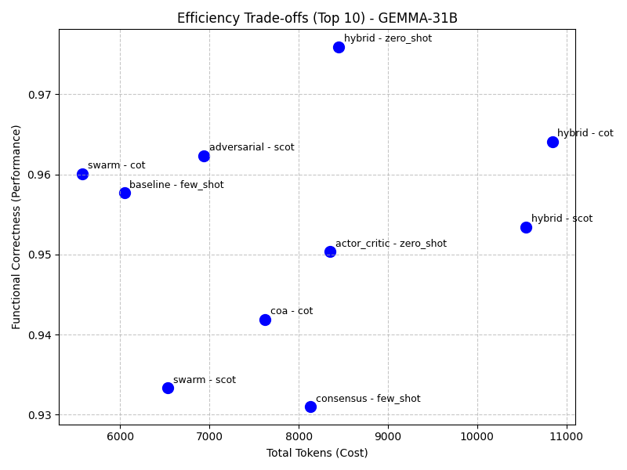
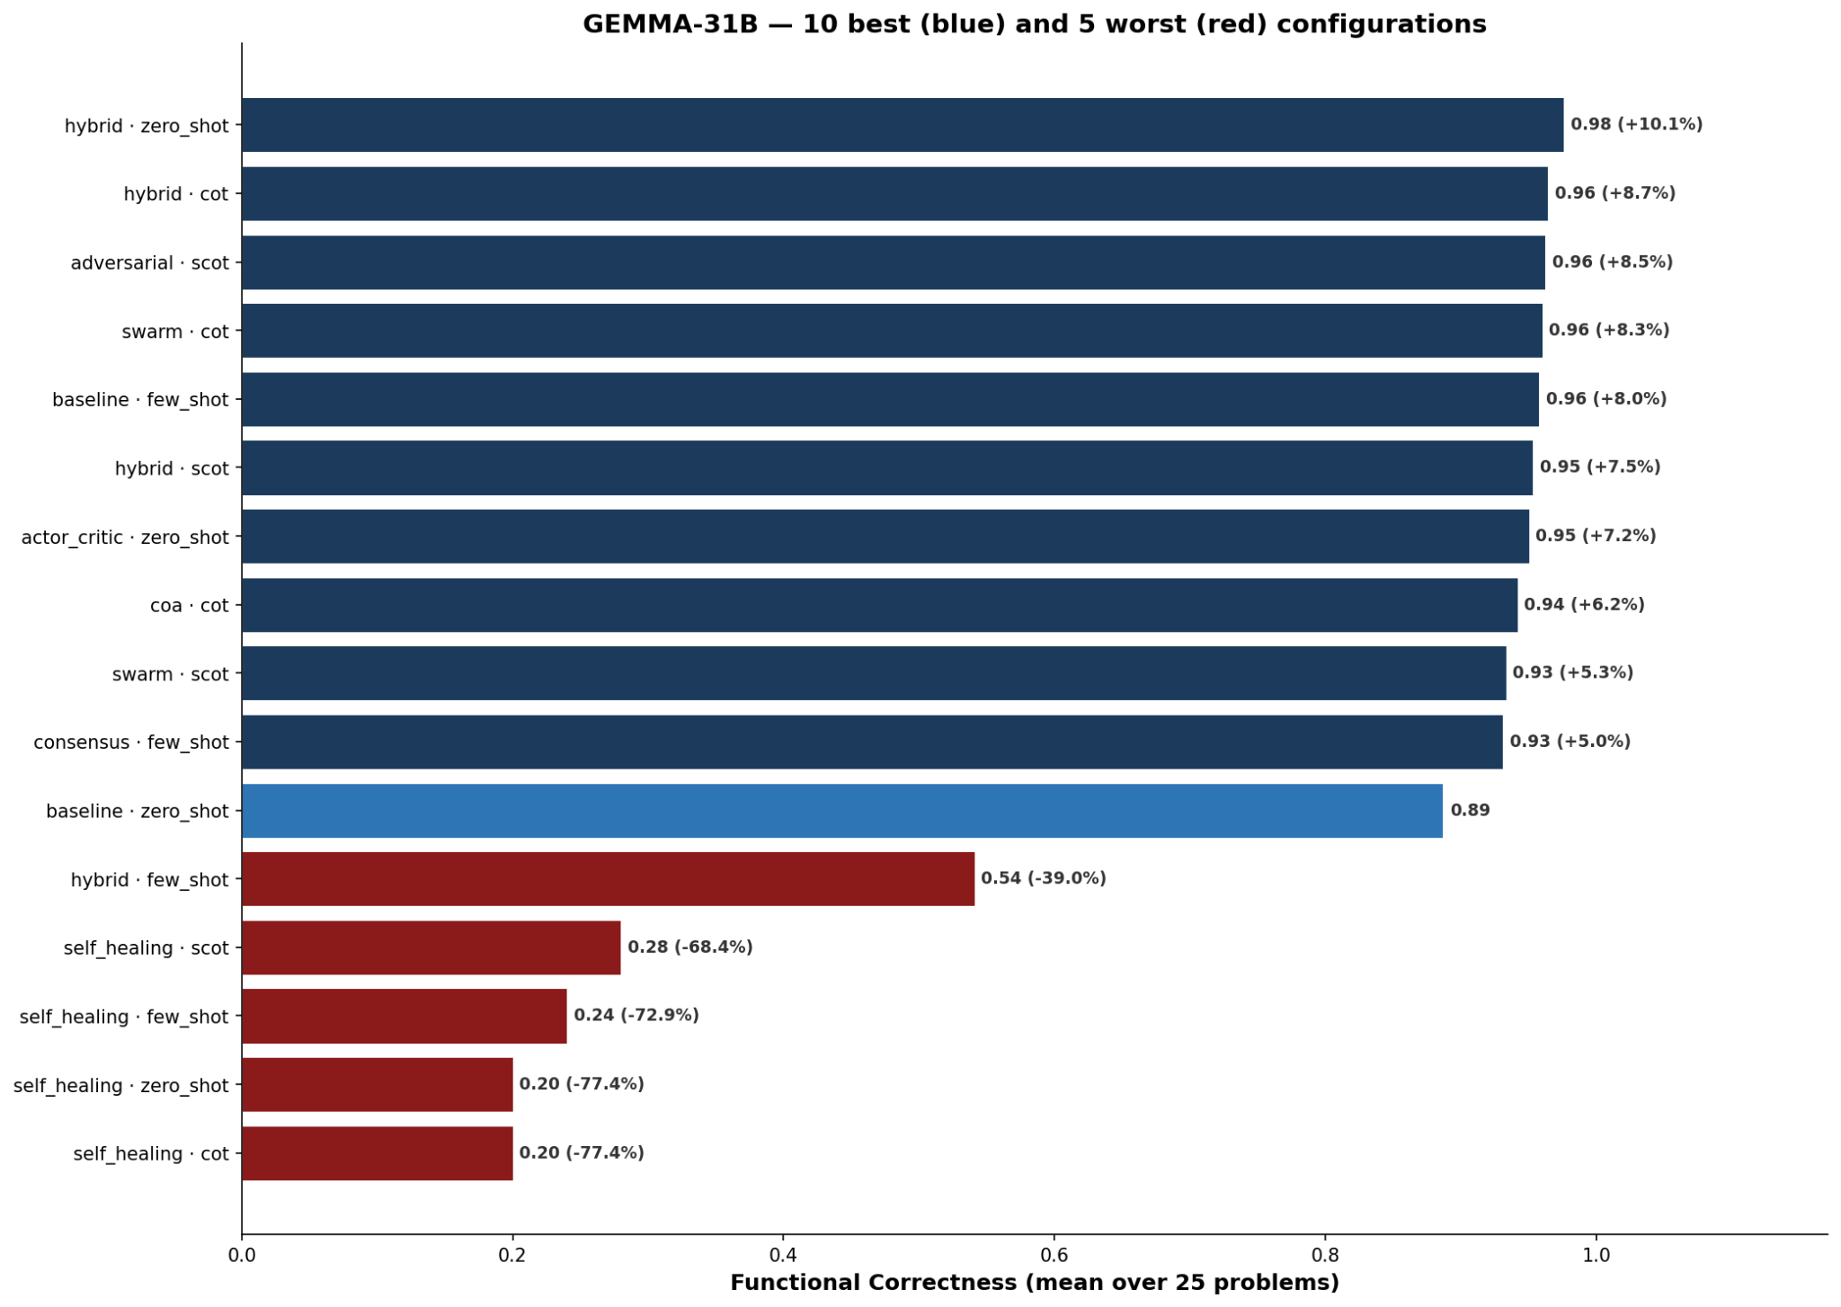
POLITECNICO DI TORINO
Results — Gemma-4-31B
Large Language Models for Software Engineering · Group Project
— 13 —
Considerations:
The unassisted zero_shot baseline starts at a massive 88.6%.
The hybrid:zero_shot architecture reaches a near-perfect 97.6% accuracy.
Few-Shot Penalty: Providing examples harms performance (e.g., forcing a few_shot on the hybrid agent drops accuracy to 54%).
Extreme Token Efficiency Adding agents does not equate to higher cloud costs. swarm:cot achieves 96.0% accuracy while consuming fewer tokens than the raw baseline (~5575 vs ~6894) .
Self-repair patterns destroy the model's native logic, dropping accuracy to ~20-28%.
Politecnico di Torino · Large Language Models for Software Engineering · 2025 / 2026

Slide 14
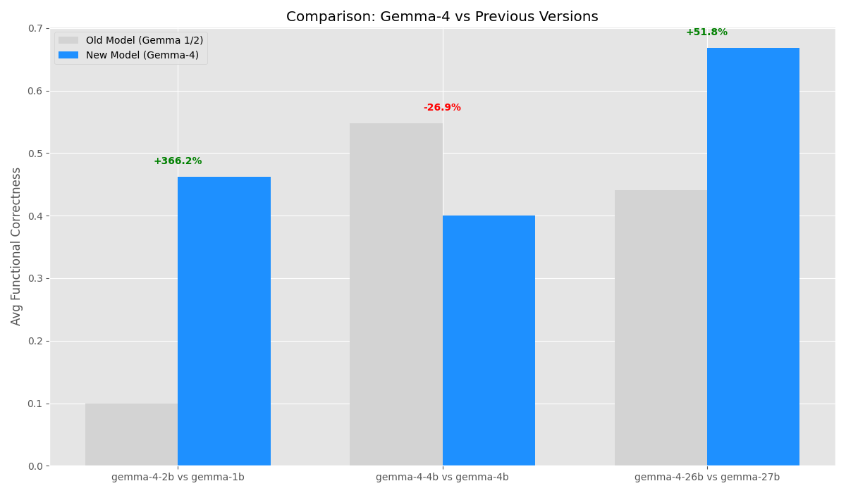
POLITECNICO DI TORINO
Previous vs current Gen
Large Language Models for Software Engineering · Group Project
— 14 —
In April 2026, the Gemma 4 family was introduced.
We tried the best combinations we found in the previous Gen to compare how the new gen would perform:
The Gemma-4 architecture provides extreme performance boosts for the smallest models and the larger models.
However, the Gemma-4-4B model underperforms compared to its predecessor
Politecnico di Torino · Large Language Models for Software Engineering · 2025 / 2026

Slide 15
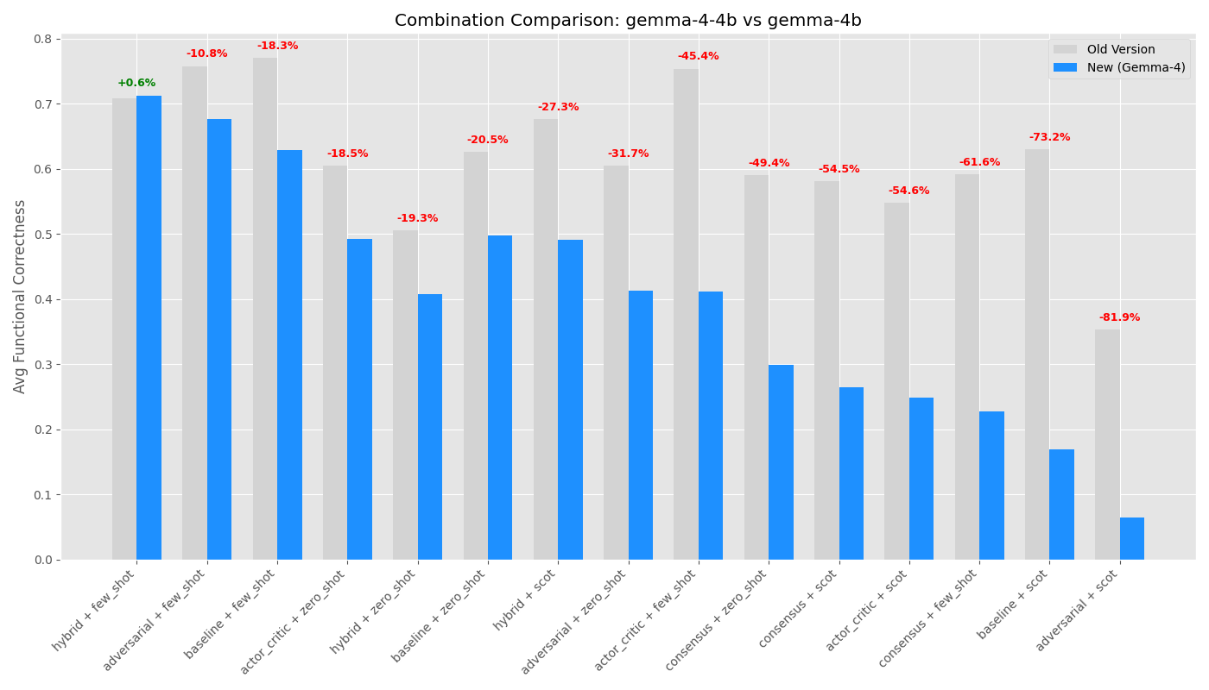
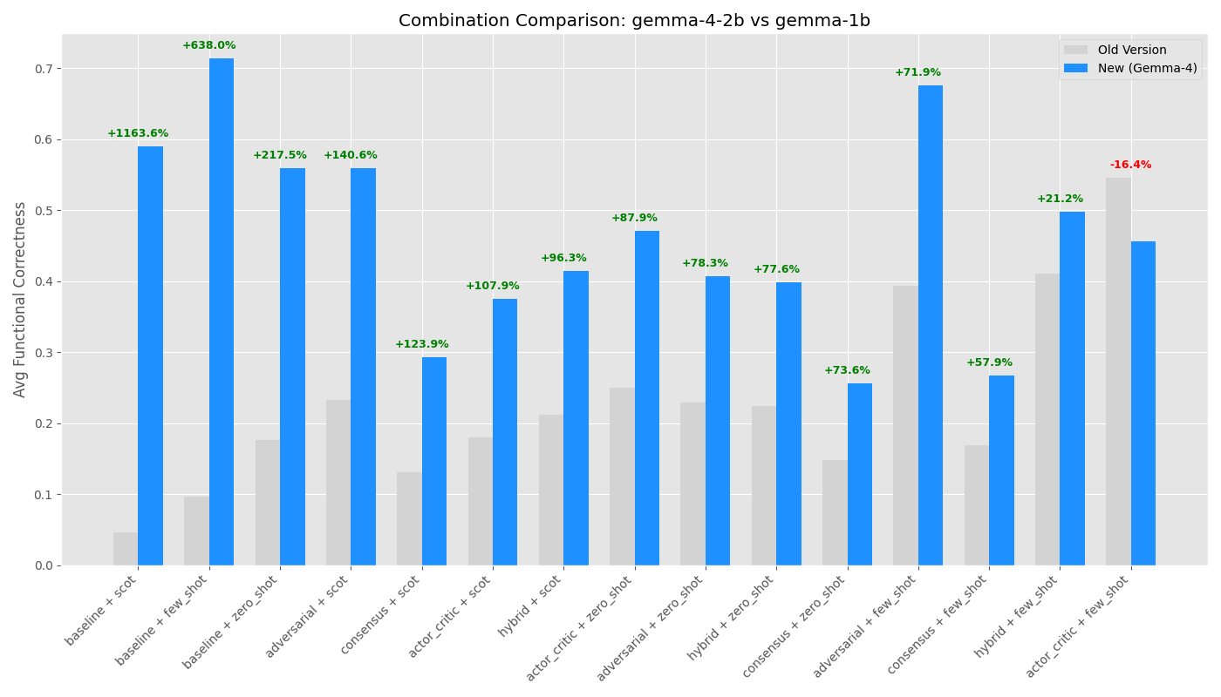
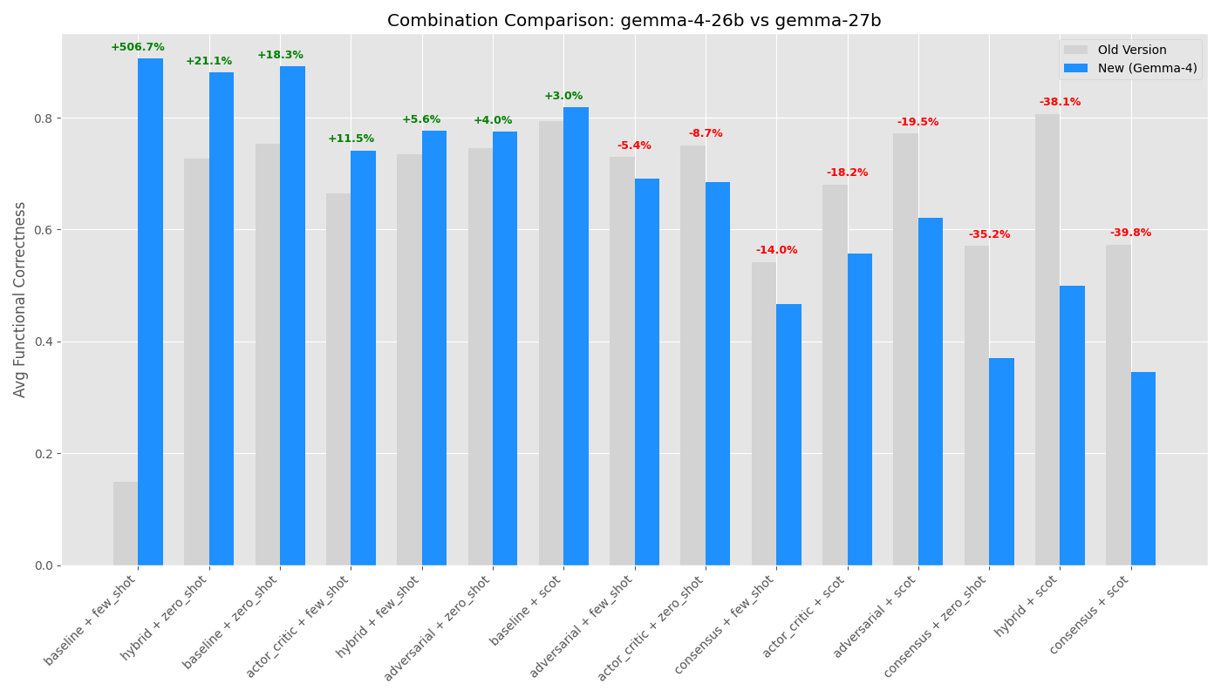
POLITECNICO DI TORINO
Previous vs current Gen
Large Language Models for Software Engineering · Group Project
— 15 —
Baselines Beating Agents (Small Tier): The raw, zero-shot capabilities of the new 2B model easily surpass the absolute highest, most heavily agent-assisted peak of the older 1B version.
The Efficiency Trap (Mid Tier): To compensate for its unexpected regression, the new 4B model is forced to rely on token-expensive multi-agent pipelines just to catch up to the old 4B's standard baseline.
The Obsolescence of Agents (Large Tier): The new 26B model is so inherently capable out-of-the-box (~89% zero-shot accuracy) that it renders complex, expensive multi-agent architectures completely unnecessary for these tasks.
Politecnico di Torino · Large Language Models for Software Engineering · 2025 / 2026

Slide 16
POLITECNICO DI TORINO
Model Evolution: Gen 3 vs. Gen 4
Large Language Models for Software Engineering · Group Project
— 16 —
Key Insights: Comparative Analysis of Generational Leap
Breakthrough
Disappointment
Efficiency Gap
2B vs. 1B
Massive performance jump (+366%).
Expected since we double the size
4B vs. 4-4B
Global performance drop (-27%).
Extreme prompt fragility: High-density models suffer "structural collapse".
26B vs. 27B
Superior raw performance but extremely inefficient.
Gen 4 consumes ~11x more tokens due to reasoning overhead.
Final Verdict
Gen 4 models are overall smarter but more "capricious" (more sensitive to architecture) and expensive.
Politecnico di Torino · Large Language Models for Software Engineering · 2025 / 2026

Slide 17
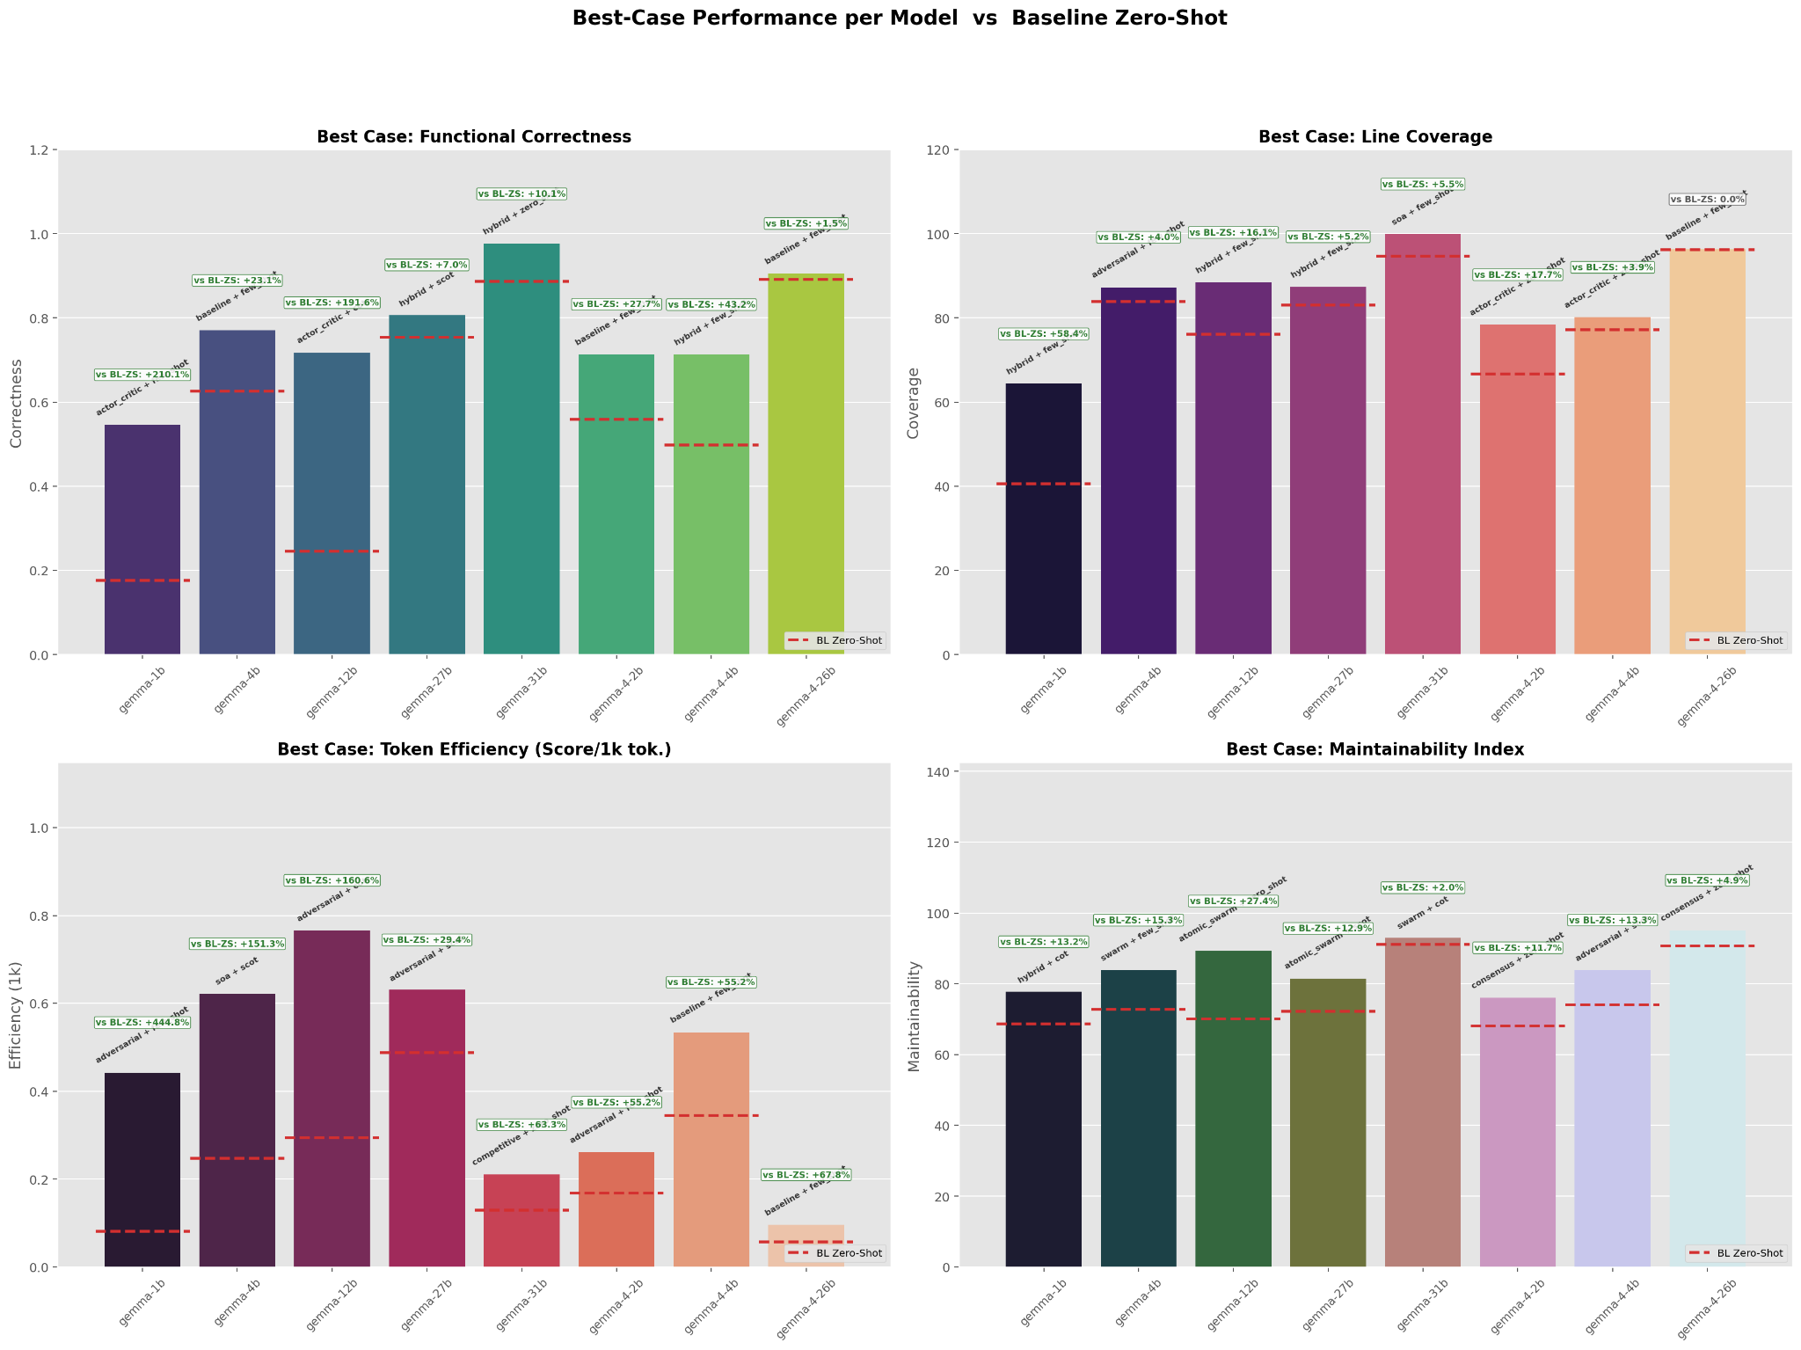
POLITECNICO DI TORINO
Best Configurations — Cross-Model
Large Language Models for Software Engineering · Group Project
— 17 —
PassRate Optimization
The smallest models show the biggest margin for improvement.
Token Efficiency Leaders
Adversarial and SOA, despite not being the strongest in terms of Pass Rate/Tokens.
Line Coverage Maxima
Hybrid architectures reach peak levels in many models, while the max is achieved by SOA+few_shot in Gemma 31B.
Maintainability Gains
Complex agents like Consensus or Atomic Swarm show the biggest improvement for MI, leading to modular code.
Politecnico di Torino · Large Language Models for Software Engineering · 2025 / 2026

Slide 18
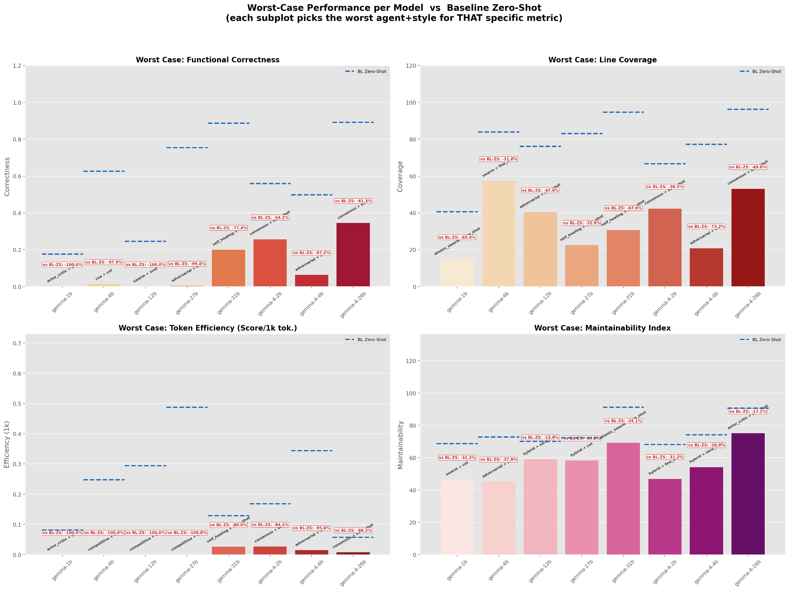
POLITECNICO DI TORINO
Worst Configurations & Failure Modes
Large Language Models for Software Engineering · Group Project
— 18 —
Efficiency Collapse
Using complex agents (Consensus/Swarm) in Zero-Shot mode results in an efficiency drop of >85%.
PassRate Degradation
Small models (1B) in high-overhead architectures without Few-Shot support can reduce PassRate by 65%.
Maintainability Pitfalls
Swarm + COT reduces Maintainability Index by up to 37% due to over-engineered logic.
Architecture Overkill
A "Complexity Penalty" occurs where multi-call overhead becomes a liability without sufficient model capacity.
Decoupled Quality
MI evaluates code structure rather than execution, making it less sensitive to logic errors.
Politecnico di Torino · Large Language Models for Software Engineering · 2025 / 2026

Slide 19
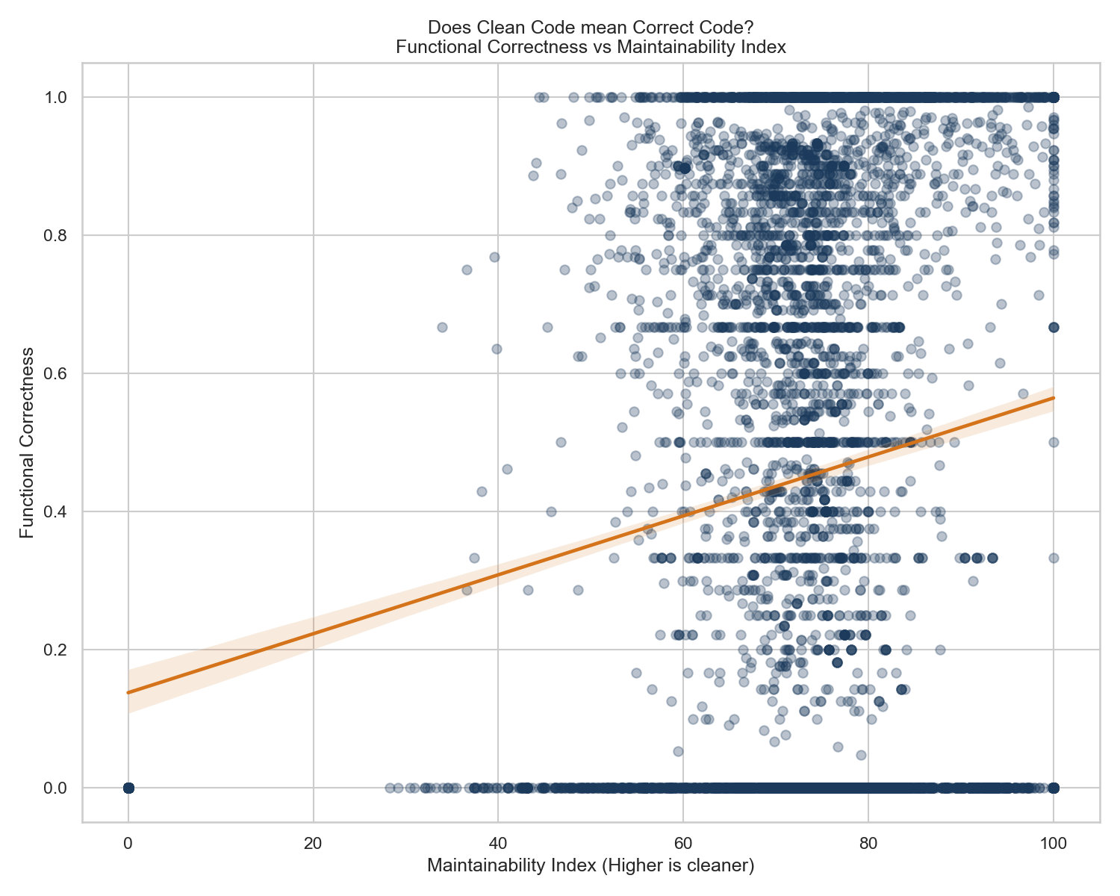
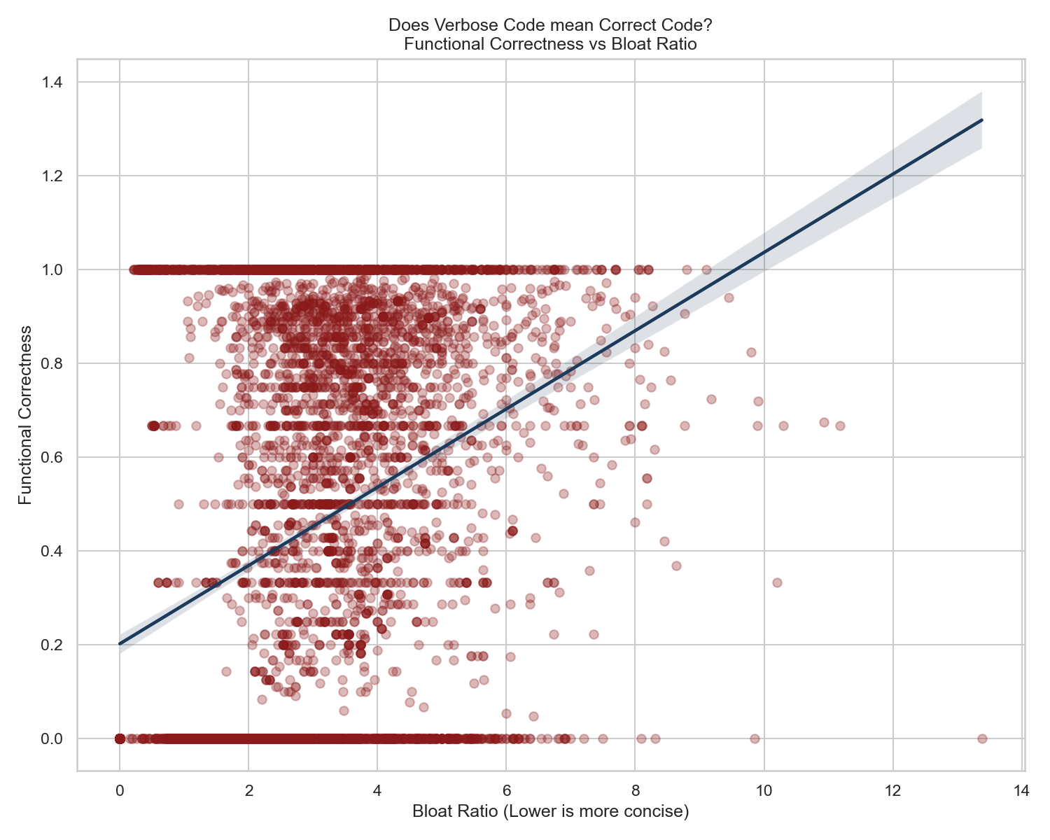
POLITECNICO DI TORINO
Metrics — Pass Rate
Large Language Models for Software Engineering · Group Project
— 19 —
Definition and Formula
Definition: Fraction of EvalPlus tests passed per task.
Formula: PR = passed_tests / total_tests
Advantage: Catches edge cases that memorized solutions miss.
Interpretation and Thresholds
> 0.80: "Production-viable" threshold.
< 0.40: "Unreliable, reject".
Primary Metric for this study
Observation: While low bloat (concise code) is usually preferred, here PassRate correlates with high bloat.
Limitations: Measures test behavior, not code quality.
Politecnico di Torino · Large Language Models for Software Engineering · 2025 / 2026

Slide 20
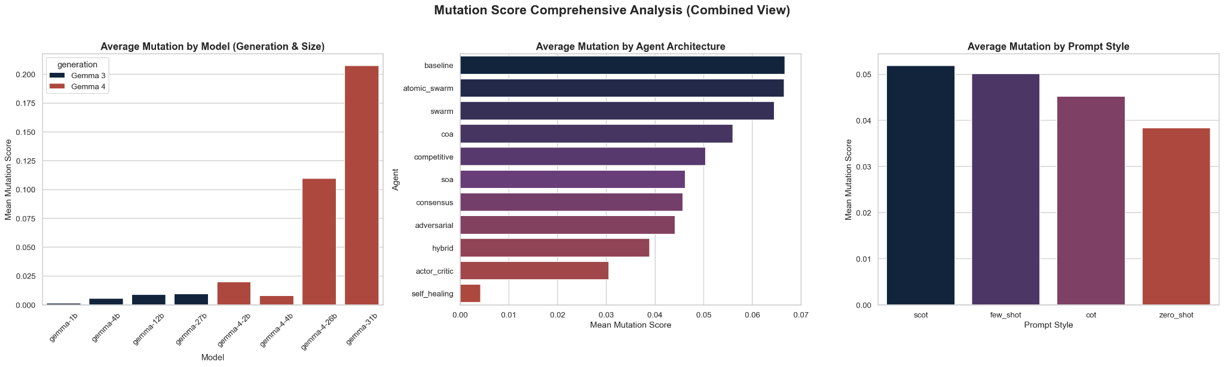
POLITECNICO DI TORINO
Metrics — Mutation Score
Large Language Models for Software Engineering · Group Project
— 20 —
Observation: This is the metric where the generational gap is shown the most.
Take-away: Baseline performs best, zero-shot and actor-critic underperforms.
Politecnico di Torino · Large Language Models for Software Engineering · 2025 / 2026

Slide 21
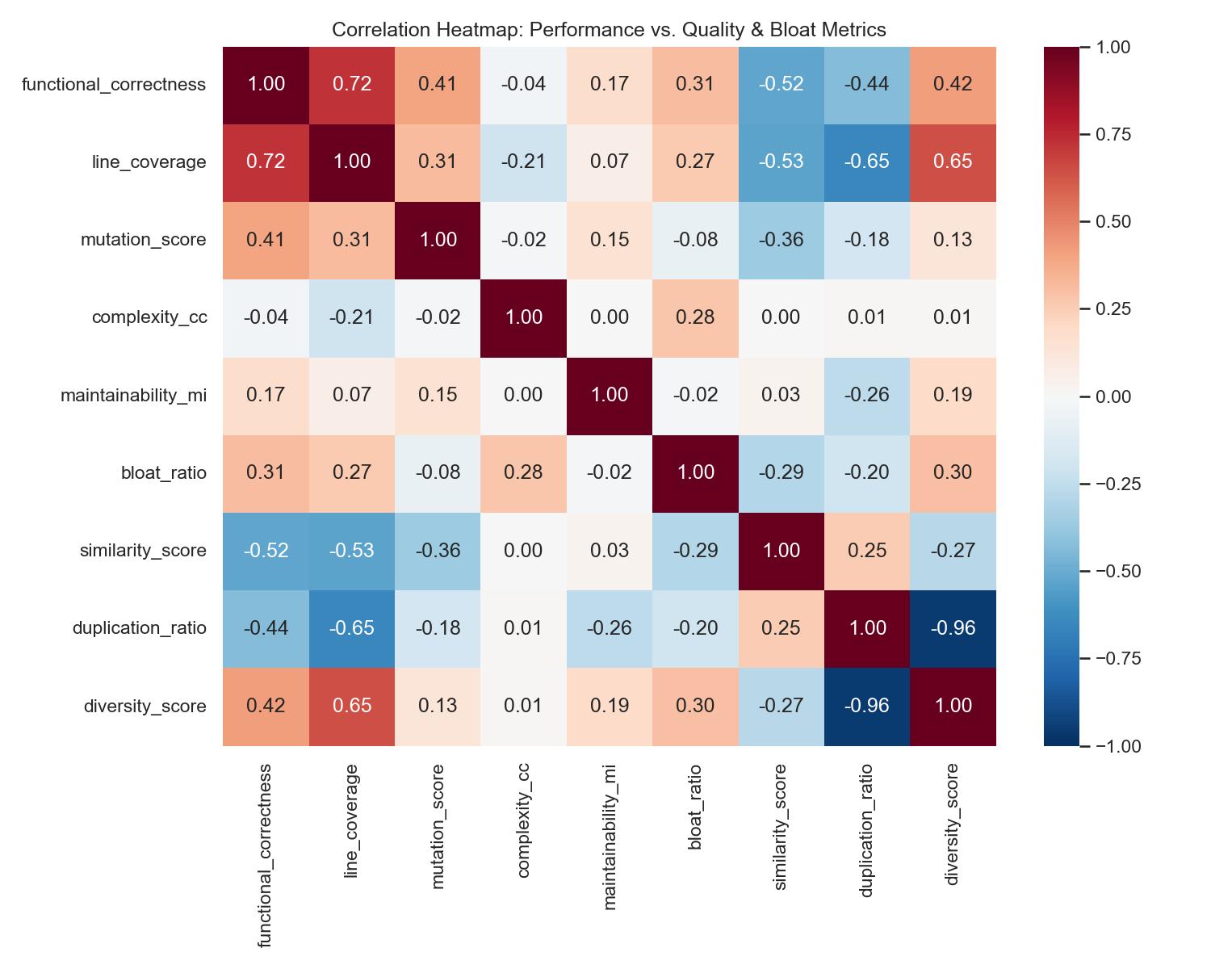
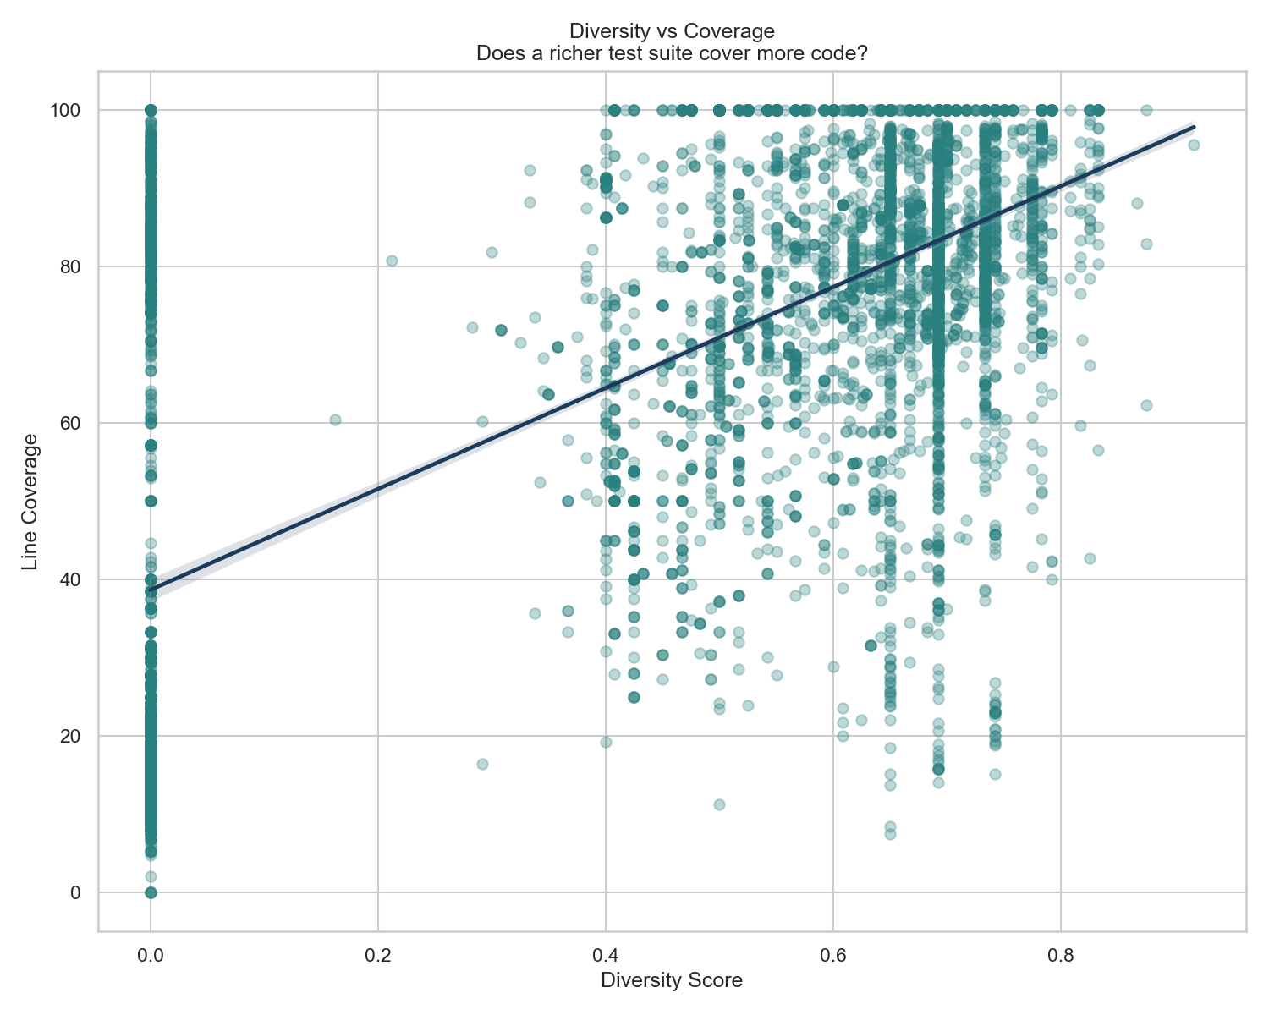
POLITECNICO DI TORINO
Metrics correlations
Large Language Models for Software Engineering · Group Project
— 21 —
Metric Definitions & Methodology
Line Coverage: Fraction of executable lines hit.
Branch Coverage: Fraction of control-flow branches traversed.
Line ≈ Branch: Indicates linear code with few conditionals.
Line ≫ Branch: Heavy conditionals with many missed edges.
Diversity Score: Measures input/structural test variety.
Key Observations & Correlations
Logic Gap: Coverage ≠ correctness; high coverage on buggy code is possible.
Coverage vs. PassRate (≈ 0.72)
Coverage vs. Diversity (≈ 0.65)
Coverage vs. Mutation (≈ 0.31)
Takeaway: Coverage is necessary but not sufficient. It measures breadth, while mutation measures depth. Atomic Swarm can hit ~100% on buggy code via circular tests.
Politecnico di Torino · Large Language Models for Software Engineering · 2025 / 2026

Slide 22
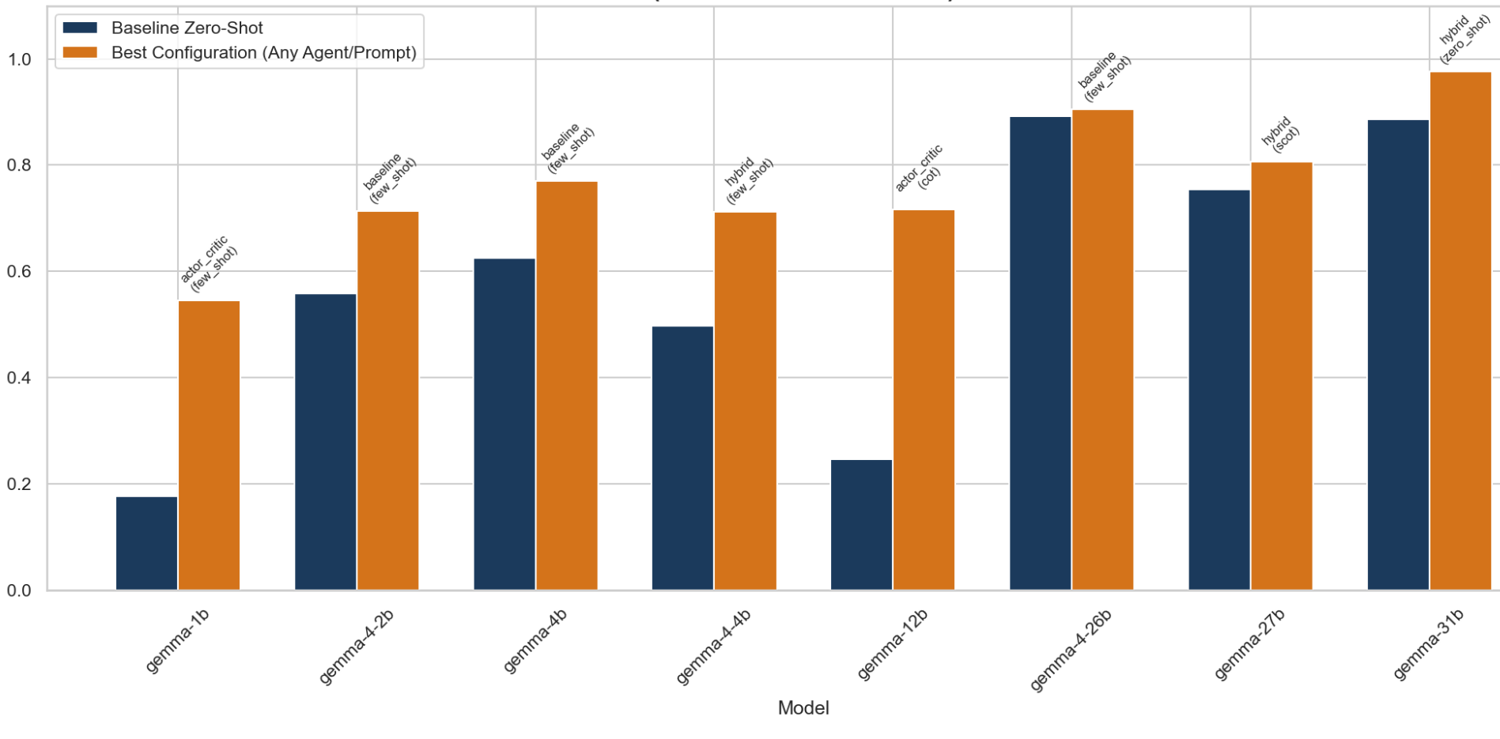
POLITECNICO DI TORINO
Baseline vs Best Configuration: Pass Rate
Large Language Models for Software Engineering · Group Project
— 22 —
Key Insights
Significant performance gains observed across all model sizes when switching from Baseline to Best Configuration.
Smaller models benefit proportionally more from agent tuning, effectively narrowing the gap with larger models.
Consistent outperformance of Zero-Shot configurations validates the impact of specialized agent architectures.
Takeaway: Optimized agent architectures can bridge the generational gap, occasionally allowing smaller or older models to match the baseline performance of larger, next-generation counterparts.
Politecnico di Torino · Large Language Models for Software Engineering · 2025 / 2026

Slide 23
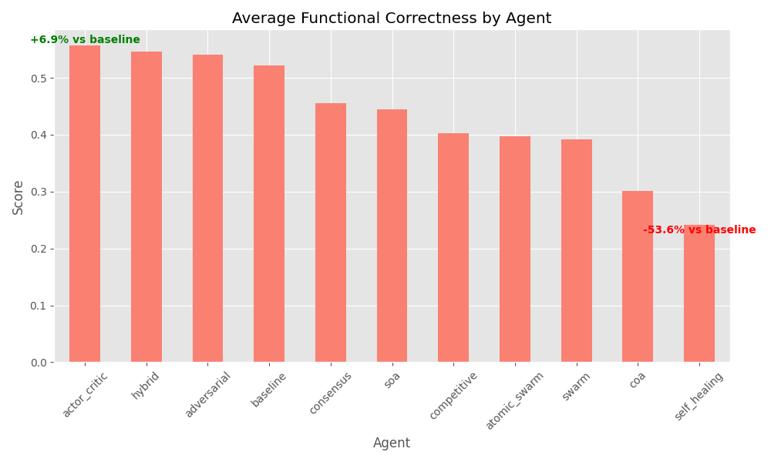
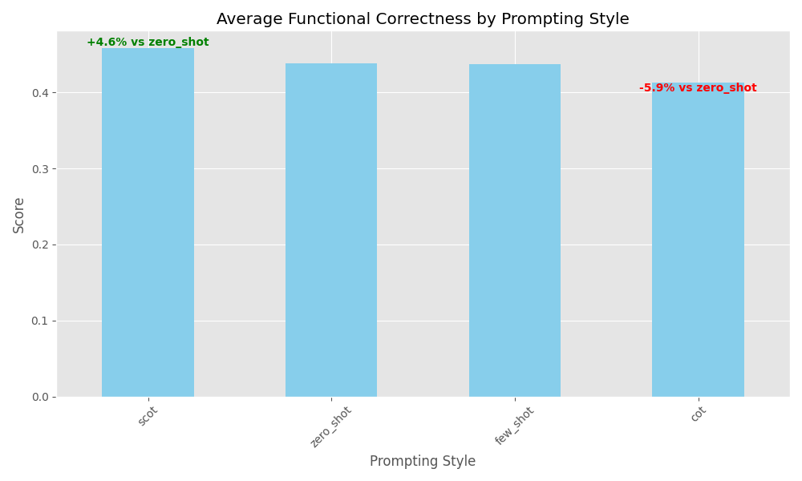
POLITECNICO DI TORINO
Cross-Model Averages — Agent vs Prompt
Large Language Models for Software Engineering · Group Project
— 23 —
• Spread is wider on agent axis than on prompt axis: agent design has a greater impact than prompting alone, particularly regarding performance degradation.
• SCoT leads on average: While SCoT performs best, CoT shows significant degradation as it is optimized for general problem-solving rather than specific coding tasks.
Note: Results represent averages across all models; individual performance varies significantly by model.
Politecnico di Torino · Large Language Models for Software Engineering · 2025 / 2026

Slide 24
POLITECNICO DI TORINO
Discussion of Results
Large Language Models for Software Engineering · Group Project
— 24 —
Architecture Dominates the Prompt
Greater influence on results, but with higher structural risks
Results & Evidences
Agent design can bridge model scale
Logical Gap: high Coverage ≠ Pass Rate ≠ Mutation score
Trade-offs & Risks
Specialized architectures can fail on generic tasks (e.g., Swarm for text generation)
No Free Lunch Theorem: No configuration is universal
Excellent architectures in specific contexts (e.g., Swarm for long-context) may be sub-optimal in others. There is no "silver bullet" for LLM-assisted software engineering; the choice strictly depends on the nature of the task and cost/performance constraints.
Politecnico di Torino · Large Language Models for Software Engineering · 2025 / 2026

Slide 25
POLITECNICO DI TORINO
Parser
Large Language Models for Software Engineering · Group Project
— 25 —
The Role of the Parser
The parser analyzes code generated by Large Language Models to extract logical structure and verify formal correctness before test execution.
Why Regex-Based Extraction?
Markdown Sanitization: It targets and extracts code within triple backtick blocks (```python), handling cases where the language tag is missing through non-greedy matching.
Robust Fallback logic: If no Markdown blocks are detected, the parser treats the entire output as raw code, applying line-by-line cleaning to ensure structural integrity.
# Robust extraction and cleaning
import re
def extract_code(text: str) -> str:
"""Extract code from LLM Markdown blocks."""
match = re.search(r"```(?:python)?\n?(.*?)```", text, re.DOTALL)
if match: code = match.group(1).strip()
else: code = text.strip()
lines = code.splitlines()
filtered = [l for l in lines if not l.lower().startswith("here is")]
return "\n".join(filtered).strip()
def clean_test_code(code: str) -> str:
"""Removes placeholder imports from sandbox code."""
pat = r"from\s+(your_module|test_module)\s+import"
return re.sub(pat, "", code)
Security & Efficiency: By parsing the code first, we avoid executing broken scripts in our testing environment.
Politecnico di Torino · Large Language Models for Software Engineering · 2025 / 2026

Slide 26
POLITECNICO DI TORINO
Conclusion
Large Language Models for Software Engineering · Group Project
— 26 —
Key Takeaways
Agentic Architecture: Greater potential for improvement, but also higher risk of degradation compared to standard prompting.
Model Size: Remains an extremely critical factor in overall performance.
Deterministic Phase: A Python-based parser is essential for reliable results.
Project Scope & Reliability
Limitations: 25 tasks, 5 model sizes, within the HumanEval scope.
Reproducibility: All configs, seeds, and prompts are versioned in Git.
Acknowledgment: Special thanks to the supervisor and the entire project team.
"Agent design has a greater impact than prompting alone, but requires robust validation."
Politecnico di Torino · Large Language Models for Software Engineering · 2025 / 2026

Slide 27
POLITECNICO DI TORINO
Future Work — RLM
Large Language Models for Software Engineering · Group Project
— 27 —
2026: Status Quo
In 2026, we used models up to 31B parameters.
Experimental efficiency was high, with total API costs kept under 4 euros.
2027: Projections
Expectation for slightly larger but significantly more efficient model families.
Anticipated improvements in agentic task benchmarks.
Vision: RLM
Application of Recursive Language Models (RLM) to tackle the Long Context barrier.
Overcoming the primary bottleneck of this project.
Key Objective: Solving the "Long Context" Challenge
Enabling more complex software engineering workflows through RLM architectures.
Politecnico di Torino · Large Language Models for Software Engineering · 2025 / 2026

Slide 28
POLITECNICO DI TORINO
Large Language Models for Software Engineering · Academic Year 2025 / 2026
Thank you for your attention

