Slide 1



Gary Kumfert with
Bill Bosl, Tammy Dahlgren,
Tom Epperly, Scott Kohn, &
Steve Smith
Achieving Language
Interoperability with
Notes:
1

Slide 2
Babel’s Scope & CCA
CCA Compliant
Frameworks
Babel provides language interoperability, not components.
We collaborate with CCA to add parallel distributed support
We also provide tools (Quorum & Alexandria) to facilitate component development and
deployment
Component
Semantics
Compilers &
Linkers
Operating System

Slide 3
Release Announcement
BETA 0.5
C, C++, F77, Python(client)

Slide 4
babel-0.5.0.tar.gz
Babel code generator
  written in Java
Babel runtime library
  written in ANSI C
Docs (minimal)
  papers, talks, javadoc html
  babel101 tutorial

Slide 5
Hand Coded
Language Interoperability
JNI
Native
SWIG
Platform Dependent
f77
C
f90
C++
Python
Java

Slide 6
Babel Enabled
Language Interoperability
Truly Object Oriented
Reference Counting
Exception Handling
RMI (future)
f77
C
f90
C++
Python
Java

Slide 7
Babel Enabled
Language Interoperability
What’s In This Release:
f77
C
f90
C++
Python
Soon!!!
Java

Slide 8
Babel Has Two Types of Customers
Developers
Users
Have a code
Want to increase their user base
Will learn SIDL
Want Babel general and powerful
Have a problem
Want to solve their problem
May never see SIDL
Want software that’s easy & trustworthy

Slide 9
Babel’s Design Priorities
Performance
Developer/User dichotomy
What’s natural for each language?
  Could expose C array structs in C++
  C++ style would be SIDL::array<T>
template <>
array<item_t> : public array2
< array_t, item_t,
item_cxx_wrapper_t> { }

Slide 10
SIDL (Scientific Interface
Definition Language)
Builds on Industry IDL technology
  CORBA
  COM
Designed for Scientific Apps
  complex types
  dynamic multidimensional arrays
version Hello 1.0;
package Hello {
class World {
string getMsg();
}
}

Slide 11
version MySolverLib 0.1.0;
import ESI;
package MySolverLib {
interface MatrixGenerator { ... }
class OptionDatabase {
void getOption( in string name,
out string val);
}
class Vector implements-all ESI.Vector {
void setOptions( in OptionDatabase db );
}
class Bizarre implements MatrixGenerator {
...
void setData( in array<dcomplex,2> a );
}
}

Slide 12
Many forms of language interoperable interfaces
Human Compatible
Compiler Compatible
SIDL
IOR
Scientific Interface
Definition Language
Internal Object
Representation
XML
eXtensible Markup
Language
Web Compatible

Slide 13

XML enables...
...automated creation
via higher-level tools
...Type Descriptions
on Shared Repositories
CCAScript
...automated
search & discovery by advanced builders
...Browsing
for Types

Slide 14
Language Interoperability:
How Babel Makes it Work
Application
Application: user’s LOP
(Language Of Preference)
Implementation: developers LOP (Can be wrappers to legacy code)
Stubs
If developer used Babel,
they also have a SIDL file.
IORs
SIDL
Skels
Impls

Slide 15
Language Interoperability:
How Babel Makes it Work
Application
Application: user’s LOP
(Language Of Preference)
Implementation: developers LOP (Can be wrappers to legacy code)
Stubs
Client Side Stubs: user’s LOP to C
Internal Object Representation (IOR): Always in C
Server Side Skeletons: translates IOR (in C) to developer’s LOP
IORs
Skels
Impls

Slide 16
How Much Language Interoperability Have We Achieved?
Basic Types
  bool
  char
  int
  long
  float
  double
  fcomplex
  dcomplex
  string
  opaque
Modes
  in
  out
  inout
  return value
Extended Types
  Objects
  enumerations
  arrays of basic types
  arrays of objects
  (arrays are multidimensional, no arrays of arrays)
OO Method Dispatch
  regular
  final
  static
  interfaces
  classes
Exception Handling
For All Combinations of Languages
  C C
  C++ C++
  F77 F77
  Python
1431 test cases
(and counting)

Slide 17

What we foresee, based on experience with our tests...
Language Interoperability
Developer Concerns:
Configuration,
Packaging,
& Deployment
User Concerns:
Installation
Trust

Slide 18
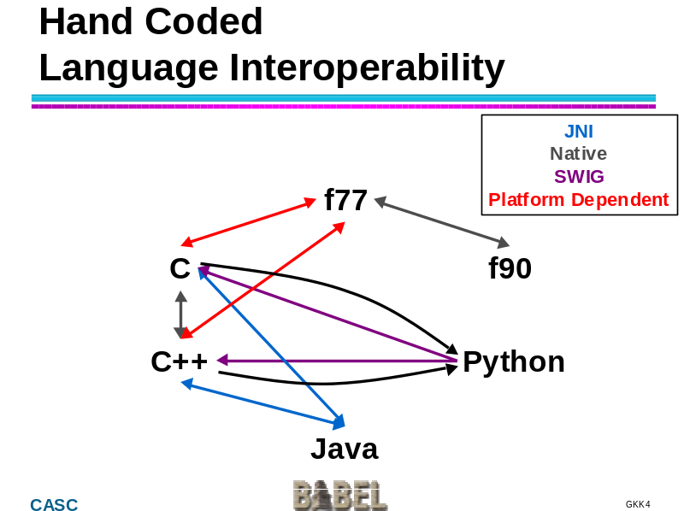
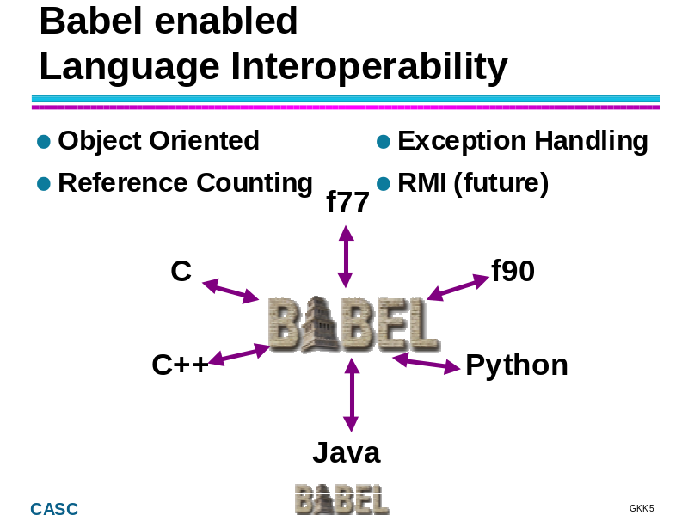
These aren’t new problems...
But they are on a larger scale
Developer Concerns:
Configuration,
Packaging,
& Deployment
User Concerns:
Installation
Trust

Slide 19
For Example...
To support Python and Java
  All libraries must be shared (*.so) not statically linked (*.a)
C++ shared libraries are problematic
  Exception support is platform/compiler dependent
  Linking issues when interoperating with other languages
Can create valid shared library with uncatchable exceptions

Slide 20
Babel’s Configuration/Build
GNU Make
Autoconf
configuration
Automake
build Makefiles
Libtool
shared libraries
CUTE
custom testing
python’s own build system
java’s built-in (broken) make
helper scripts
fixes to autoconf, automake & libtool
lots of hacks

Slide 21
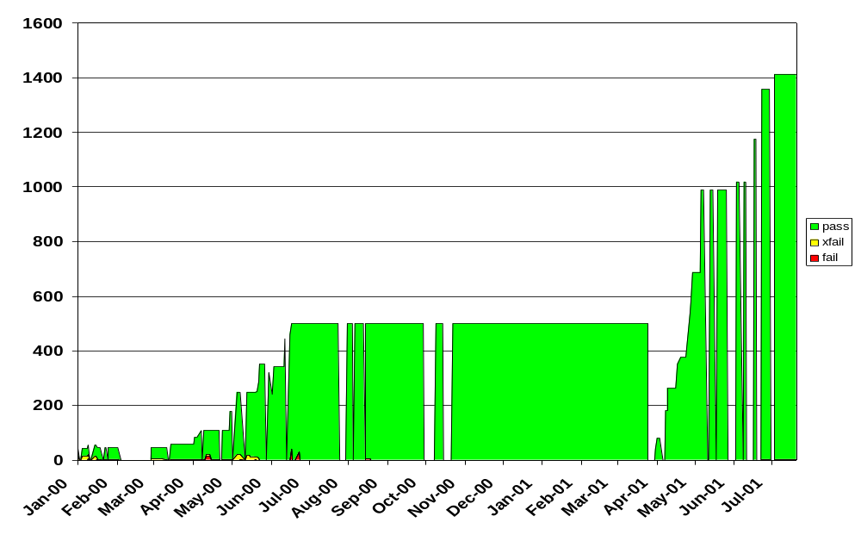
Test History
sparc-sun-solaris2.7-gcc
babel 0.5.x
babel 0.4.x
Configure/Build/Repository faults,
not software failures!!!
# Test Cases
IOR Rewrite
Date

Slide 22
Problems affect the User too...
How does a user get and install “language interoperable” software?
  Binary: if supplied by developer
  Source:
    Assume “configure; make install”?
How to link into application?
  If any C++ code, must use C++ linker
  Which C++ to use?
  C++ has no std binary interface

Slide 23
Crux of the problem
We’re building 21st century technology...
... using 30 year old tools.
C++
F77
Python
Java
C
Autoheader
libtool (perl/sh)
aclocal
Automake (perl)
Autoconf (M4)
Make
Bourne shell

Slide 24
Solution
Integrated config, build, package, test and management system.
  no make inside!
    can have action create many files
    understands directories
  uses real database
  program all aspects in one language
  MUST BE OPEN SOURCE

Slide 25
In the mean time...
Babel works on other platforms,
just not automated config/testing
  Java code generator (precompiled)
  ANSI C runtime library (no problem)
Babel’s tests are (necessarily) pathological worst-case examples
We didn’t create these problems,
we just exercise them aggressively

Slide 26
Future Babel:
Will Provide More Build Help
“babel.make”
  currently lists code generated
  may add additional flags, macros, etc.
configure
  currently used for regression tests
  may generate artifacts useful for developers
    helper scripts
    warnings

Slide 27
Farther Future Babel:
Will Do Distributed Computing
Application
Line Protocol
Stubs
Unmarshaler
IORs
Internet
IORs
Marshaler
Skels
Line Protocol
Impls

Slide 28
Closing Remarks
Babel Beta 0.5 is released
Babel enables language interoperability
  connect C, C++, F77, and Python
  provide a uniform object-model,
  even in non-OO languages.
Deploying & Installing Language Interoperable Code in General
  is still very hard
  has broken every tool we use

Slide 29
The End
babel-announce@llnl.gov
babel-users@llnl.gov
http://www.llnl.gov/CASC/components
components@llnl.gov
Bill Bosl, Tammy Dahlgren,
Tom Epperly, Scott Kohn,
Gary Kumfert, & Steve Smith

Slide 30
A.3. Can HPC and Component
Technology REALISTICALLY be integrated?
Yes.
But HPC Components have huge (and unique) hurdles:
  Diverse Architectures
  Diverse OS’s
  Integration of SPMD and Dist. Comp.
  Archaic Pkg/Devel/Config/Build tools
  Non-CS trained (or interested) users

Slide 31
B.3. Can the HPC community really afford yet another compiler such as
Babel?
Is language interoperability important?
How important?

Slide 32
B.3. How is the Java subset of C++ inadequate as an HPC IDL?
What is a “Java subset of C++” ?
How does one
  use it to bind to other languages?
  get a common inheritance model?
  get a common exception model?

Slide 33
B.5. What is the role of traditional (parallel) tools in component technology?
Hopefully, they’re replaced by modern parallel tools.

Slide 34
B.9. What will be the configuration issues for components...to be portable and high-performance?
Lots.
Lack of Configuration, Packaging, & Deployment tools
  is the #1 Achilles heel for components
  is the #1 day-to-day pain in Babel development
  #1 cause for failure in regression tests

Slide 35
C.1. Will anyone actually make the effort to componentize their applications software?
Yes.
  But it will be messy.
Efforts to Babelize at LLNL:
  hypre - want OOP in ANSI C & automatic F77 bindings
  ALPS - want scripting interface for laser plasma physics
  SAMRAI - framework used in ALPS

Slide 36
D.4. Should components be viewed as mostly a library/runtime developer technology?
No.
I used components in this PowerPoint Presentation
Users can use components without knowing they’re using them.
  This is harder to achieve in UNIX than other platforms

Slide 37
UCRL-VG-144649
23 July 2001
Work performed under the auspices of the U. S. Department of Energy by the University of California, Lawrence Livermore National Laboratory under Contract W-7405-Eng-48

Slide 38
Ominous Foreshadows
Components are to OO what
OO is to structured programming
Writing good OO libraries
is harder than
writing good subroutines
Writing good Components
is harder than
writing good OO libraries

Slide 39
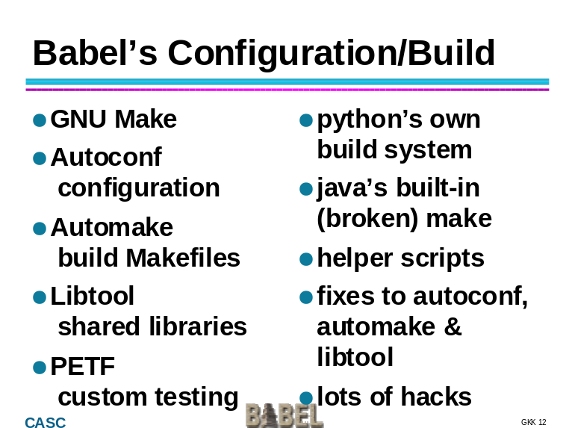
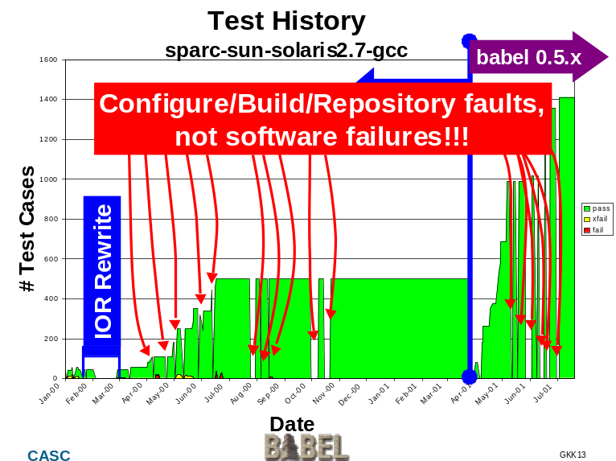
How Much Harder ?
10 times harder
90% of my coding time is spent on portability/configure/build issues

Slide 40
How it all works
Developer’s POV
SIDL
SIDL
Component Developer
  creates a SIDL spec
  uses babel to generate IORs, Skels, & Impls in language of choice
  writes implementation in Impl files
  compiles it all into a library
  posts SIDL & library to repository
babel
IOR.c
Skel.c
Impl.c
IOR.h
Skel.h
Impl.h
Compile/
ranlib
www-casc.llnl.gov
Lib.so
Lib.so

Slide 41
How it all works
User’s POV
www-casc.llnl.gov
Component User
  searches repository for appropriate component
  specifies application language, platform
Repository
  returns the appropriate library and SIDL file.
  uses babel to generates Stubs and IORs
Component User
  develops application using Stubs
  compiles and links it all together
babel
SIDL
Lib.so
Stub.c
IOR.h
Stub.h
main.c
Compile/
Link
a.out

