Slide 1


Scott Kohn with
Tom Epperly and Gary Kumfert
Center for Applied Scientific Computing
Lawrence Livermore National Laboratory
October 3, 2000
Component Technology for High-Performance Scientific Simulation Software
Notes:
1
1
1
1
1
1
1
1
1
1
1
1
1
1
5
5

Slide 2
Presentation outline
Motivation
DOE community activities (CCA)
Language interoperability technology (Babel)
Component type and software repository (Alexandria)
Research issues in parallel component communication
Deep thoughts...
Goal: Provide an overview of the approach, techniques, and tools we are exploring in adopting software component technology for scientific computing

Slide 3
Numerical simulation software is becoming increasingly complex and interdisciplinary
Scientists are asked to develop 3d, massively parallel, high-fidelity, full-physics simulations; and do it quickly
This requires the integration of software libraries developed by other teams
  local resources are limited and expertise may not exist
  loss of local control over software development decisions
  language interoperability issues (f77, C, C++, Python, Java, f90)
Techniques for small codes do not scale to 500K lines

Slide 4
What are the barriers to software re-use, interoperability, and integration?
Technological barriers
  incompatible programming languages (f90 calling C++)
  incompatibilities in C and C++ header files (poor physical design)
  conflicting low-level run-time support (e.g., reference counting)
Sociological barriers
  trust (“how do I know you know what you’re doing?”)
  “I could re-write it in less time than it would take to learn it…”
Domain understanding barriers (the interesting one!)
  understand interactions of the math and physics packages
  write software that reflects that understanding
  this is where we gain insights and make scientific progress

Slide 5
Component technologies address issues of software complexity and interoperability
Industry created component technology to address...
  interoperability problems due to languages
  complexity of large applications with third-party software
  incremental evolution of large legacy software
Observation: The laboratory must address similar problems but in a different applications space (parallel high-performance scientific simulation, not business).

Slide 6
Current industry solutions will not work in a scientific computing environment
Three competing industry component approaches
  Microsoft COM
  Sun JavaBeans and Enterprise JavaBeans
  OMG CORBA
Limitations for high-performance scientific computing
  do not address issues of massively parallel components
  industry focuses on abstractions for business (not scientific) data
  typically unavailable on our parallel research platforms
  lack of support for Fortran 77 and Fortran 90
However, we can leverage techniques and software

Slide 7
Component technology extends OO with interoperability and common interfaces
Start with object-oriented technology
Add language interoperability
  describe object calling interfaces independent of language
  add “glue” software to support cross-language calls
Add common behavior, packaging, and descriptions
  all components must support some common interfaces
  common tools (e.g., repositories, builders, …)
Component technology is not…
  object-oriented design, scripting, or frameworks
  structured programming (e.g., modules)
  the solution for all of your problems (just some of them)

Slide 8
Component technology approaches help to manage application software complexity
“Monolithic” approach
“Building-block” approach
timestep loop {
time
stepper
if ( test1 )
solver1( )
solver1
share
“hard-coded”
data
else if ( test2 )
solver2( )
solver2
model
equations
}
• tightly-coupled code
• less flexible, extensible
• re-use is difficult
• well-understood by community
• loosely-coupled code
• more flexible, extensible
• high re-use potential
• new to community

Slide 9
SAMRAI ALPS application combines three physics packages with local time refinement
Time Refinement
Integrator
Regridding
Algorithm
Hierarchy
Description
Berger
Rigoutsos
Clustering
Gradient
Detector
Load
Balancer
Laser-Plasma
Integrator
Conservative
Hyperbolic Level
Integrator
Ion Advection
Numerical
Routines
Light
Propagation
Routines
Electrostatic
Field Solver
Poisson Hierarchy Solver

Slide 10
CCA is investigating high-performance component technology for the DOE
Common Component Architecture (CCA) forum
  regular workshops and meetings since January, 1998
  ANL, LANL, LBNL, LLNL, ORNL, SNL, Indiana, and Utah
  http://z.ca.sandia.gov/~cca-forum
Goal: interoperability for high-performance software
  focus on massively parallel SPMD applications
  modify industry approaches for the scientific domain
Writing specifications and reference implementation
  leverage technology developed by CCA participants
  plan to develop a joint reference implementation by FY02

Slide 11
The CCA is researching a variety of component issues in scientific computing
Communication between components via ports
Standard component repository formats and tools
Composition GUIs
Language interoperability technology
Dynamic component loading
Distributed components
Parallel data redistribution between SPMD components
Domain interface standards (e.g., solvers, meshes, …)
Efficient low-level parallel communication libraries

Slide 12
Presentation outline
Motivation
DOE community activities (CCA)
Language interoperability technology (Babel)
Component type and software repository (Alexandria)
Research issues in parallel component communication
Conclusions

Slide 13
Motivation #1:
Language interoperability
Motivated by Common Component Architecture (CCA)
  cross-lab interoperability of DOE numerical software
  DOE labs use many languages (f77, f90, C, C++, Java, Python)
  primary focus is on tightly-coupled same-address space codes
Scripting Driver
(Python)
Simulation Framework
(C)
Visualization System
(Java)
Numerical Routines
(f90)
Solver Library
(C++)

Slide 14
Motivation #2:
Object support for non-object languages
Want object implementations in non-object languages
  object-oriented techniques useful for software architecture
  but … many scientists are uncomfortable with C++
  e.g., PETSc and hypre implement object-oriented features in C
Object support is tedious and difficult if done by hand
  inheritance and polymorphism require function lookup tables
  support infrastructure must be built into each new class
IDL approach provides “automatic” object support
  IDL compiler automates generation of object “glue” code
  polymorphism, multiple inheritance, reference counting, RTTI, ...

Slide 15
There are many tradeoffs when choosing a language interoperability approach
Hand generation, wrapper tools (e.g., SWIG), IDLs
We chose the IDL approach to language interoperability
  goal: any language can call and use any other language
  component tools need a common interface description method
  sufficient information for automatic generation of distributed calls
  examples: CORBA, DCOM, ILU, RPC, microkernel OSes
f77
f77
C
JNI
Native
SWIG
f90
C
f90
IDL
C++
Python
C++
Python
Java
Java

Slide 16
An IDL for scientific computing requires capabilities not present in industry IDLs
Industry standard IDLs: CORBA, COM, RPC, …
Desired capabilities for a scientific computing IDL
  attributes for parallel semantics
  dense dynamic multidimensional arrays and complex numbers
  bindings for f77/f90 and “special” languages (e.g., Yorick)
  small and easy-to-modify IDL for research purposes
  rich inheritance model (Java-like interfaces and classes)
  high performance for same address-space method invocations

Slide 17
SIDL provides language interoperability for scientific components
SIDL is a “scientific” interface definition language
  we modified industry IDL technology for the scientific domain
  SIDL describes calling interfaces (e.g., CCA specification)
  our tools automatically generate code to “glue languages”
user runs this ...
package ESI {
interface Vector {
void axpy(in Vector x, in double a);
double dot(in Vector x);
…
};
interface Matrix {
…
};
};
f77
C
SIDL
tools
C++
Python
library writer develops this
f90
… and gets this

Slide 18
SIDL incorporates ideas from Java and CORBA to describe scientific interfaces
version Hypre 0.5;
version ESI 1.0;
import ESI;
package Hypre {
interface Vector extends ESI.Vector {
double dot(in Vector y);
void axpy(in double a, in Vector y);
};
interface Matrix {
void apply(out Vector Ax, in Vector x);
};
class SparseMatrix implements Matrix, RowAddressible {
void apply(out Vector Ax, in Vector x);
};
};
class
enumeration
exception
interface
package

Slide 19
Users call automatically generated interface code completely unaware of SIDL tools
C++ Test Code
Fortran 77 Test Code
hypre::vector b, x;
hypre::matrix A;
hypre::smg_solver smg_solver;
b = hypre::vector::NewVector(com, grid, stencil);
...
x = hypre::vector::NewVector(com, grid, stencil);
...
A = hypre::matrix::NewMatrix(com, grid, stencil);
...
smg_solver = hypre::smg_solver::New();
smg_solver.SetMaxIter(10);
smg_solver.Solve(A, b, x);
smg_solver.Finalize();
integer b, x
integer A
integer smg_solver
b = hypre_vector_NewVector(com, grid, stencil)
...
x = hypre_vector_NewVector(com, grid, stencil)
...
A = hypre_matrix_NewMatrix(com, grid, stencil)
...
smg_solver = hypre_smg_solver_new()
call hypre_smg_solver_SetMaxIter(smg_solver, 10)
call hypre_smg_solver_Solve(smg_solver, A, b, x)
call hypre_smg_solver_Finalize(smg_solver)

Slide 20
SIDL version management
Simple version management scheme for SIDL types
  all symbols are assigned a fixed version number
  SIDL version keyword requests specified version (or latest)
  supports multiple versions of specs (e.g., ESI 0.5, ESI 0.5.1)
version ESI 0.5.1; // access ESI spec v0.5.1
version HYPRE 0.7; // define HYPRE spec v0.7
package HYPRE {
// define v0.7 of HYPRE.Vector using v0.5.1
// of the ESI.Vector interface
interface Vector extends ESI.Vector {
...
}
}

Slide 21
Language support in the Babel compiler
C, f77, C++ mostly finished using old SIDL grammar
  approximately 500 test cases probe implementation
  used by hypre team for exploratory development
Currently migrating system to use new grammar
Java, Python, and Yorick support next
  Python and Yorick are scripting languages (Yorick from LLNL)
  hope to begin development in October timeframe
  “should be quick” because of C interface support in languages
f90 and MATLAB will (hopefully) begin early next year

Slide 22
We are collaborating with hypre to explore SIDL technology in a scientific library
Collaborators: Andy Cleary, Jeff Painter, Cal Ribbens
SIDL interface description file generated for hypre
  approximately 30 interfaces and classes for hypre subset
  use Babel tools to generate glue code for object support
Benefits of SIDL use in the hypre project
  automatic support for object-oriented features in C
  Fortran capabilities through SIDL in upcoming version
  plan to integrate existing C, Fortran, and C++ in one library
  SIDL is a useful language for discussing software design
  creating better hypre design based on SIDL OO support
  cost overhead in same-address space too small to measure

Slide 23
Presentation outline
Motivation
DOE community activities (CCA)
Language interoperability technology (Babel)
Component type and software repository (Alexandria)
Research issues in parallel component communication
Conclusions

Slide 24
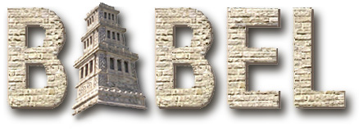

We are developing a web-based architecture to simplify access by scientists and tools
web
pages
scientist
SIDL tools
servlets
JSP
web server
XML
tool
SQL database
Scientists and library developers must have easy access to our technology; otherwise, they simply will not use it
Our web-based deployment lowers the “threshold of pain” to adopting component technology

Slide 25
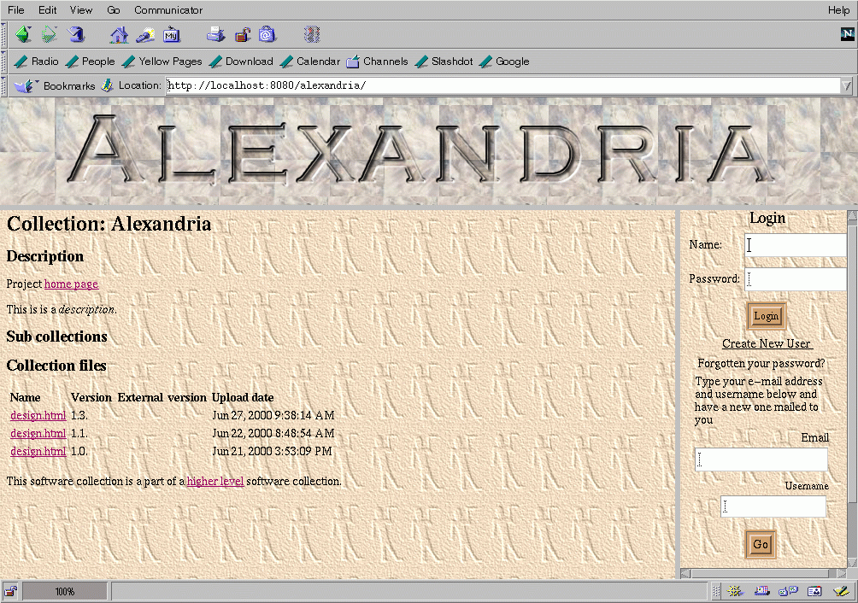
Alexandria is a web-based repository for component software and type descriptions
The Alexandria repository supports...
  SIDL type descriptions for libraries and components
  library and component implementations
  an interface to the Babel language interoperability tools

Slide 26
The Babel parser converts SIDL to XML that is stored in the Alexandria repository
SIDL is used to generate XML interface information
XML type description used to generate glue code
url://interface.sidl
parser
type repositories
url://interface.xml
type repository
C
XML
f77
code generator
C++
XML
machine
configuration
...

Slide 27
Sample XML file for Hypre.Vector
<?xml version="1.0" encoding="UTF-8”?>
<!DOCTYPE Symbol PUBLIC “-//CCA//SIDL Symbol DTD v1.0//EN” “SIDL.dtd”>
<Symbol>
<SymbolName name="Hypre.Vector" version="1.0" />
<Metadata date="20000816 08:47:22 PDT">
<MetadataEntry key="source-url" value="file:/home/skohn/hypre.sidl" />
...
</Metadata>
<Comment />
<Interface>
<ExtendsBlock>
<SymbolName name="Hypre.Object" version="1.0" />
</ExtendsBlock>
<AllParentInterfaces>
<SymbolName name="SIDL.Interface" version="0.5" />
<SymbolName name="Hypre.Object" version="1.0" />
</AllParentInterfaces>
<MethodsBlock>
<Method communication="normal" copy="false" definition="abstract" name="Axpy">
...
</Method>
</MethodsBlock>
</Interface>
</Symbol>

Slide 28
Presentation outline
Motivation
DOE community activities (CCA)
Language interoperability technology (Babel)
Component type and software repository (Alexandria)
Research issues in parallel component communication
Conclusions

Slide 29
Parallel redistribution of complex data structures between components
Parallel data redistribution for non-local connections
  example: connect parallel application to visualization server
  cannot automatically redistribute complex data structures
  must support redistribution of arbitrary data structures
Approach - modify SIDL and special interface support

Slide 30
Parallel components will require special additions to SIDL interface descriptions
Special RMI semantics for parallel components
  provide a local attribute for methods
  will also need a copy attribute for pass-by-value, etc.
  however, no data distribution directives - must be done dynamically
package ESI {
interface Vector {
double dot(copy in Vector v);
int getGlobalSize();
int getLocalSize() local;
}
}

Slide 31
Dynamic redistribution of arbitrary data:
Ask the object to do it for you!
Irregular data too complex to represent in IDL
Basic approach:
  objects implement one of a set of redistribution interfaces
  library queries object at run-time for supported method
interface ComplexDistributed {
void serialize(in Array<Stream> s);
void deserialize(in Array<Stream> s);
}
...
interface ArrayDistributed {
// use existing array description
// from PAWS or CUMULVS
}
two streams on M1
three streams on M2
A
B
A
B
A
M1
M2

Slide 32
Will component technology be part of the future of scientific computing?
Well, maybe - or maybe not
Component technology does offer new capabilities
  techniques to manage large-scale application complexity
  language interoperability and easier plug-and-play
  leverage technology, not re-invent the wheel
  bridges to interoperate with industry software (e.g., SOAP)
However, capabilities come at a price
  ties scientists to using component technology tools
  steep learning curve (needs to become part of culture)
  different paradigm for developing scientific applications

Slide 33
Acknowledgements
Work performed under the auspices of the U.S. Department
of Energy by University of California Lawrence Livermore National Laboratory under Contract W-7405-Eng-48.
Document UCRL-VG-140549.

