Slide 1
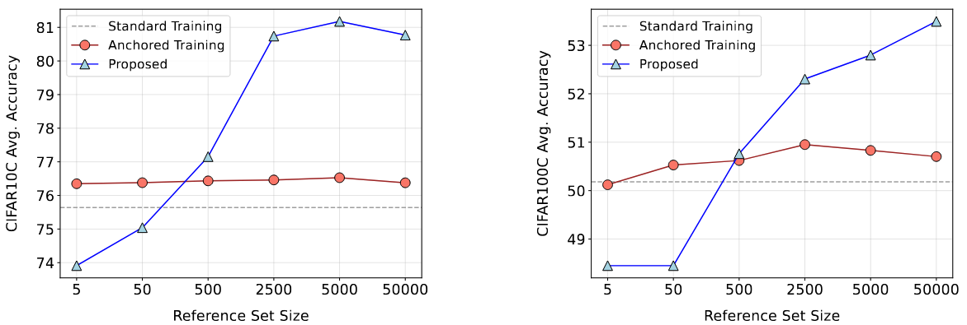
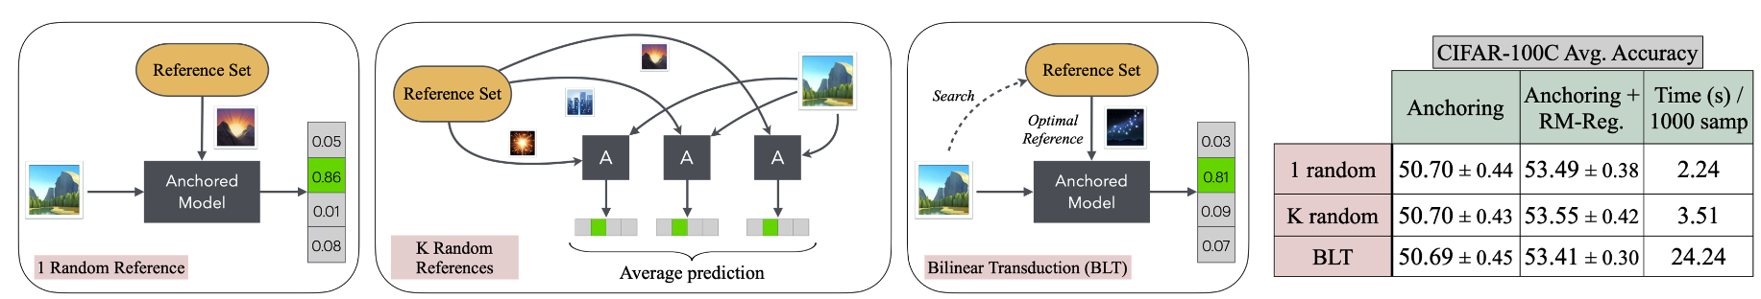
Train: CIFAR10 Test: CIFAR10C
Train: CIFAR100 Test: CIFAR100C

Slide 2
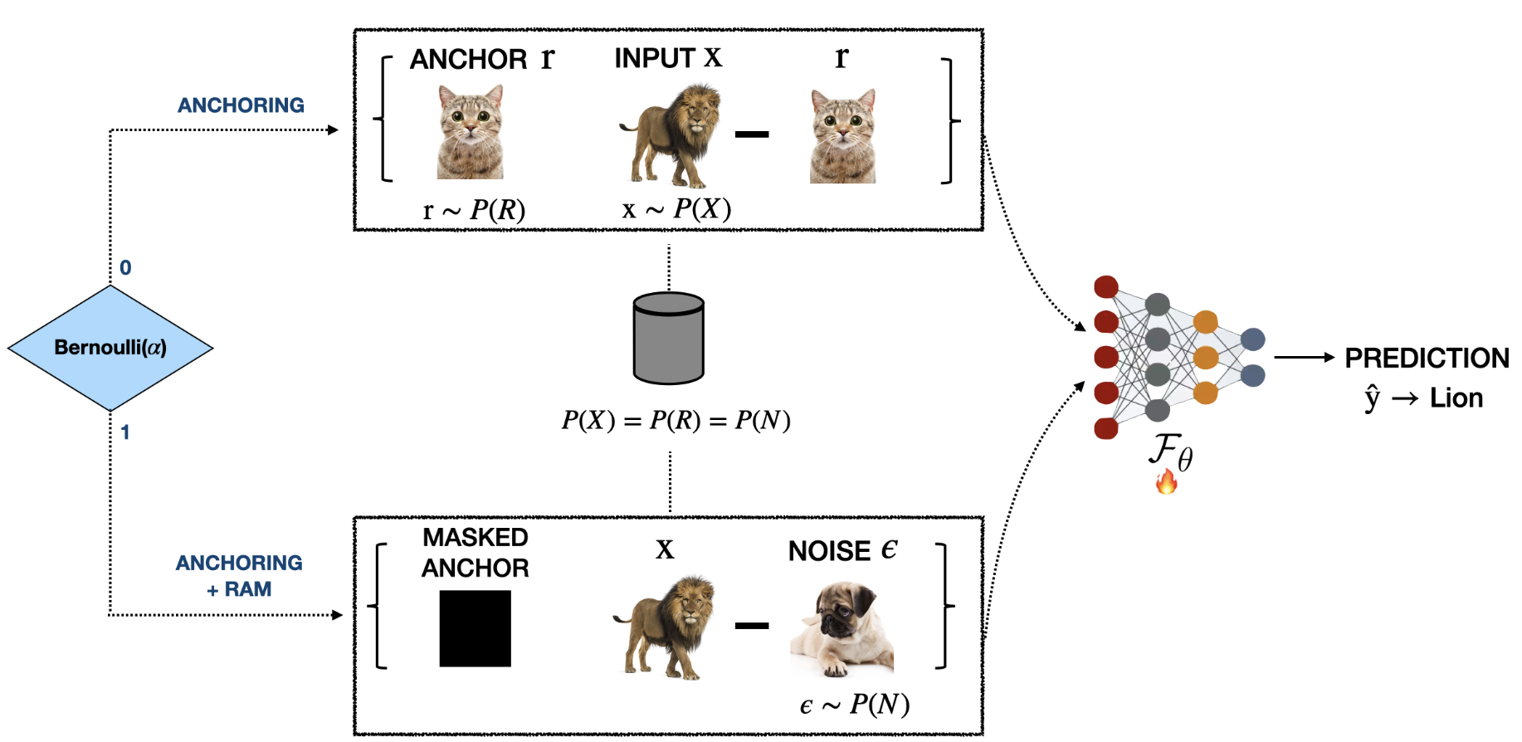

Slide 3

Lion!
(Minimize Cross Entropy Loss)
Don’t Know!
(Match predictions to Uniform PMF)

Slide 5
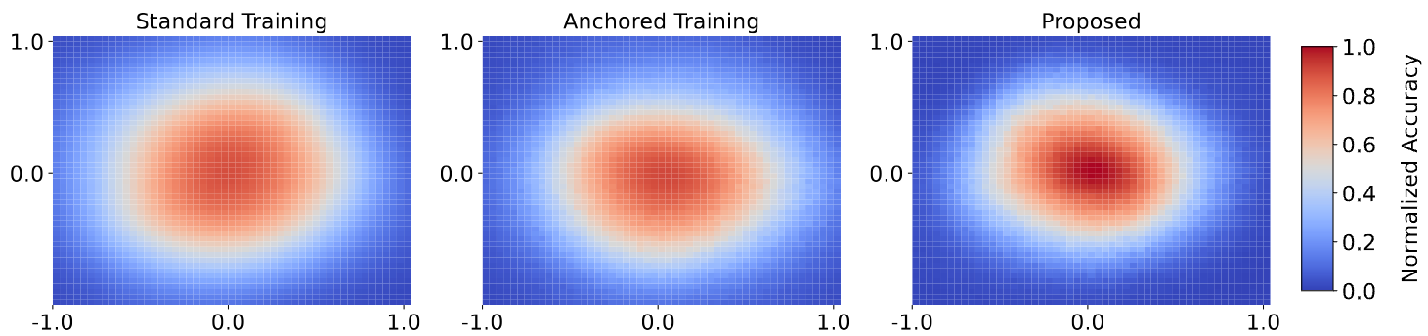
Our protocol produces flatter and wider optima leading to improved generalization!

Slide 6
Produces non-trivial generalization gains when used on top of existing augmentation protocols!

Slide 7
Robust to Label Noise!

