Slide 1
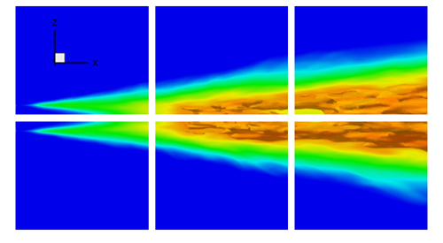
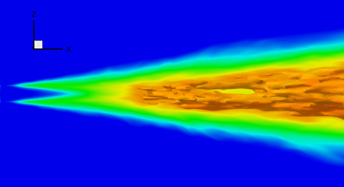
Blockbuster
blockbuster on desktop display
blockbuster + sidecar on Powerwall
Streaming Movie
Powerwall usage: break movie or image sequence into separate pieces and show each piece on a different display.
  Each backend node only has to render its part. Less disk I/O per node, so faster movie playing.
  Allows 30 fps display of multiple megapixel movies, which are too big to show on a single node at that speed.
Streaming movies played with blockbuster can use multiple resolutions, compression and other techniques for speedup.
Technology: DMX, MPI, SLURM, OpenGL
Not LLNL-specific -- works on any DMX display.

Slide 2
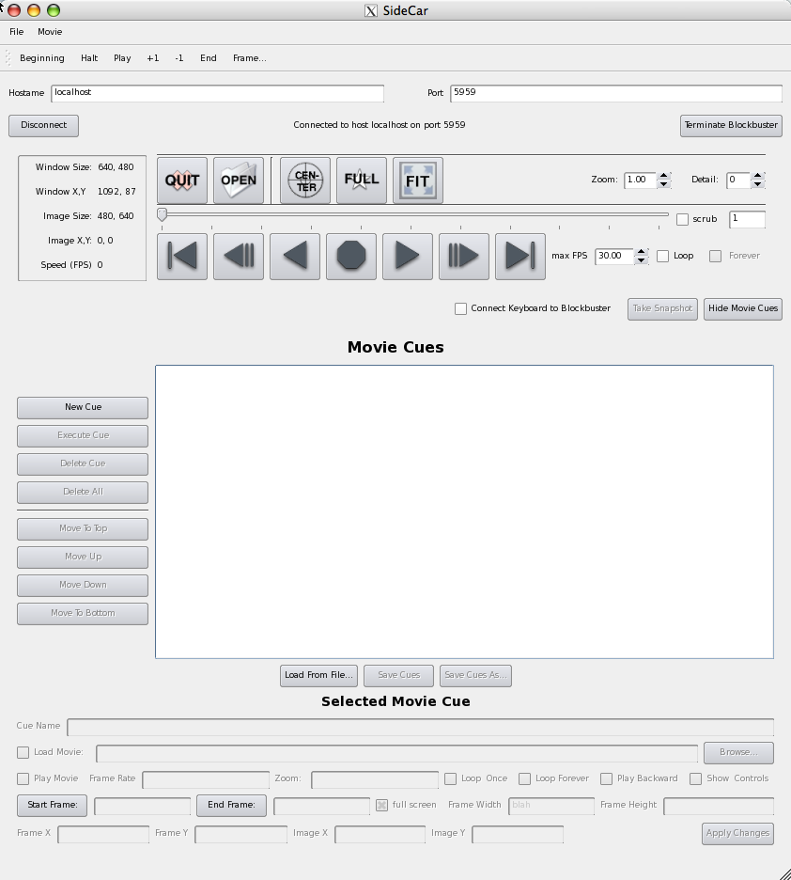
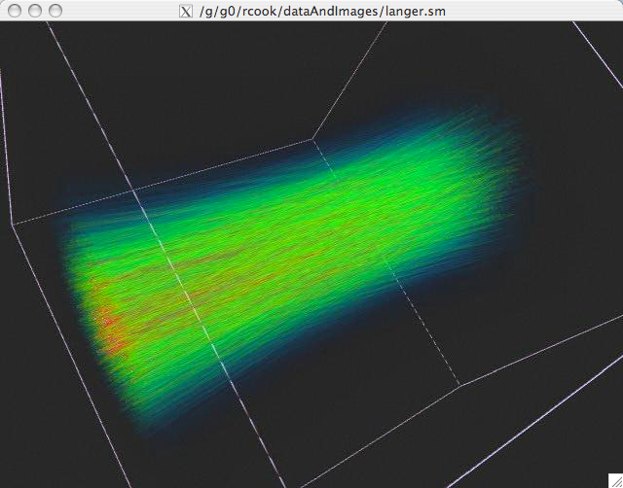
Sidecar
Process management: Launch and connect to blockbuster.
Remote control: Sidecar user interface on console, controlling remote blockbuster on powerwall.
  Why? Blockbuster controls are a very small “click target” on powerwall and obscure and distract from presentation.
Presentation scripting: Create, save and load lists of “movie cues.”
  Example movie cue: Load “movie.sm” , zoom in on important detail in movie, play in a loop at 5 FPS, starting at frame 39, played at a certain spot in powerwall.
sidecar
blockbuster

