Slide 1
ICF Surrogate Modeling
Current ML Questions
Dataset Statistics
It’s unclear how one measures accuracy of prediction as traditional metrics of L2 error/ PSNR etc. are not necessarily scientifically meaningful.
One proposed measure of accuracy of the forward model is to measure the accuracy of the inverse model. Since this predicts into the space of parameters, traditional metrics are more applicable.
How well does the neural network preserve “Scientific Constraints” ?
With no explicit knowledge of physics, are we able to obtain satisfactory models that also respect the physics?
Can this be modeled as a hyper-parameter search using current regularizers?
Inputs: 5 dimensional input parameters obtained by design of experiments
Outputs:
Images: 4 channel X-ray images of simulated explosions, where each channel is a measurement at a different energy. These are 64x64 in size.
Scalars: 22 dimensional scalar quantities that are highly correlated with the images.
Size of initial dataset is 10K and currently developing datasets of size 100K, 1M, 100M. There are also plans to increase images to 12 from 4, and include temporal information to increase from 12 to ~48.
Current training requires ~30 mins to train the multimodal autoencoder and about ~30min to converge the surrogate model on a single NVIDIA P100 GPU.

Slide 2
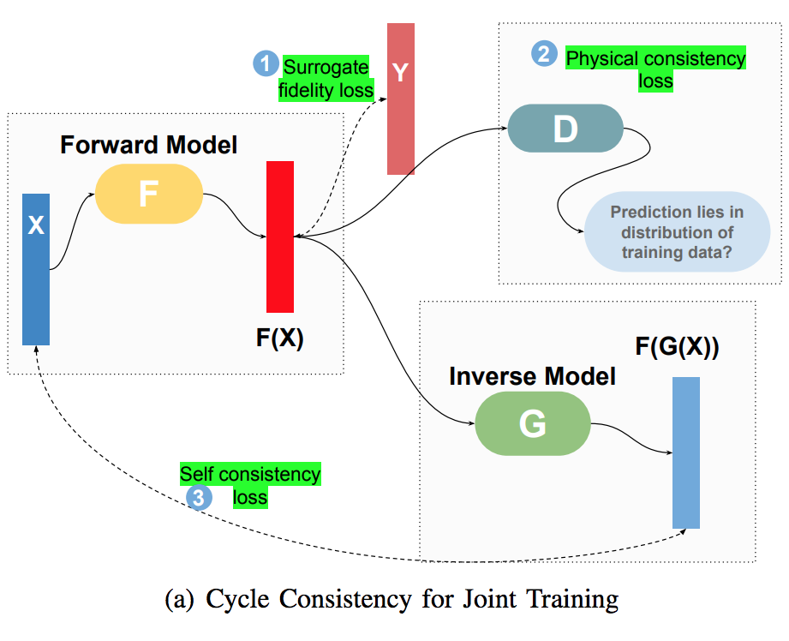
ICF Surrogate Modeling – ML Problem Description
We want to accurately model 1D, 2D physics simulators with machine learning.
These are posed as high dimensional regression functions that go from simulator inputs --> simulator outputs.
We have 4 networks in the architecture (See fig):
An autoencoder on the space of outputs (with possibility for uncertainties like VAE or WAE)
A forward network that predicts from inputs → outputs
An inverse network that predicts from outputs → inputs
A discriminator that tries to distinguish real vs fake predictions.
The autoencoder is pre-trained, and the other 3 networks are trained together.
All implementations are in Tensorflow.
Figure from: http://hyperion.usc.edu/UQ-SciML-2018/upload/RushilAnirudhpaper.pdf

