Slide 1
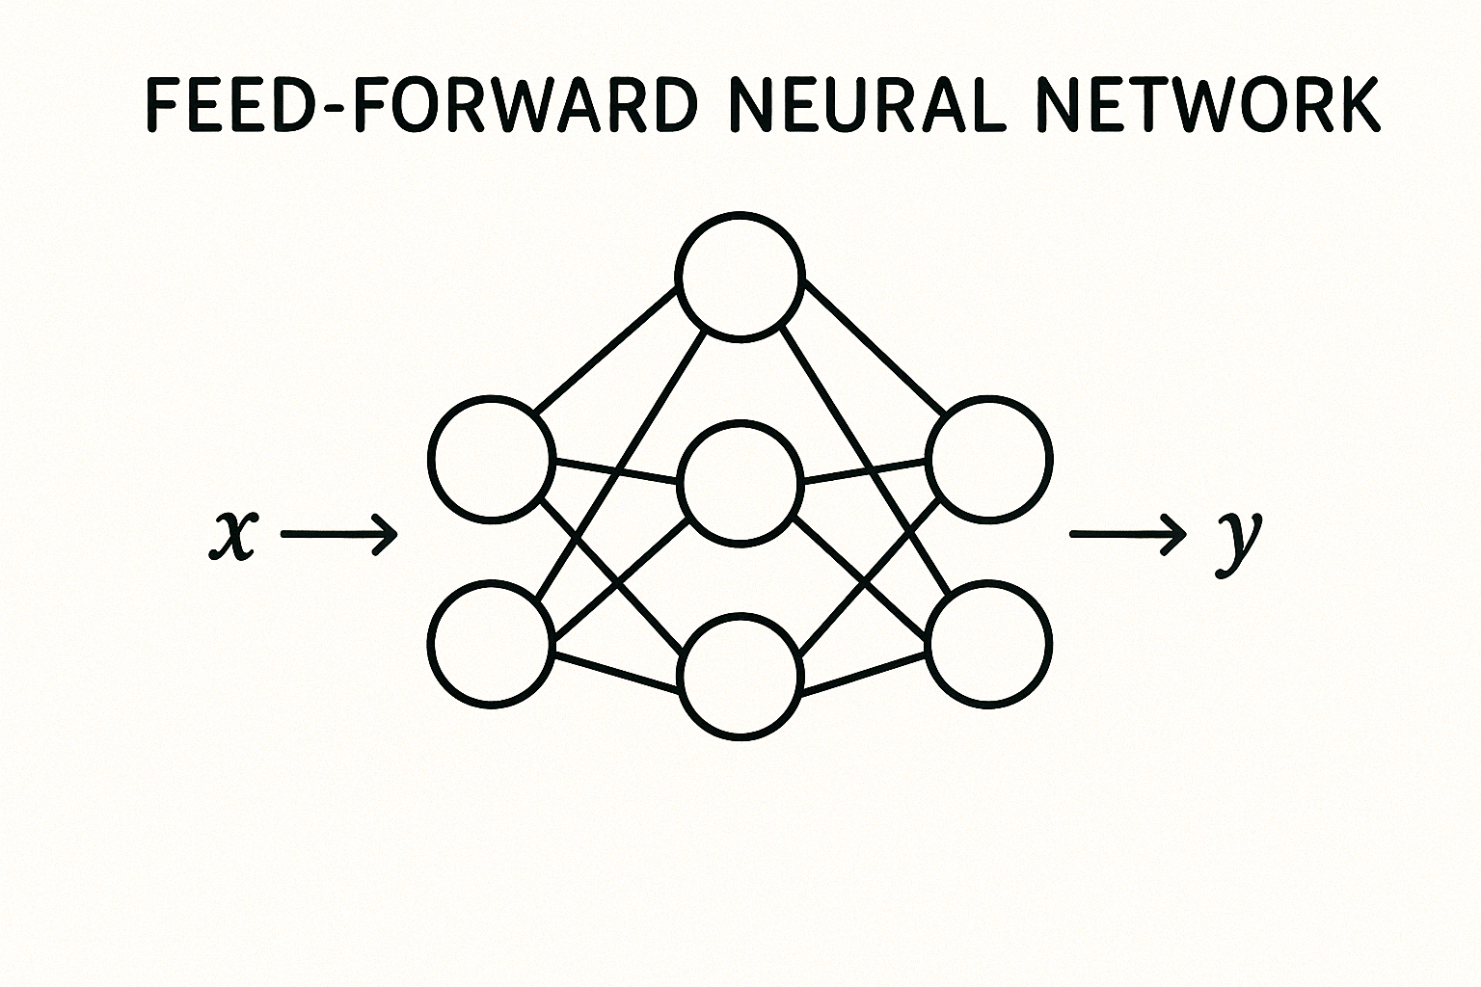


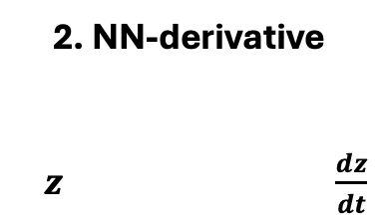


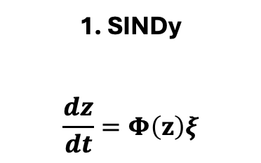







a)
E
Encoder
D
Decoder
$$x_{t}$$
$$x_{t+Δt}$$
$$X_{t}$$
Normalize
$$X_{t+Δt}$$
$$z$$
Denormalize
$$z_{t}$$
$$z_{t+Δt}$$
F
Dynamics
$$M_{t}$$
$$M_{t+Δt}$$
$$Δt$$
b)
1. SINDy
$$\frac{dz}{dt}=Φ\left(z\right)ξ$$
2. NN-derivative
$z \frac{dz}{dt}$
3. Autoregressive (AR)
$z_{t} { z}_{t+1}$

Slide 2
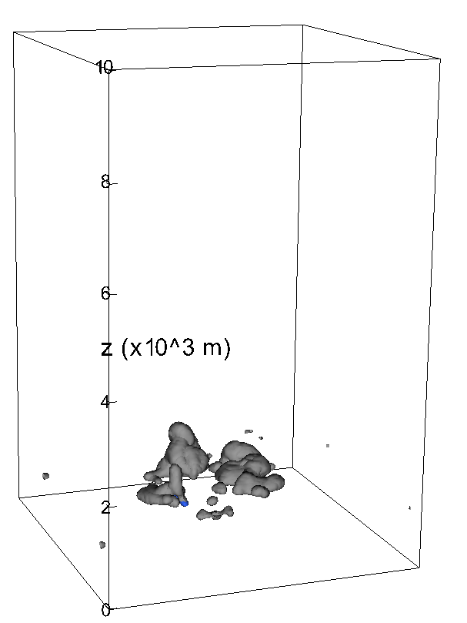
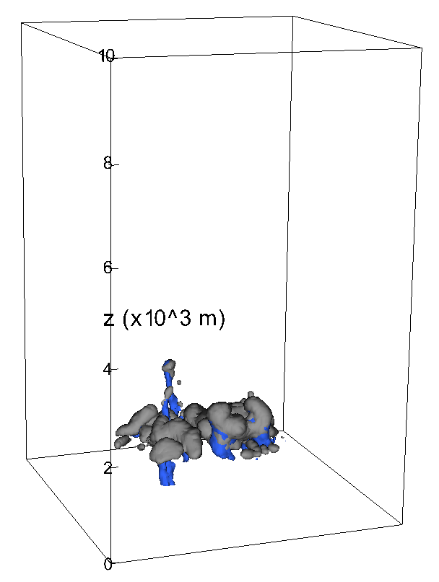
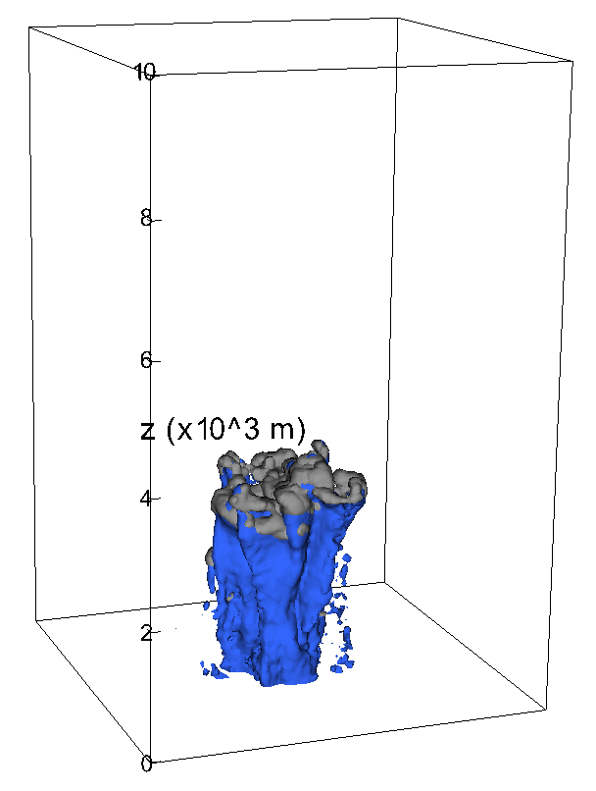
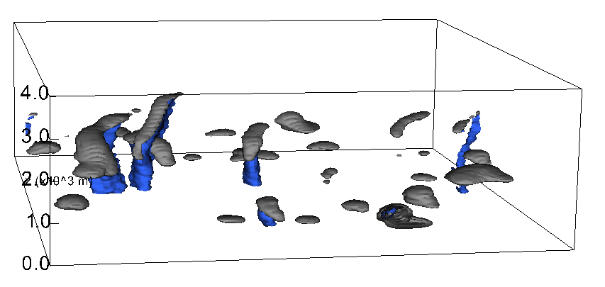
a) 80min
b) 1.5h*
c) 2h
d) RICO: 20h

Slide 3
a) SINDy
b) NN-derivative
c) Autoregressive (AR)

Slide 4
Figure 4 concept (NNdzdt)
a)
b) SINDy
Wasserstein Distance
c) NN-derivative*
d) AR
P90
P10
P50

Slide 5
a) SINDy
b) NN-derivative
c) AR

Slide 6
a)
Figure 6 concept (NNdzdt)
b) SINDy
c) NN-derivative
d) AR
P50
P75
P25
P5

Slide 7
a)
b)
c)
d)

