Slide 1
Quandary for Spin Chain Simulations
Jan 2023
Stefanie Guenther

Slide 2
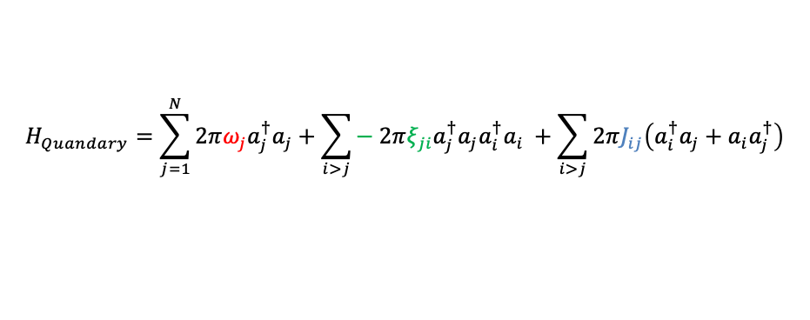
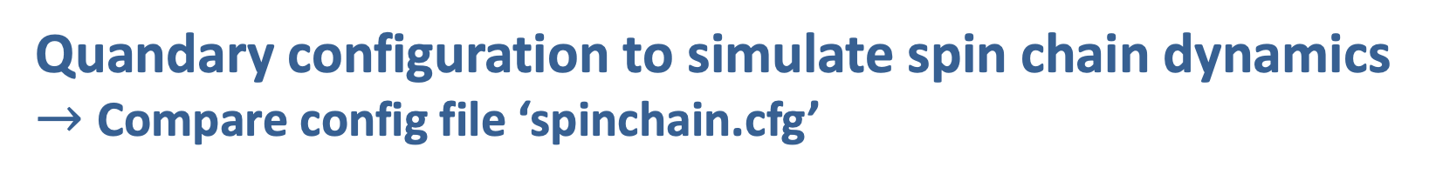
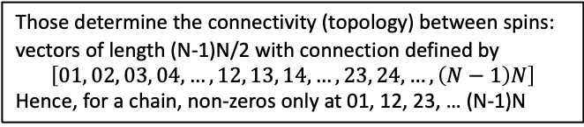
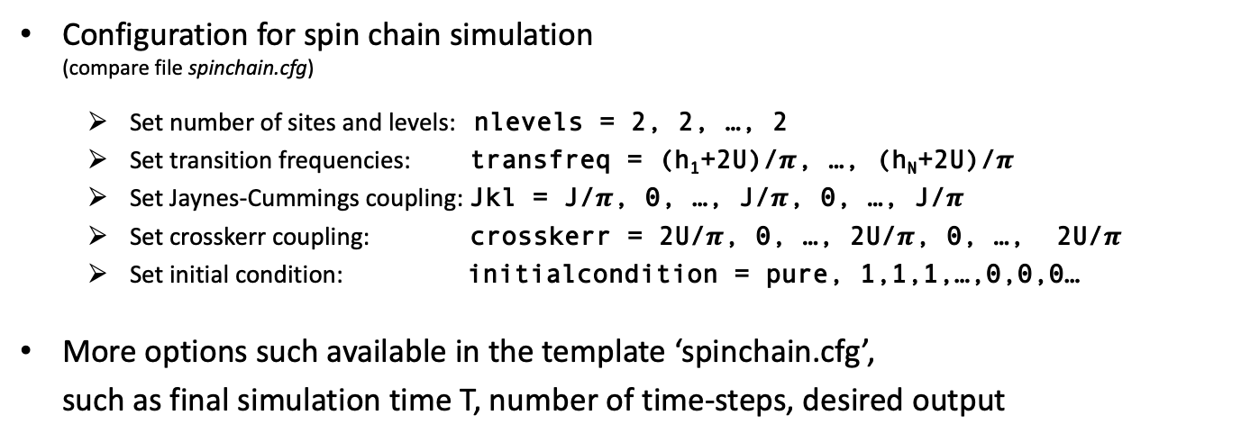
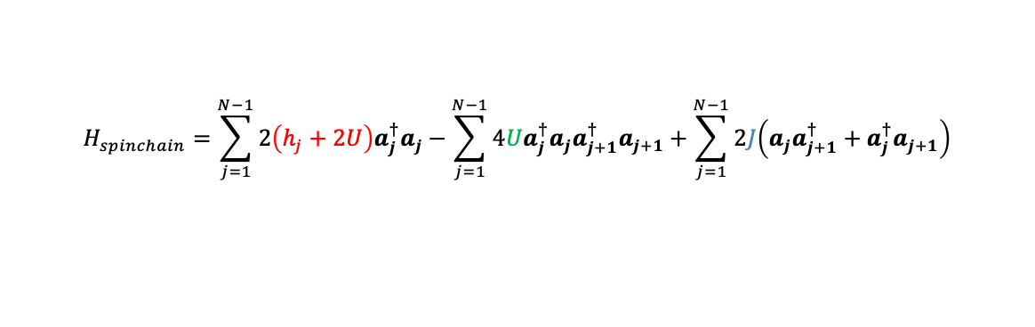
Quandary configuration to simulate spin chain dynamics $→$Compare config file ‘spinchain.cfg’
Execute Quandary once:
$> </path/to/quandary/main> spinchain.cfg
OR in parallel on <x> cores:
$> mpirun -np <x> <path/to/quandary/main> spinchain.cfg $> srun –n <x> </path/to/quandary/main> spinchain.cfg
Plot result e.g. with Gnuplot:
$gnuplot> plot ‘data_out/nhalf.iinit0001.dat’ with lines
$$H_{spinchain}=\sum_{j=1}^{N−1}{2\left(h_{j}+2U\right)a_{j}^{†}a_{j}}−\sum_{j=1}^{N−1}{4Ua_{j}^{†}{a_{j}a}_{j+1}^{†}a_{j+1}}+\sum_{j=1}^{N−1}{2J\left(a_{j}a_{j+1}^{†}+a_{j}^{†}a_{j+1}\right)}$$
$$H_{Quandary}=\sum_{j=1}^{N}{2πω_{j}a_{j}^{†}a_{j}}+\sum_{i>j}{− 2πξ_{ji}a_{j}^{†}a_{j}a_{i}^{†}a_{i}} +\sum_{i>j}{2πJ_{ij}\left(a_{i}^{†}a_{j}+a_{i}a_{j}^{†}\right)}$$
“transfreq”
“crosskerr”
“Jkl”
Configuration for spin chain simulation (compare file spinchain.cfg)
Set number of sites and levels: nlevels = 2, 2, …, 2
Set transition frequencies: transfreq = (h₁+2U)/$π$, …, (h_{N}+2U)/$π$
Set Jaynes-Cummings coupling: Jkl = J/$π$, 0, …, J/$π$, 0, …, J/$π$
Set crosskerr coupling: crosskerr = 2U/$π$, 0, …, 2U/$π$, 0, …, 2U/$π$
Set initial condition: initialcondition = pure, 1,1,1,…,0,0,0…
More options such available in the template ‘spinchain.cfg’, such as final simulation time T, number of time-steps, desired output
N sites each modelled with 2 energy levels
One for each site. Note: Quandary multiplies $2π$ internally!
Those determine the connectivity (topology) between spins: vectors of length (N-1)N/2 with connection defined by $$\left[01, 02, 03, 04,…,12, 13, 14,…, 23, 24,…,\left(N−1\right)N\right]$$ Hence, for a chain, non-zeros only at 01, 12, 23, … (N-1)N
Domain wall at t=0: $|1111…0000…⟩$

Slide 3
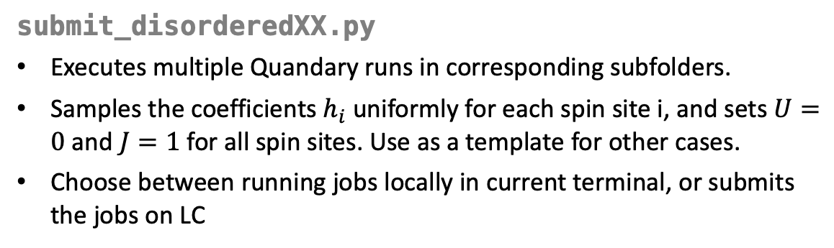
Python scripts to execute multiple simulations and gather results
submit_disorderedXX.py
Executes multiple Quandary runs in corresponding subfolders.
Samples the coefficients $h_{i}$uniformly for each spin site i, and sets $U=0$ and $J=1$ for all spin sites. Use as a template for other cases.
Choose between running jobs locally in current terminal, or submits the jobs on LC
Execute multiple Quandary instances:
$> python submit_disorderedXX.py
Gather results and plot:
$> python plotresults_disorderedXX.py
plotresults_disorderedXX.py
Gathers results from each subfolder and averages observables
Writes and plots averaged observable Nhalf and averaged magnetization. Note: averaged magnetization might not be what you want to see, consider ploting magnetization for only one instance by changing the bottom of this script.

