Slide 1
Figures
DE-FOA-0002501
Data reduction for science

Slide 2
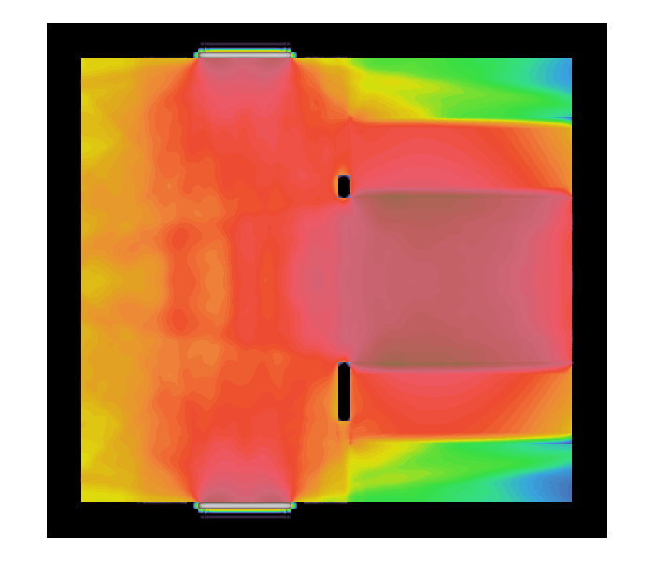
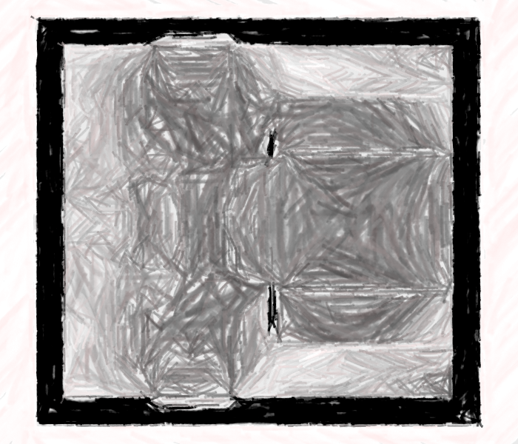
Data reduction
Data
Reduced order model
Predictive solution
Laws of physics
physics constraints:
energy conservation
symmetry
Speed-up of 100x or higher
Relative error of less than 1%

