Slide 1
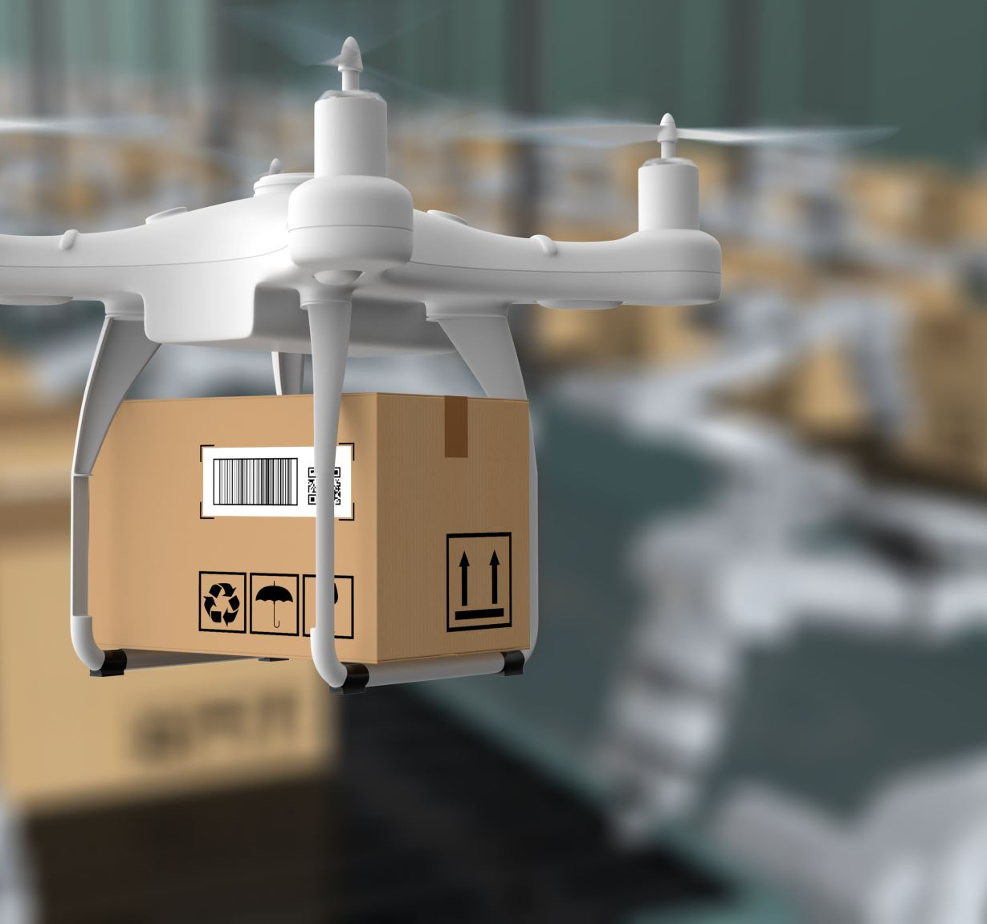
B-BAY ECOMMERCE SYSTEM
Delivery Date
January 3rd, 2023
Team Qnet
Linsong, Li
Fatoumata, Ceesay
Habiba Karim, Rinky
October 25, 2022
Prepared for:
Sung, Shin
Owner of
Sung’s & Co Limited
550 Main Avenue
Brookings SD, 57007
605-456-7890
Sung.Shin@Outlook.com

Slide 2
Table on contents
Introduction…………………………………………………………3
Proposed System Overview………………………………4
Intelligent Recommendation system………………12
Non-Functional requirements…………………………17
Cool parts……………………………………………………………18
Questions?.......................................................19

Slide 3

Introduction
B-Bay and its Five major functionalities
The B-Bay Ecommerce system is our proposed solution to provide a website with intelligent tools to make buying and selling easier for people in Brookings.
Major Functionalities
Account Creation and Login
Selling Request
Administrator Interface
Customer Interface (Intelligent Recommendation)
Merchandise Interface (Intelligent Recommendation)

Slide 4
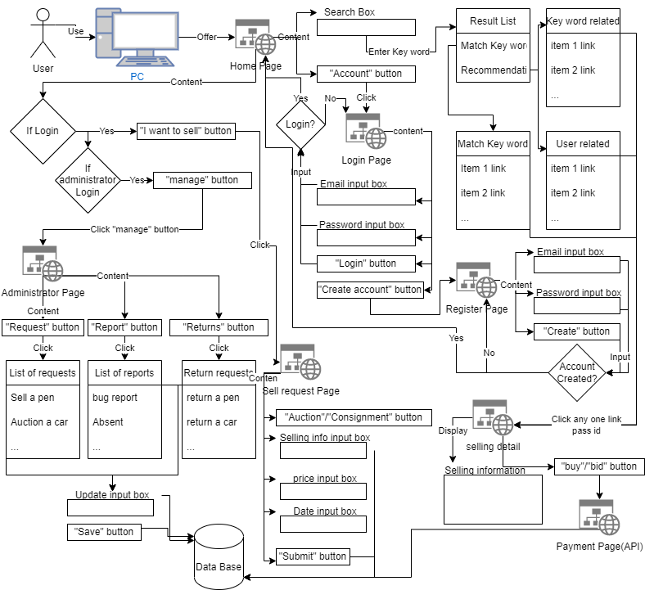
Proposed system overview

Slide 5
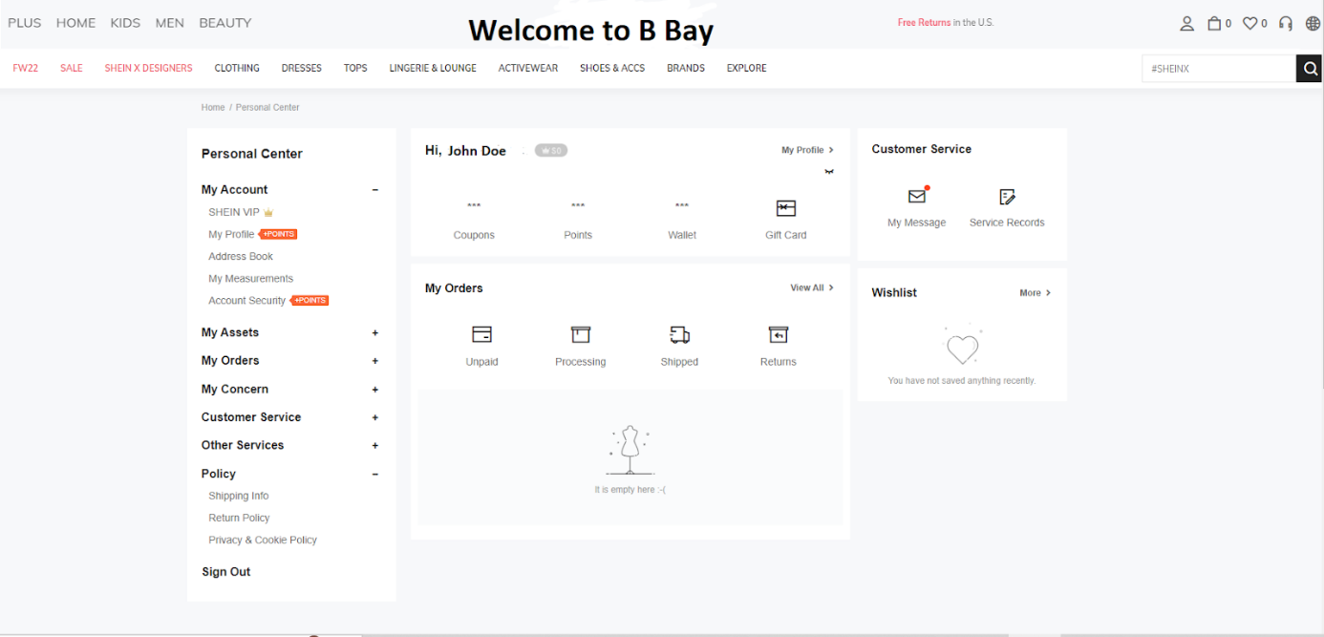
Home page

Slide 6
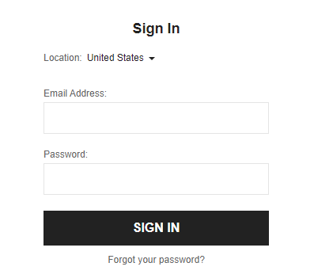
Login Page

Slide 7
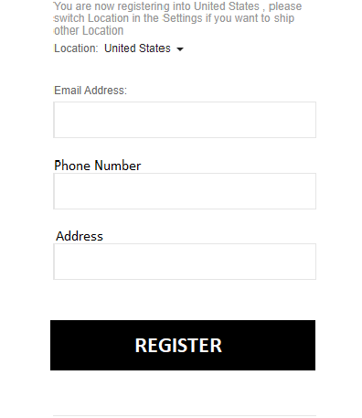
Register page

Slide 8
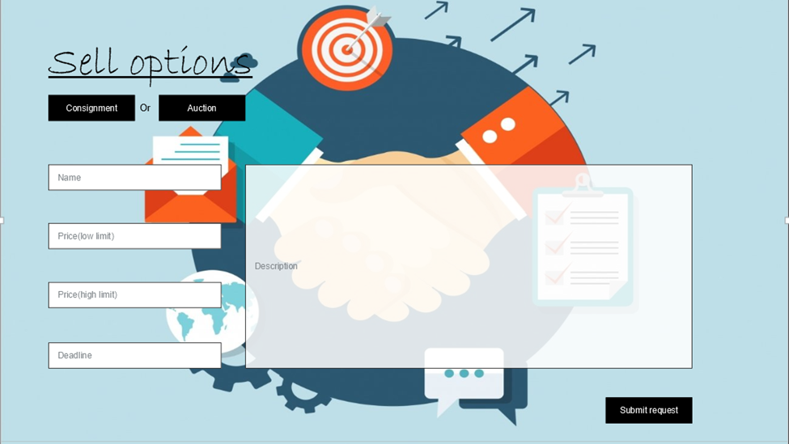
Selling request Page

Slide 9
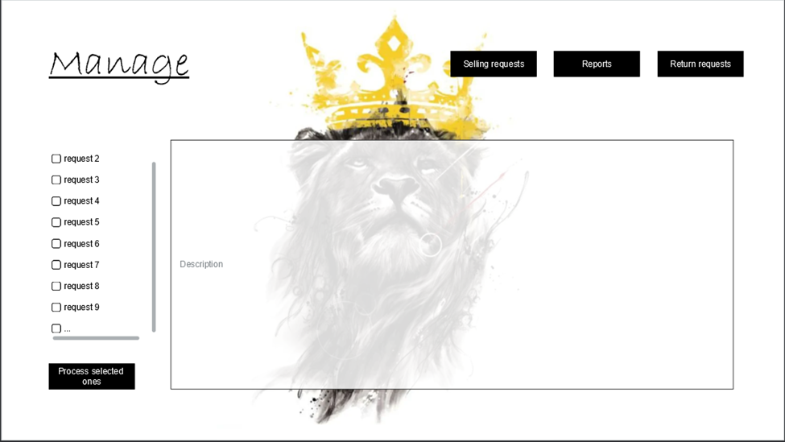
Administrator interface

Slide 10
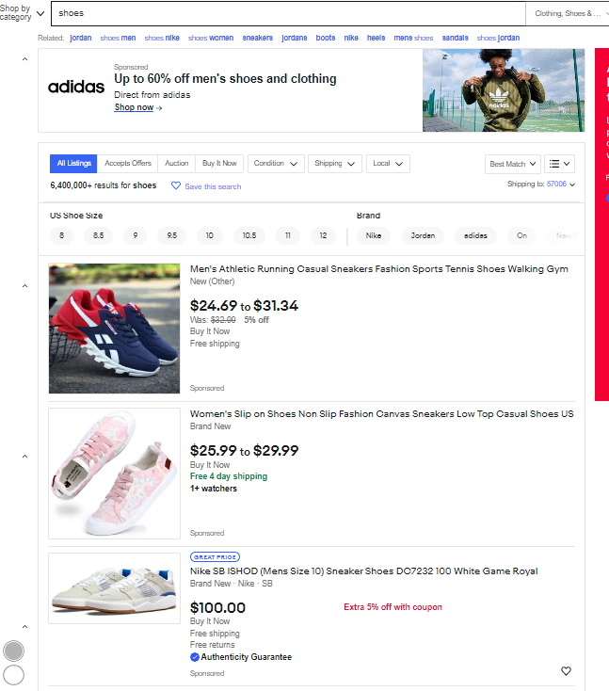
Home page- search list

Slide 11
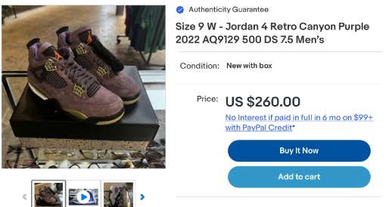

Merchandise detail page
Or

Slide 12
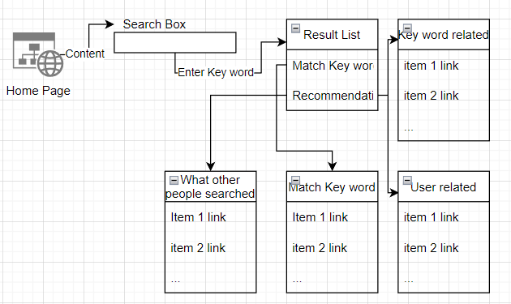
Intelligent recommendation system
While user input key words in search box from Home page, and press Enter, our system will offer a list of links that point to each merchandise’s detail page. This list is generated by results of four different searches. Direct key word search, related words search, what other people searched, and user information based search.

Slide 13

The direct key word search
The direct key word search is the simplest one, it will find the top 10 matchs from data base by using the whole key word, and then split the key word into words, do search of each, and find top 3 for each word.
User information based search
User information based search is similar to direct key word search, but the key words this search used come from user profile.

Slide 14
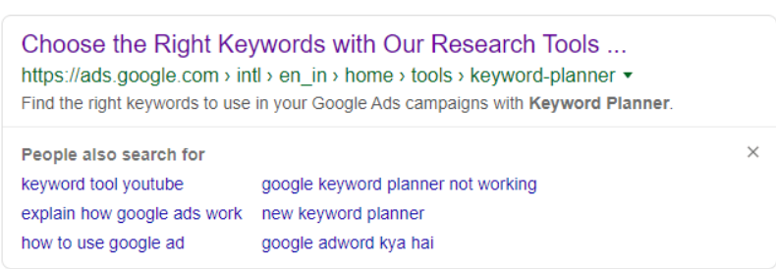
What other people searched
What other people searched is a search that tell user what’s the top 10 populer key words used by people who did the same search as user. Each user’s search history is stroed at data base related to their id. When a user did a search, the What other people searched search will select a table of all searched items from search history of all users who searched the same thing. And count the numbers of appear of each merchandise. The top 10 populer merchandises will be in the result of this search.

Slide 15
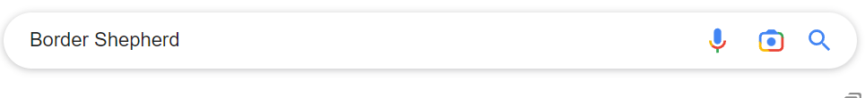
Related Words Search
Related words search is a search that will find related words and do search for each related tags that’s been found. We will use CNN techniques to train a module that do text classification to each merchandise’s name, classification will relate the name with a tag exist or create a tag, then relate the name with the tag. While user input key word, we will use the same module to classifly which tag is related, and use the merchandises in the tag as the result.

Slide 16
Text classification Module Training
Tools: Tensorflow, Jupytor notebook, python
Training and testing data collection: category names with merchandises’ names, obtain by using web crawler to Best Buy, Amazon and so on… using 80% of data as training data and 20% of data as testing data
Using CNN
References
Minaee, S., Kalchbrenner, N., Cambria, E., Nikzad, N., Chenaghlu, M., & Gao, J. (2022). Deep learning--based text classification. ACM Computing Surveys, 54(3), 1–40. https://doi.org/10.1145/3439726

Slide 17
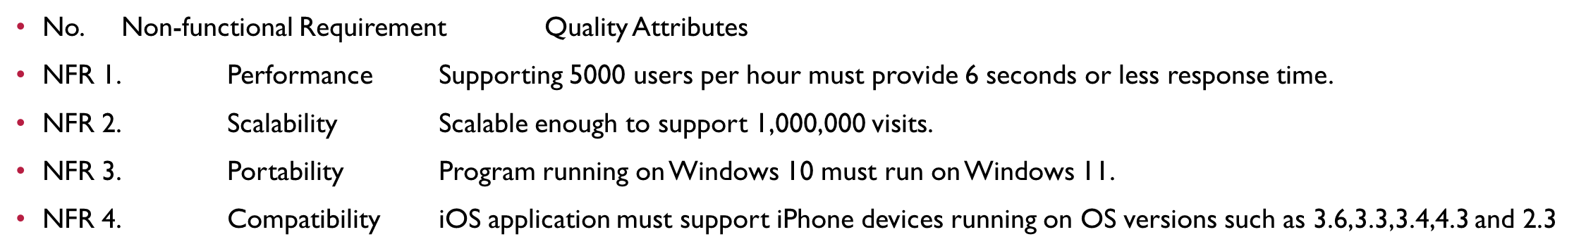
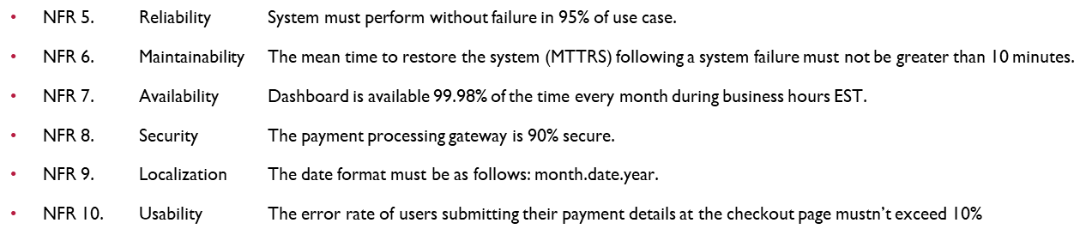
Non-functional requirements

Slide 18
Cool parts
Generated Tags
Take image as input?
24/7 Customer Service
Coupon code?

Slide 19

Questions?

