Slide 1
SKA – Static Kernel Analysis using LLVM IR
Kartik Ramkrishnan and Ben Bergen
Applied Computer Science (CCS-7)
Los Alamos National Laboratory
Notes:
Should the title be register allocation for SKA, or just SKA itself ?
The paper is titled SKA, although it mostly talks about register allocation.

Slide 2

What is SKA
SKA – Static Kernel Analyzer
SKA is a very useful tool to improve the development process.
Performs static architecture aware analysis of kernels.
Outputs code metrics during the development process.
Visualizes the code execution on the specified pipeline.
Notes:
SKA is different from existing static analyzers, such as Byfl or Clang Static Kernel Analyzer . Doesn’t static refer to pure code analysis rather than providing inputs and doing the execution ?
The SKA technical report published by LANL says that SKA does not reorder the instructions and that is what static refers to.
2. Code metrics – what are they useful for ? Refer the slide that contains code metrics.
3. I want to replace the term architecture aware with something less strong. Maybe architecture dependent ?
4. Can I add a cartoon to make this slide less boring ?

Slide 3
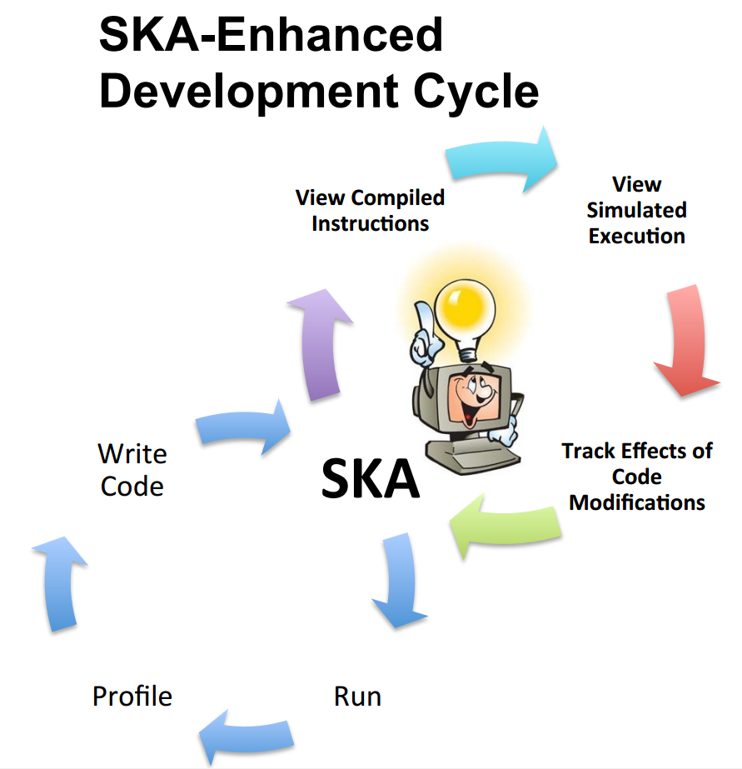
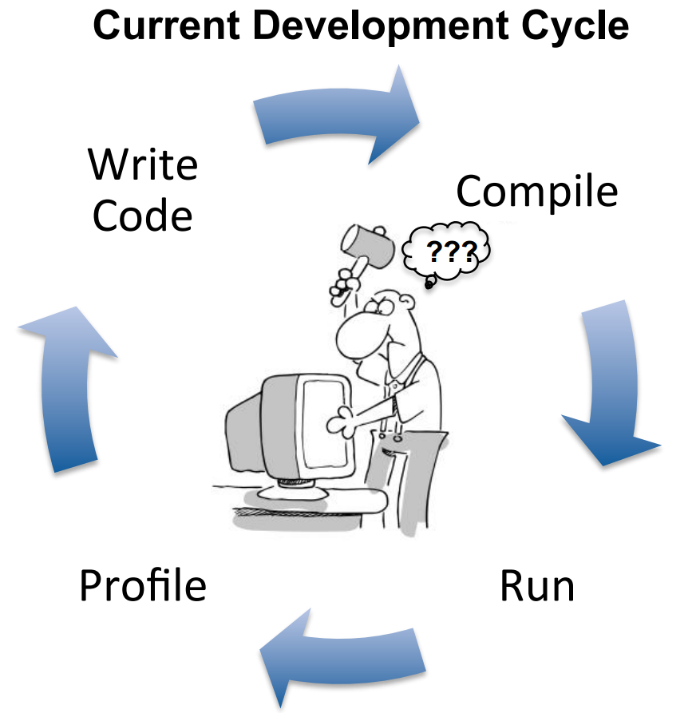
SKA-Enhanced Development Cycle
Notes:
Add reference to Ben’s technical report on SKA.
SKA is useful because it provides metrics about the compiled code during the development process itself.

Slide 4
Example kernel – saxpy.ll
define i32 @main(i32 %argc, i8** nocapture %argv) nounwind uwtable readnone {
entry:
%a1 = alloca [32 x float], align 4
%b2 = alloca [32 x float], align 4
%c3 = alloca [32 x float], align 4
br label %"3"
"3": ; preds = %"3", %entry
%indvars.iv = phi i64 [ 0, %entry ], [ %indvars.iv.next, %"3" ]
%0 = getelementptr [32 x float]* %a1, i64 0, i64 %indvars.iv
%1 = load float* %0, align 4
%2 = getelementptr [32 x float]* %b2, i64 0, i64 %indvars.iv
%3 = load float* %2, align 4
%4 = getelementptr [32 x float]* %c3, i64 0, i64 %indvars.iv
%5 = load float* %4, align 4
%6 = fmul float %3, %5
%7 = fadd float %1, %6
store float %7, float* %4, align 4
%indvars.iv.next = add i64 %indvars.iv, 1
%lftr.wideiv = trunc i64 %indvars.iv.next to i32
%exitcond = icmp eq i32 %lftr.wideiv, 32
br i1 %exitcond, label %"5", label %"3"
"5": ; preds = %"3"
ret i32 0

Slide 5
Register allocation support for SKA
LLVM IR is SSA (single static assignment) which has infinite register count.
ISAs(instruction set architectures) have a limited number of registers.
We improve SKA’s fidelity by allocating registers to the IR based on the target ISA.
Notes:
Register allocation – what kind of figure would help here

Slide 6
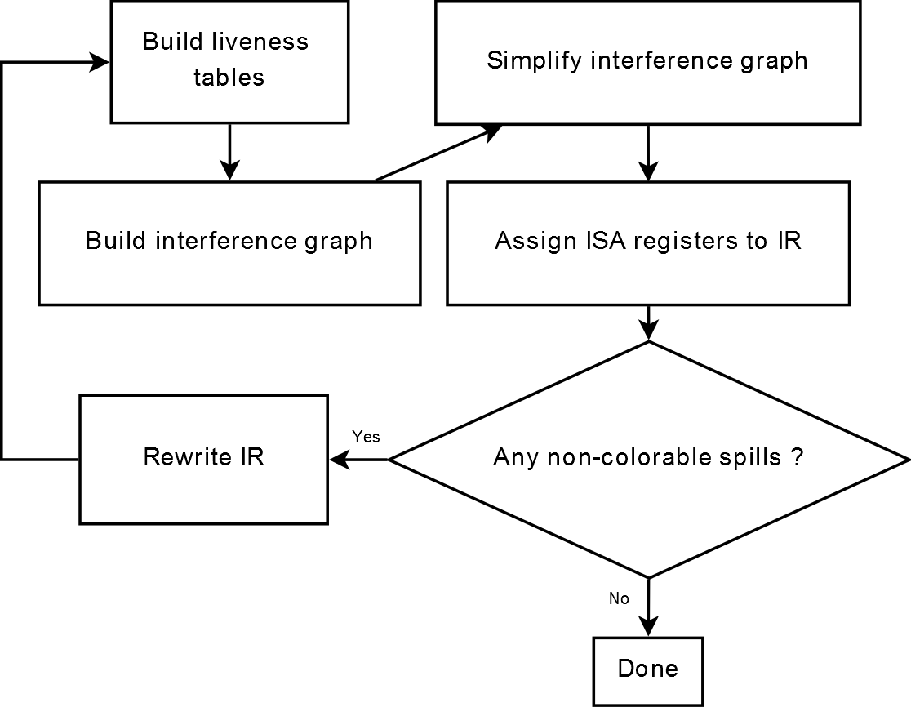
Register Allocation algorithm
Simple register allocation algorithm.
Notes:
Add an example that shows register allocation on these slides. Maybe saxpy.ll ?

Slide 7
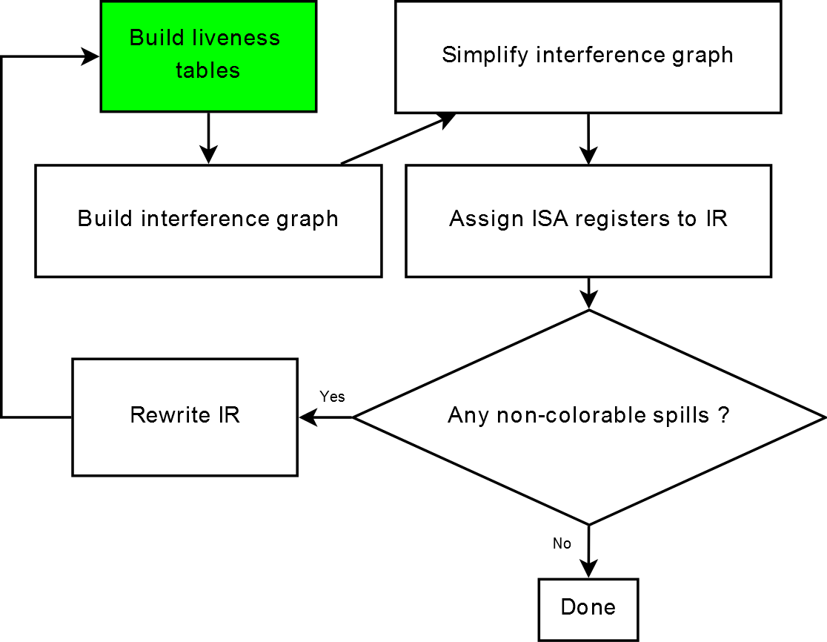
Build Liveness Tables

Slide 8
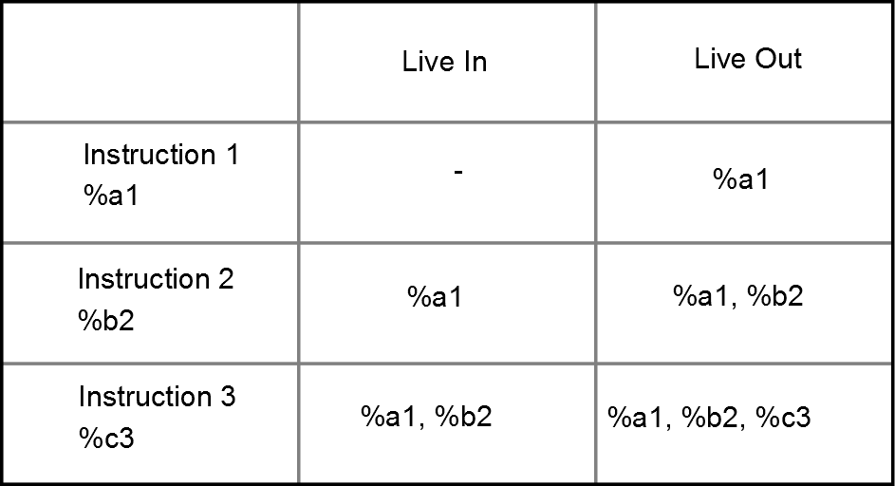
Build Liveness Tables
SKA takes an LLVM IR module as input and builds a liveness table.
Partial liveness table for saxpy.ll

Slide 9
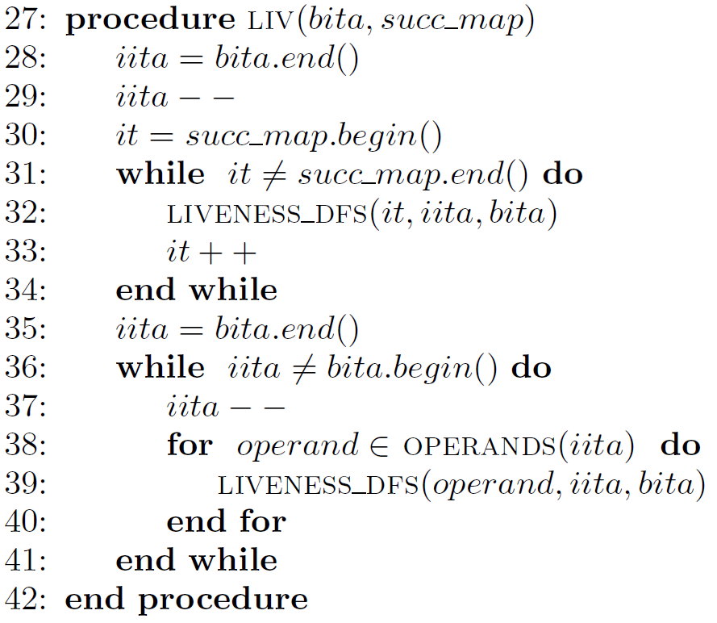
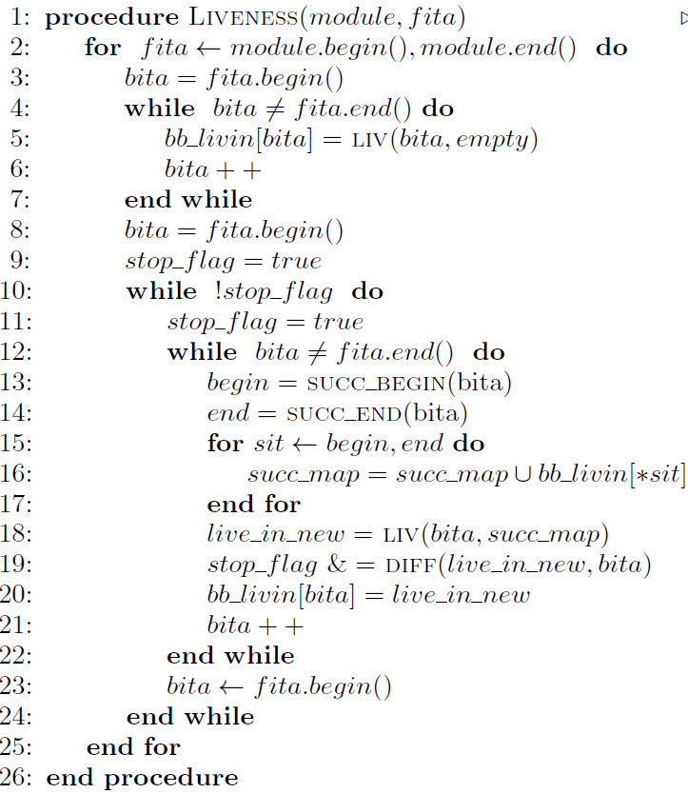
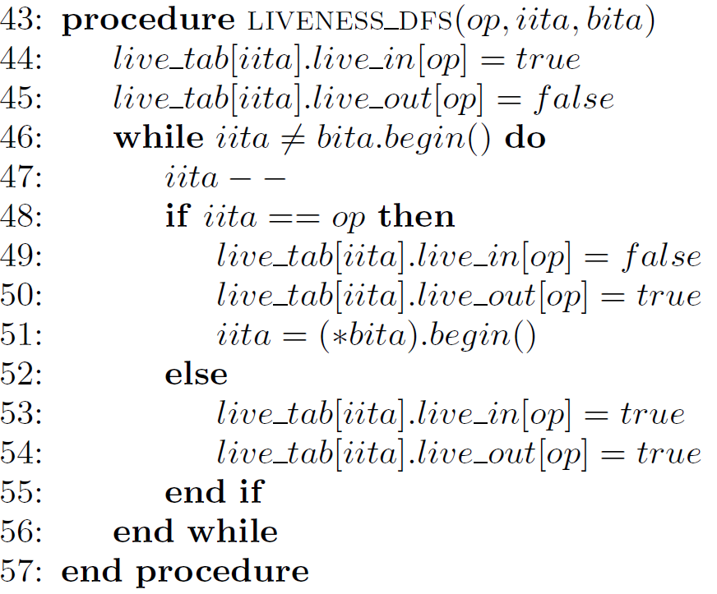
Build Liveness Tables
Single BB liveness calculation
Populate liveness table
Top level loop

Slide 10
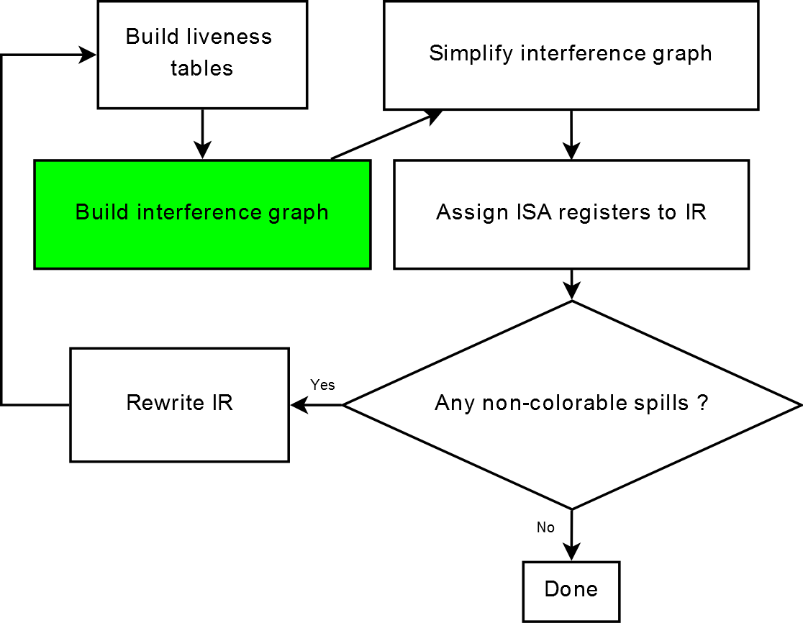
Build Interference Graph

Slide 11
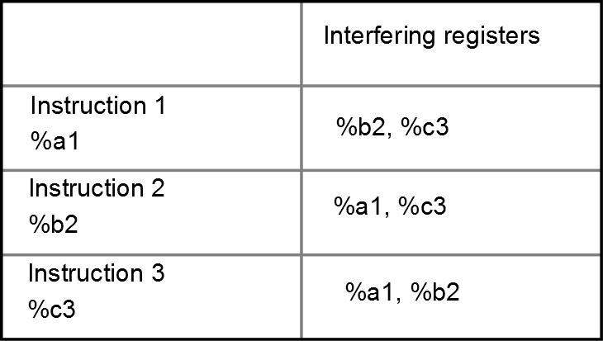
Build Interference Graph
Traverse the liveness table to create the interference graph.
Partial igraph for saxpy.ll

Slide 12
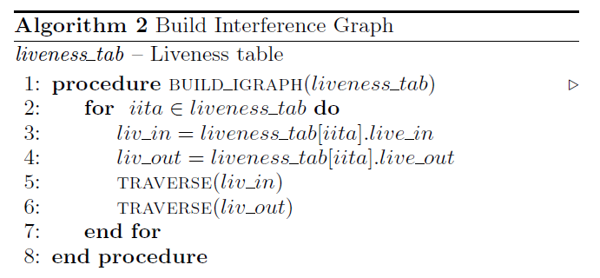
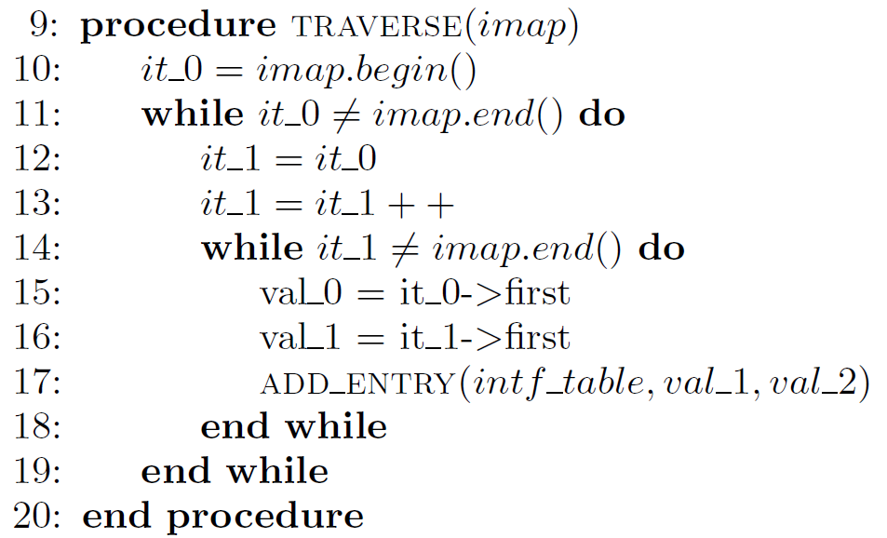
Build Interference Graph
Top level loop
Populate igraph

Slide 13
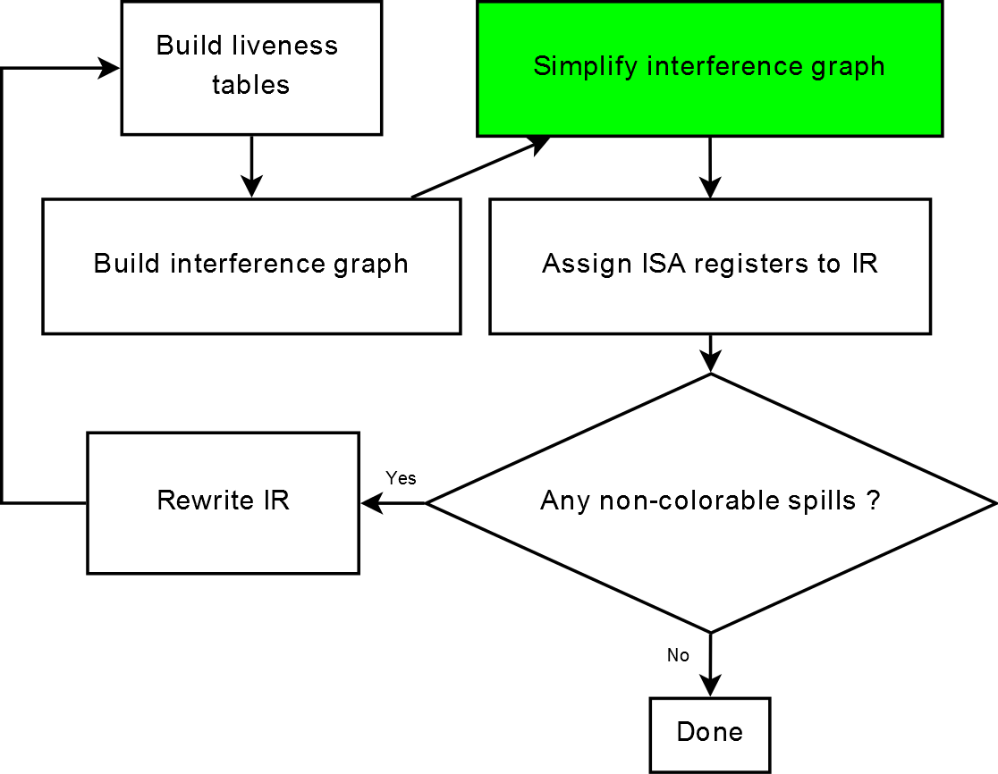
Simplify Interference Graph

Slide 14
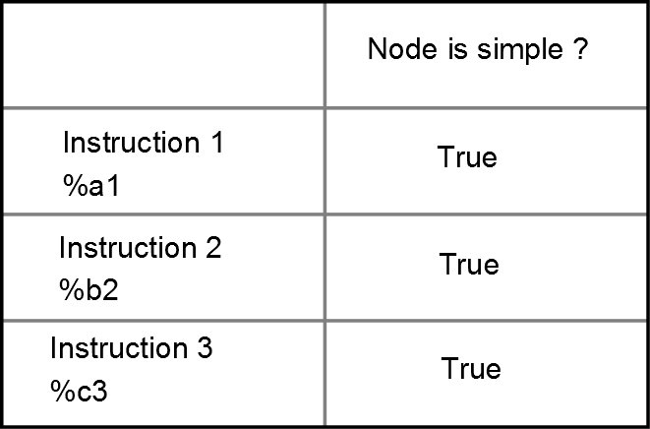
Simplify Interference Graph
Populate a stack which records whether a register (node) is simple or not.
Partial node stack for saxpy.ll

Slide 15
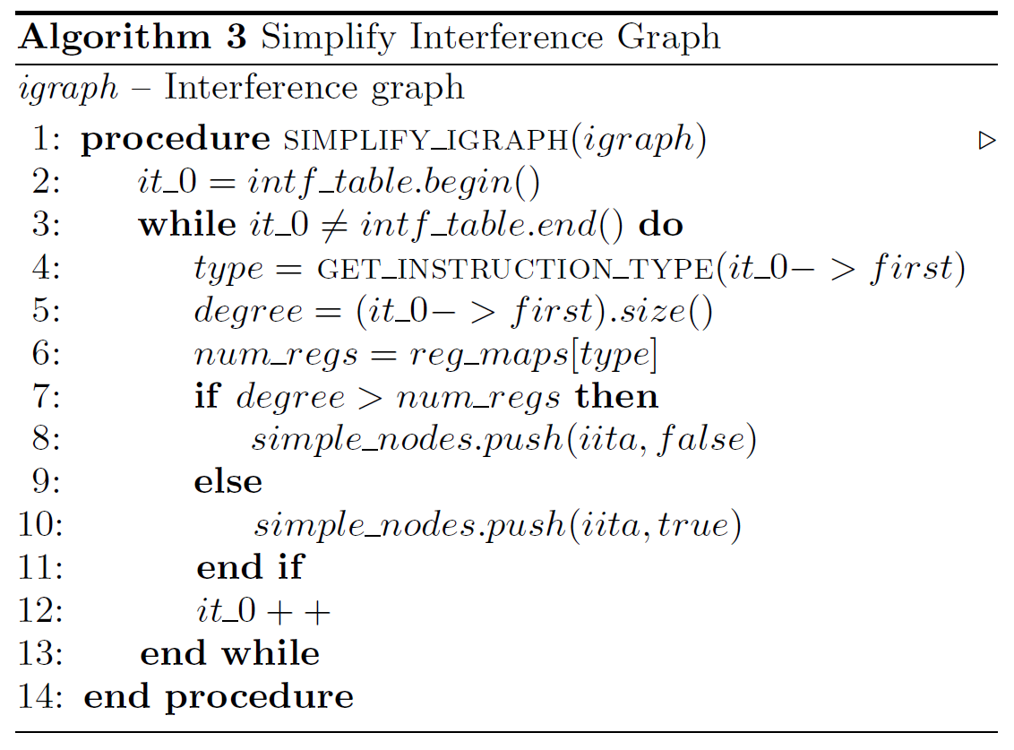
Simplify Interference Graph
Populate simple node stack

Slide 16
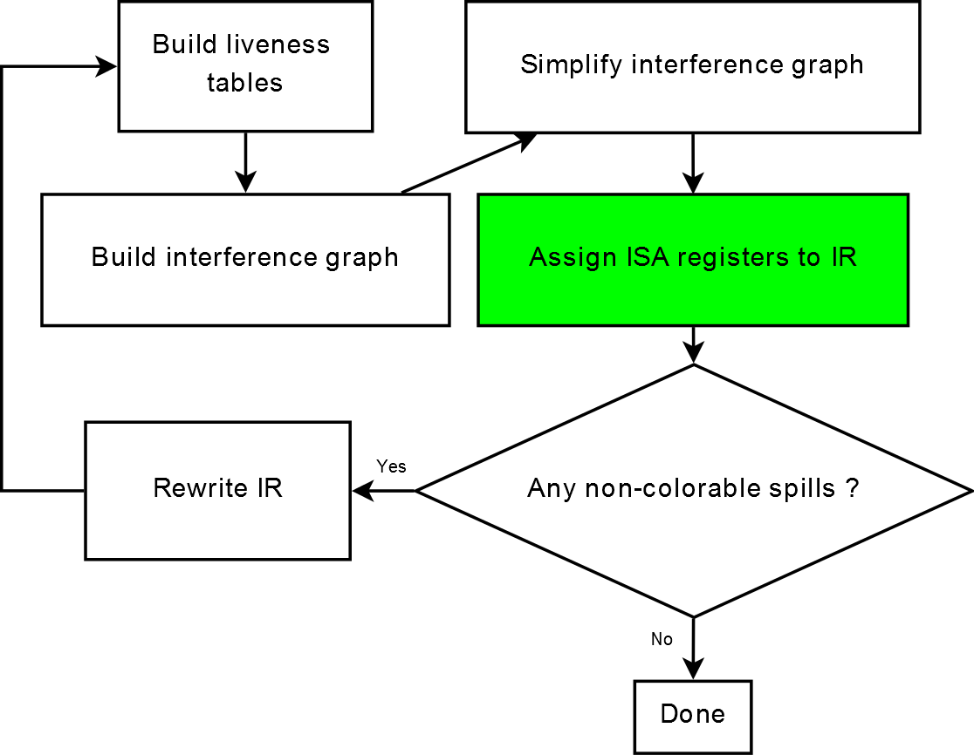
Assign ISA Registers to IR

Slide 17
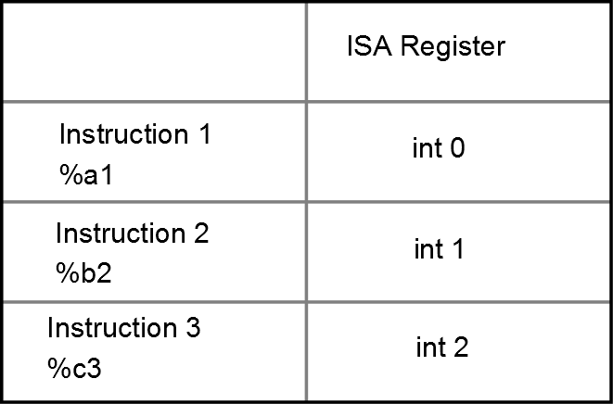
Assign ISA Registers to IR
Assign ISA registers to IR, if no true spill.
We choose between int, float and vector.
Partial register allocation for saxpy.ll

Slide 18
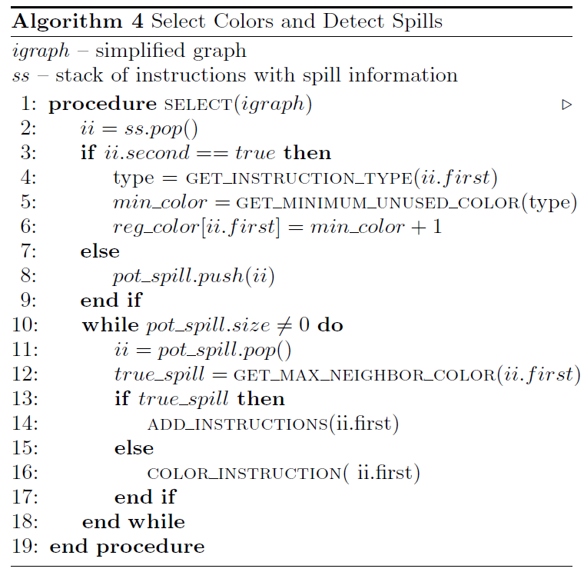
Assign ISA registers to IR
Assign register if no true spill

Slide 19
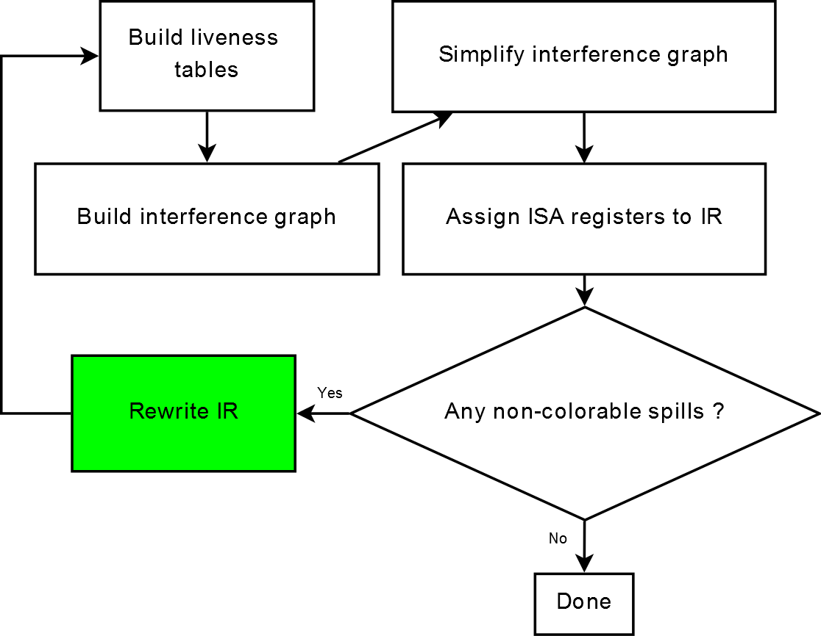
Rewrite IR

Slide 20
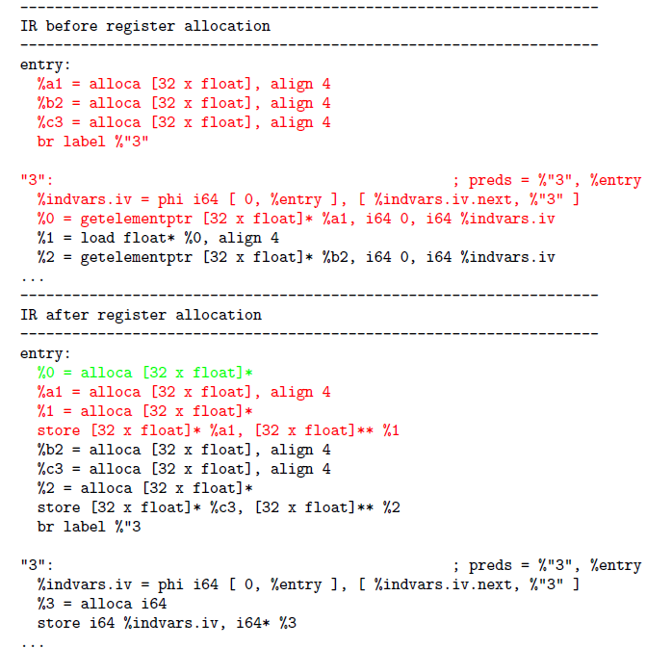
Rewrite IR
The live range of %a1 is shown in red. It reduces after rewriting the IR.
Notes:
Question – How do you handle phi nodes ?
Answer – In the current implementation, we don’t handle phi nodes. In the future implementation
we will handle phi nodes by

Slide 21
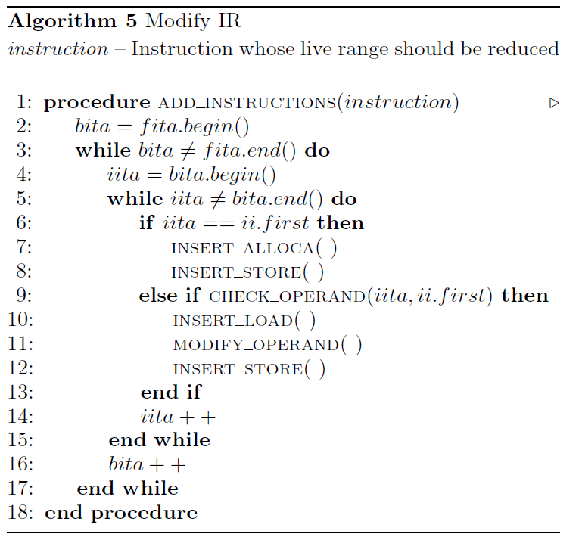
Rewrite IR
Store instruction into stack
Load, use and store

Slide 22
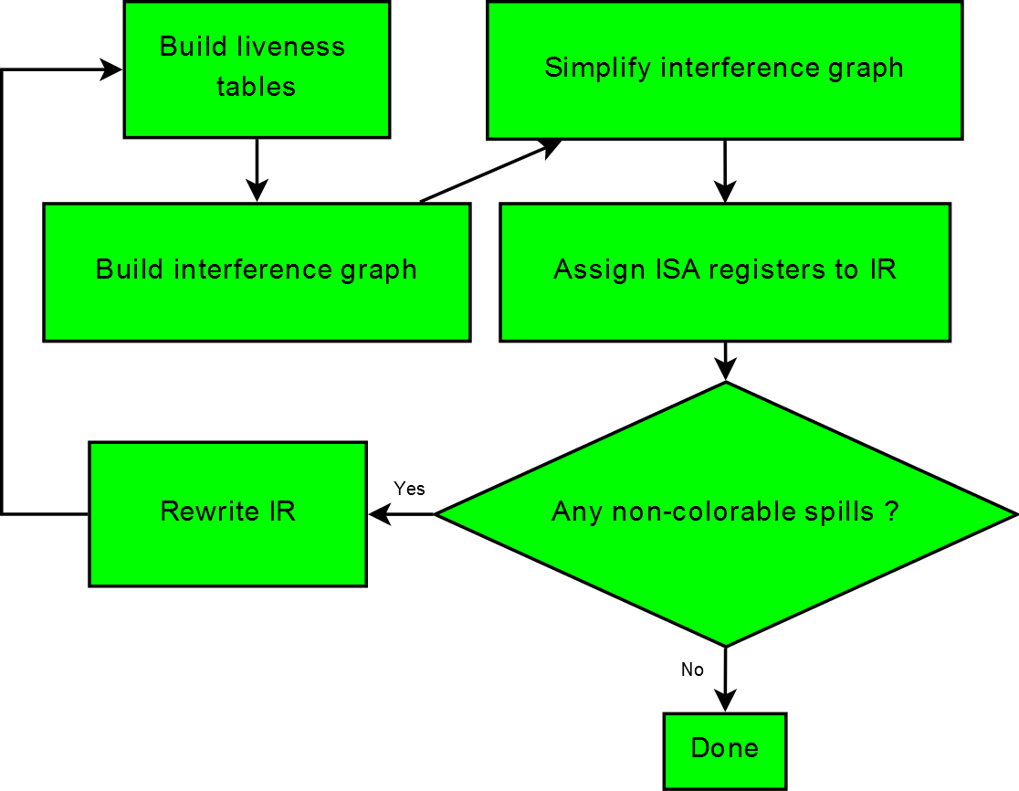
Register allocation done !

Slide 23
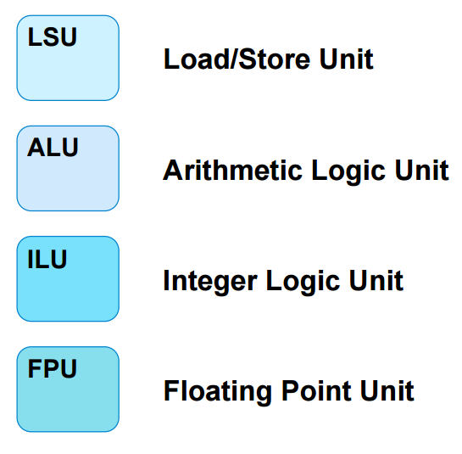
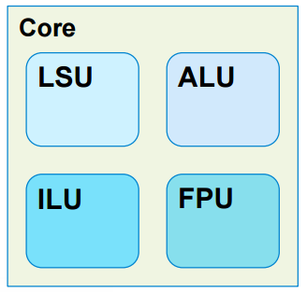
Virtual architecture specification
Specified in an xml file.
Specifies logical units, instructions they process, latencies, issue width …
Partial architecture example

Slide 24
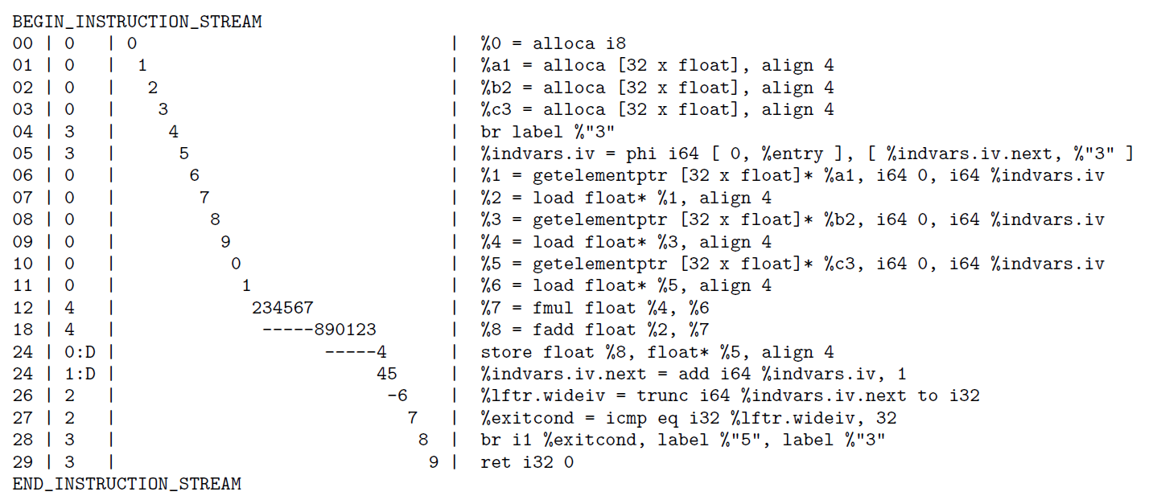
Pipeline simulation
Pipeline simulation of saxpy.ll

Slide 25
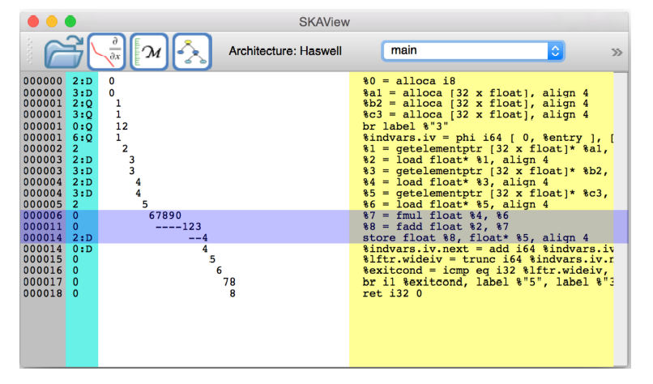
Skaview
Graphical visualization of saxpy.ll
Notes:
Can SKA show control hazards ?

Slide 26
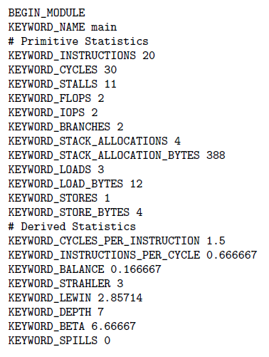
Code metrics
SKA outputs useful metrics about the code.
Primitive statistics include basic performance counters, such as instructions, cycles and stalls.
Derived statistics are obtained from primitive statistics.
Notes:
Strahler – measure of the branching complexity
Lewin number – average width of the DAG or the AST (number of instructions/ width)
-- average ILP of the dag

Slide 27
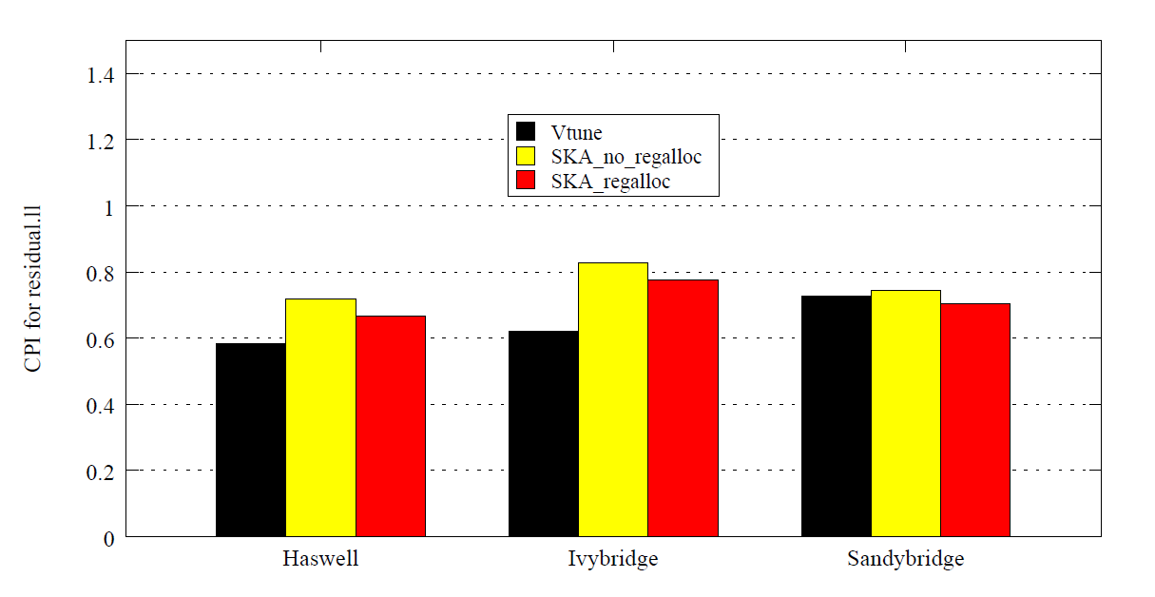
Results for residual.ll
CPI prediction is better after register allocation.

Slide 28
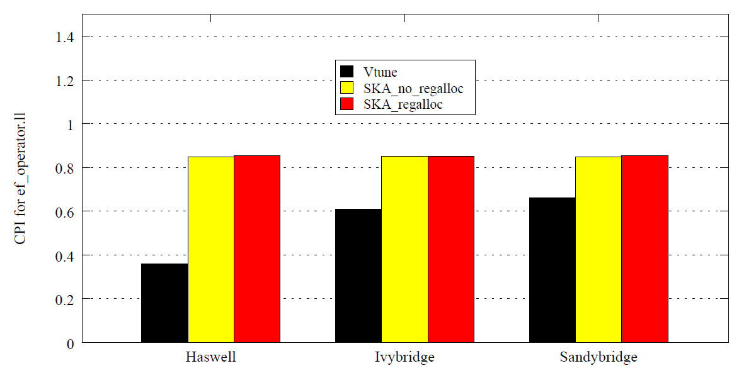
Results for ef_operator.ll
No change in CPI prediction. Why ?

Slide 29
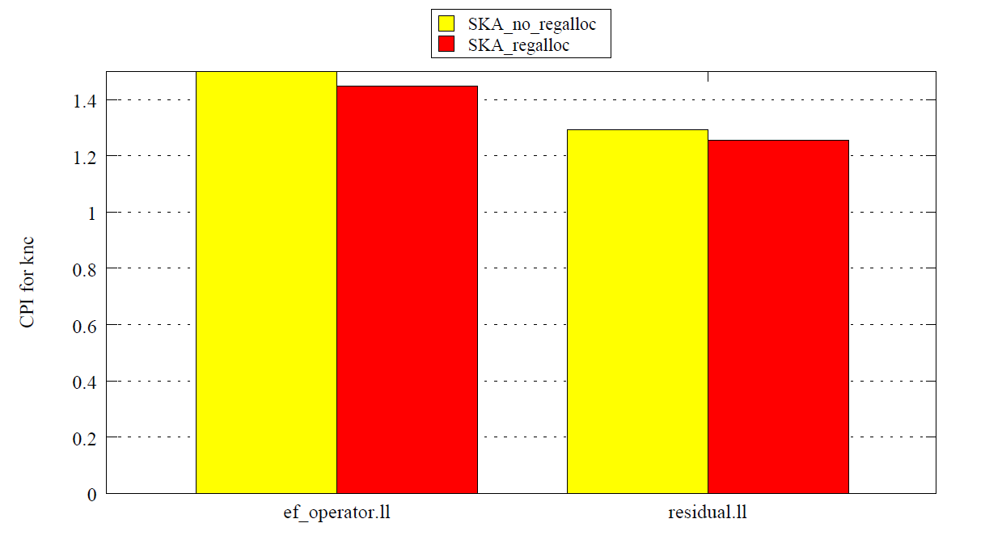
Results for KNC (Knights corner)
Predicts CPI > 1.0 for KNC for single threaded workloads.

Slide 30
Conclusion
SKA now supports register allocation.
Register allocation improves SKA’s fidelity by 5-10% across three architectures for a compute intensive benchmark.
Dynamic scheduling and cache models can further improve SKA fidelity.
Notes:
Possible questions :
How can cache models improve SKA fidelity.
Why was CPI used as a metric ?

Slide 31
Thank You !
Questions ?
Notes:
Eg : Why not leverage backend LLVM infrastructure.

