Slide 1
Optimizing OpenCL Applications for FPGAs
Hongbin Zheng, Alexandre Isoard

Slide 2
Heterogeneous Computing System in Top500 list
Reason: Significant performance/energy-efficiency boost from GPU/MIC
Notes:
As we know that OpenCL is an open standard for programing heterogeneous computing systems,
and these systems are becoming more and more popular in the Top500 list.
People are putting accelerators like GPU/Xeon PHI into they supercomputers
because these accelerators deliver better performance and energy-efficiency

Slide 3
GPU: Specialized Accelerator for a set of applications
Specialized accelerator for data-parallel applications
Optimized for processing massive data
Give up unrelated goal and features
Give up optimizing latency for processing single data
Give up branch prediction, out-of-order execution
Give up large traditional cache hierarchy
More resource for parallel are processing
More cores, more ALU
Data
Core
Data
Data
Core
Data
Data
Core
Data
Data
Core
Data
Notes:
Takes GPUs as an example,
They give up extracting performance from arbitrary applications,
instead, they focus on the set of data-parallel applications
the GPU architects optimize the hardware architecture based on the assumptions within such a problem space,
And achieve good results on the given set of applications

Slide 4

Unique Accelerator for a single application?
Notes:
Following story, we may ask,
Instead of focusing on a set of applications,
How about focus on a single application,
and create an unique accelerator which is optimal for the application?

Slide 5
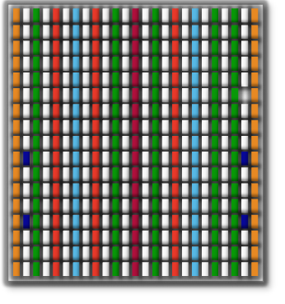
Creating Application-Specific Accelerator with FPGA
Logic Fabric
LUT-6 CLB
Precise, Low Jitter Clocking
MMCMs
On-Chip Memory
36Kbit/18Kbit Block RAM
Enhanced Connectivity
PCIe® Interface Blocks
DSP Engines
DSP48E1 Slices
Hi-perf. Parallel I/O Connectivity
SelectIO™ Technology
Hi-performance Serial I//O Connectivity
Transceiver Technology
Virtex®-7 FPGA
Only provides primitive building blocks for computation
Register, addition/multiplication , memories, programmable boolean operations and connections
Build application-specific accelerator from primitives building blocks
Interconnection between primitive functional units
Timing of data movement between primitive functional units
Opportunities for optimizations for a specific application!
Maximizing efficiency while throwing away redundancy
Notes:
And FPGAs allow us to create such accelerators,
<next>
Specifically, FPGAs provides primitive building blocks for computation,
<next>
from these building blocks, the users can build they own accelerator for their applications
With this fine-grain programmability
<next>
Such a fine-grain programmability from those primitive building blocks,
Provide the opportunities to optimize the accelerator for a given application,
For every single bit and every single clock cycle
This allow the users to maximize efficiency while minimizing redundancy in the accelerator

Slide 6
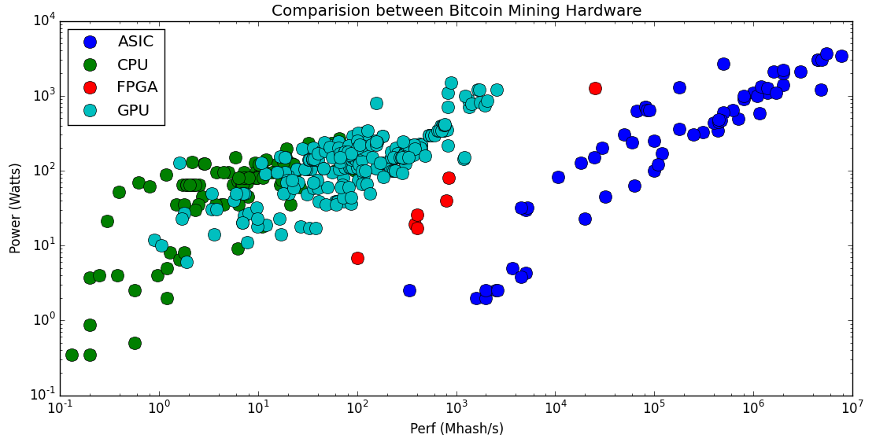
Performance/Power at different levels of specialization
FPGA
ASIC
(not programmable)
CPU
GPU
https://en.bitcoin.it/wiki/Non-specialized_hardware_comparison
https://en.bitcoin.it/wiki/Mining_hardware_comparison
Notes:
Lets takes the bitcoin mining hardware as an example
We should the power and performance comparison in this graph
We have CPU, GPU, FPGA and the application-specific integrated-circuit, which also known as ASIC
And among all those programmable devices, FPGAs deliver the best performance and energy-efficiency.
Because people built optimal processing pipeline for bitcoin mining from FPGAs,
In such a pipeline, almost every bit, every computations are designed to do bitcoin mining only,
And this application-level specialization deliver the best performance and and energy-efficiency
-------
As we can see that the ASIC delivers the best performance and energy-efficiency.
FPGA provide the best performance and energy-efficiency
It is how you design that matter
CNN five years ago?
CNN two years ago?

Slide 7

The challenges of promoting FPGAs among software engineers
Require tremendous efforts
Extensive knowledge of digital circuit design
The potential of FPGAs is not easily accessible by common software engineers
AXI Master
Timing Closure
Burst inference
DSP48
Stable interface
Loop rewind
Notes:
But designing such an optimal pipeline for a given application requires tremendous efforts,
<next>
As well as extensive digital circuit design knowledge
<next>
For example, all these words,
<next>
Just sounds like magical spells for most of the software developers
<next>
As a result, the potential of FPGAs is not easily accessible by common software engineers,
And we want to change this
---
Fpga – spatial expension – pipeline parallelism, internal memory bandwidth – advantage over gpu – and weakness – memory band width

Slide 8
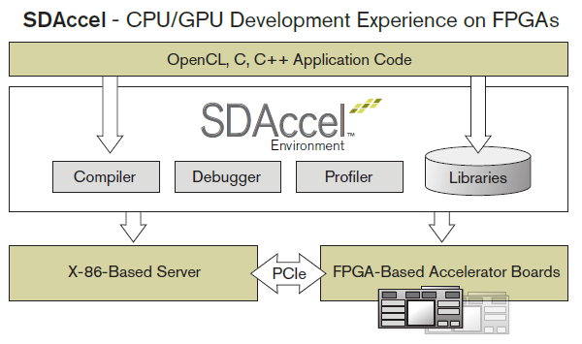
Enable FPGA programming for the masses
Provide a system-level solution
Runtime/driver on the host side
Host/device communication logic on FPGA
User focus on application
Compiler takes more responsibilities
Memory access optimizations
Loop optimizations
Task-level parallizations
This talk focus on the OpenCL to FPGA compilation flow
Notes:
For this reason,
we provide a system level solution,
Which include runtime, compiler and interface logic,
To make it easier for the users to design they applications on FPGAs
<next>
Specifically,
We want the compiler to takes more responsibilities
To help users to access the full processing power of FPGAs
<next>
And we are going to talk about this under the context of the OpenCL to FPGA compilation

Slide 9

Overview of OpenCL to FPGA compilation: Input and Output
Managed by runtime
__kernel void
add(__global const float *a,
__global const float *b,
__global float *c)
{
int id = get_global_id(0);
c[id] = a[id] + b[id];
}
parallel_for (all workgroups)
parallel_for (all workitems) {
}
load a
load b
Materialized in Hardware
- Will be optimized by the compiler
a + b
load a
load b
store c
a + b
store c
Allocate resource statically for each instruction
- Different from CPU/GPU
Virtex®-7 FPGA
Notes:
First of all, lets takes a look at the input and output
The input is opencl,
<next>
The output is the processing pipeline in FPGAs that implement functionalities described by the opencl input
<next>
Currently the workgroups loops are managed by the runtime,
<next>
the workitems loops are materialized in hardware
And we will optimize it together with the workiterm pipeline
<next>
We allocate resource statically for each instruction
To enable parallelism for different parts of the pipeline
----
Compilation flow – each stage and focus
Work-iterm loops
Work-group loops
Objectives – pipeline parallelism, memory bandwidth utilization

Slide 10
Objectives of OpenCL to FPGA compilation
Approach the peak throughput of FPGAs
Energy is usually not a problem as FPGA is running at a low frequencies (200MHz to 600MHz)
Approaching peak throughput for computation part is not a big problem
Even the traditional FPGA design flow without C-to-FPGA compilation is sufficient
The difficult part is fetching data fast enough to saturate the computation part
Especially true for the data-parallel tasks
Maximize memory bandwidth utilization
External memory - FPGA/DDR interface
On-chip memories – block RAM and registers
Notes:
The objective of our compilation flow is
To generate processing pipeline that approach the peak throughput of FPGAs
<next>
In fact,
Doing this for the computation part only is not a big problem
<next>
Our challenge is,
Being able to fetch data fast enough from memory to saturate the computation part
Which is especially true for the data-parallel tasks
<next>
For this reason, we need to maximize memory bandwidth utilization
For both external memories and on-chip memories
---
In order to apply these optimization
8bit Mul: 28.1 TOPs – 7.1TOPs
The challenging part is fetch/push data fast enough to saturate datapath and/or DDR interface

Slide 11



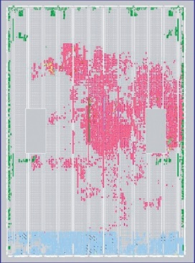
Overview of OpenCL to FPGA compilation: Flow
Clang generate LLVM IR from OpenCL application
Clang actually generate SPIR, a subset of LLVM IR
Middle-end accept LLVM IR and apply high-level transformation
Leverage high-level analyses/transformation from LLVM/Polly
Static memory coalescing (like vectorizing memory accesses)
Memory banking for on-chip memories
Loop transformations
Task-level pipelining/parallization
Backend Lower LLVM IR to FPGA IR and generate FPGA design
Apply FPGA-specific optimizations (usually bit-level optimizations)
Scheduling (and pipelining)
Resource allocation and binding
Clang
Middle-end
Backend
Notes:
To achieve our objectives,
We are building our compilation flow based on Clang/LLVM/Polly.
<next>
In the flow, clang first generates LLVM IR from opencl input
<next>
Then We apply high-level transformation in the middle end
These transformations improve memory bandwidth utilization and throughput of the design
<next>
Later we lower LLVM IR to FPGA IR in the Backend and generate FPGA design
<next>
Talk about the general idea
<next>
We are going to talk about static memory coalescing,
which is one of the most critical optimization for improving memory bandwidth utilization

Slide 12
Static memory coalescing
The core transformation to improve memory bandwidth utilization
Our DDR interface has better throughput when transferring a block of data
Coalesce memory accesses statically at compile time
Static word-level memory coalescing
10x performance boost
Static block-level memory coalescing
100x performance boost
Up to 1000x performance boost!
if do it correctly <= the challenging part
Single request
Multiple requests
(consecutive addresses)
Notes:
Static memory coalescing try to coalesce memory accesses statically at compile time
Because our DDR interface has better throughput when transferring a block of data
And also because we do not have the hardware that dynamically discover the memory coalescing opportunities at runtime
<next>
We have the word-level coalescing
Which coalesce accesses for different parts of the same word into a single access
<next>
We also have the block-level coalescing
Which coalesce word-level accesses with consecutive addresses into a single access
<next>
If we do it correctly, we can achieve thousand x performance improvement

Slide 13
Static memory coalescing – identifying the opportunities
Look for accesses that accesses consecutive memory addresses
Be aware of alignment – need specially handling in code generation
Prove those accesses can be parallelized
Need dependencies analysis
More a less like vectorizing the memory accesses
Strided accesses are also supported
Do not introduce any overhead for word-level coalescing
Need to consider the ratio between used/transferred data for block-level coalescing
Notes:
In order to do static memory coalescing
We need to identify the coalescing opportunities.
<next>
First of all, we need to Look for accesses that accesses consecutive memory addresses
<next>
We also need to prove those accesses can be parallelized with the help of dependencies analysis
<next>
In fact, strided access patterns are partially supported by memory coalescing, but it is a little bit tricky
Now let look at how we do static memory coalescing using the previous vector addition example

Slide 14
Static memory coalescing example – word-level
__kernel void
add(__global const float *a,
__global const float *b,
__global float *c)
{
int id = get_global_id(0);
c[id] = a[id] + b[id];
}
parallel_for (all workitems) {
}
load a
consecutive addresses
load b
a + b
store c
Notes:
First of all, we need to identify the coalescing opportunities on array a, b and c
We need to identify consecutive address, and prove they are parallelizable

Slide 15
Static memory coalescing example – word-level
Workgroup size
Strip mining according to the size of a word
parallel_for (i=0;i<N;i+=16) {
parallel_for (j=i;j<i+16;++j) {
}
}
parallel_for (all workitems) {
}
load a
load a
load b
# floats per word
load b
a + b
a + b
store c
store c
Notes:
Then we apply strip mining to the workitem loop according to the size of a word of our DDR interface

Slide 16
Static memory coalescing example – word-level
Move accesses out of the inner loop and access the entire word
parallel_for (i=0;i<N;i+=16) {
parallel_for (j=i;j<i+16;++j) {
}
}
load a[i:i+16]
load b[i:i+16]
a + b
store c[i:i+16]
Later transformations can optimize the inner loop
Notes:
Now we can move the accesses our of the inner loop and coalesce them
<next>
For the inner loop,
Our later transformations can apply further optimizations

Slide 17
Static memory coalescing example – block-level
Identify the consecutive word-level accesses
parallel_for (i=0;i<N;i+=16) {
parallel_for (j=i;j<i+16;++j) {
}
}
load a[i:i+16]
load b[i:i+16]
a + b
store c[i:i+16]
Notes:
We can further apply the block-level coalescing,
First of all, we do the same coalescing opportunities analysis on these word-level accesses

Slide 18
Static memory coalescing example – block-level
Move accesses out of the inner loop and access the entire block
for (i=0;i<N;i+=16)
load a[i:i+16]
for (i=0;i<N;i+=16)
load b[i:i+16]
for (i=0;i<N;i+=16)
parallel_for (j=i;j<i+16;++j)
a + b
for (i=0;i<N;i+=16)
store c[i:i+16]
Notes:
Similarly, we move the accesses our of the loop by applying loop fission
<next>

Slide 19
Static memory coalescing example – block-level
Replace by the memcpy intrinsics – map to a single request
memcpy a
memcpy b
for (i=0;i<N;i+=16)
parallel_for (j=i;j<i+16;++j)
a + b
memcpy c
Notes:
We then replace the loop by memcpy intrinsics, which will be mapped to a single request during code generation

Slide 20
Static memory coalescing example – block-level
memcpy a
Add buffer to cache data
memcpy b
Using on-chip memories
The buffers can be further specialized to pipe
Only support First-In-First-Out
More efficient
May requires less memories
Enable fine-grain pipeline parallelism
Not always possible
for (i=0;i<N;i+=16)
parallel_for (j=i;j<i+16;++j)
a + b
memcpy c
Notes:
We also add buffers to cache the data from those memcpys
We can further specialized these buffers to pipes,
Which only support first-in-first-out accesses
Pipes are more efficient than random access memories,
But such a transformation is not always possible

Slide 21
The memory-compute-memory pipeline
Time
Overlap the memory transfer and computation by task-level pipeline
Can start processing when the first b is available with pipe
More details available in the documentation of dataflow pragma of Vivado HLS
Computation should only access on-chip memories
memcpy a
memcpy b
Compute
memcpy c
for (i=0;i<N;i+=16) {
parallel_for (j=i;j<i+16;++j) {
}
}
a + b
Notes:
Now we have a memory-compute-compute pipelilne,
In which the memcpys maximize external memory bandwidth utilization,
we overlap the memory transfer and the computation to maximize throughput

Slide 22
Further improve static coalescing with loop transformations
Static coalescing opportunity may not be directly available
Loop transformations are required to expose the static coalescing opportunities
__kernel void
foo(__global const float *a,
__global const float *b,
__global float *c)
{
int id = get_global_id(0);
for (int i = 0; i < N; ++i) {
… = a[i * N + id];
}
}
for (int i = 0; i < N; ++i) {
parallel_for (all workitems) {
… = a[i * N + id];
}
}
parallel_for (all workitems) {
for (int i = 0; i < N; ++i) {
… = a[i * N + id];
}
}
Loop interchange
Column major order in inner loop
Consecutive memory address
Notes:
However, memory coalescing is not always this simple.
For example, we are not able to apply coalescing at compile-time here
Because the addresses are not consecutive
<next>
Sometimes, we need to apply loop transformations before we can coalesce the memory accesses at compile time
For example, we can apply loop interchange and enable memory coalescing in this example

Slide 23
Further improve static coalescing with loop transformations
Block-level coalescing may introduce overhead if the block is huge
Apply block-level coalescing after tiling the loop can mitigate the overhead
Time
memcpy a[0:N]
Require too much on-chip memory
Increase processing latency
for (i=0;i<N;i+=block_size) {
}
memcpy b[0:N]
parallel_for (all workitems) {
}
Time
memcpy a[i:i+block_size]
Reduced on-chip memories usage
Reduce processing latency
a + b
memcpy c[0:N]
memcpy b[i:i+block_size]
parallel_for (j=i;j<i+block_size;++j) {
}
a + b
memcpy c[i:i+block_size]
Need design space exploration about the tile size (e.g. block_size in this example)
Notes:
In addition,
Block-level coalescing may introduce overhead if the block is huge.
In this example, we need to copy the entire array A before we can process the data
Which may require too much on-chip memory and increase processing latency
<next>
To address this problem,
We may tile the loop before the block level coalescing
If we do tile-by-tile coalescing, we are able to reduce the on-chip memory usage
and the processing latency
<next>
But there is a huge design spaces for the tile size we need to explore

Slide 24
Other important optimizations
Memory banking/array partition
Map data to different (on-chip) memory banks
Improve internal memory bandwidth utilization / internal memory access parallelism
Include transformation from array-of-struct to struct-of-array
Array-to-pipe transformation
Further reduce on-chip memory usage
Enable fine-grain parallelism in task-level pipeline
And a lot more … join us to find out!
Notes:
This is our what we are doing and going to do to get the thousand x performance improvement
<next>
We also have other important optimizations in our opencl-to-fpga compilation we don’t have time to cover
<next>
For example
The memory banking which also known as array partition,
Which can improve internal memory bandwidth utilization
<next>
We also have the array-to-pipe transformation
Which enable fine-grain parallelism in the task-level pipeline
<next>
And a lot more

Slide 25
Summary
FPGA-based acceleration has a big potential
Allow maximizing efficiency while minimizing redundancy for a given application
Need system-level solution, i.e. compiler + runtime + interface, to realize the potential
Compiler need to takes more responsibility to help the users
Static memory coalescing may achieve 1000x performance boost
Sophisticated loop transformation is required to improve static memory coalescing
Notes:
A system level solution

Slide 26
Thank you & Questions?

