Slide 1
Linear-Time Zero-Knowledge Arguments in Practice

Slide 2
Contents
Background
Proof System Models: Interactive oracle proofs (IOPs)
Polynomial Commitment Scheme
Linear Code
t-dimensional Polynomial Commitment
Zero-knowledge t-dimensional Polynomial Commitment
Notes:
Brakedown constructs a new linear-time code and uses it in a low-dimensional polynomial commitment construction.
First goal of project: Brakedown has an efficient implementation. BCG20 (higher dimension) does not. I want to Implement these high dimensional polynomial commitment scheme and see whether they are concretely efficient.
Second goal of project: Brakedown is NOT ZK. I want to Investigate two different versions of ZK to find out which one is best.

Slide 3
Proof System Models
Interactive proofs (IPs)
Verifier exchanges k-rounds of messages with a prover, and then either accepts or rejects the statements.
.
.
.
m_{i}
P
V
r_{i}
.
.
.

Slide 4
Proof System Models
Interactive oracle proofs (IOPs)
Verifier has oracle access to the prover’s messages and may query them on a few positions probabilistically (rather than having to read the proof string in full).
.
.
.
q_{j}
P
m_{i}
V
m_{i}[q_{j}]
.
.
.
Notes:
Poentital to improve efficiency
Flexibility
Prover time
Verifier time
Proof size
soundness

Slide 5
Polynomial Commitment Scheme
Many interesting real-world statements can be reduced into a polynomial and the proof of such a statement can be converted to an evaluation of a specific point.
Polynomial commitments can be used to compile polynomial-query IOPs into arguments.
Linear time polynomial commitment schemes can imply a linear-time proof system.

Slide 6
Polynomial Commitment Scheme
Prover commits to a secret polynomial and convinces the verifier that the evaluation result of the committed secret polynomial is correct after several rounds of communication later.
commit(poly)
subprotocols
P
x
V
y
poly(x) = y ?

Slide 7
Polynomial Commitment Scheme
Zero-knowledge
Verifier learns nothing extra about the polynomial except the evaluation result.
Zero-knowledge polynomial commitment schemes can imply a Zero-knowledge proof system.
Linear time
If the polynomial has N coefficients, prover runs in O(N) time.
Linear-time polynomial commitment schemes can imply a linear-time proof system.

Slide 8
Linear Code
The encoding function of a linear code will map a message in F^{m} to a codeword in F^{N}
Any linear combination of codewords is also a codeword.
Relative Distance: the minimum distance between any two valid codeword divided by code length N.

Slide 9
Linear Code in Proof Systems
Linear codes are essential in many proof systems.
They rely on special families of linear codes, whose structures and properties influence the overall performance of the proof systems.
Our polynomial commitment scheme uses linear code.
Notes:
It affects soundness error.

Slide 10
2-dimensional Polynomial Commitment in Brakedown
Commitment Phase:
IOP Model
Merkle Tree Commitment
m
N
polynomial coefficients
Linear Encoding
m
m
M₀
M₀’
Notes:
This relative distance property direct affect the soundness error and the efficiency of the construction
we need to use very special encoding functions to get linear time and the best concrete efficiency. Some systems also use Reed–Solomon codes

Slide 11
2-dimensional Polynomial Commitment in Brakedown
m
N
Testing Phase:
Testing Phase:
(Proximity Test)
Encoding
m
m
M₀
M₀’
Probabilistic Checks
Sample l random tuples (i1, i2) from [N]²
Larger the l, smaller the soundness error
r₁
Linear Combination
Encoding
M₁
M₁’
Notes:
the testing phase proves that the committed message is encoded properly

Slide 12
2-dimensional Polynomial Commitment in Brakedown
m
N
Evaluation Phase:
Encoding
m
m
M₀
M₀’
Probabilistic Checks
Sample l random tuples (i1, i2) from [N]²
Larger the l, smaller the soundness error
q₁
Linear Combination
Encoding
M₁
M₁’
Notes:
the evaluation phase helps to prove that the polynomial evaluation is correct.

Slide 13
t-dimensional (t=3) Polynomial Commitment
[BCG20, BCL22]
Commitment Phase:
Tensor Code
Relative distance:Δ^{t}
Encoding

Slide 14
t-dimensional (t=3) Polynomial Commitment
Testing Phase:
Testing Phase:
(Proximity Test)
Encoding
M₀’
M₀
r1
Linear Combination
Sample l random tuples
(i1, i2, i3) from [N]³
l should be larger to achieve soundness error
Checks
M₁
Encoding
M₁’
r2
Linear Combination
Checks
Encoding
M₂’
M₂
Notes:
The structure is similar, especially when we look at this part of the protocol. It’s exactly the protocol when t=2
We just add one more round before that, and reduce the dimension. Just like a recursive algorithm

Slide 15
t-dimensional (t=3) Polynomial Commitment
Testing Phase:
Testing Phase:
(Proximity Test)
Encoding
M₀’
M₀
r1
Linear Combination
Sample l random tuples
(i1, i2, i3) from [N]³
l should be larger to achieve soundness error
Checks
M₁
Encoding
M₁’
r2
Linear Combination
Checks
Encoding
M₂’
M₂
Notes:
The structure is similar, especially when we look at this part of the protocol. It’s exactly the protocol when t=2
We just add one more round before that, and reduce the dimension. Just like a recursive algorithm

Slide 16
t-dimensional (t=3) Polynomial Commitment
Testing Phase:
Testing Phase:
(Proximity Test)
Encoding
M₀’
M₀
r1
Linear Combination
Sample l random tuples
(i1, i2, i3) from [N]³
l should be larger to achieve soundness error
Checks
M₁
Encoding
M₁’
r2
Linear Combination
Checks
Encoding
M₂’
M₂
Notes:
The structure is similar, especially when we look at this part of the protocol. It’s exactly the protocol when t=2
We just add one more round before that, and reduce the dimension. Just like a recursive algorithm

Slide 17
t-dimensional (t=3) Polynomial Commitment
Evaluation Phase:
Encoding
M₀’
M₀
q1
Linear Combination
Sample l random tuples
(i1, i2, i3) from [N]³
l should be larger to achieve soundness error
Checks
M₁
Encoding
M₁’
q2
Linear Combination
Checks
Encoding
M₂’
M₂
Notes:
The structure is similar, especially when we look at this part of the protocol. It’s exactly the protocol when t=2
We just add one more round before that, and reduce the dimension. Just like a recursive algorithm

Slide 18
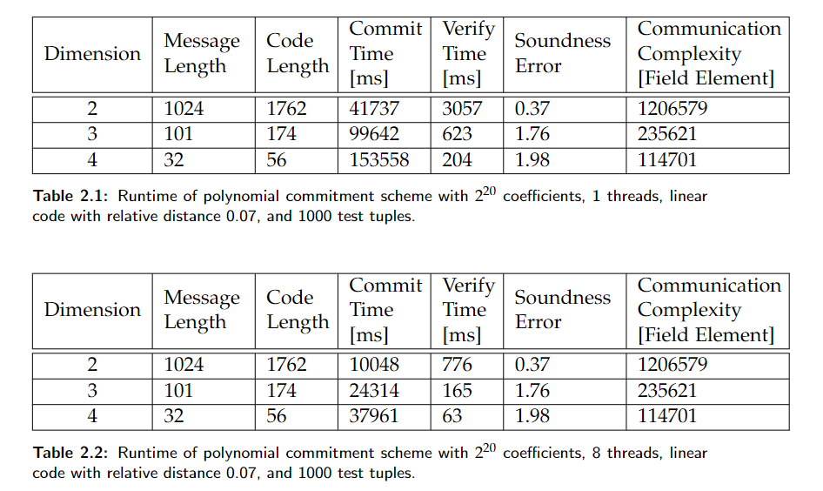
Benchmark
Notes:
the soundness error is larger than 1 for t = 3 and 4,
They are actually unusable for this reason.
So one of my conclusion is: high dimension polynomial commitment scheme is not worth using unless we can improve the relative distance of these linear code in the constructions,
And improving relative distance seems to be a difficult task.

Slide 19
Conclusion
High dimension polynomial commitment scheme is not worth using unless we can improve the relative distance of these linear code used in the constructions. However, improving relative distance seems to be a difficult task.

Slide 20
Zero-Knowledge Polynomial Commitment
Zero-Knowledge Linear Code
Simple Modified Construction

Slide 21
Zero-Knowledge Linear Code
Zero-knowledge:
It looks random, if only access a few positions in the codeword
Notes:
Brakedown constructs a new linear-time code and uses it in a low-dimensional polynomial commitment construction.
First goal of project: Brakedown has an efficient implementation. BCG20 (higher dimension) does not. I want to Implement these high dimensional polynomial commitment scheme and see whether they are concretely efficient.
Second goal of project: Brakedown is NOT ZK. I want to Investigate two different versions of ZK to find out which one is best.

Slide 22
General Transformation [DI14][BCL22]
From Linear Code to Zero-knowledge Linear Code
Encoding
Redistribution
Randomization
Reverse Encoding
x
a
b
c
y
Notes:
In paper DI14, the author presents an idea to transform a linear code to a zero knowledge linear code.
I want to investigate the efficiency of this general transformation when applied to the specific Brakedown code to make it zero knowledge.

Slide 23
Step 1: Encoding
Encoding
Redistribution
Randomization
Reverse Encoding
x
a
b
c
y
Brakedown linear code encoding function

Slide 24
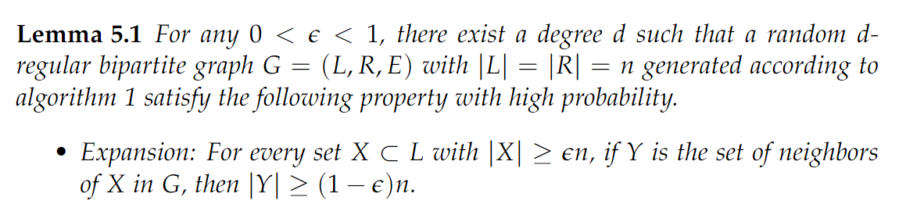
Step 2: Redistribution
Encoding
Redistribution
Randomization
Reverse Encoding
x
a
b
c
y
Redistribute the elements in a according to a expander graph

Slide 25
Step 3: Randomization
Encoding
Redistribution
Randomization
Reverse Encoding
x
a
b
c
y
c = b * H
1, 2, 0, 0, 0, 0
3, 4, 0, 0, 0, 0
0, 0, 5, 6, 0, 0
0, 0, 7, 8, 0, 0
0, 0, 0, 0, 9, 1
0, 0, 0, 0, 2, 3

Slide 26
Step 4: Reverse Encoding
Encoding
Redistribution
Randomization
Reverse Encoding
x
a
b
c
y

Slide 27
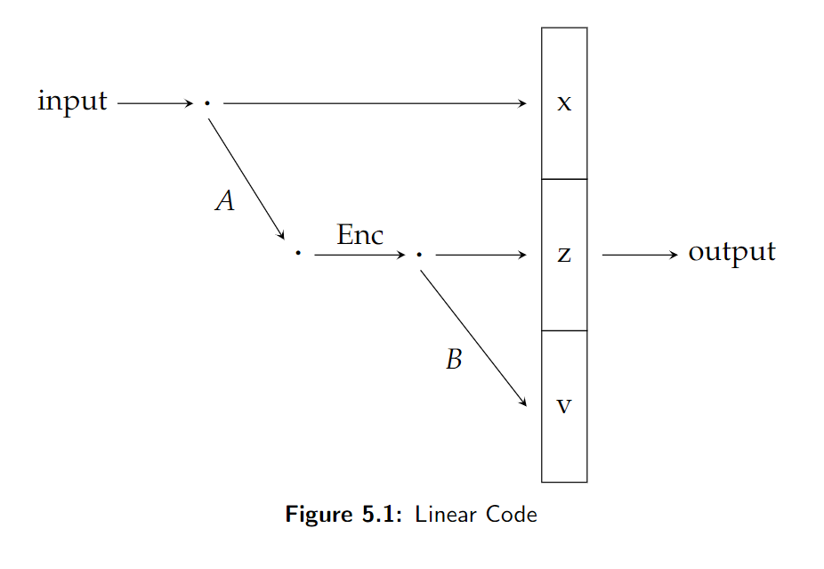
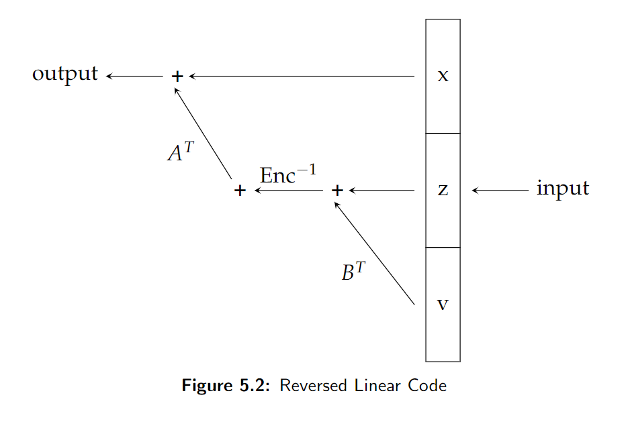
Brakedown Linear Code
Randomness Extractor

Slide 28
Efficiency Bottleneck
Encoding
Redistribution
Randomization
Reverse Encoding
X
A
B
C
Y
How to generate expander graph?
Explicit Construction: slow, hard to find
Random graph

Slide 29
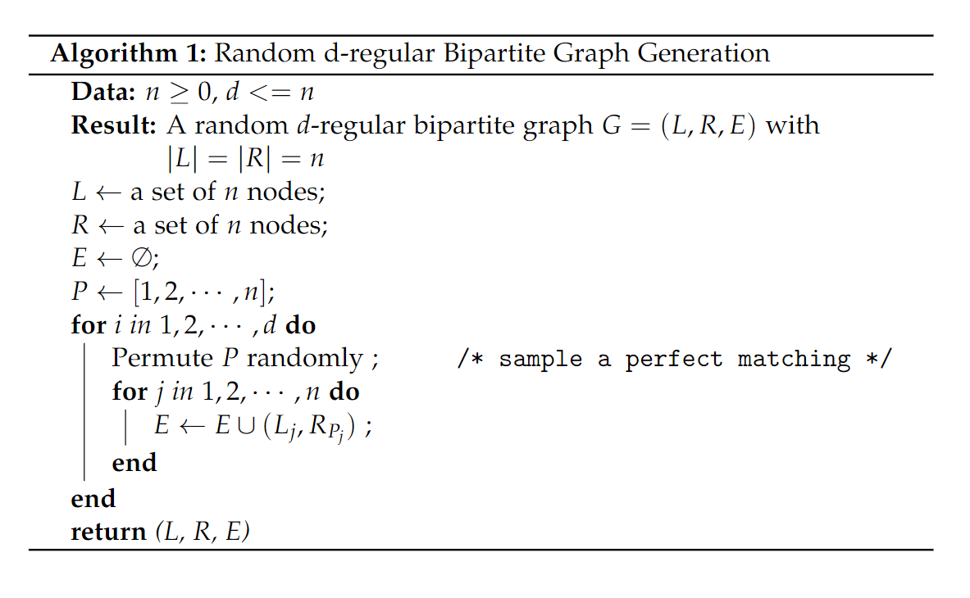
Sample a random graph

Slide 30
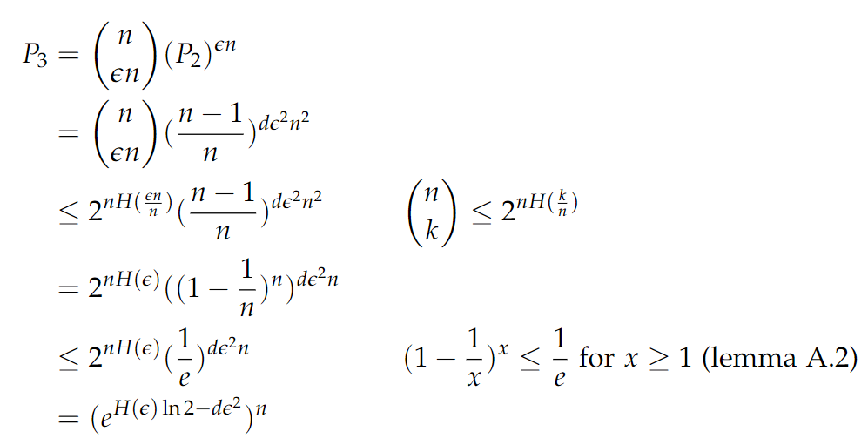
Probability: a random graph is not a expander graph
Notes:
ideally we would like the degree to be small;
the degree of the graph is directly related to the prover time.

Slide 31
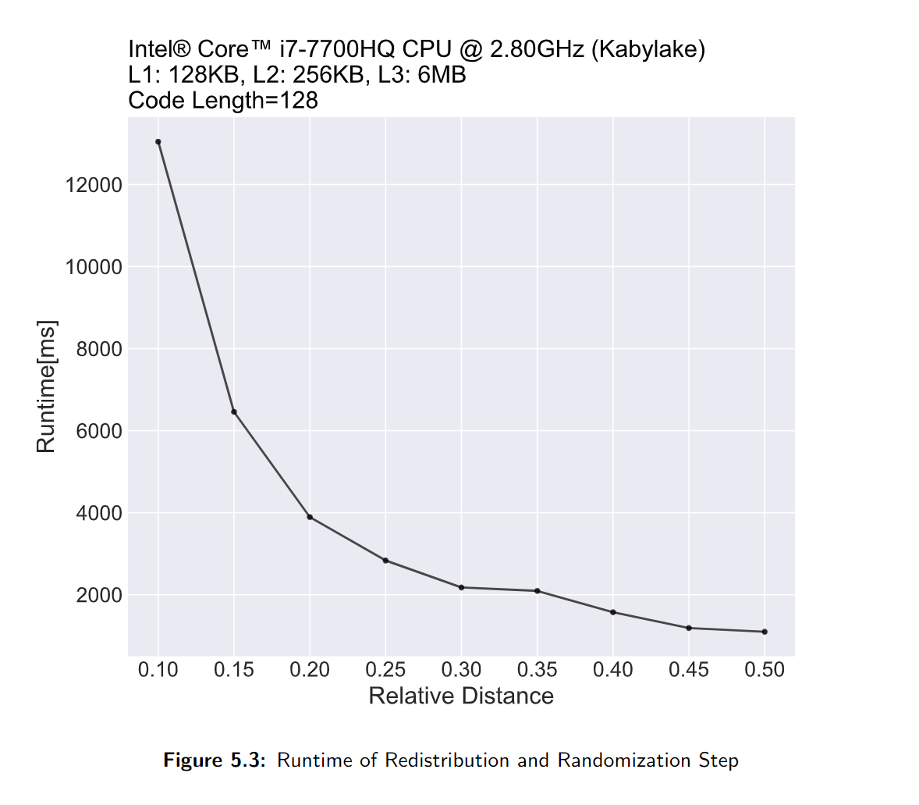
Transforming Linear Code

Slide 32
Transforming Linear Code
Relative distance in Brakedown:
0.02 ~ 0.07

Slide 33


General Transformation [DI14]
From Linear Code to Zero-knowledge Linear Code
Simple to understand
No restrictions on verifier queries
Better Distance Property
Inefficient in practice
Hard to implement

Slide 34
Zero-Knowledge Polynomial Commitment
Zero-Knowledge Linear Code
Simple Modified Construction

Slide 35
t-dimensional (t=3) Polynomial Commitment
Testing Phase:
(Proximity Test)
Encoding
M₀’
M₀
r1
Linear Combination
Sample l random tuples
(i1, i2, i3) from [N]³
l should be larger to achieve soundness error
Checks
M₁
Encoding
M₁’
r2
Linear Combination
Checks
Encoding
M₂’
M₂
Notes:
The structure is similar, especially when we look at this part of the protocol. It’s exactly the protocol when t=2
We just add one more round before that, and reduce the dimension. Just like a recursive algorithm

Slide 36
Simple Zero-Knowledge Construction
Commitment Phase:
[BCGGHJ17][XZS22]
Plain text
Coef
Encoding
Coef’
+
One time pad
PAD₀
Encoding
PAD₀’
=
Cipher text
M₀
Encoding
M₀’

Slide 37
Simple Zero-Knowledge Construction
Hidden
Testing Phase:
[BCGGHJ17][XZS22]
Plain text
Coef
Encoding
Coef’
+
One time pad
PAD₀
Encoding
PAD₀’
=
Cipher text
M₀
Encoding
M₀’
Notes:
Just looking at one of them, it looks completely random

Slide 38
Simple Zero-Knowledge Construction
Hidden
Testing Phase:
[BCGGHJ17][XZS22]
Plain text
Coef
Encoding
Coef’
+
Restriction:
Verifier is not allowed to query the pad matrix and the cipher text matrix at the same position.
One time pad
PAD₀
Encoding
PAD₀’
=
Cipher text
M₀
Encoding
M₀’

Slide 39
Attack?
Linear code:
[a b] -> [a b a]
Encoding
Coef’
Plain text
Coef
[w1 w2]
[w1 w2 w3]
+
One time pad
PAD₀
[a1 a2]
Encoding
[a1 a2 a3]
PAD₀’
=
Cipher text
M₀
[b1 b2]
Encoding
[b1 b2 b3]
M₀’

Slide 40
Attack?
Linear code:
[a b] -> [a b a]
Encoding
Coef’
Plain text
Coef
[w1 w2]
[w1 w2 w3]
+
One time pad
PAD₀
[a1 a2]
Encoding
[a1 a2 a3]
PAD₀’
=
w1 = b1 - a1
= b3 - a1
Cipher text
M₀
[b1 b2]
Encoding
[b1 b2 b3]
M₀’

Slide 41
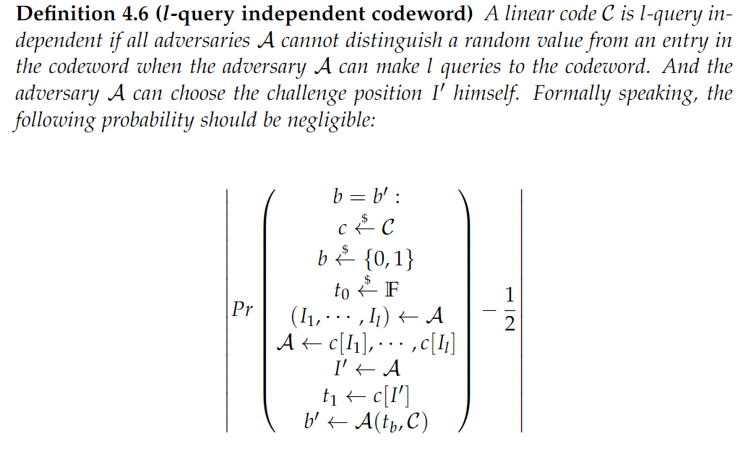
A possible fix

Slide 42
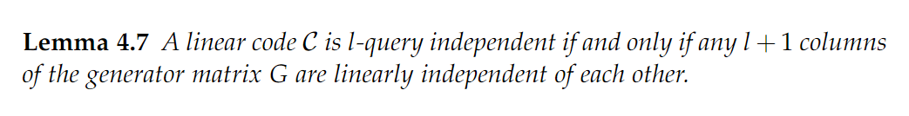
A possible fix

Slide 43
Simple Zero-Knowledge Construction
Simple to understand
Easy to implement
Only increase the prover time/verifier time/proof size by a factor of 2
Have restrictions on the queries the verifier can make
Require l-query-independent property from the linear code

Slide 44
Conclusions
Using the method similar to one-time-pad encryption, we can add zero-knowledge property into the polynomial commitment scheme if the underlying linear code satisfying the l-query-independent property. And it is practical and efficient compared with the alternative approach.
Notes:
General conclusions, what I learned from it? Future research direction?

Slide 45
LWE (Learning with error)
LWE problem is one of the fundamental lattice problems upon which lots of the lattice-based cryptography rests.
LWE was first introduced by Regev in 2009, whose main result is a quantum reduction from lattice problems (GAPSVP and SIVP) to LWE problem.
LWE states that for a tuple (A, u) it is hard to find a small s and a small e such that
u = As + e
The protocol makes use of polynomials and linear codes.

Slide 46
LWE (Learning with error)
The original protocol use Reed-Solomon linear code, whereas we use the Brakedown linear code. Brakedown linear code can encode a message in linear time, which is more efficient than Reed-Solomon linear code.
One message in the original protocol is only a subset of the one in our protocol. Our version reduces the computation required by the verifier at the cost of increasing communication complexity / proof size. Also, our security proof could be cleaner and simpler.

Slide 47
Thanks

