Slide 1
Linear-Time Zero-Knowledge Arguments in Practice

Slide 2
Zero-Knowledge Arguments
Argument
P
m
V
f(x) = y ?
Notes:
Polynomial commitment protocols imply general protocols so it's ok to focus on polynomial commitment schemes.
ZK means that the verifier learns nothing extra about p
Since The topic of the project is linear-time prover algorithms So If Polynomial p has N coefficients, prover runs in O(N) time.

Slide 3
Zero-Knowledge Arguments
Argument
P
m
V
f(x) = y ?
Polynomial Commitment
m
p(x) = y ?
P
V
Notes:
Polynomial commitment schemes can imply general protocols so it's ok to focus on polynomial commitment schemes.
ZK means that the verifier learns nothing extra about p
Since The topic of the project is linear-time prover algorithms So If Polynomial p has N coefficients, prover runs in O(N) time.

Slide 4
Zero-Knowledge Arguments
Argument
P
m
V
f(x) = y ?
ZK property: verifier learns nothing extra about f/p
Linear time: If polynomial p has N coefficients, prover runs in O(N) time.
Polynomial Commitment
m
p(x) = y ?
P
V
Notes:
Polynomial commitment protocols imply general protocols so it's ok to focus on polynomial commitment schemes.
ZK means that the verifier learns nothing extra about p
Since The topic of the project is linear-time prover algorithms So If Polynomial p has N coefficients, prover runs in O(N) time.

Slide 5
Contents
Low-dimensional (t = 2) Polynomial Commitment in Brakedown
High-dimensional (t = 3, 4, 5, …) Polynomial Commitment [BCG20, BCL22]
Zero-Knowledge Polynomial Commitment
Simple Modified Construction
Zero-Knowledge Linear Code
Notes:
Brakedown constructs a new linear-time code and uses it in a low-dimensional polynomial commitment construction.
First goal of project: Brakedown has an efficient implementation. BCG20 (higher dimension) does not. I want to Implement these high dimensional polynomial commitment scheme and see whether they are concretely efficient.
Second goal of project: Brakedown is NOT ZK. I want to Investigate two different versions of ZK to find out which one is best.

Slide 6
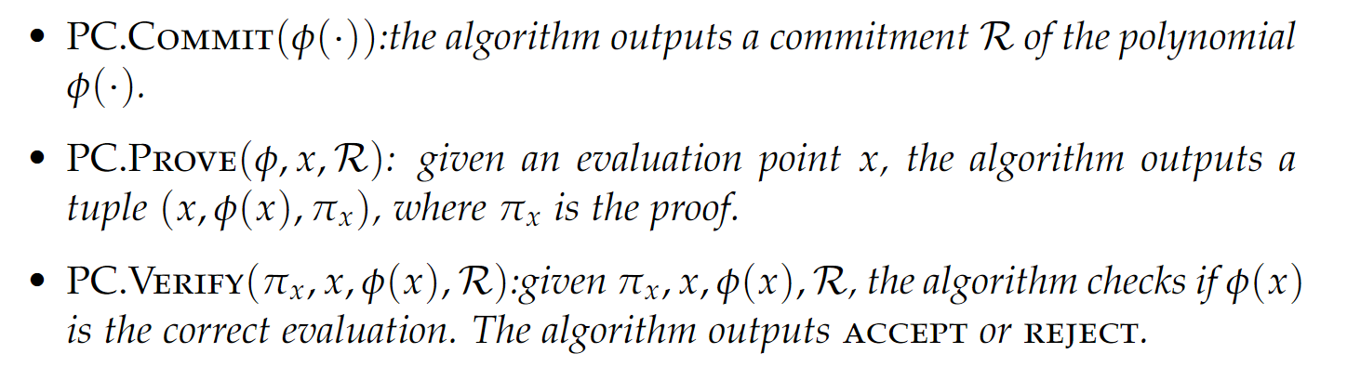
Polynomial Commitment
A Polynomial Commitment consists of three algorithms:

Slide 7
2-dimensional Polynomial Commitment in Brakedown
Commitment Phase:
IOP Model
Merkle Tree Commitment
m
N
polynomial coefficients
Linear Encoding
m
m
M₀
M₀’
Encoding Function: F^{m} -> F^{N}
Relative Distance: the minimum distance between any two valid codeword divided by code length N
Notes:
This relative distance property direct affect the soundness error and the efficiency of the construction
we need to use very special encoding functions to get linear time and the best concrete efficiency. Some systems also use Reed–Solomon codes

Slide 8
Polynomial Commitment
A Polynomial Commitment consists of three algorithms:

Slide 9
Polynomial Commitment
A Polynomial Commitment consists of three algorithms:

Slide 10
2-dimensional Polynomial Commitment in Brakedown
m
N
Testing Phase:
Encoding
m
m
M₀
M₀’
Probabilistic Checks
Sample l random tuples (i1, i2) from [N]²
Larger the l, smaller the soundness error
r1
Linear Combination
Encoding
M₁
M₁’
Notes:
the testing phase proves that the committed message is encoded properly

Slide 11
2-dimensional Polynomial Commitment in Brakedown
m
N
Evaluation Phase:
Encoding
m
m
M₀
M₀’
Probabilistic Checks
Sample l random tuples (i1, i2) from [N]²
Larger the l, smaller the soundness error
q1
Linear Combination
Encoding
M₁
M₁’
Notes:
the evaluation phase helps to prove that the polynomial evaluation is correct.

Slide 12
Contents
Low-dimensional (t = 2) Polynomial Commitment in Brakedown
High-dimensional (t = 3, 4, 5, …) Polynomial Commitment [BCG20, BCL22]
Zero-Knowledge Polynomial Commitment
Simple Modified Construction
Zero-Knowledge Linear Code
Notes:
Brakedown constructs a new linear-time code and uses it in a low-dimensional polynomial commitment construction.
First goal of project: Brakedown has an efficient implementation. BCG20 (higher dimension) does not. I want to Implement these high dimensional polynomial commitment scheme and see whether they are concretely efficient.
Second goal of project: Brakedown is NOT ZK. I want to Investigate two different versions of ZK to find out which one is best.

Slide 13
t-dimensional (t=3) Polynomial Commitment
Commitment Phase:
Tensor Code
Relative distance:Δ^{t}
Encoding

Slide 14
t-dimensional (t=3) Polynomial Commitment
Testing Phase:
Encoding
M₀’
M₀
r1
Linear Combination
Sample l random tuples
(i1, i2, i3) from [N]³
l should be larger to achieve soundness error
Checks
M₁
Encoding
M₁’
r2
Linear Combination
Checks
Encoding
M₂’
M₂
Notes:
The structure is similar, especially when we look at this part of the protocol. It’s exactly the protocol when t=2
We just add one more round before that, and reduce the dimension. Just like a recursive algorithm

Slide 15
t-dimensional (t=3) Polynomial Commitment
Testing Phase:
Encoding
M₀’
M₀
r1
Linear Combination
Sample l random tuples
(i1, i2, i3) from [N]³
l should be larger to achieve soundness error
Checks
M₁
Encoding
M₁’
r2
Linear Combination
Checks
Encoding
M₂’
M₂
Notes:
The structure is similar, especially when we look at this part of the protocol. It’s exactly the protocol when t=2
We just add one more round before that, and reduce the dimension. Just like a recursive algorithm

Slide 16
t-dimensional (t=3) Polynomial Commitment
Testing Phase:
Encoding
M₀’
M₀
r1
Linear Combination
Sample l random tuples
(i1, i2, i3) from [N]³
l should be larger to achieve soundness error
Checks
M₁
Encoding
M₁’
r2
Linear Combination
Checks
Encoding
M₂’
M₂
Notes:
The structure is similar, especially when we look at this part of the protocol. It’s exactly the protocol when t=2
We just add one more round before that, and reduce the dimension. Just like a recursive algorithm

Slide 17
t-dimensional (t=3) Polynomial Commitment
Evaluation Phase:
Encoding
M₀’
M₀
q1
Linear Combination
Sample l random tuples
(i1, i2, i3) from [N]³
l should be larger to achieve soundness error
Checks
M₁
Encoding
M₁’
q2
Linear Combination
Checks
Encoding
M₂’
M₂
Notes:
The structure is similar, especially when we look at this part of the protocol. It’s exactly the protocol when t=2
We just add one more round before that, and reduce the dimension. Just like a recursive algorithm

Slide 18
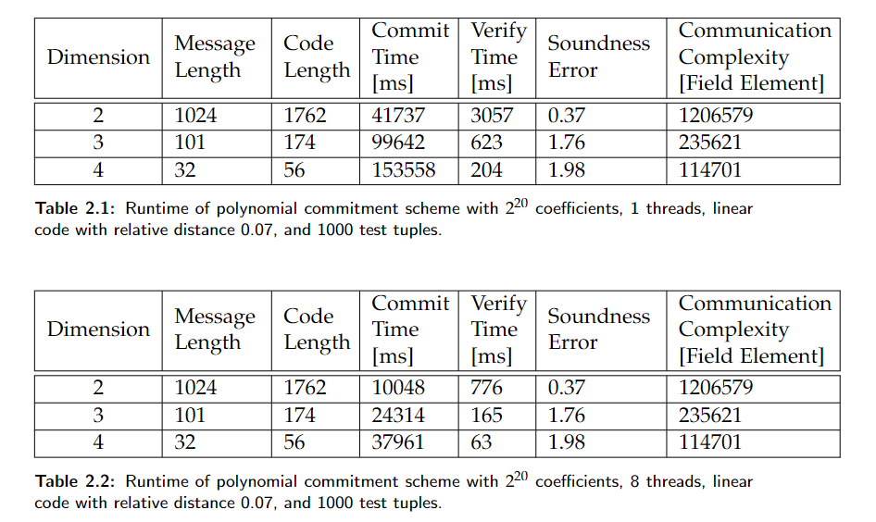
Benchmark
Notes:
the soundness error is larger than 1 for t = 3 and 4,
They are actually unusable for this reason.
So one of my conclusion is: high dimension polynomial commitment scheme is not worth using unless we can improve the relative distance of these linear code in the constructions,
And improving relative distance seems to be a difficult task.

Slide 19
Contents
Low-dimensional (t = 2) Polynomial Commitment in Brakedown
High-dimensional (t = 3, 4, 5, …) Polynomial Commitment [BCG20, BCL22]
Zero-Knowledge Polynomial Commitment
Simple Modified Construction
Zero-Knowledge Linear Code
Notes:
Brakedown constructs a new linear-time code and uses it in a low-dimensional polynomial commitment construction.
First goal of project: Brakedown has an efficient implementation. BCG20 (higher dimension) does not. I want to Implement these high dimensional polynomial commitment scheme and see whether they are concretely efficient.
Second goal of project: Brakedown is NOT ZK. I want to Investigate two different versions of ZK to find out which one is best.

Slide 20
t-dimensional (t=3) Polynomial Commitment
Testing Phase:
(Proximity Test)
Encoding
M₀’
M₀
r1
Linear Combination
Sample l random tuples
(i1, i2, i3) from [N]³
l should be larger to achieve soundness error
Checks
M₁
Encoding
M₁’
r2
Linear Combination
Checks
Encoding
M₂’
M₂
Notes:
The structure is similar, especially when we look at this part of the protocol. It’s exactly the protocol when t=2
We just add one more round before that, and reduce the dimension. Just like a recursive algorithm

Slide 21
Simple Zero-Knowledge Construction
Commitment Phase:
[BCGGHJ17][XZS22]
Plain text
Coef
Encoding
Coef’
+
One time pad
PAD₀
Encoding
PAD₀’
=
Cipher text
M₀
Encoding
M₀’

Slide 22
Simple Zero-Knowledge Construction
Hidden
Testing Phase:
[BCGGHJ17][XZS22]
Plain text
Coef
Encoding
Coef’
+
One time pad
PAD₀
Encoding
PAD₀’
=
Cipher text
M₀
Encoding
M₀’

Slide 23


Simple Zero-Knowledge Construction
Simple to understand
Easy to implement
Do not require any special property from the linear code
Have restrictions on the queries the verifier can make
Increase the prover time/verifier time/proof size by a factor of 2

Slide 24
Contents
Low-dimensional (t = 2) Polynomial Commitment in Brakedown
High-dimensional (t = 3, 4, 5, …) Polynomial Commitment [BCG20, BCL22]
Zero-Knowledge Polynomial Commitment
Simple Modified Construction
Zero-Knowledge Linear Code
Notes:
Brakedown constructs a new linear-time code and uses it in a low-dimensional polynomial commitment construction.
First goal of project: Brakedown has an efficient implementation. BCG20 (higher dimension) does not. I want to Implement these high dimensional polynomial commitment scheme and see whether they are concretely efficient.
Second goal of project: Brakedown is NOT ZK. I want to Investigate two different versions of ZK to find out which one is best.

Slide 25
Zero-Knowledge Linear Code
Encoding Function: F^{k} -> F^{n}
Linearity: any linear combination of codeword is also a codeword
Distance: the distance between any two valid codeword
Zero-knowledge:
It looks random, if only access a few positions in the codeword

Slide 26
General Transformation [DI14][BCL22]
From Linear Code to Zero-knowledge Linear Code
Encoding
Redistribution
Randomization
Reverse Encoding
x
a
b
c
y
Notes:
In paper DI14, the author presents an idea to transform a linear code to a zero knowledge linear code.
I want to investigate the efficiency of this general transformation when applied to the specific Brakedown code to make it zero knowledge.

Slide 27
Step 1: Encoding
Encoding
Redistribution
Randomization
Reverse Encoding
x
a
b
c
y
Brakedown linear code encoding function

Slide 28
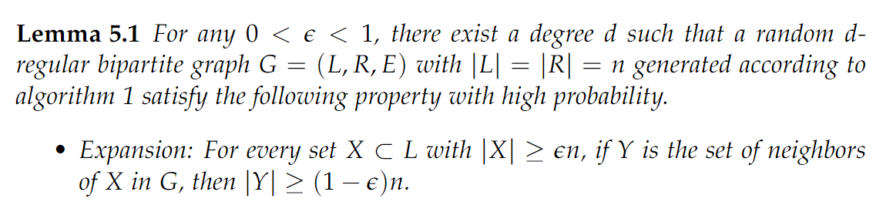
Step 2: Redistribution
Encoding
Redistribution
Randomization
Reverse Encoding
x
a
b
c
y
Redistribute the elements in a according to a expander graph

Slide 29
Step 3: Randomization
Encoding
Redistribution
Randomization
Reverse Encoding
x
a
b
c
y
c = b * H
1, 2, 0, 0, 0, 0
3, 4, 0, 0, 0, 0
0, 0, 5, 6, 0, 0
0, 0, 7, 8, 0, 0
0, 0, 0, 0, 9, 1
0, 0, 0, 0, 2, 3

Slide 30
Step 4: Reverse Encoding
Encoding
Redistribution
Randomization
Reverse Encoding
x
a
b
c
y

Slide 31
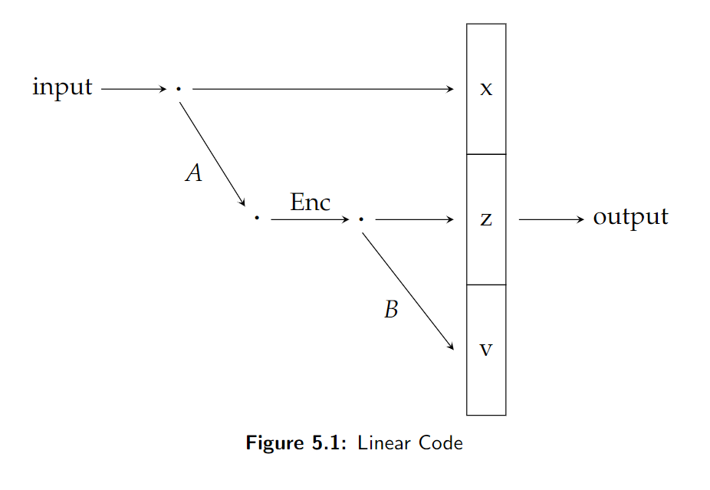
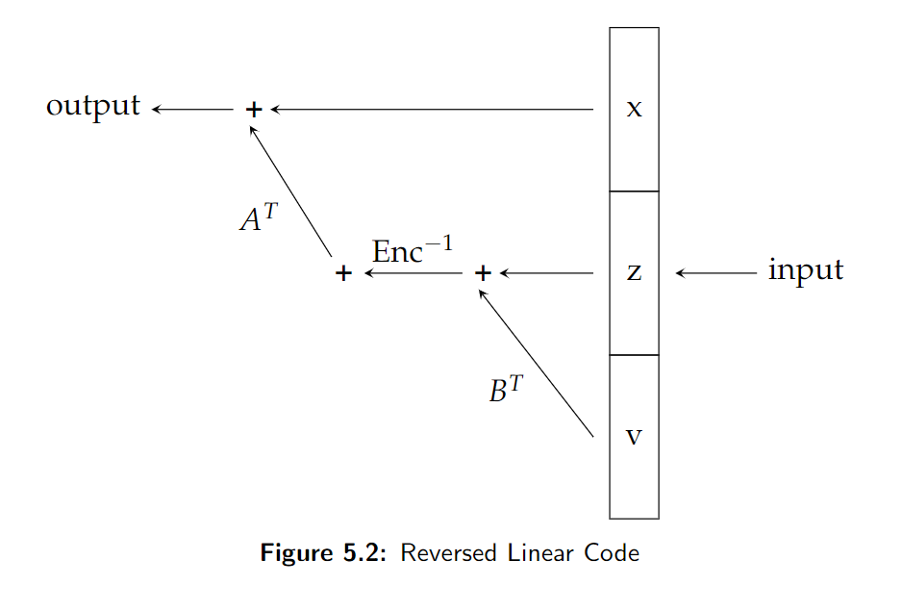
Brakedown Linear Code
Randomness Extractor

Slide 32
Efficiency Bottleneck
Encoding
Redistribution
Randomization
Reverse Encoding
X
A
B
C
Y
How to generate expander graph?
Explicit Construction: slow, hard to find
Random graph

Slide 33
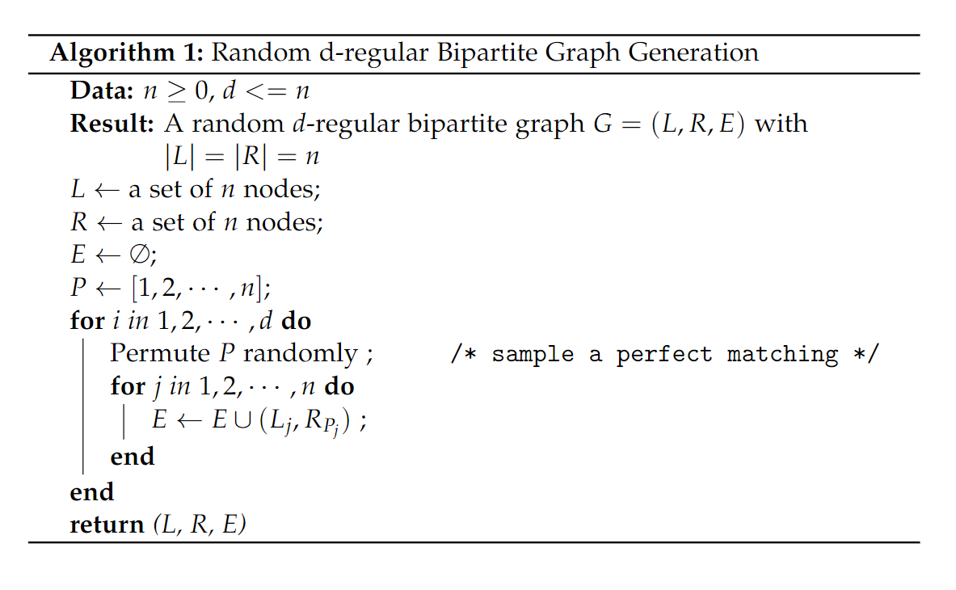
Sample a random graph

Slide 34
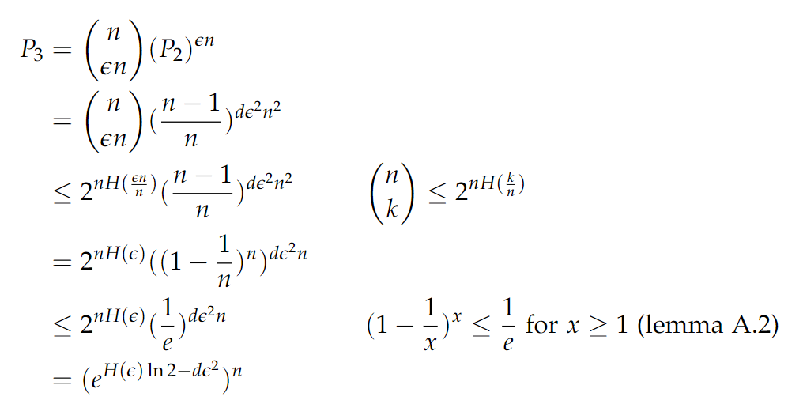
Probability: a random graph is not a expander graph
Notes:
ideally we would like the degree to be small;
the degree of the graph is directly related to the prover time.

Slide 35
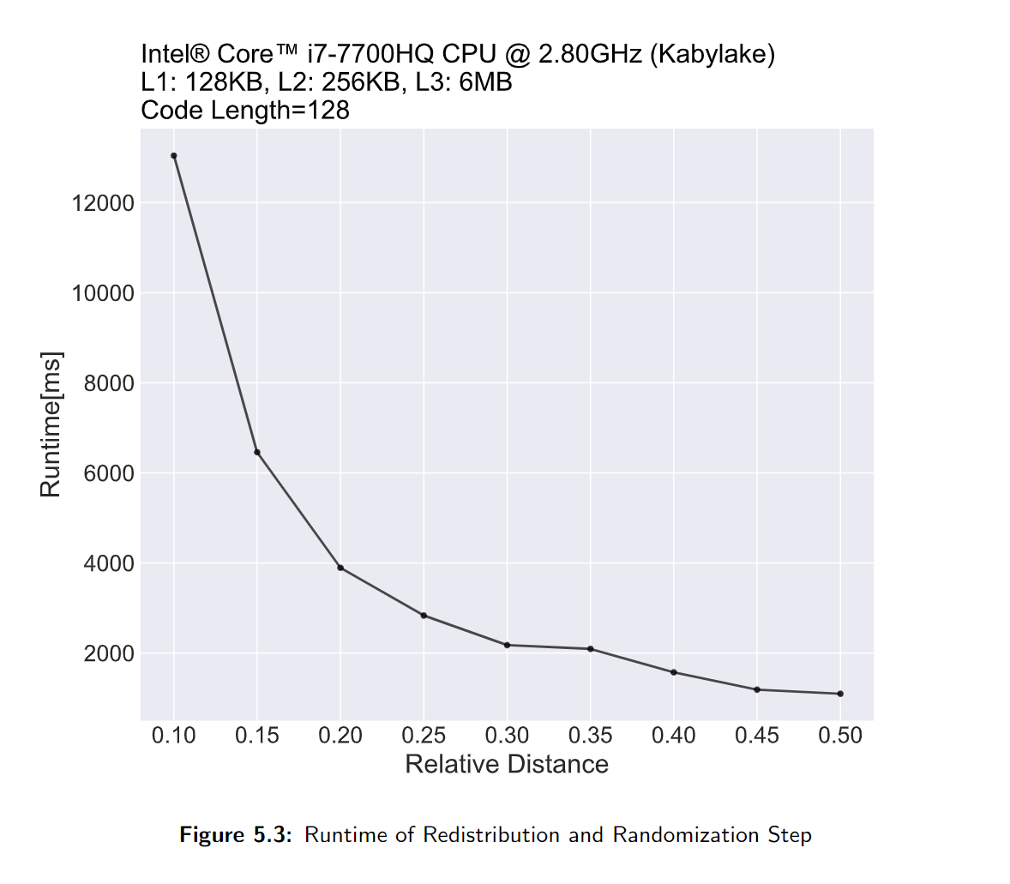
Transforming Linear Code

Slide 36
Transforming Linear Code
Relative distance in Brakedown:
0.02 ~ 0.07

Slide 37
General Transformation [DI14]
From Linear Code to Zero-knowledge Linear Code
Simple to understand
No restrictions on verifier queries
Zero-Knowledge Property
Better Distance Property
Require zero-knowledge property from the linear code
Inefficient in practice
Hard to implement

Slide 38
Conclusions
High dimension polynomial commitment scheme is not worth using unless we can improve the relative distance of these linear code used in the constructions. However, improving relative distance seems to be a difficult task.
Using the method similar to one-time-pad encryption, we can add zero-knowledge property into the polynomial commitment scheme. And it is practical and efficient compared with the alternative approach.

Slide 39
Remaining Goals
Find a better way to generate a good expander graph
Apply this commitment scheme to a real system and benchmark the performance

Slide 40
Thanks

