Slide 1
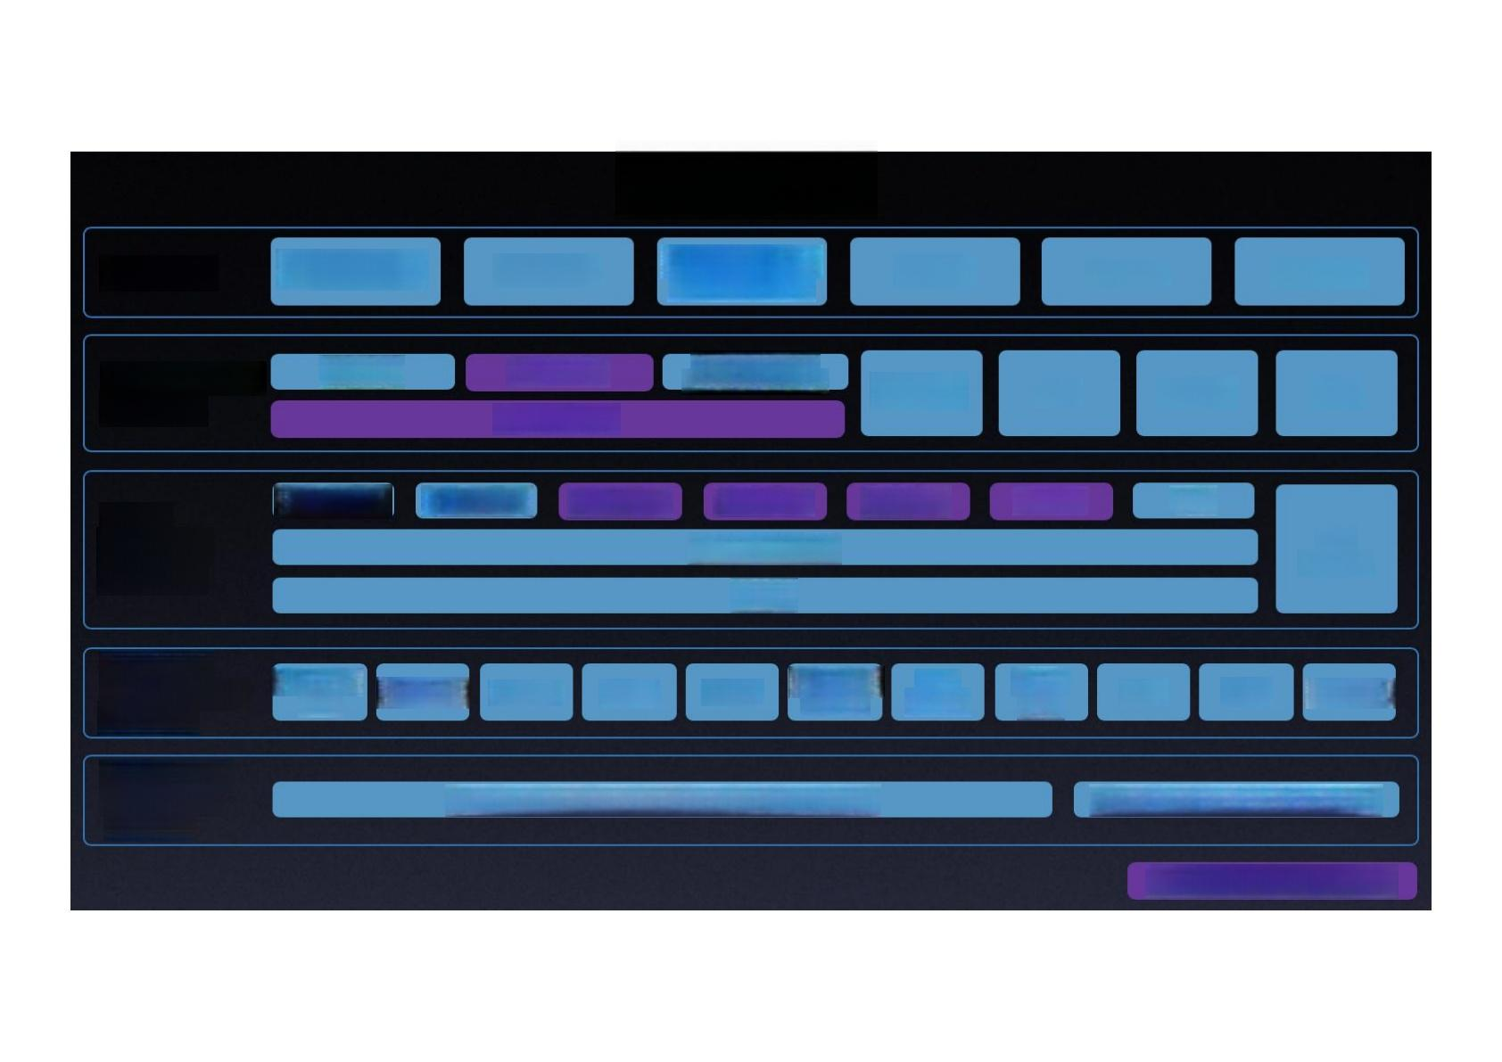
Apollo 5.5
Valet Parking
RoboTaxi
ntelligent signal
CarOS
Solutions
control system
Mini
Bus
Micro Car
Cloud service platform
HD Map
Simulation
Data Pipeline
Mass Production Service Component
Security
OTA
Dueros
V2X
Open
Software Platform
Map Engine Localization
Perception
Prediction
Apollo Cyber RT
Planning
Control
HMI
V2X
Adapter
RTOS
Hardware
Development Platform
Open Vehicle Certification
Platform
Computing Unit
Utrasonic
Sensor
HMI
Device
Black Box
GPS/IMU Camera LDAR Radar
ASU
AXU V2X OBU
Certified Apollo Compatible Dre vehicle
Open Vehicle Intertace Standard
Major updates in Apollo 5.5

