Slide 1
Effects of Climate Change in Guam

Slide 2
Why study Climate Change?
All animals, plants and even the inanimate water, air and soil face face new challenges for survival because of climate change.
Climate change is predicted to cause more frequent and intense drought, storms, heat waves, rising sea levels, melting glaciers and warming oceans.
These effects are already evident in measurements these past 20 years and this can directly harm animals, destroy the places they live, and wreak havoc on people's lives and communities.

Slide 3
What should we do?
Destroying animals’ habitats by clearing forests, overfishing and over-hunting has devastated much of the Earth’s wildlife.
These activities have been having more and more of an effect on our planet as the human population level has increased dramatically over the past 50 years and it seems there is no end in sight.

Slide 4
How can we help each other and our planet?
One way is to study the changes to the Earth’s climate and report them, as scientists are doing.
Another way is to create compelling stories to persuade more humans to look at the destruction that human actions have caused and are still causing.
Examples of small countries or small territories could maybe help in this effort if their stories are widely told and shared. One such small territory is Guam.

Slide 5
About Guam: The United States controls the area
Guam is an organized, unincorporated territory of the United States in the Micronesia subregion of the western Pacific Ocean.
Guam's capital is Hagåtña, and the most populous village is Dededo.
Guam became a U.S. territory in 1898 and placed under the jurisdiction of the U.S. Navy. The Guam Organic Act of 1950 conferred U.S. citizenship on Guamanians and established the territory's government. The Act also transferred Federal jurisdiction over Guam from the U.S. Navy to the Department of the Interior.
Because the United States controls Guam, we should be first to help them cope with changes and thrive.

Slide 6
Obtaining data
The data comes from the National Centers for Environmental Information National Oceanic and Atmospheric Administration (NOAA).
We collected a total of 11 years of annual data (from 2013 through 2023), with measurements of wind direction, wind speed, sky cloud level, visibility distance, dew point temperature, air temperature, and sea level air pressure.
The data files are in csv format with daily measurements of all climate variables for each day.

Slide 7
Preparing Data
Using Jupyter Notebook and pandas:
Dropping and Separating columns
Columns containing integer values are the main focus of our climate prediction analysis. There are 6 main climate variables: wind, sky cloud level, visibility, air temperature, dew temperature and sea level pressure.Related quality measures for each climate variable were kept.
Dropping rows with null values
Notes:
Using Jupyter Notebook and pandas:
Each annual csv file was read into a DataFrame
Unnecessary columns were dropped
Rows marked as containing missing climate data were dropped
A new annual data csv file for each year was saved.
Next, the annual cleaned data files were read into one DataFrame containing 56147 rows and 20 columns.
Data types for each column were checked and the column containing the datetime of measurement was converted to a datetime field from a string.

Slide 8
Preparing Data
8.
Columns containing integer values are the main focus of our climate prediction analysis. There are 6 main climate variables: wind, sky cloud level, visibility, air temperature, dew temperature and sea level pressure.Related quality measures for each climate variable were kept.
9. The resulting DataFrame was checked for duplicate rows. 46 duplicated rows were found and dropped. This left 56101 rows of climate date for the 11 years.
10. For each of the 6 types of climate data a new csv data file containing all years of data was saved.
Notes:
Columns containing integer values are the main focus of our climate prediction analysis. There are 6 main climate variables: wind, sky cloud level, visibility, air temperature, dew temperature and sea level pressure.Related quality measures for each climate variable were kept.
9. The resulting DataFrame was checked for duplicate rows. 46 duplicated rows were found and dropped. This left 56101 rows of climate date for the 11 years.
10. For each of the 6 types of climate data a new csv data file containing all years of data was saved.

Slide 9
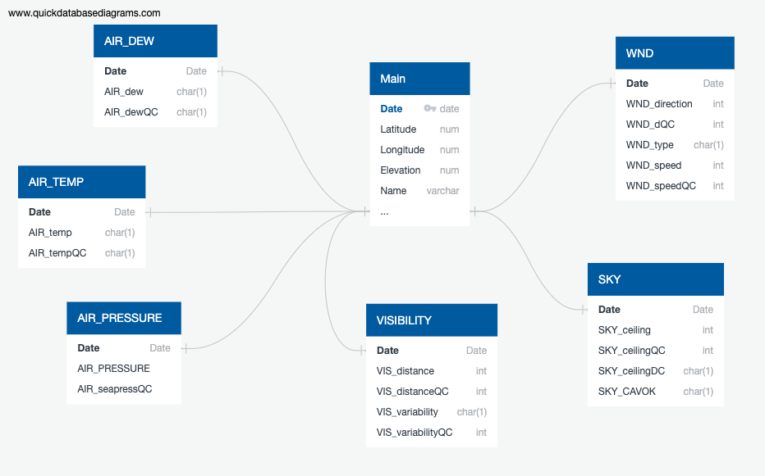
Postgres Database tables

Slide 10
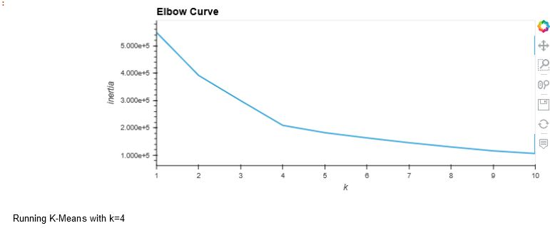
Machine Learning Model
Unsupervised machine learning using principal component analysis (PCA) algorithm.
Processing data for PCA:
get_dummies
StandardScaler
Reducing Data Dimensions
6 features reduced to 3 PCs ordered by variance
Clustering Weather Variables
Best value for K

Slide 11
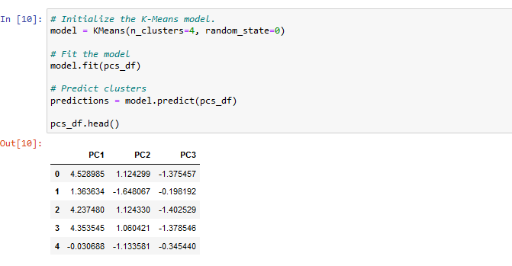
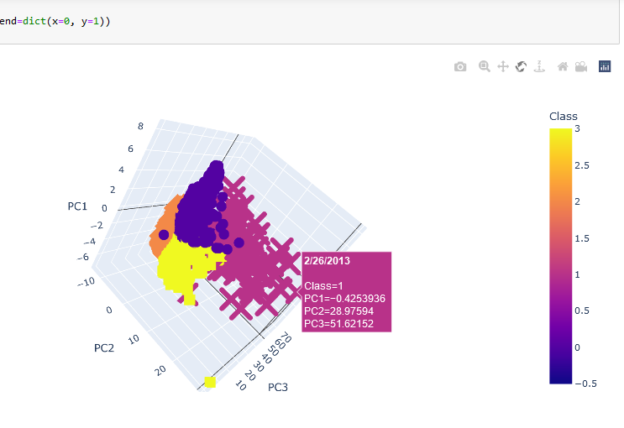
Machine Learning Model Cont.
4.
6. Visualize Results of 3D-Scatter with Clusters

Slide 12
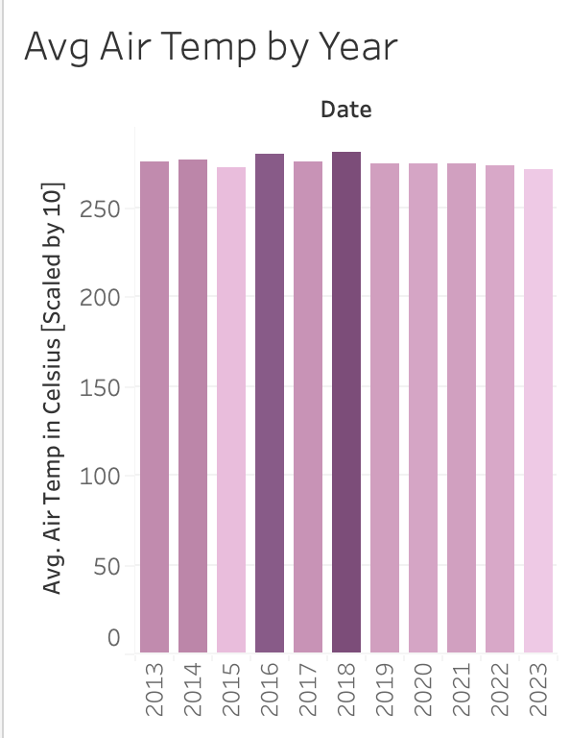
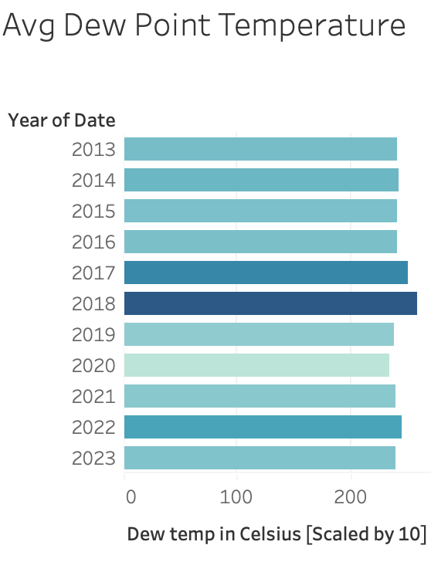
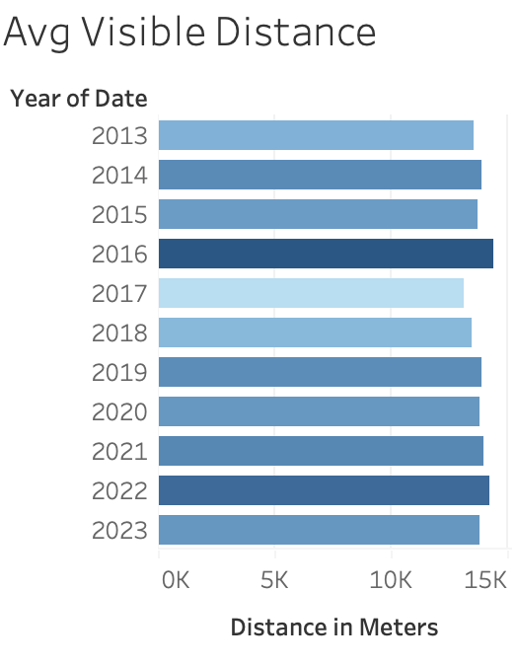
Visualizations: Temperature and Distance

Slide 13
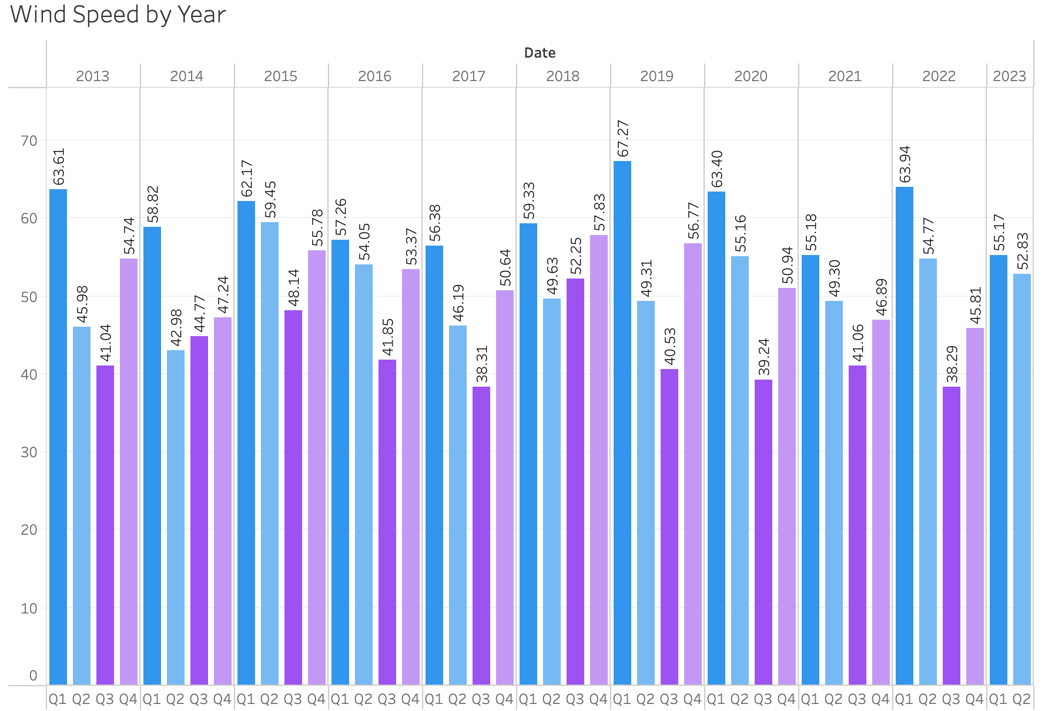
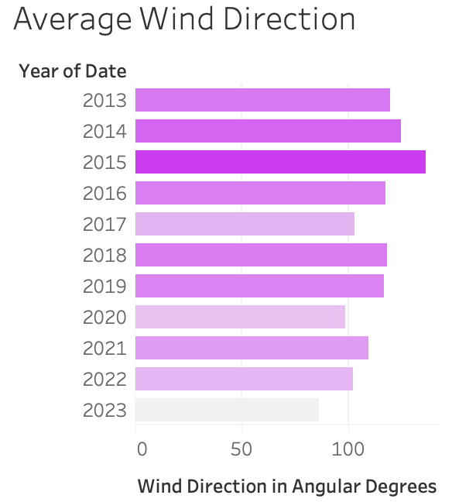
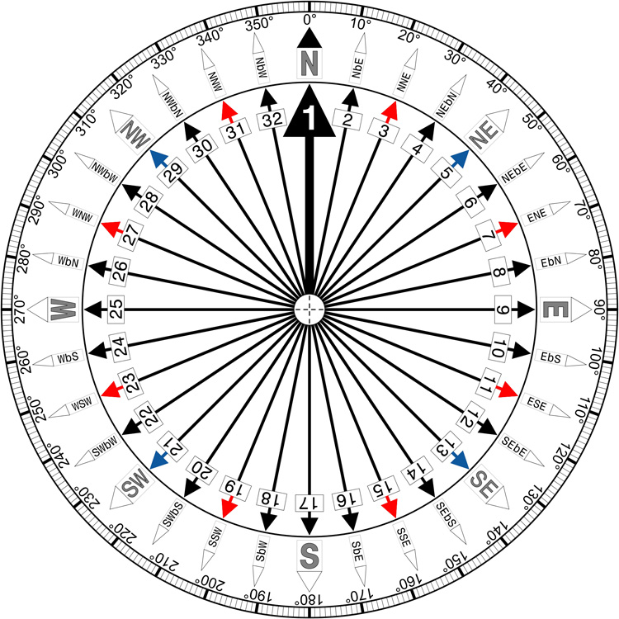

Visualizations Cont’d: Wind Direction & Speed

Slide 14
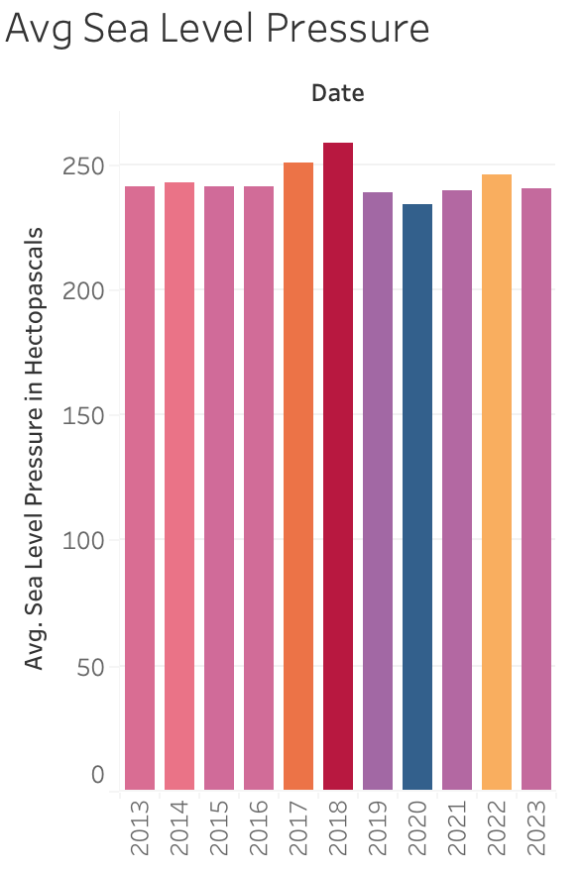
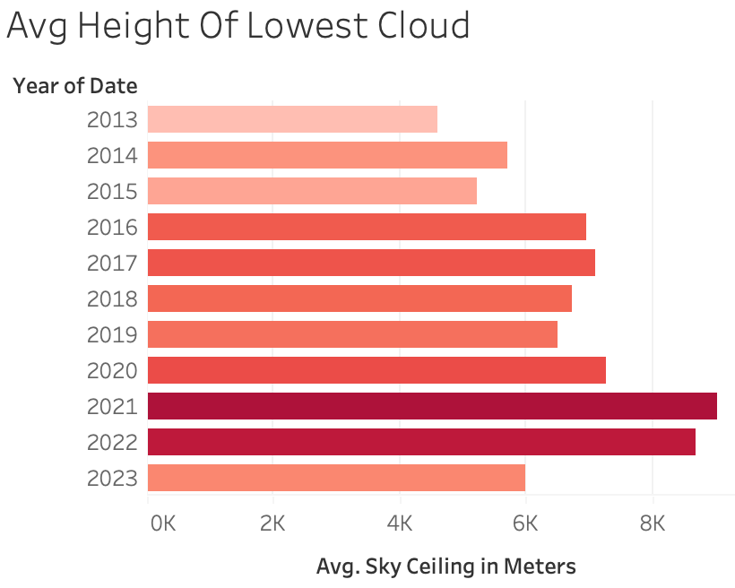
Visualizations Cont’d: Sea & Sky

