Slide 1
Effects of Climate Change in Guam
Ludivina LeMay
Heather Hutchinson
Taylor Dacpano
Tyee Montoya
Valerie Chau

Slide 2
Why study Climate Change?
All animals, plants and even the inanimate water, air and soil face face new challenges for survival because of climate change.
Climate change is predicted to cause more frequent and intense drought, storms, heat waves, rising sea levels, melting glaciers and warming oceans.
These effects are already evident in measurements these past 20 years and this can directly harm animals, destroy the places they live, and wreak havoc on people's lives and communities.

Slide 3
What should we do?
Destroying animals’ habitats by clearing forests, overfishing and over-hunting has devastated much of the Earth’s wildlife.
These activities have been having more and more of an effect on our planet as the human population level has increased dramatically over the past 50 years and it seems there is no end in sight.

Slide 4
How can we help each other and our planet?
One way is to study the changes to the Earth’s climate and report them, as scientists are doing.
Another way is to create compelling stories to persuade more humans to look at the destruction that human actions have caused and are still causing.
Examples of small countries or small territories could maybe help in this effort if their stories are widely told and shared. One such small territory is Guam.

Slide 5
About Guam: The United States controls the area
Guam is an organized, unincorporated territory of the United States in the Micronesia subregion of the western Pacific Ocean. Guam's capital is Hagåtña, and the most populous village is Dededo.
Guam became a U.S. territory in 1898 and placed under the jurisdiction of the U.S. Navy. The Guam Organic Act of 1950 conferred U.S. citizenship on Guamanians and established the territory's government. The Act also transferred Federal jurisdiction over Guam from the U.S. Navy to the Department of the Interior.
Because the United States controls Guam, we should be first to help them cope with changes and thrive.

Slide 6
Obtaining data
The data comes from the National Centers for Environmental Information National Oceanic and Atmospheric Administration (NOAA).
We collected a total of 11 years of annual data (from 2013 through 2023), with measurements of wind direction, wind speed, sky cloud level, visibility distance, dew point temperature, air temperature, and sea level air pressure.
The data files are in csv format with daily measurements of all climate variables for each day.
Notes:
Heather

Slide 7
Preparing Data
Using Jupyter Notebook and pandas:
Dropping and Separating columns
Columns containing integer values are the main focus of our climate prediction analysis. There are 6 main climate variables: wind, sky cloud level, visibility, air temperature, dew temperature and sea level pressure.Related quality measures for each climate variable were kept.
Dropping rows with null values
Notes:
Heather
Using Jupyter Notebook and pandas:
Each annual csv file was read into a DataFrame
Unnecessary columns were dropped
Rows marked as containing missing climate data were dropped
A new annual data csv file for each year was saved.
Data types for each column were checked and the column containing the datetime of measurement was converted to a datetime field from a string.

Slide 8
Preparing Data
3. Converting all dates to DateTime format
4. Dropping all duplicate rows
5. Saving as new CSV files
For each of the 6 types of climate data a new csv data file containing all years of data was saved. Also, a new annual data csv file for each year individual year was saved
Notes:
Heather
Data types for each column were checked and the column containing the datetime of measurement was converted to a datetime field from a string.
The resulting DataFrame was checked for duplicate rows. 46 duplicated rows were found and dropped. This left 56101 rows of climate date for the 11 years.
the annual cleaned data files were read into one DataFrame containing 56147 rows and 20 columns.
For each of the 6 types of climate data a new csv data file containing all years of data was saved.

Slide 9
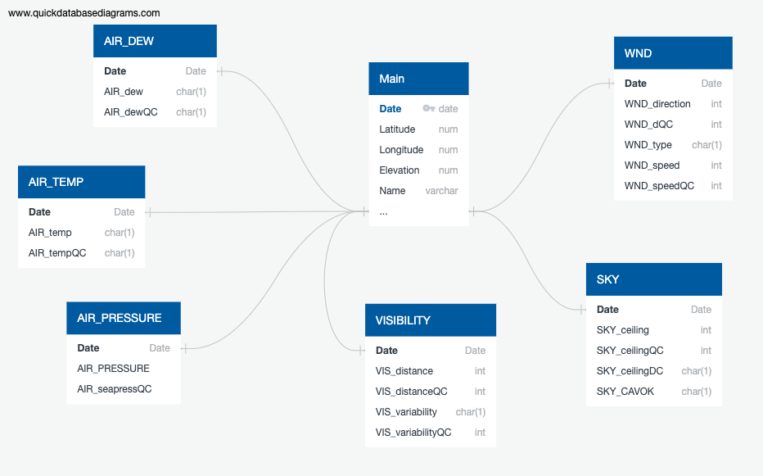
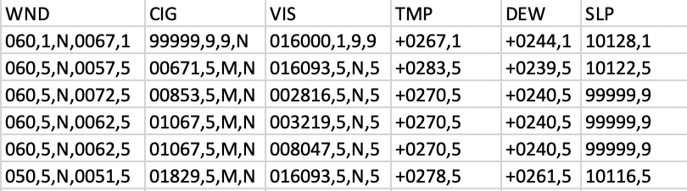

Entity Relationship Diagram
ERD
Raw Data
Notes:
Once we were able to inspect the data, it became apparent that the variables we wanted to focus our testing on, were recorded in a sequence form. Each input consisted of two - five smaller variables. These variables contained meteorological information on the basic elements of winds, visibility, and temperature. Therefore, we used QuickDBD to create an ERD to help visualize the relationships between our data before were imported it into our database.

Slide 10
Machine Learning Model
Unsupervised machine learning using principal component analysis (PCA)
Processing numeric climate data for PCA:
StandardScaler used to standardize the variables’ so they could be compared
Reducing Data Dimensions
6 features reduced to 3 principle components (linear combinations of the variables)

Slide 11
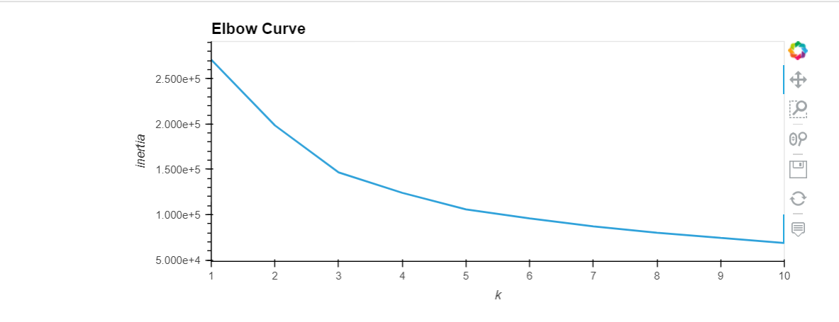
Machine Learning Model Cont.
3. Clustering Weather Variables
Best value for K chosen after viewing elbow curve
k=3

Slide 12
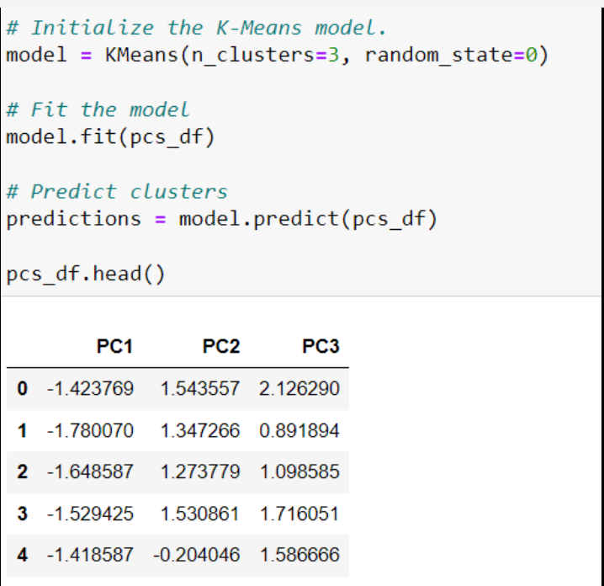
Machine Learning Model Cont.
4.

Slide 13
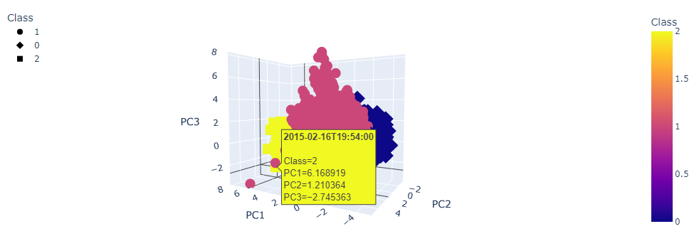
Machine Learning Model Cont.
5. 3D- Scatter plot output
Shows clusters of the grouped data with similar features and outliers
Each data point shows the date, the class number, and the PC values

Slide 14
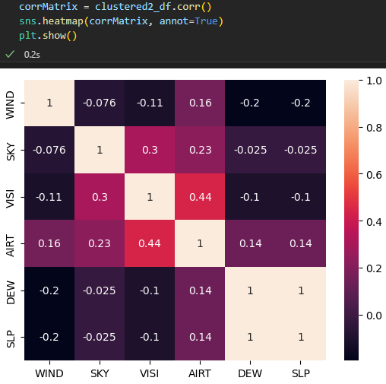
Machine Learning Model Cont.
A correlation matrix was used to visualize the correlation coefficient between all weather features

Slide 15
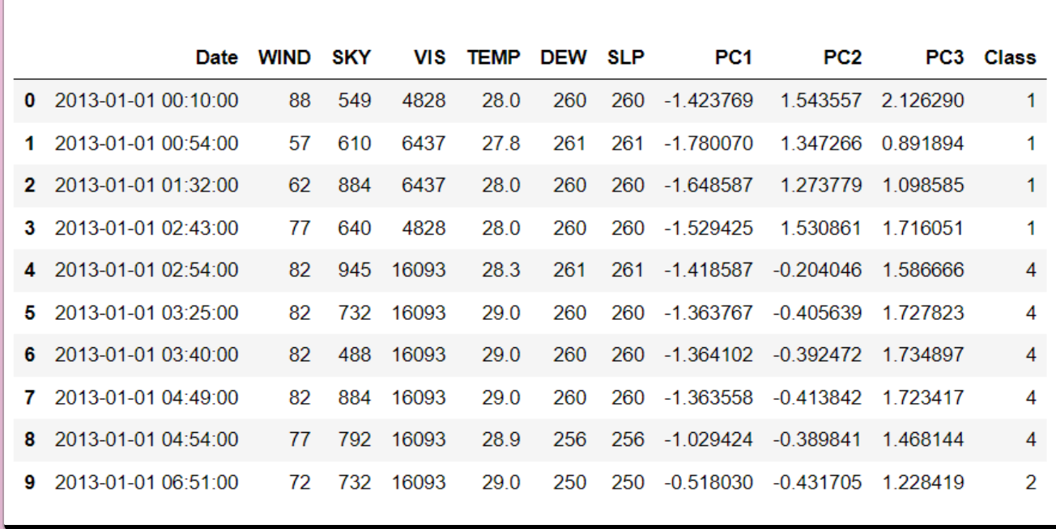
In Summary: Machine Learning Model
Used the unsupervised machine learning model using the PCA algorithm
Time series data usually analyzed with other algorithms
New data frame to further analyze the weather features.

Slide 16
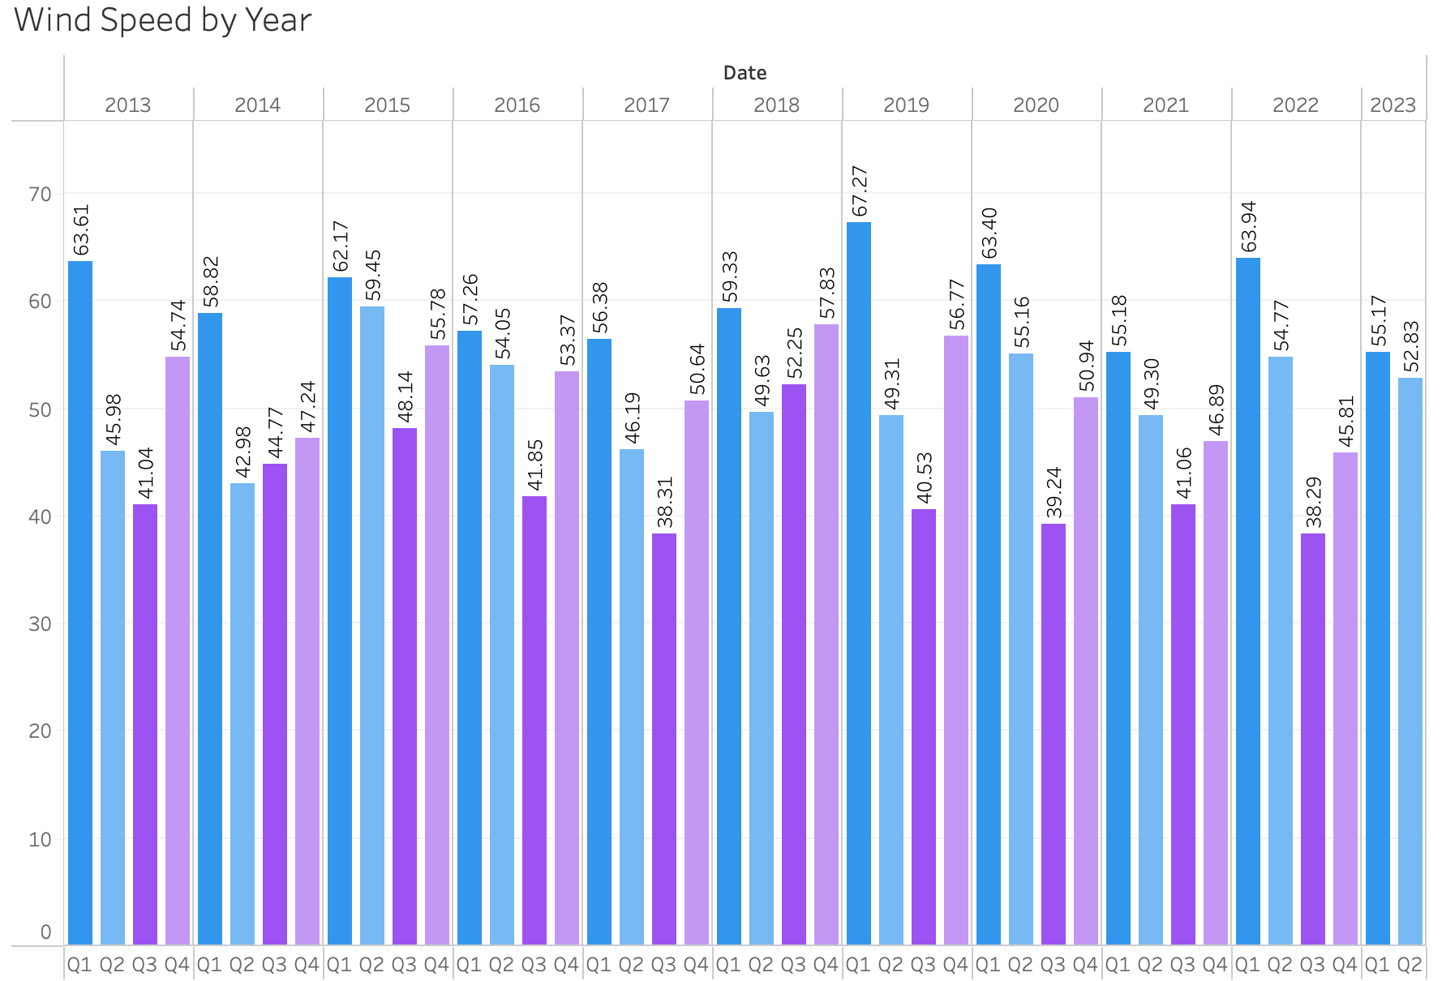
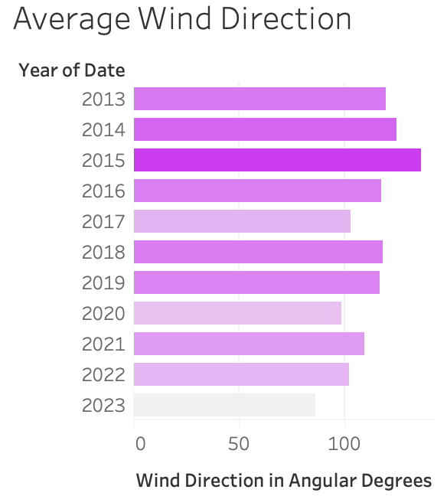
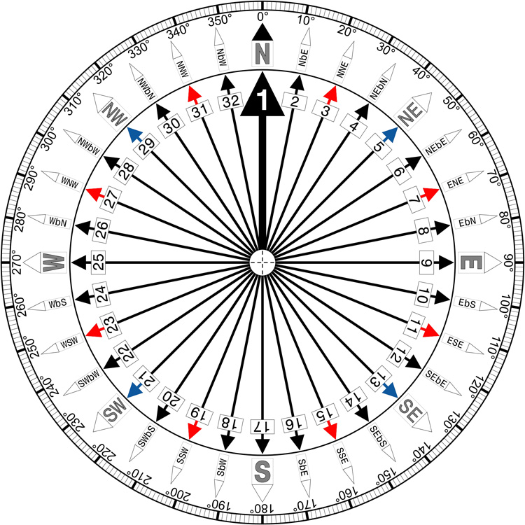

Visualizations Cont’d: Wind Direction & Speed
https://public.tableau.com/app/profile/taylor.dacpano/viz/Wind_16825479230220/Dashboard1
Notes:
Once we finished the machine learning portion, we used Tableau to create visualizations of our data.
https://public.tableau.com/app/profile/taylor.dacpano/viz/Wind_16825479230220/Dashboard1
13: 119.50
14: 124.99
15: 136.15
16: 117.72
17: 103.05
18: 118.44
19: 116.70
20: 98.98
21: 109.68
22: 102.39
23: 86.20

Slide 17
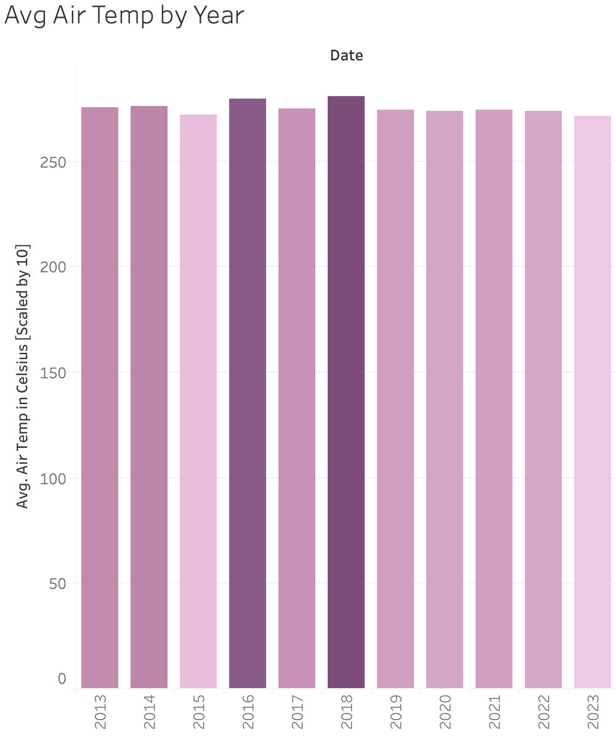
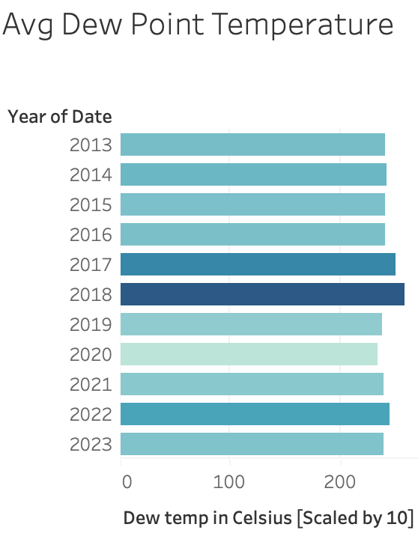
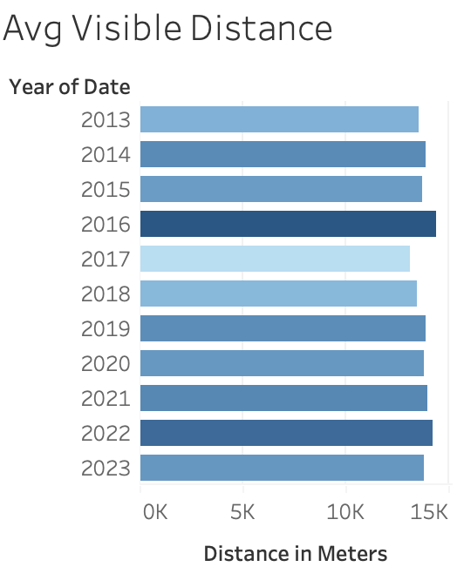
Visualizations: Temperature and Distance
https://public.tableau.com/app/profile/taylor.dacpano/viz/Group_Project_1_16823891754510/Dashboard2
Notes:
Once we finished the machine learning portion, we used Tableau to create visualizations
https://public.tableau.com/app/profile/taylor.dacpano/viz/Group_Project_1_16823891754510/Dashboard2
13: 275.612 / 241.27 / 13,535
14: 275.987 / 242.44 / 13,897
15: 272.062 / 240.73 / 13,737
16: 279.596 / 240.79 / 14,420
17: 274.997 / 250.61 / 13,127
18: 280.661 / 258.23 / 13,480
19: 274.181 / 238.54 / 13,881
20: 273.755 / 234.01 / 13,775
21: 274.123 / 239.30 / 13,928
22: 273.513 / 245.79 / 14,227
23: 271.273 / 240.12 / 13,785

Slide 18
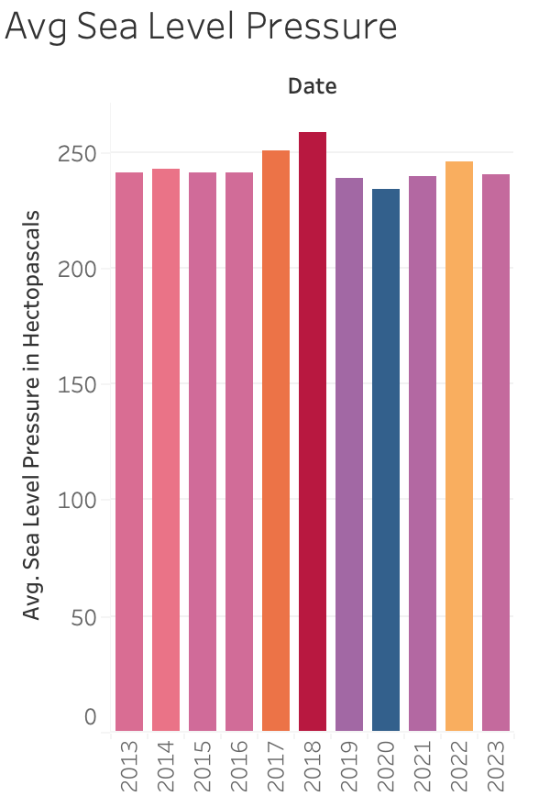
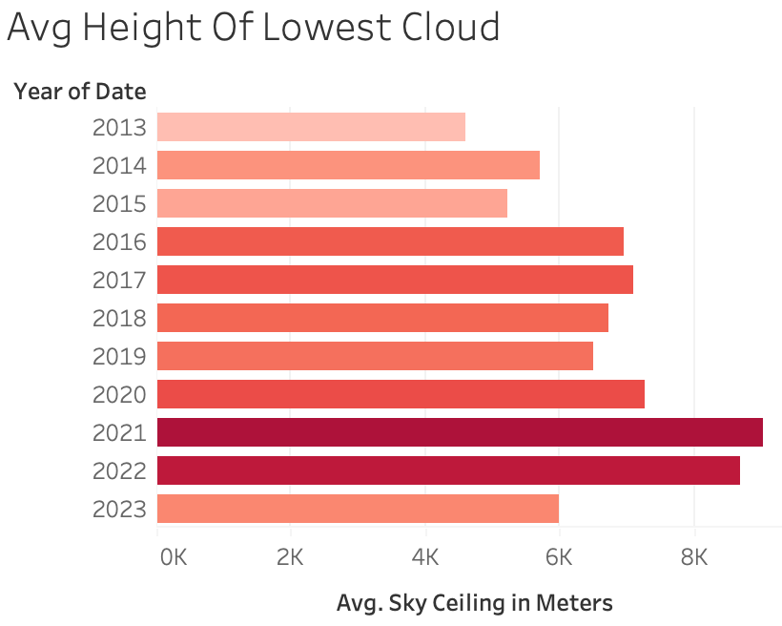
Visualizations Cont’d: Sea & Sky
https://public.tableau.com/app/profile/taylor.dacpano/viz/Sky_16825483013840/Dashboard3
Notes:
https://public.tableau.com/app/profile/taylor.dacpano/viz/Sky_16825483013840/Dashboard3
13: 241.27 / 4,605
14: 242.44 / 5,703
15: 240.73 / 5,231
16: 240.79 / 6,964
17: 250.61 / 7,102
18: 258.23 / 6,715
19: 238.54 / 6,500
20: 234.01 / 7,276
21: 239.30 / 9,030
22: 245.79 / 8,679
23: 240.12 / 5,984

Slide 19
Conclusion
We found that the eleven years of climate data does not show much change over time other than the lowest clouds appear to be higher each year
Perhaps there are other measures for Guam that would indicate the climate change is affecting their island, but our analysis did not show effects of climate change
It would be good to study other small islands to see how their weather has changed over the past decade in order to better understand how climate change affects the people there. These studies could help wealthier nations to help the people being affected by climate change.

