Slide 1

Progetto finale ISS
PARKMANAGERSERVICE
Corso di Laurea Magistrale in Ingegneria Informatica
Anno Accademico 2020-2021
Presentata da:
Luca Marchegiani
Simone Mattioli

Slide 2
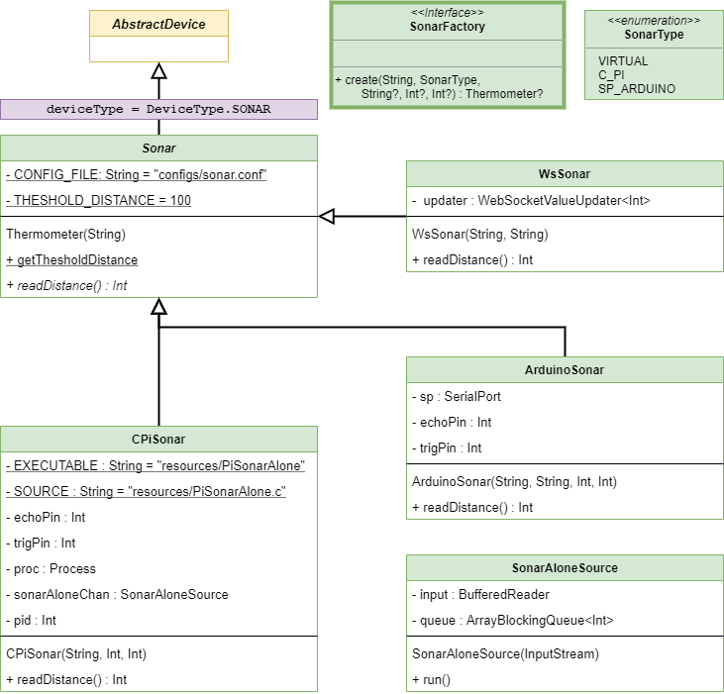
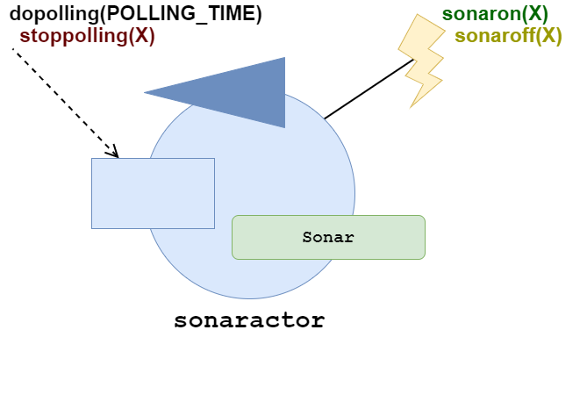
Basic Devices – Sonar
1

Slide 3
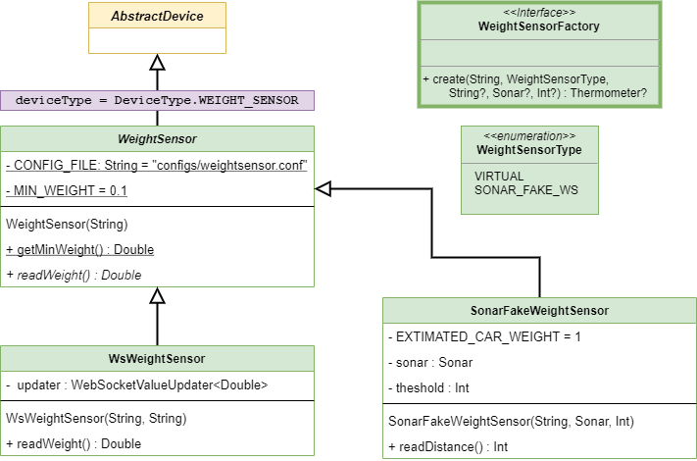
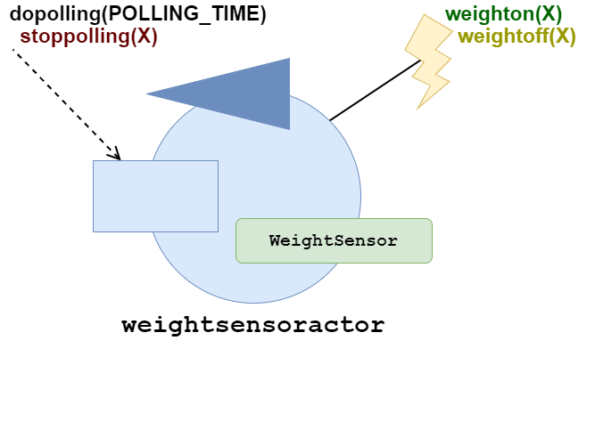
Basic Devices – Weight sensor
2

Slide 4
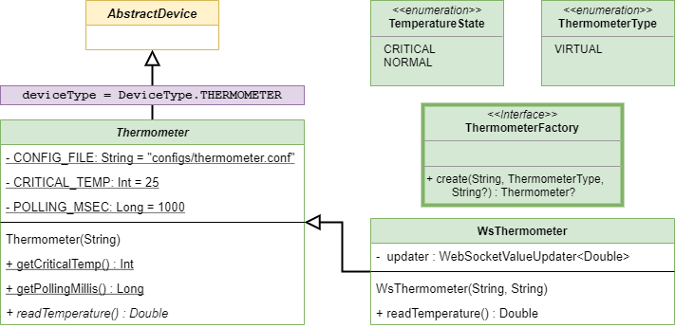
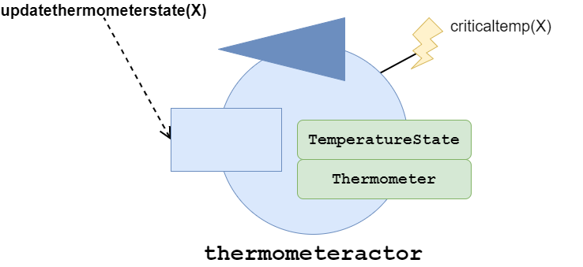
Basic Devices – Thermometer
3

Slide 5
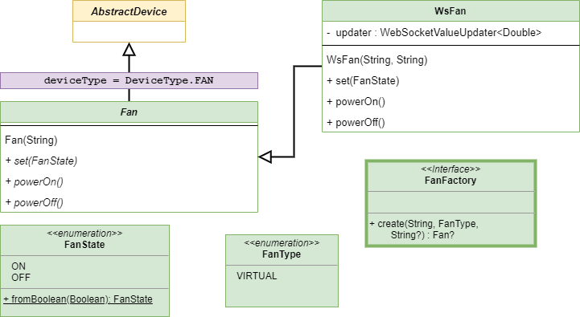
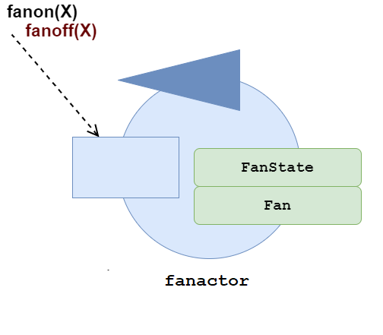
Basic Devices – Fan
4

Slide 6
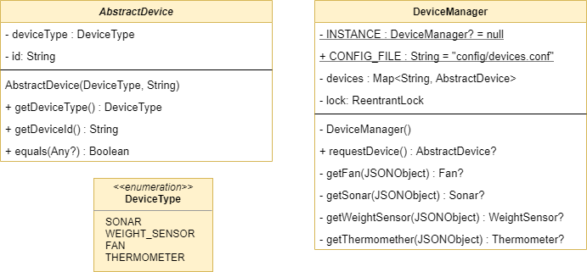
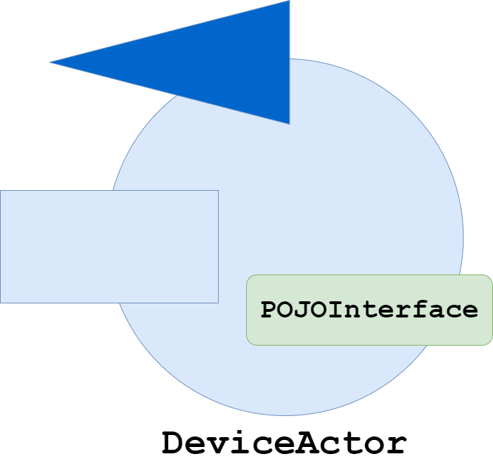
Device Manager
5

Slide 7
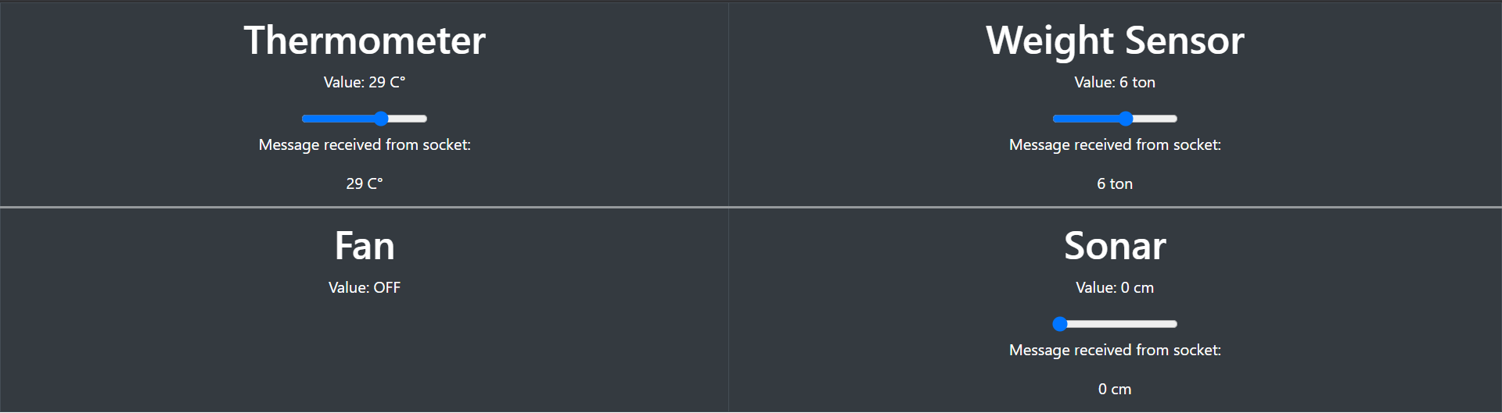
WebServer – Virtual devices
8

Slide 8
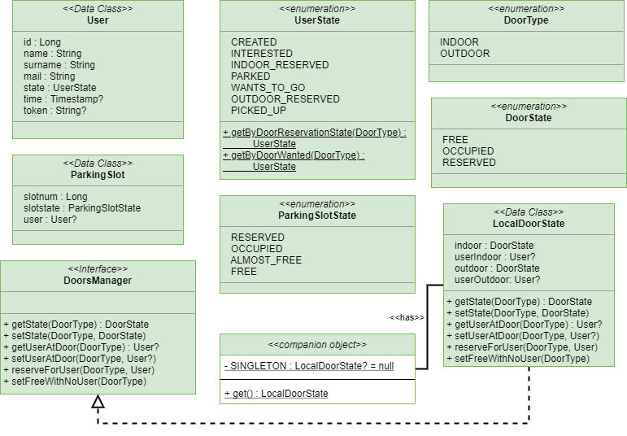
State maintenance - Bean
6

Slide 9
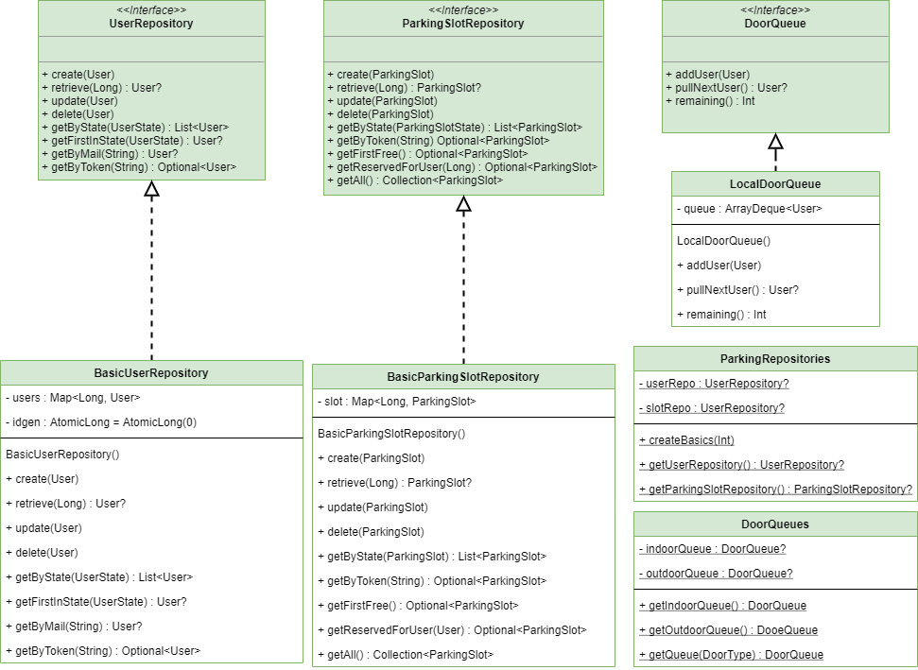
State maintainance - Persistence
7

Slide 10
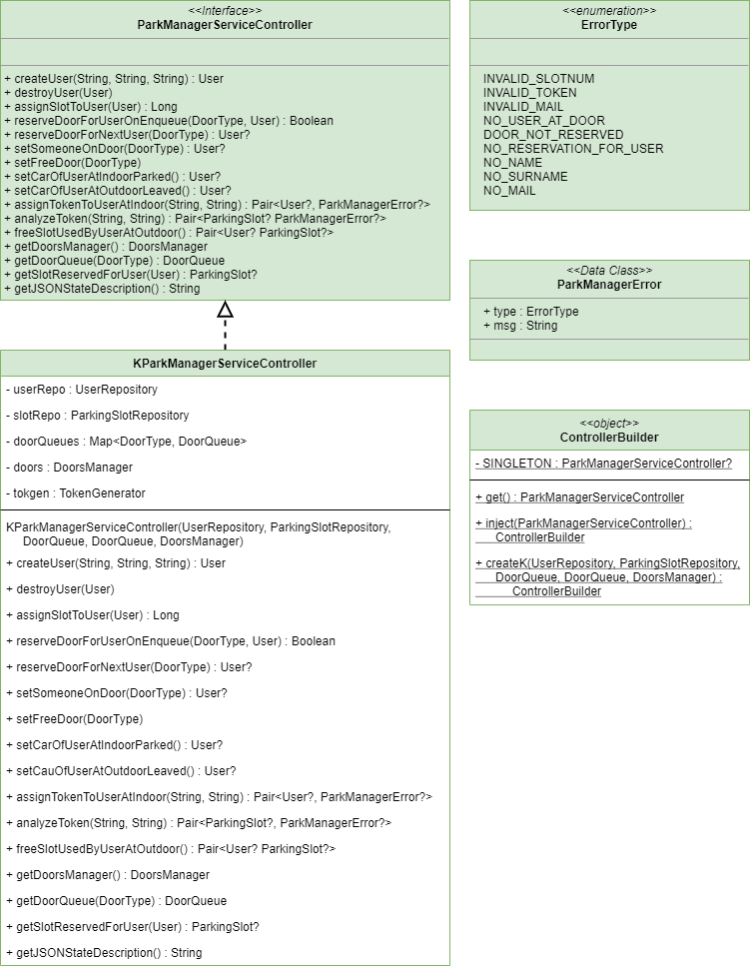
Controller
8

Slide 11
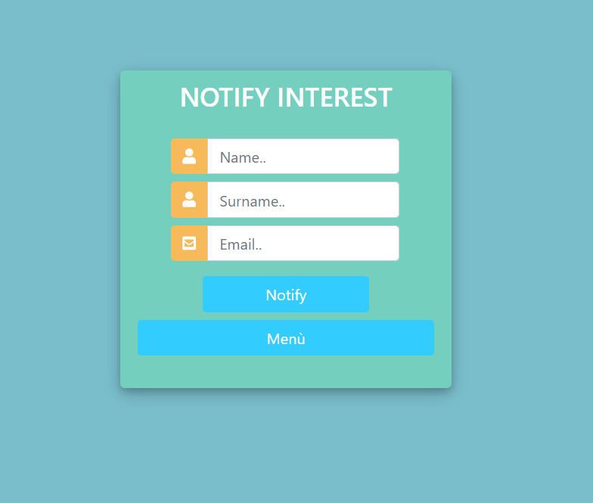
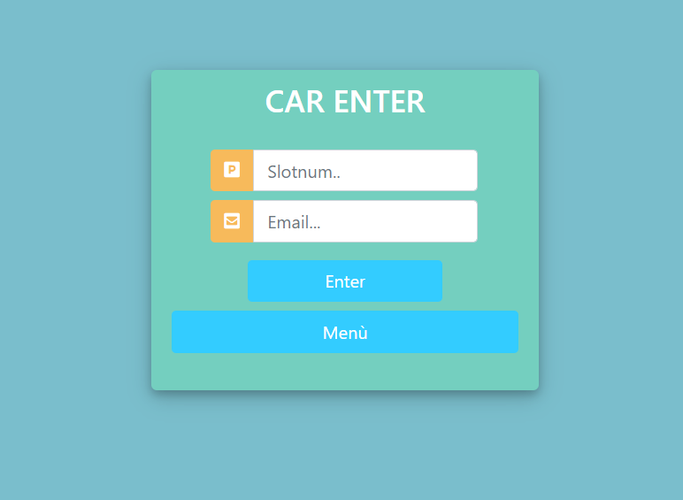
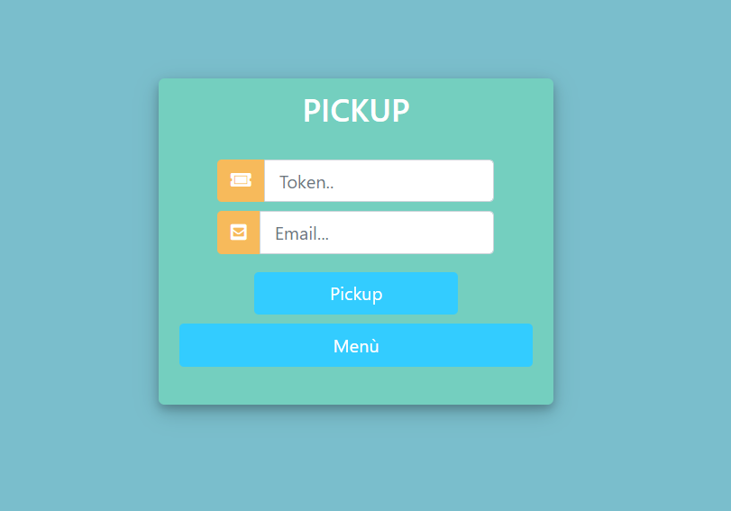
WebServer - Client
8

Slide 12
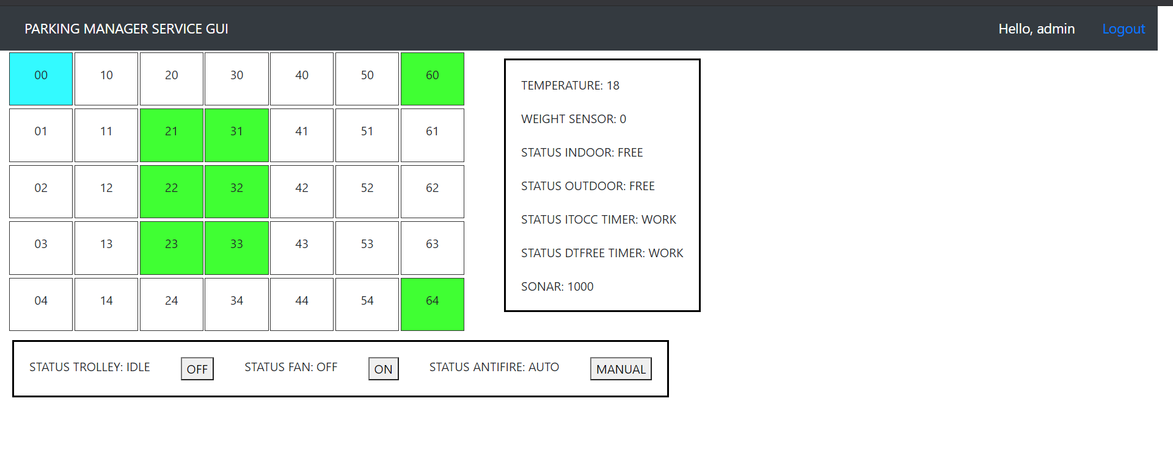
WebServer - Manager
8

Slide 13
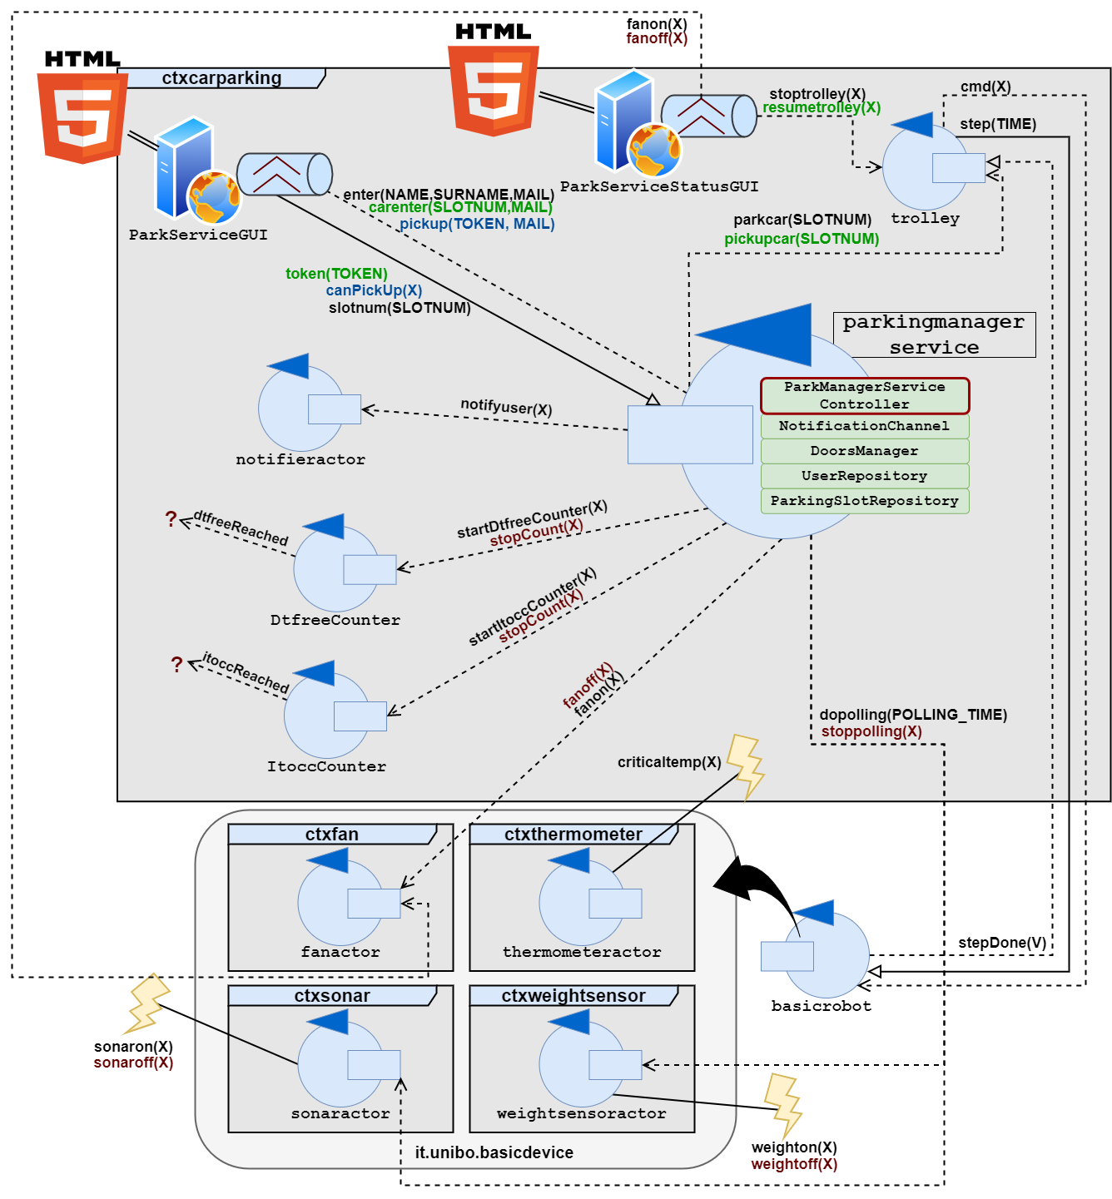
Logical architecture 10
9

Slide 14
Fine
Grazie per l’attenzione
10

